Slide 1



What is the future of genetics?
KS3
In association with Oxford Biomedica
Written by VotesforSchools
©VotesforSchools 2023

Slide 2

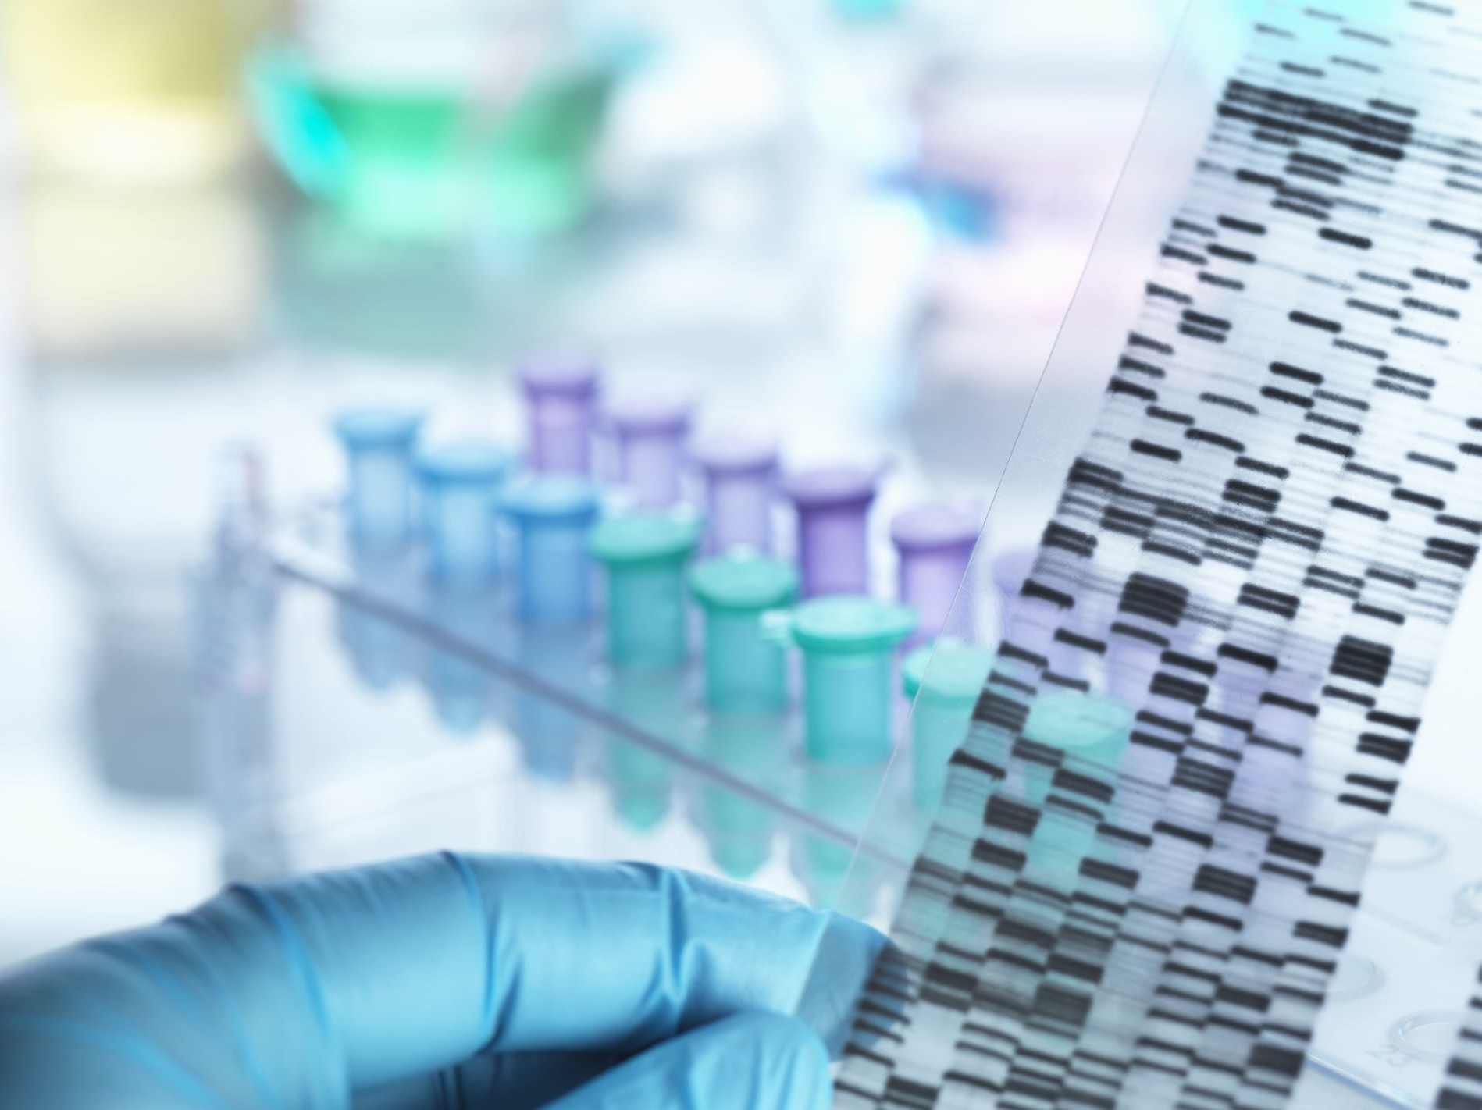
1
What are genes?
Pair discussion (2-3 mins)
Talk to a partner: what do you already know about genes?
A gene is a short length of DNA found on a chromosome.
Definition: DNA
Carries genetic code for a characteristic of a living thing.
Definition: Chromosome
Chromosomes are thin strands of DNA (deoxyribonucleic acid).
©VotesforSchools 2023
Notes:
Images
Microsoft Office 365
References
www.oxb.com

Slide 3
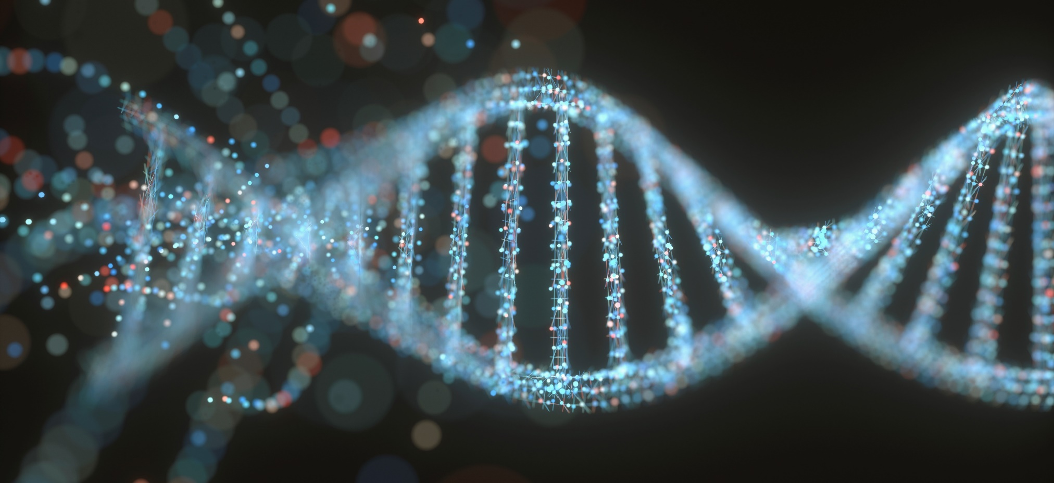
1
What are genes?
DNA stands for deoxyribonucleic acid. It is a spiral, a double-helix structure that carries genetic information: the genetic code.
It has all the instructions that a living organism needs. DNA is passed on from parents to their children.
©VotesforSchools 2023
Notes:
Images
Microsoft Office 365
References
www.oxb.com

Slide 4
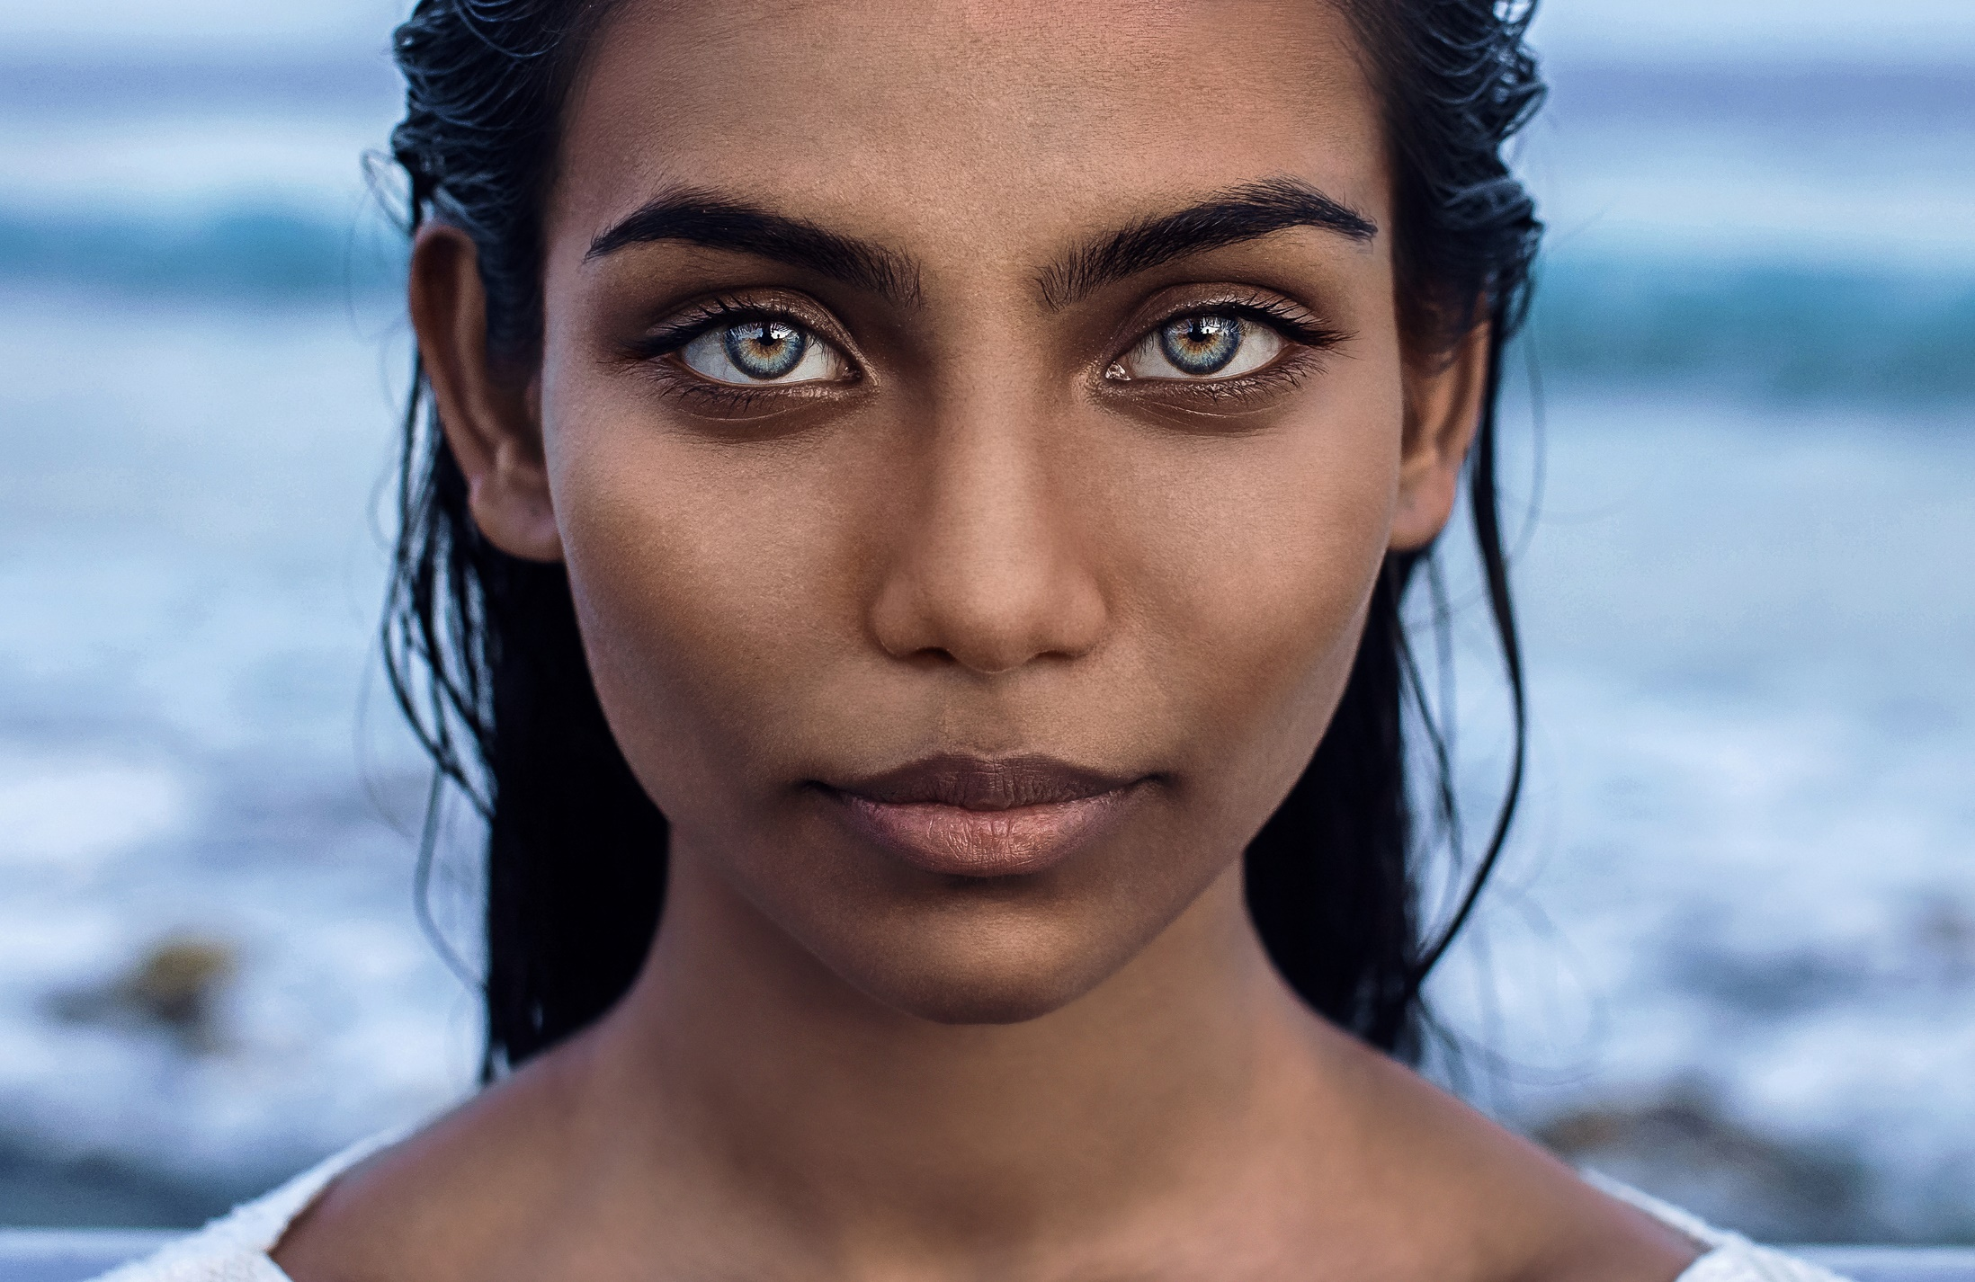
2
Why are genes important?
Genes are responsible for things like your hair or eye colour. Around 23,000 genes make up a person.
We have 46 chromosomes: we inherit 23 from each of our parents. Other organisms have different amounts.
Genes are arranged into larger coiled structures called chromosomes.
Pair discussion (2-3 mins)
Talk to a partner: what do genes do?
©VotesforSchools 2023
Notes:
Images
Microsoft Office 365

Slide 5
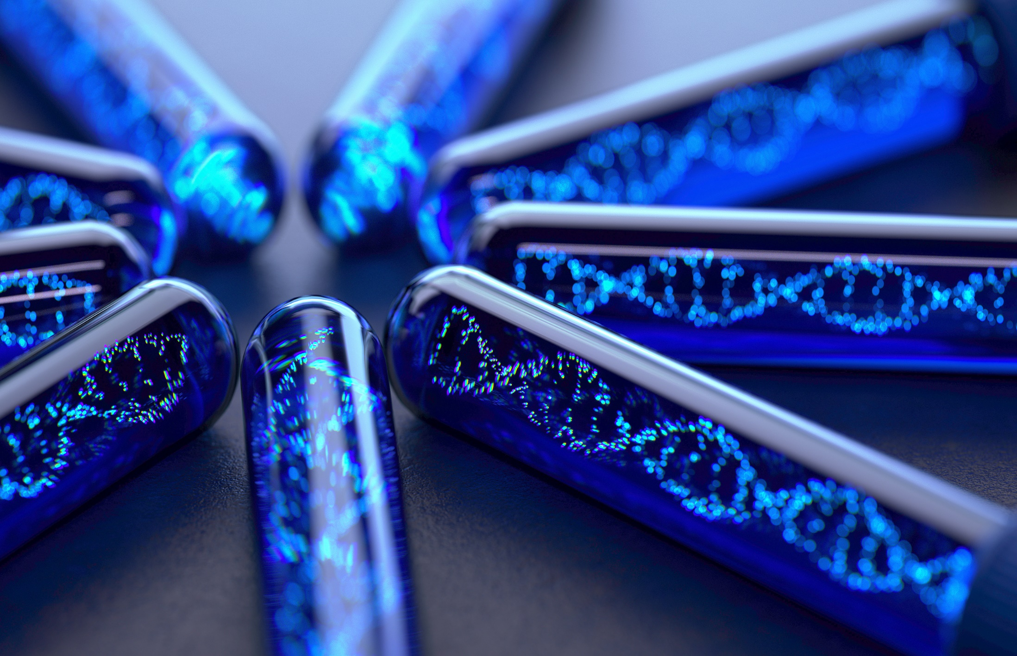
2
Why are genes important?
Discuss (2-3 mins)
Do you know what happens when genes go wrong?
Definition: Genetic mutation
Genetic conditions passed from the parent to the child.
Oxford Biomedica is one of the first companies to create cell and gene therapy.
There are advances in genetic engineering that can help with these mutations.
©VotesforSchools 2023
Notes:
References
https://dictionary.cambridge.org/dictionary/english/mutation
Images
Microsoft Office 365

Slide 6
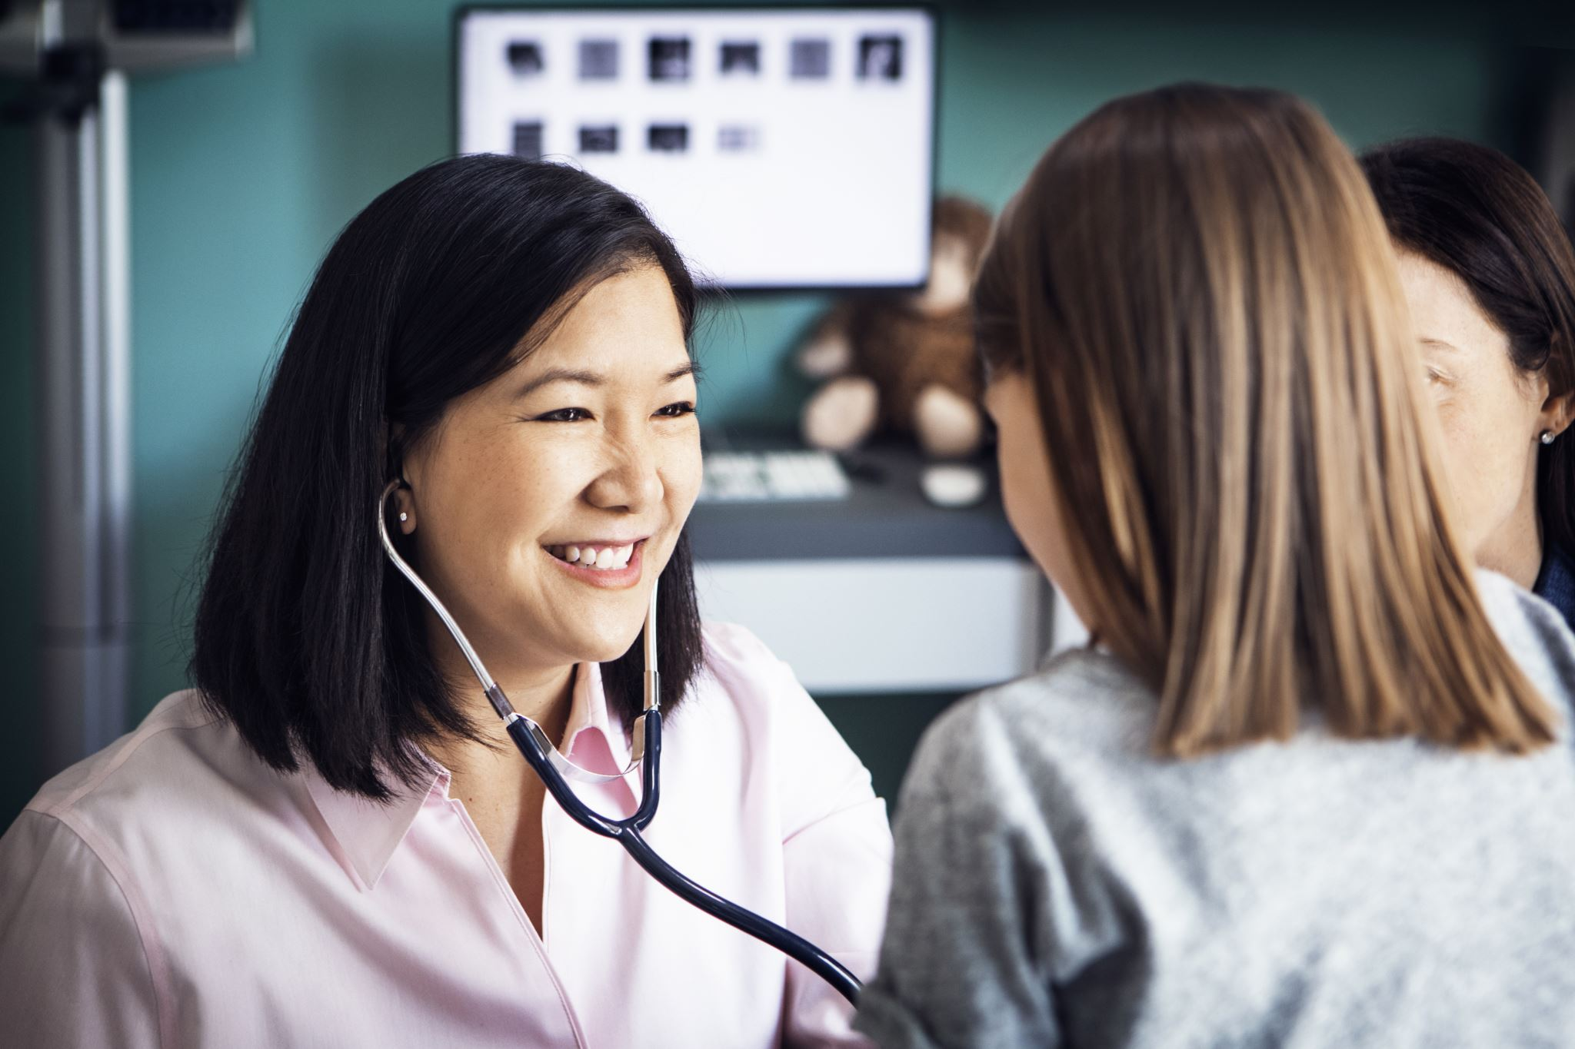
3
What is a genetic condition?
Discuss (3-4 mins)
Do you know what a genetic condition is?
A genetic condition is a condition or disease that is passed from one or both parents to their children.
They are not like a cold; genetic conditions cannot be caught by others. This makes genetic conditions non-communicable diseases.
©VotesforSchools 2023
Notes:
Images
Microsoft Office 365

Slide 7
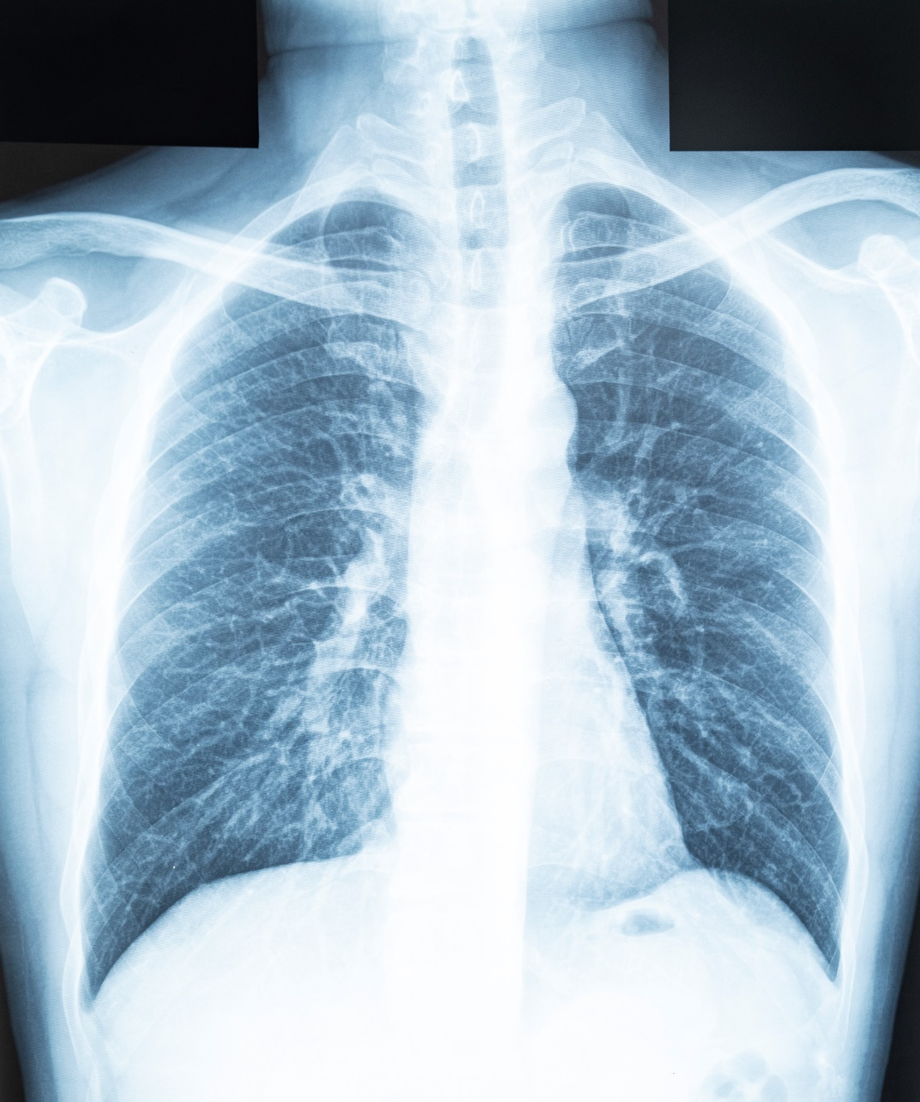
3
What is a genetic condition?
Discuss (2-3 mins)
Have you heard of Cystic Fibrosis? What do you know about it?
Cystic Fibrosis causes sticky build up in the lungs that make air exchange difficult and can cause lots of chest infections.
It can also affect the digestive system and make it difficult to digest food.
©VotesforSchools 2023
Notes:
Images
Microsoft Office 365

Slide 8
3
What is a genetic condition?
Cystic Fibrosis is a genetic disease affecting 1 in 2,500 babies in the UK.
It damages the lung tissue and reduces a person’s life expectancy.
Healthy lung
Cystic Fibrosis lung
The theory of gene therapy is to recover function and prevent the disease developing.
©VotesforSchools 2023
Notes:
Teacher’s Note: For more information on CF gene therapy, visit https://www.cff.org/research-clinical-trials/gene-therapy-cystic-fibrosis
Images
Oxb.com
Microsoft Office 365

Slide 9



4
What is gene therapy?
There are three main gene therapy approaches:
Discuss (2-3 mins)
What do you think gene therapy aims to achieve?
Definition: Gene Therapy
A technique that uses genes to treat or prevent diseases.
Gene Inactivation (turn the gene off)
Gene Correction (replace the faulty gene)
Gene Addition (add a healthy gene)
Gene therapy can be used to turn off, correct, or add genes to address the mutations that cause certain genetic diseases.
©VotesforSchools 2023
Notes:
References
https://www.who.int/health-topics/human-genome-editing
Images
Microsoft Office 365

Slide 10


4
What is gene therapy?
Gene therapy can be done in different ways.
In vivo gene therapy
Gene is packaged into viral vector (e.g. cystic fibrosis)…
…then it is put into a patient.
Ex vivo gene therapy
Gene is packaged into viral vector…
Cells can be taken from the patient.
Cells can then be genetically modified and put back into the patient
e.g. CAR-T for blood cancer
©VotesforSchools 2023
Notes:
Images
Microsoft Office 365
References
www.oxb.com

Slide 11
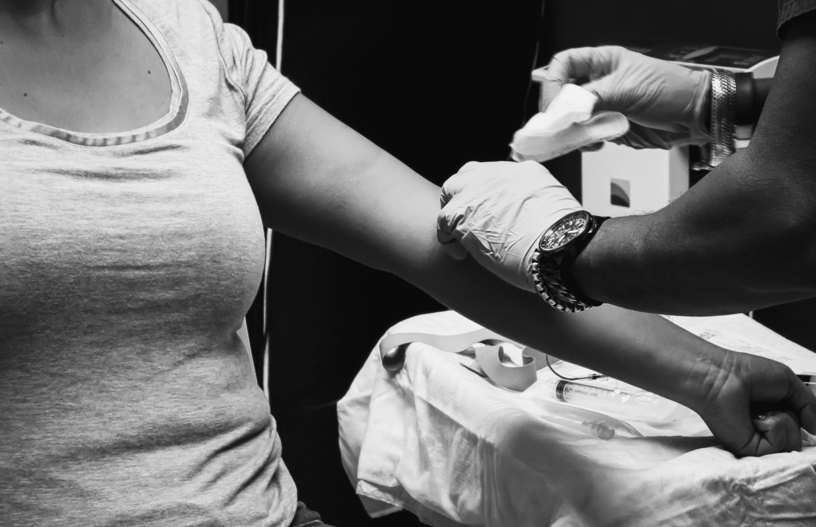
4
What is gene therapy?
The treatment of blood cancers with gene therapy begins in the clinic.
Blood is taken from the patient and the white blood cells, including the T cells, are filtered out.
©VotesforSchools 2023
Notes:
Images
Microsoft Office 365
References
www.oxb.com

Slide 12
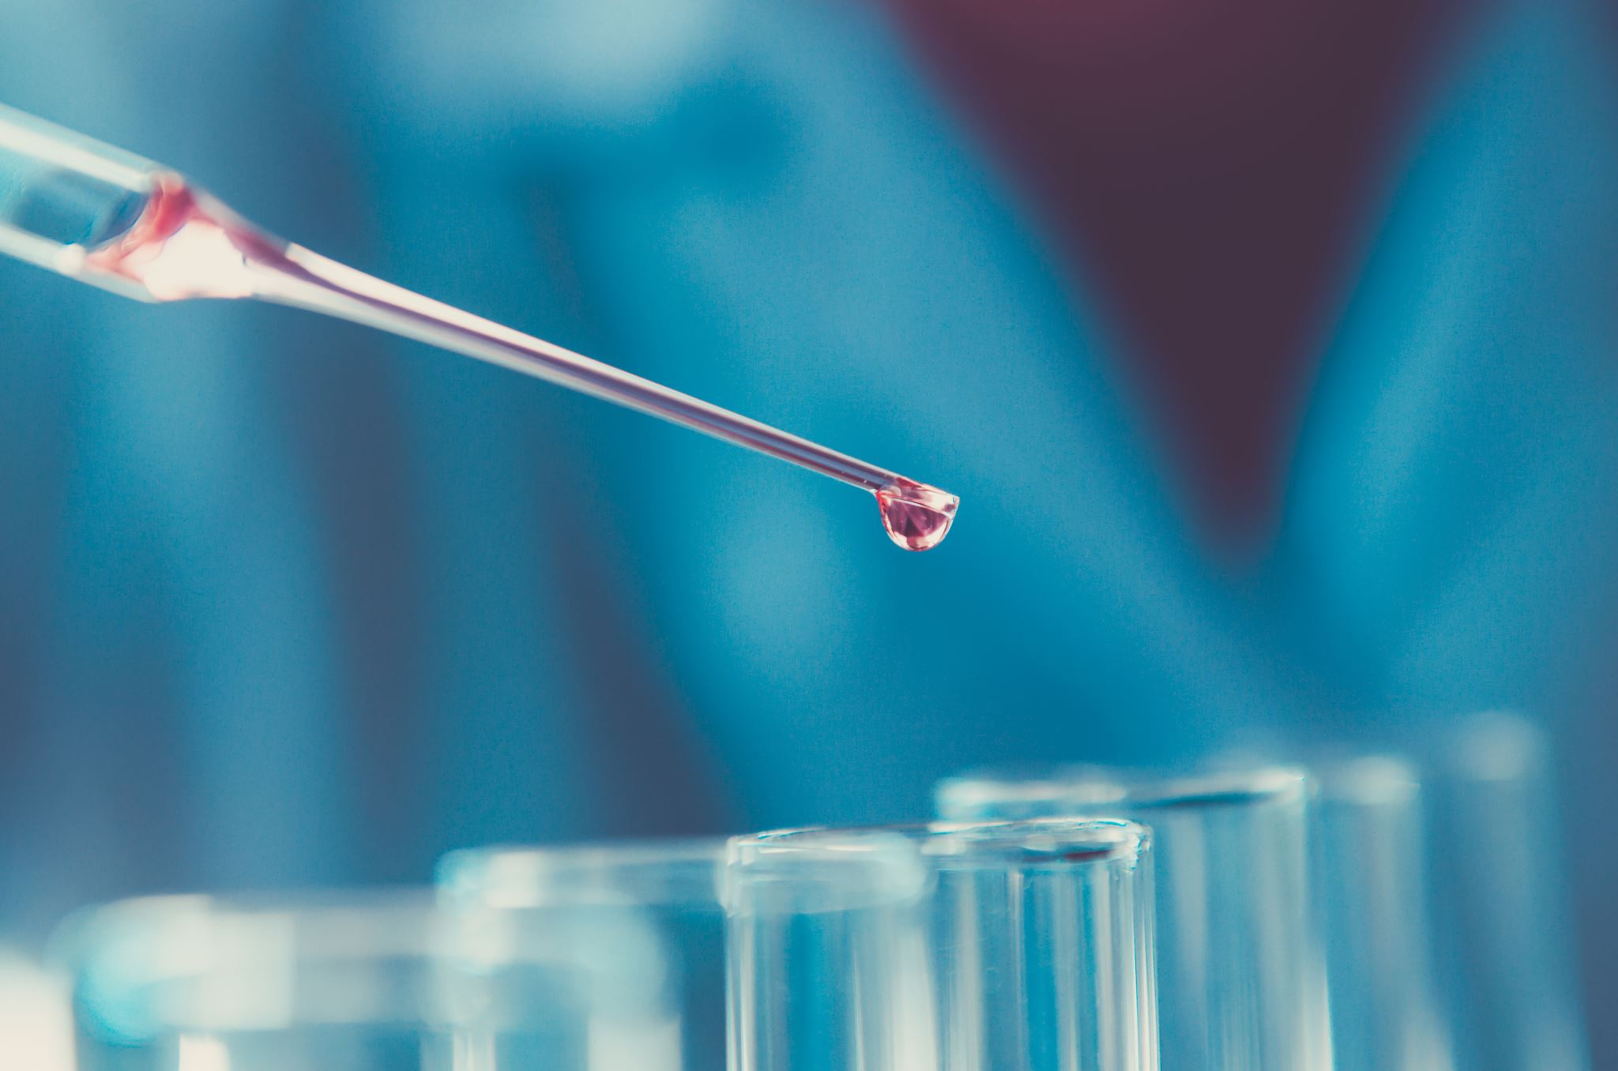
4
What is gene therapy?
Next, in the laboratory, the T cells are engineered to find and kill cancer cells.
©VotesforSchools 2023
Notes:
Images
Microsoft Office 365
References
www.oxb.com

Slide 13
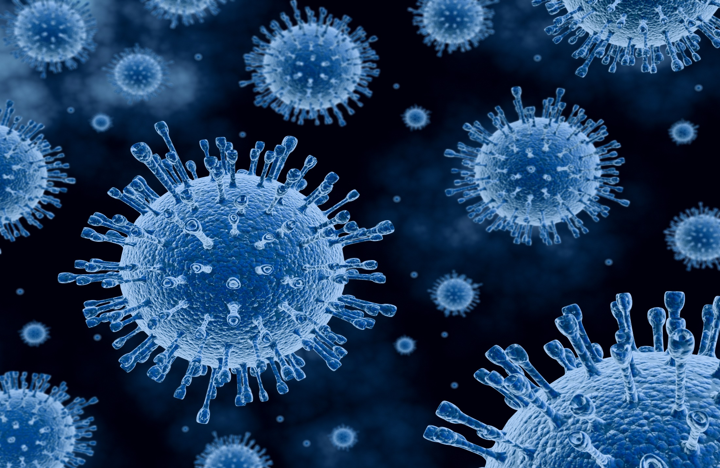
4
What is gene therapy?
Discuss (2-3 mins)
Have you heard of Oxford Biomedica? Do you know what they do?
Oxford Biomedica were one of the founders for lentiviruses for gene therapy.
On the next few slides, you will find out more about them and the work they do.
©VotesforSchools 2023
Notes:
Images
Microsoft Office 365
References
www.oxb.com

Slide 14
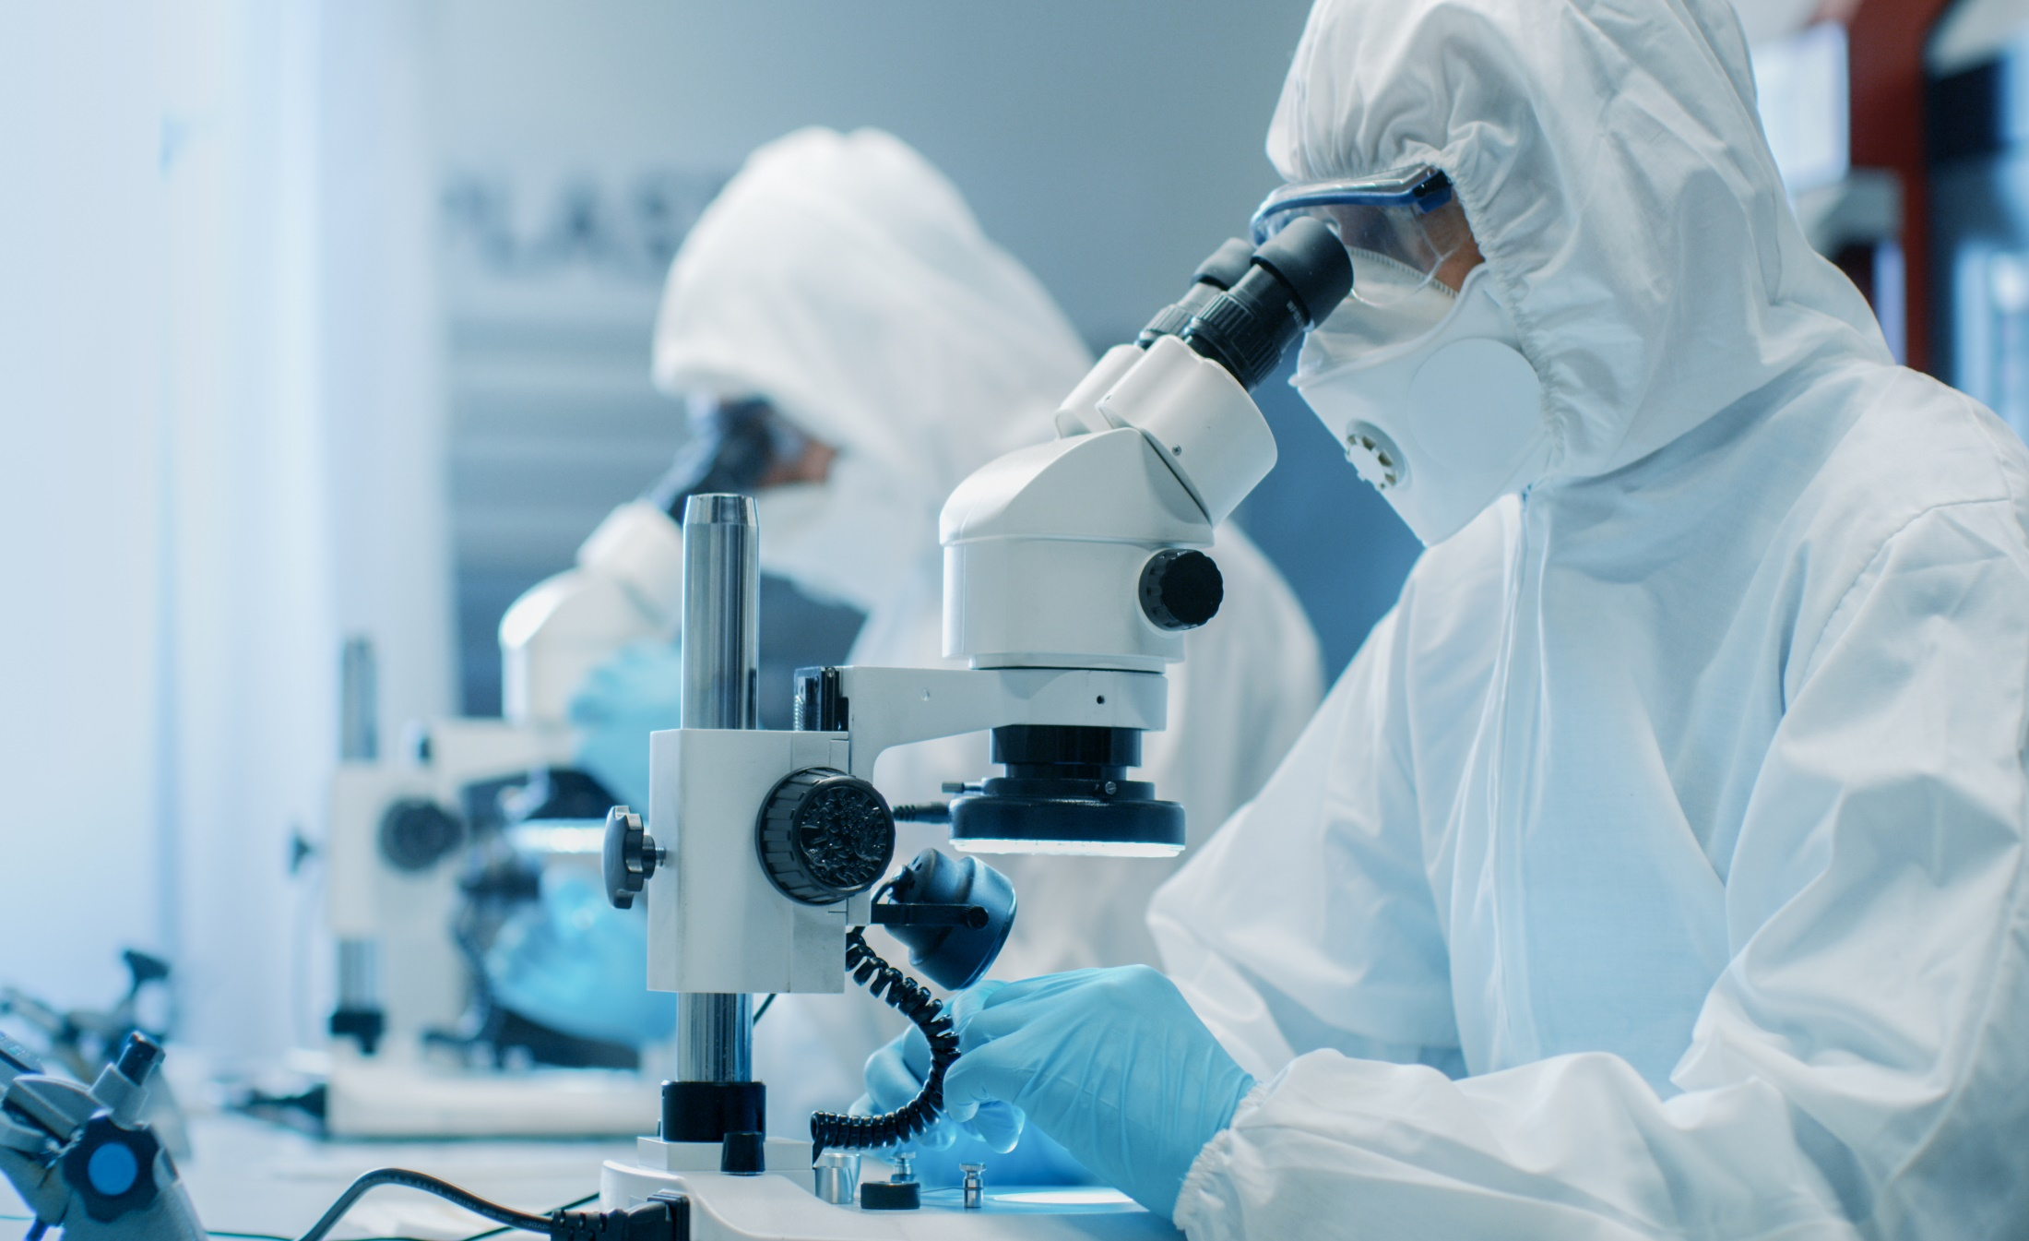
5
Who are Oxford Biomedica?
Find out more
Click on the image below to go to Oxford Biomedica’s website where you will find out much more about who they are and what they do.
©VotesforSchools 2023
Notes:
References
https://oxb.com/
Images
Microsoft Office 365

Slide 15
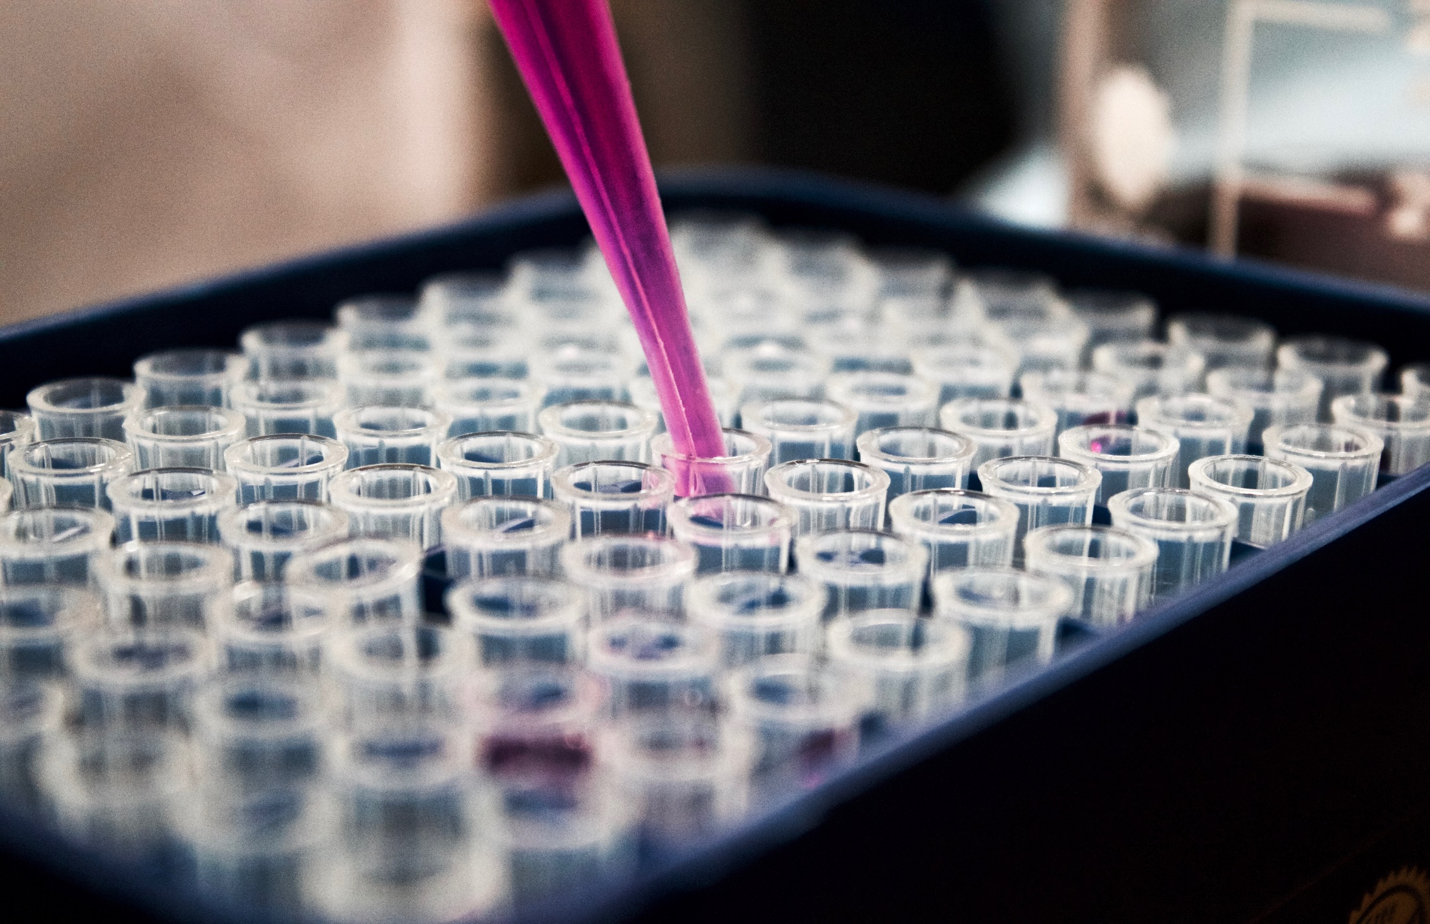

4
Who are Oxford Biomedica?
Pair discussion (2-3 mins)
Talk to a partner: have you heard of Oxford Biomedica? What do they do?
Oxford Biomedica (also known as OXB) is a quality and innovation led contract development and manufacturing organisation (CDMO) specialising in the development and manufacturing of viral vectors. Viral vectors are used by pharmaceutical to deliver life-changing therapies to patients.
You may have heard of them during the pandemic, when they produced 100 million vaccination doses.
They are based in Oxfordshire and have facilities in the US and in France too. They work with some of the most innovative pharmaceutical and biotechnology companies in the world.
©VotesforSchools 2023
Notes:
Images
Unsplash
References
www.oxb.com

Slide 16
5
Who are Oxford Biomedica?
Discuss (2 mins)
Have you had a COVID-19 vaccine?
You may have heard about Oxford Biomedica during the pandemic, when they produced 100 million vaccination doses.
They are based in Oxfordshire and have facilities in the US and in France too. They work with some of the most innovative pharmaceutical and biotechnology companies in the world.
©VotesforSchools 2023
Notes:
Images
Unsplash
References
www.oxb.com

Slide 17
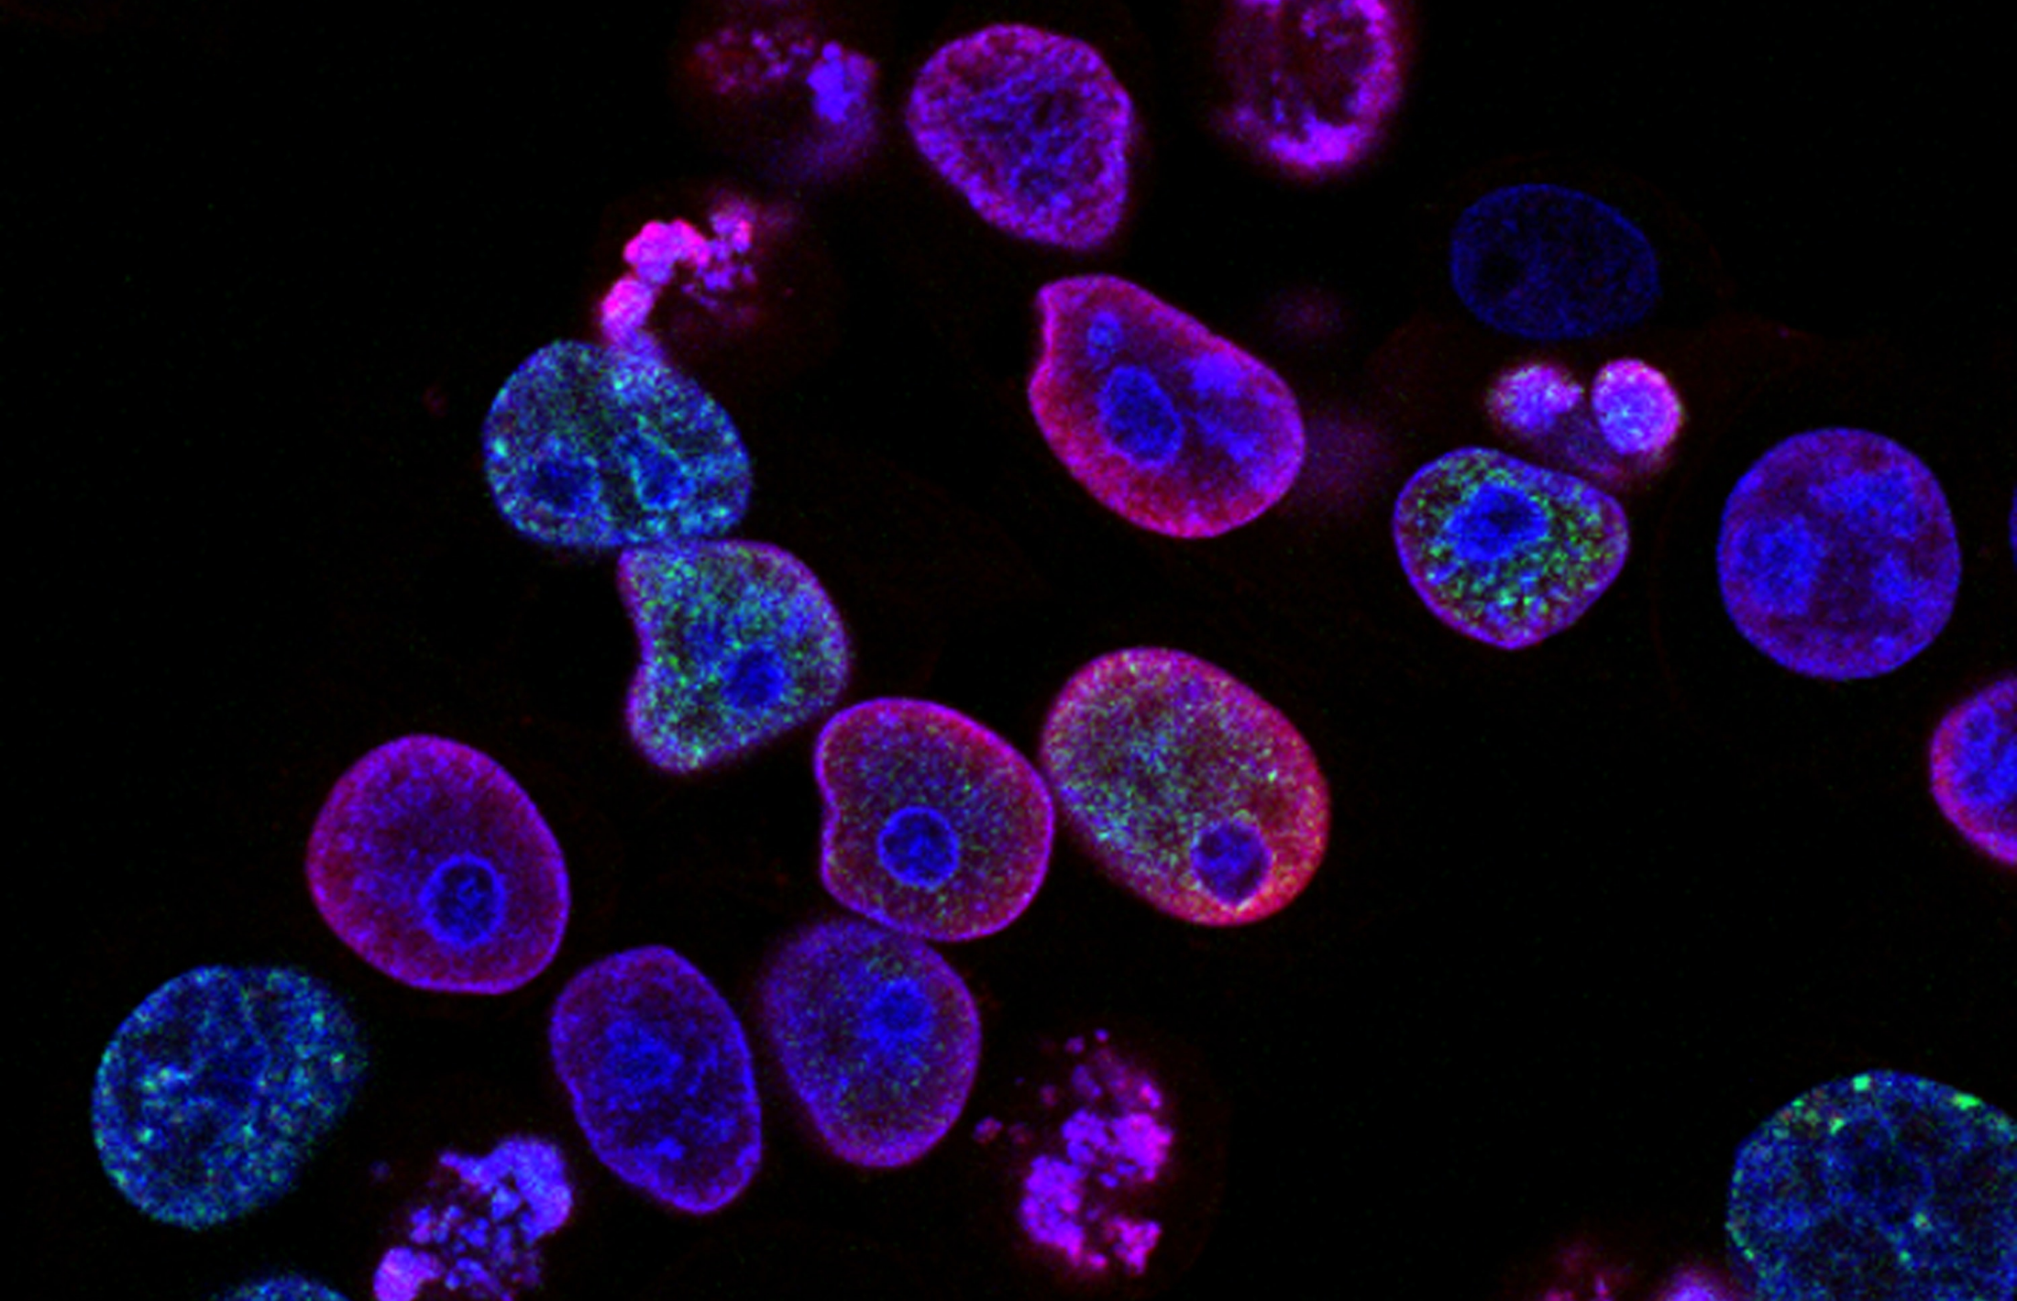
5
Who are Oxford Biomedica?
Pair discussion (2-3 mins)
How do you think the process of making vaccines is upscaled to make enough doses for a nationwide vaccination scheme?
Creating 100 million vaccines quickly was not easy!
Oxford Biomedica had to upscale their process to make large amounts of vaccine.
The next two slides explain how something can be upscaled.
©VotesforSchools 2023
Notes:
Images
iStock
References
www.oxb.com

Slide 18


5
Who are Oxford Biomedica?
Below are the ingredients needed to make paella for 4 people.
500g chicken
250g rice
1 onion
3 cloves of garlic
1 red pepper
4 tomatoes
3 tbsp. olive oil
1 tsp of salt
A pinch of saffron
650 ml water
1 chef
Total time: approx. 2 hours
Challenge:
So, what would you do if you needed to cook it for 110,000 people?
©VotesforSchools 2023
Notes:
Images
Unsplash
References
www.oxb.com

Slide 19
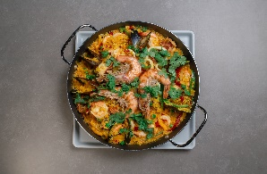
5
Who are Oxford Biomedica?
Below are the ingredients needed to make paella for 110,000 people.
13,750 kg chicken
6,875 kg rice
27,500 onions
82,500 cloves of garlic
27,500 red peppers
110,000 tomatoes
1238 litres olive oil
193 kg of salt
27,500 pinches of saffron (approx. 3.5kg)
18,000 litres water
27,500 chefs
Total time: difficult to estimate!
Do you scale-up and make one dish big enough to make 110,000 meals?
Do you scale-out and hire 27,500 chefs to cook multiple meals of 4?
In very simple terms, this is how you go from producing 100 vaccines to 100 million vaccines.
©VotesforSchools 2023
©VotesforSchools 2023
©VotesforSchools 2023
©VotesforSchools 2023
Notes:
Images
Unsplash
References
www.oxb.com

Slide 20
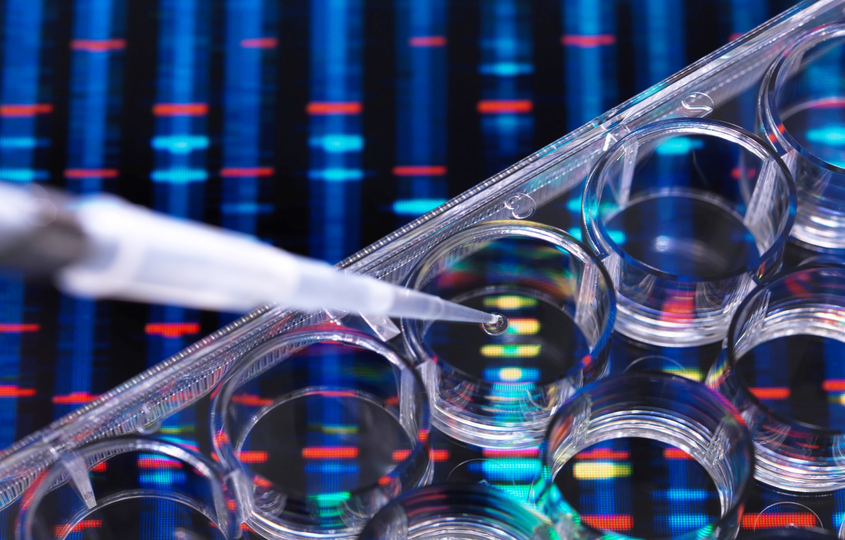
6
Which career pathways are there?
Which careers do you think need Biology?
Teacher
Pharmacist
Nurse
Geneticist
Veterinarian
Dentist
Doctor
Pathologist
Scientist
Microbiologist
Laboratory technician
Notes:
Images
Microsoft Office 365
References
www.oxb.com

Slide 21
6
Which career pathways are there?
Final reflection (2-3 mins)
If this lesson has inspired you to explore a future in Biology, why not find out more?
You could talk to family, friends and teachers about more careers using Biology.
You could have a look at the Oxford Biomedica website to find out more about what they do and if there is a future there for you.
Notes:
Images
Microsoft Office 365
References
www.oxb.com

Slide 22
What is the future of genetics?
KS3
In association with Oxford Biomedica
Written by VotesforSchools
©VotesforSchools 2023

Slide 23


Finding help & information
Oxfordshire's new careers platform, Find Your Future, is the next step for you to find out more and plan your future here in Oxfordshire.
Navigate your way around the links by clicking on the logo.
©VotesforSchools 2023
Notes:
Images
https://www.oxfordshirelep.com/findyourfuture
References
https://www.oxfordshirelep.com/findyourfuture
https://www.oxfordshirelep.com/sites/default/files/uploads/FindYourFutureParentsGuide.pdf

Slide 24

Appendix
Heredity
The study of inheritance.
Inheritance
The passing of characteristics determined by genes from parents to offspring.
Gene
A short section of DNA, which is the genetic code for a characteristic.
Genotype
The combination of alleles in an organism - genotypes are often written as pairs of letters, one for each gene.
Phenotype
The appearance of the organism's genotype - phenotypes are often written as words, not letters.
Dominant gene
Just one dominant gene in the genotype means that its appearance is seen in the phenotype.
Recessive gene
A recessive gene is only observed in the phenotype if no dominant gene is present.
Heterozygous
A genotype with one dominant and one recessive gene.
Homozygous dominant
A genotype with two dominant genes.
Homozygous recessive
A genotype with two recessive genes.
©VotesforSchools 2023
Notes:
References
https://www.biologyonline.com/dictionary
OxLEP teacher encounters

