Slide 1



What is the future of genetics?
KS5
In association with Oxford Biomedica
Written by VotesforSchools
©VotesforSchools 2023

Slide 2

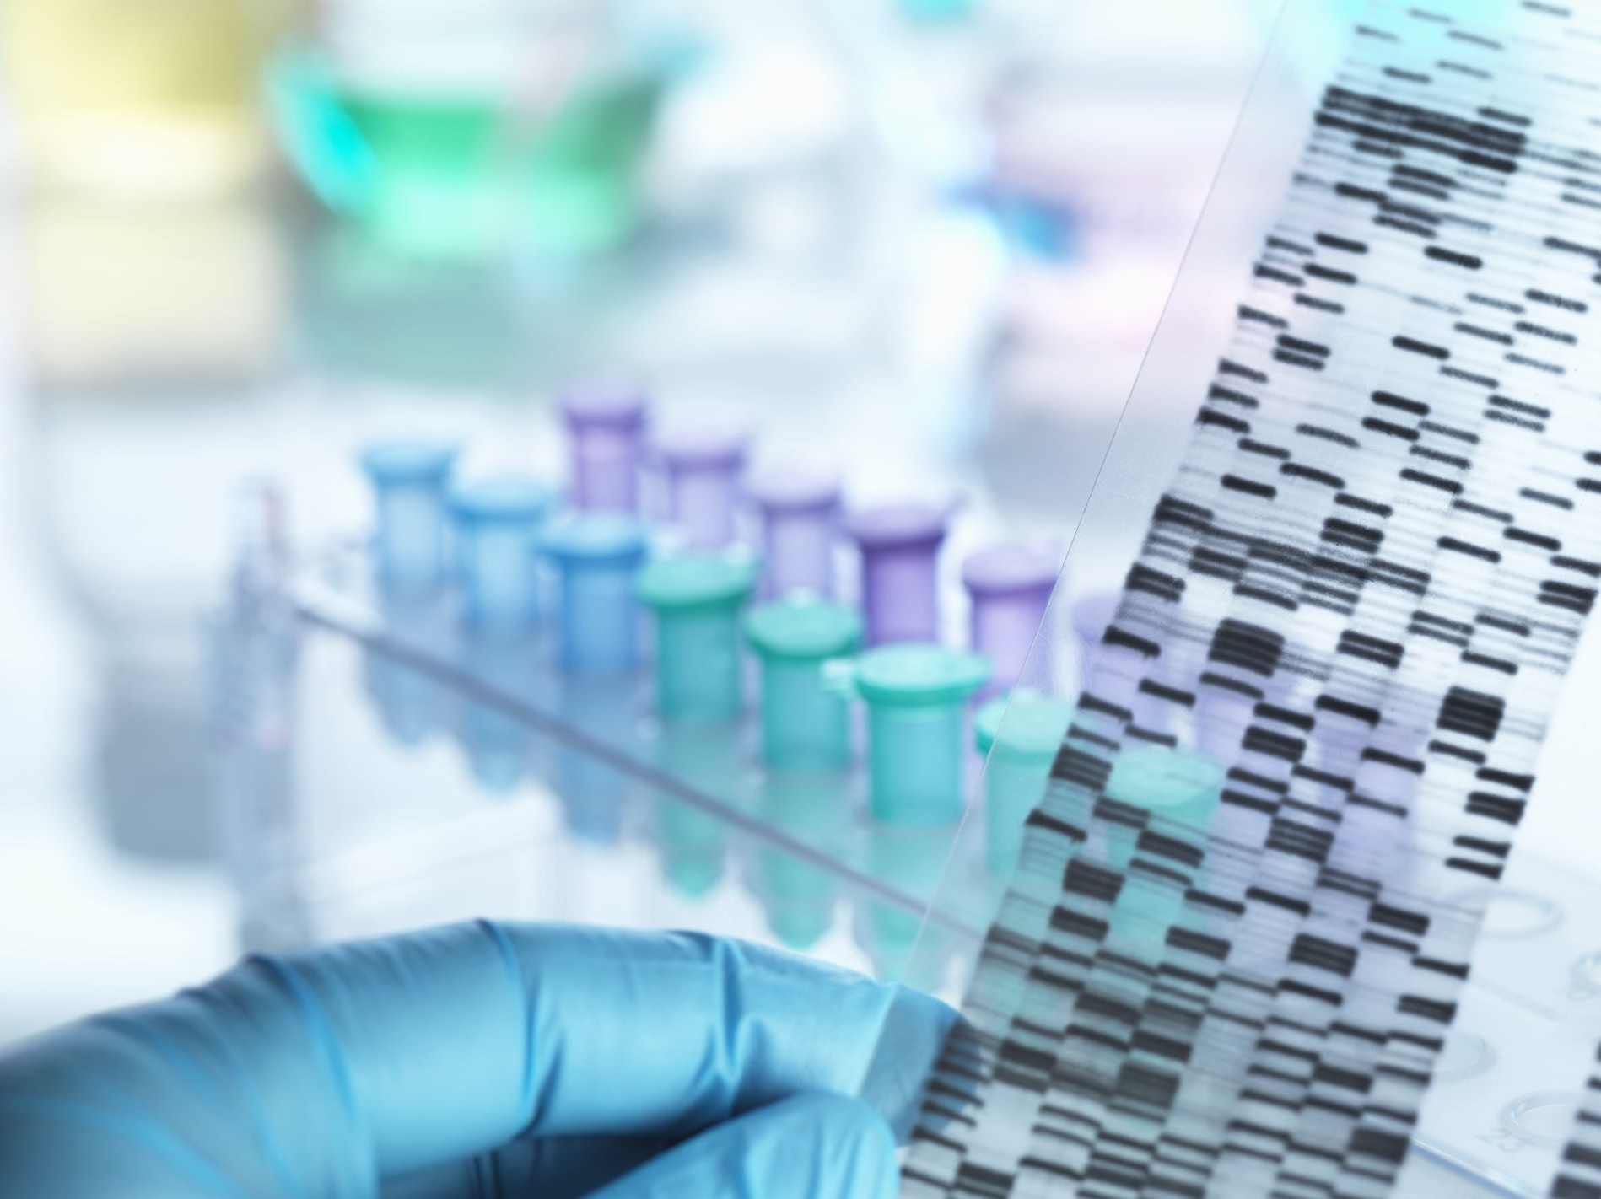
1
What are genes?
Proteins make up the human body and control all the functions within the body. There are over 50,000 genes in the human genome.
Pair discussion (2-3 mins)
What do you already know about genes?
A gene is a DNA sequence that provides instructions on how to make an individual protein.
Definition: DNA
Carries genetic code for a characteristic of a living thing.
Definition: Chromosome
Chromosomes are thin strands of DNA (deoxyribonucleic acid).
©VotesforSchools 2023
Notes:
Images
Microsoft Office 365
References
www.oxb.com

Slide 3
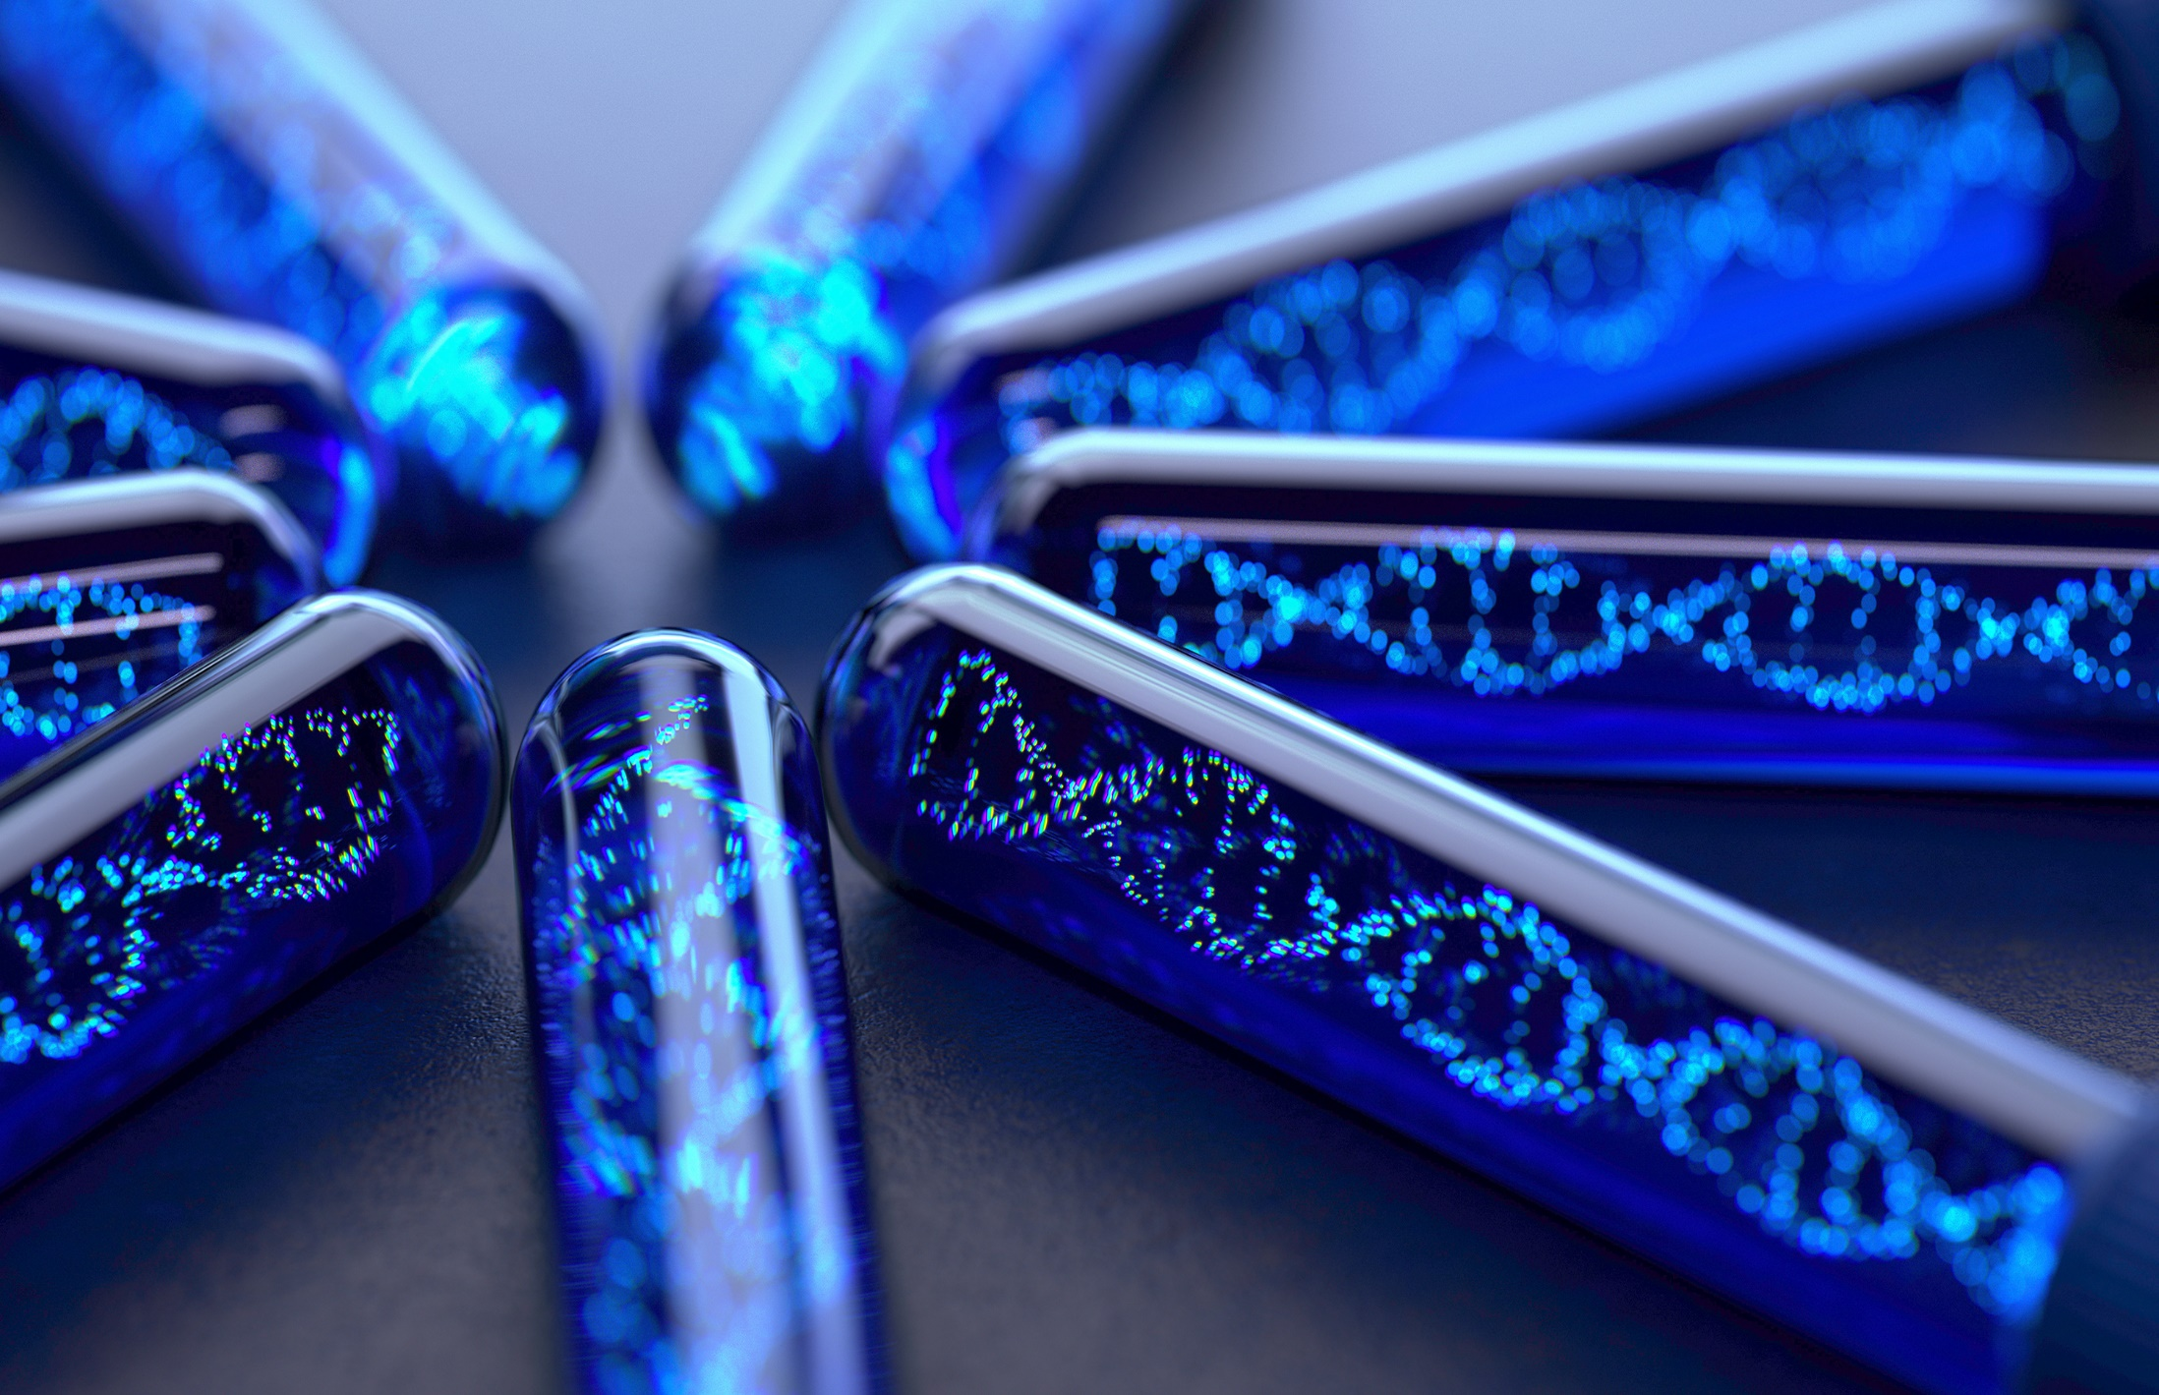
2
Why are genes important?
Discuss (2-3 mins)
What happens when genes mutate?
Definition: Mutation
A change in the structure or number of chromosomes or genes.
Definition: Genetic mutation
Genetic conditions passed from the parent to the child.
Errors can occur in the gene sequence which leads to a mutation. They can be spontaneous or inherited.
Some errors can cause disease. The incorrect instructions for protein can result in no protein being made or the protein not working.
©VotesforSchools 2023
Notes:
References
https://dictionary.cambridge.org/dictionary/english/mutation
https://dictionary.cambridge.org/spellcheck/english/?q=genetic+mutation
Images
Microsoft Office 365

Slide 4
2
Why are genes important?
Oxford Biomedica is one of the original pioneers in cell and gene therapy.
There are advances in genetic engineering that can help with these mutations.
©VotesforSchools 2023
Notes:
Images
Microsoft Office 365
References
www.oxb.com

Slide 5



3
What is gene therapy?
There are three main gene therapy approaches:
Discuss (2-3 mins)
What do you think gene therapy aims to achieve?
Definition: Gene Therapy
A technique that uses genes to treat or prevent diseases.
Gene Inactivation (turn the gene off)
Gene Correction (replace the faulty gene)
Gene Addition (add a healthy gene)
Gene therapy can be used to turn off, correct, or add genes to address the mutations that cause certain genetic diseases.
©VotesforSchools 2023
Notes:
References
https://www.who.int/health-topics/human-genome-editing
Images
Microsoft Office 365

Slide 6
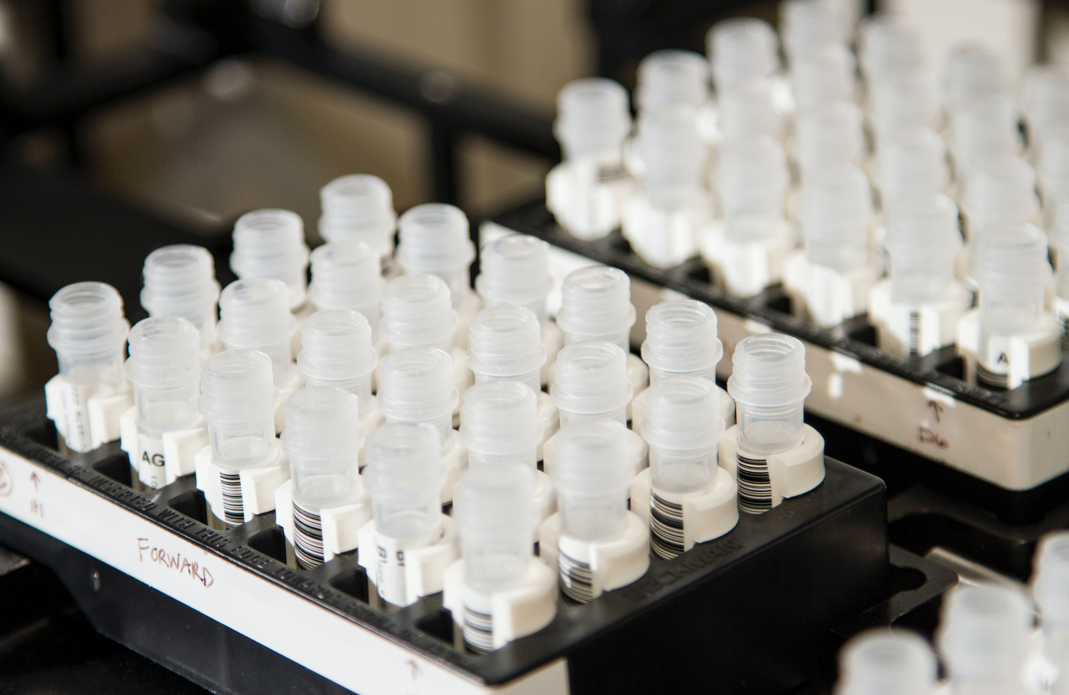
3
What is gene therapy?
Discuss (2-3 mins)
Do you know how gene therapy is delivered to the patient?
This can be achieved either by directly administering the vector to the patient (often referred to as in vivo gene therapy).
Or, by first introducing the genetic material to cells or tissue outside of the body, before administering the cells or tissue into the patient (often referred to as ex vivo gene therapy, or gene-modified cell therapy).
©VotesforSchools 2023
Notes:
Images
Microsoft Office 365
References
www.oxb.com

Slide 7
3
What is gene therapy?
In vivo gene therapy
The gene is packed into a viral vector…
…Transgene is delivered directly to the patient.
Discuss (2-3 mins)
What do you already know about cystic fibrosis?
For example, in cystic fibrosis.
It is a genetic disease affecting 1 in 2,500 babies in the UK.
It involves an error in CFTR gene encoding Cl-channel in the lungs.
0.06% of protein is missing, meaning no Cl-channel function.
A lack of Cl-channel results in mucous build up, causing chronic bacterial infections.
Unfortunately, lung tissue is destroyed over time and life expectancy is just 25 years.
©VotesforSchools 2023
Notes:
Images
Microsoft Office 365
References
www.oxb.com

Slide 8
3
What is gene therapy?
It is a genetic disease affecting 1 in 2,500 babies in the UK.
It involves an error in CFTR gene encoding Cl-channel in the lungs.
0.06% of protein is missing, meaning no Cl-channel function.
A lack of Cl-channel results in mucous build up, causing chronic bacterial infections.
Unfortunately, lung tissue is destroyed over time and life expectancy is just 25 years.
The theory of gene therapy in relation to cystic fibrosis is to introduce a working copy of the CFTR gene to lung cells which will recover function and prevent disease developing.
©VotesforSchools 2023
Notes:
Images
Microsoft Office 365
References
www.oxb.com

Slide 9



3
What is gene therapy?
Gene therapy can be also be ex vivo
The gene is packed into a viral vector…
Cells are genetically modified by viral vector.
Cells multiplied and delivered to patient.
The cells are then harvested from the patient.
This technique would be used for something like CAR-T (Chimeric Antigen Receptor Therapy) for blood cancer.
©VotesforSchools 2023
Notes:
Images
Microsoft Office 365
References
www.oxb.com

Slide 10
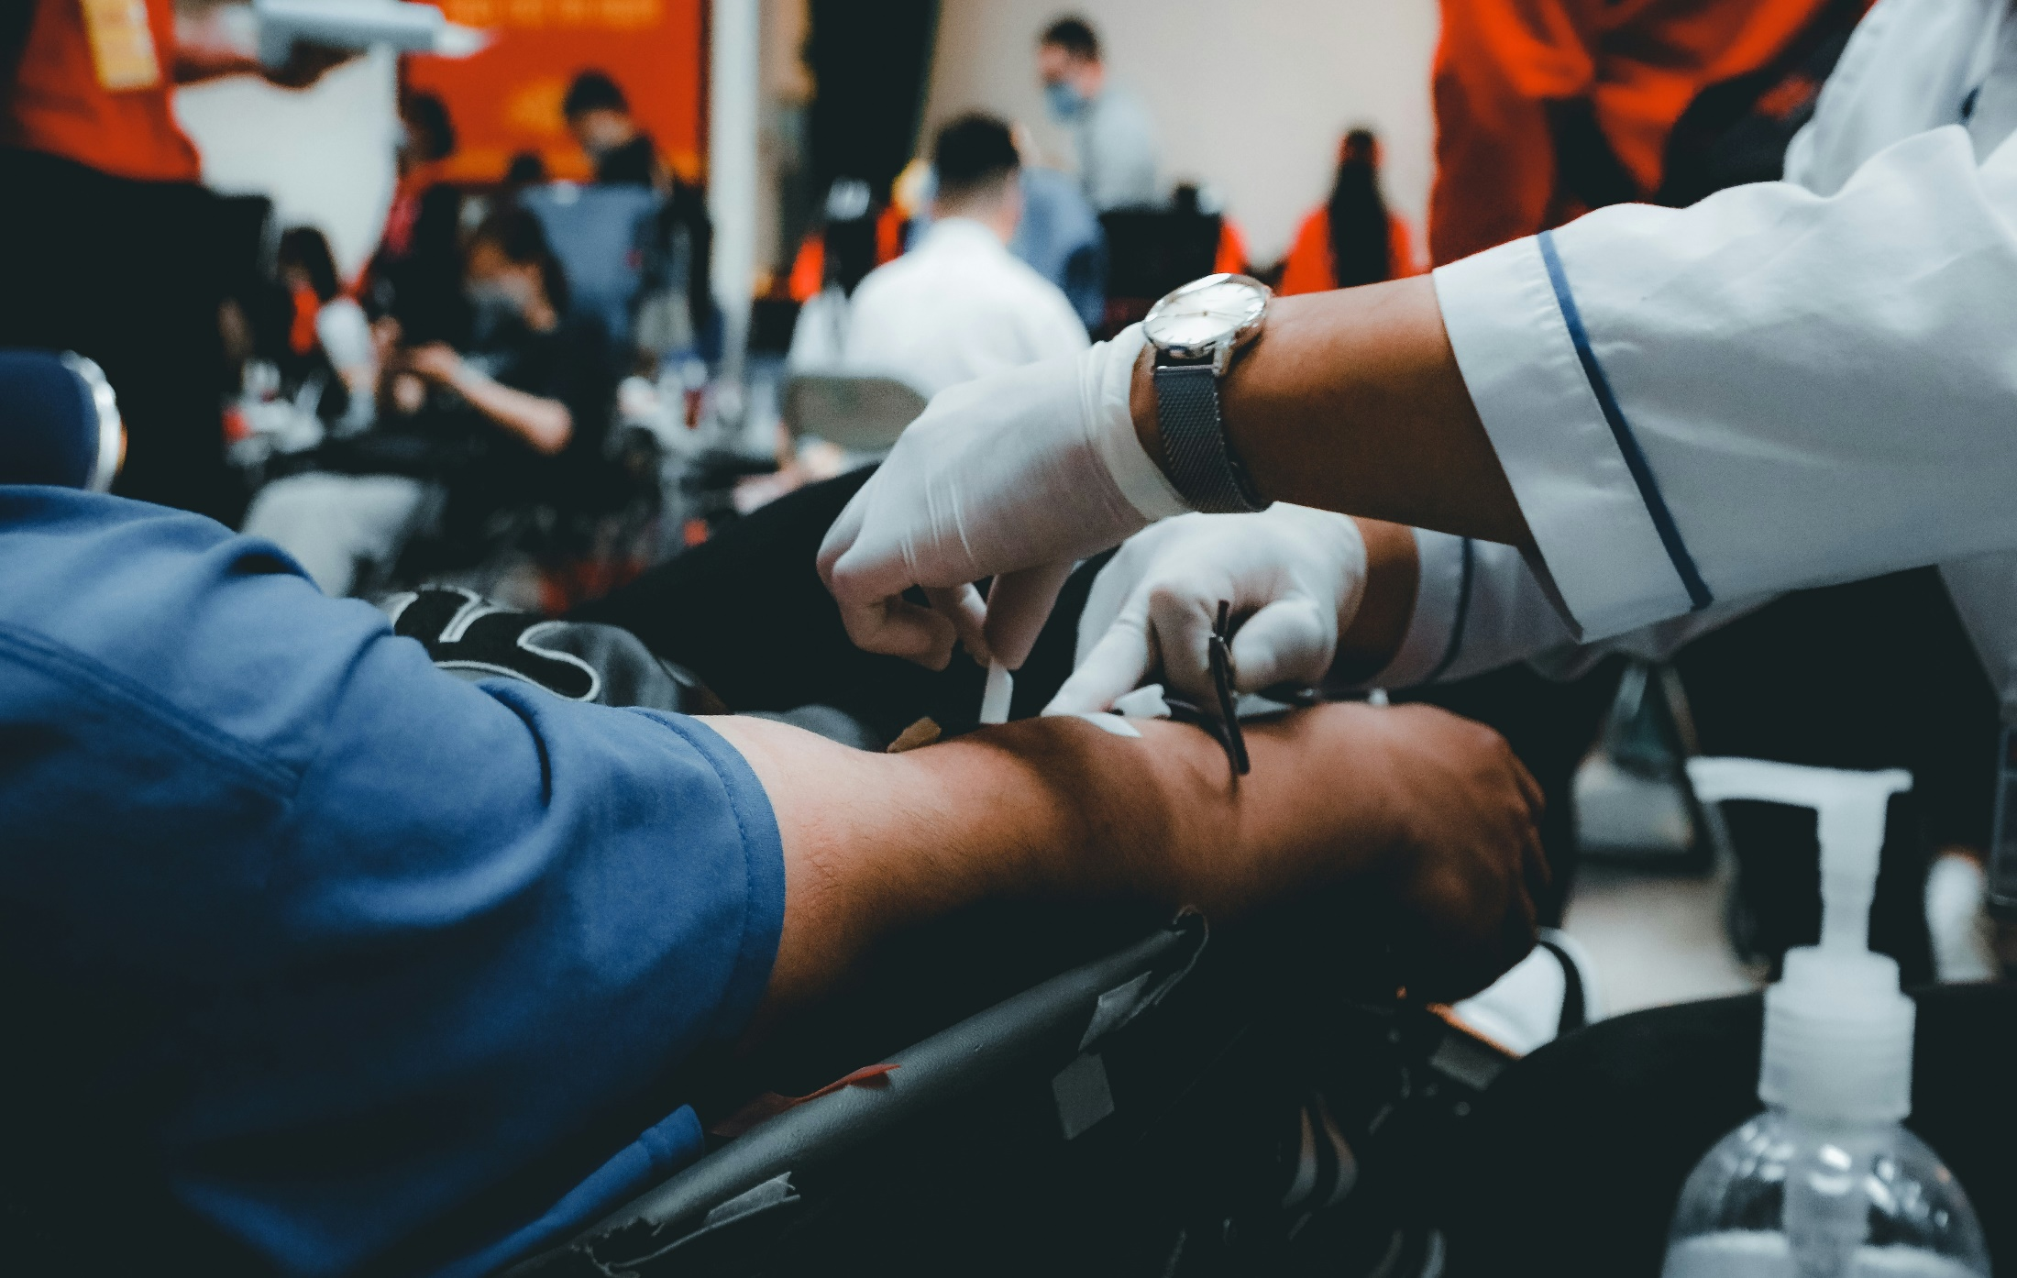
3
What is gene therapy?
The treatment of blood cancers with gene therapy begins in the clinic.
Blood is taken from the patient and the white blood cells, including the T cells, are filtered out.
©VotesforSchools 2023
Notes:
Images
Microsoft Office 365
References
www.oxb.com

Slide 11
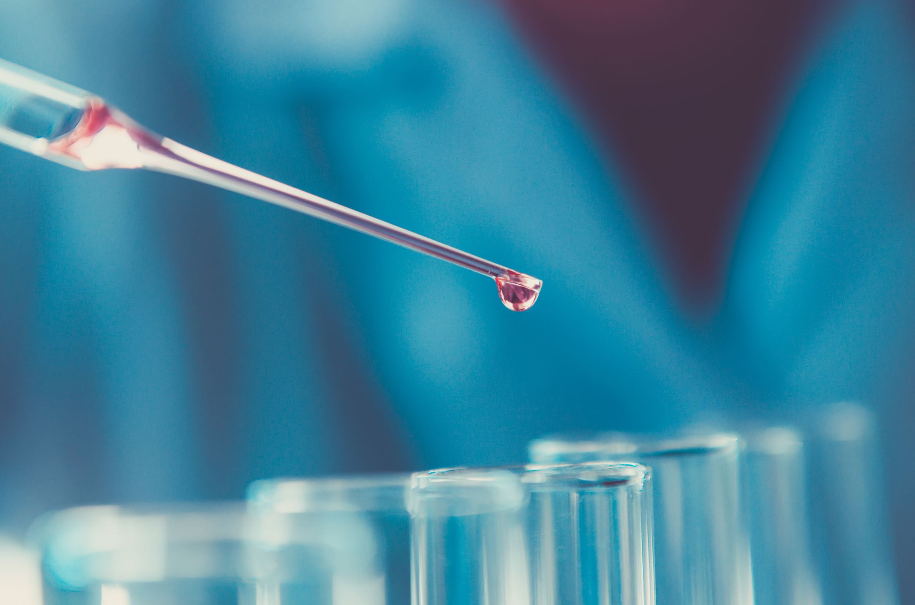
3
What is gene therapy?
Next, in the laboratory, the T cells are engineered to find and kill cancer cells. These modified T cells are now called CAR-T cells.
©VotesforSchools 2023
Notes:
References:
www.oxb.com
Images
Microsoft 365

Slide 12
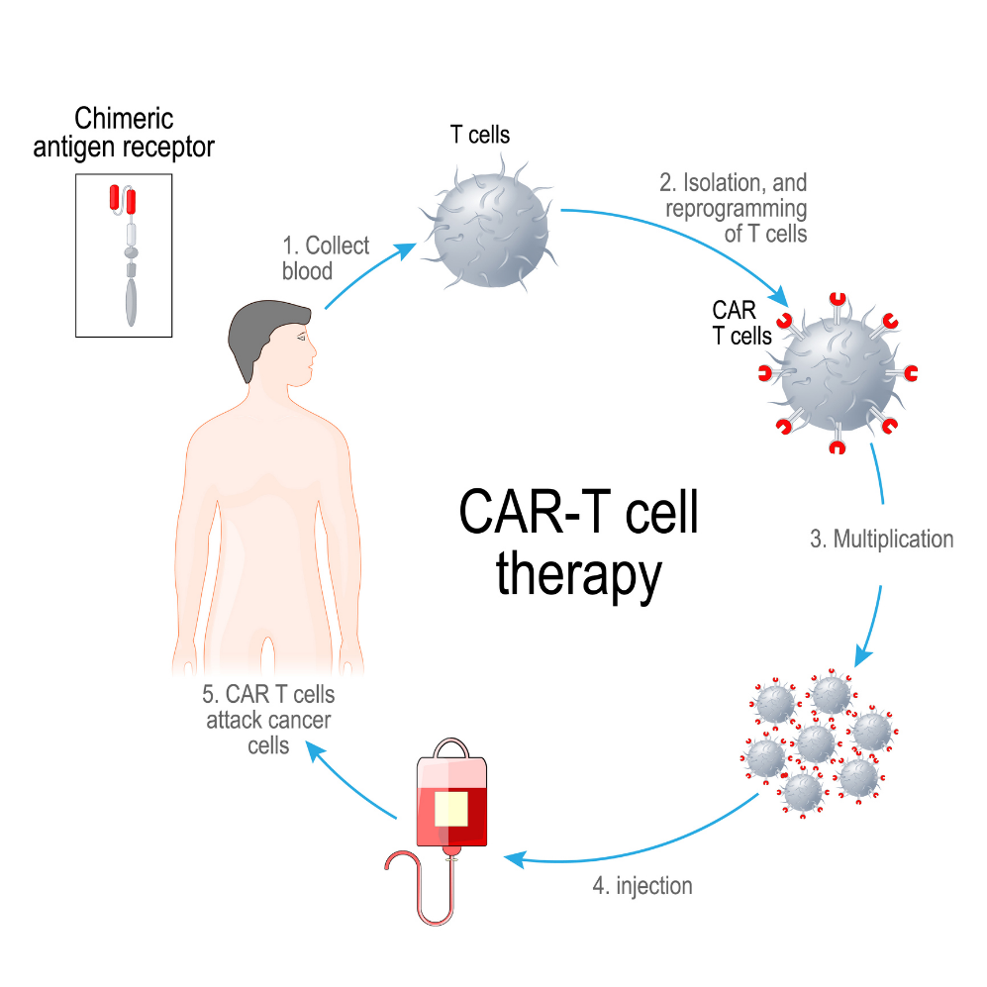
3
What is gene therapy?
Finally, the CAR-T cells are put back into the patient, usually after chemotherapy.
In the body, the receptors are attracted to targets on the cancer cells.
The CAR-T cells identify cancer cells and kill them.
©VotesforSchools 2023
Notes:
Images
iStock
References
www.oxb.com

Slide 13
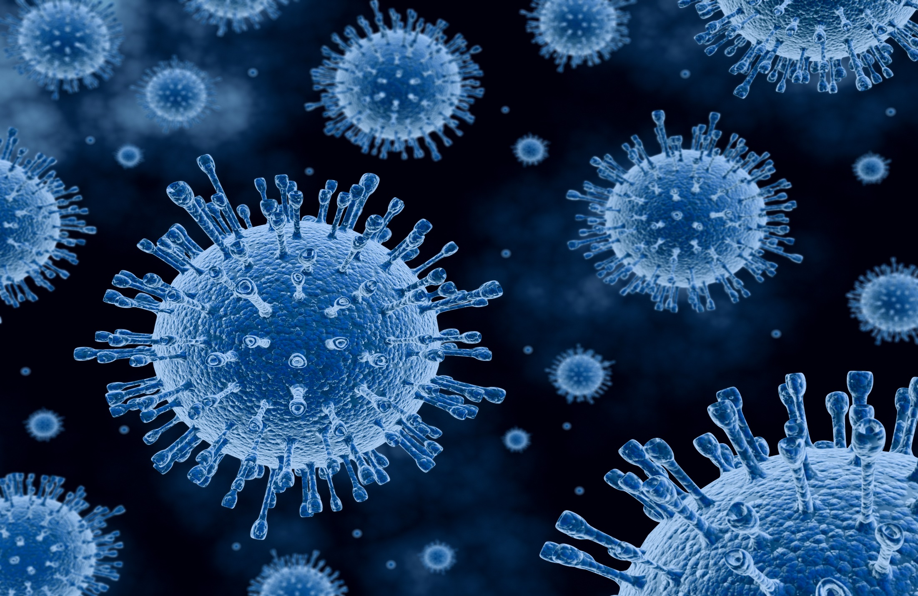
3
What is gene therapy?
Discuss (2-3 mins)
So now you know the ways to fight the mutation, how do we add or change a gene?
Oxford Biomedica were one of the founders for lentiviruses for gene therapy.
Lentiviruses are part of the retrovirus family and can be identified in many species. HIV is probably the most widely known.
They provide efficient delivery to cells and are big enough to deliver larger genes. They cause very little immune response and are long lasting in the body.
©VotesforSchools 2023
Notes:
Images
Microsoft Office 365
References
www.oxb.com

Slide 14
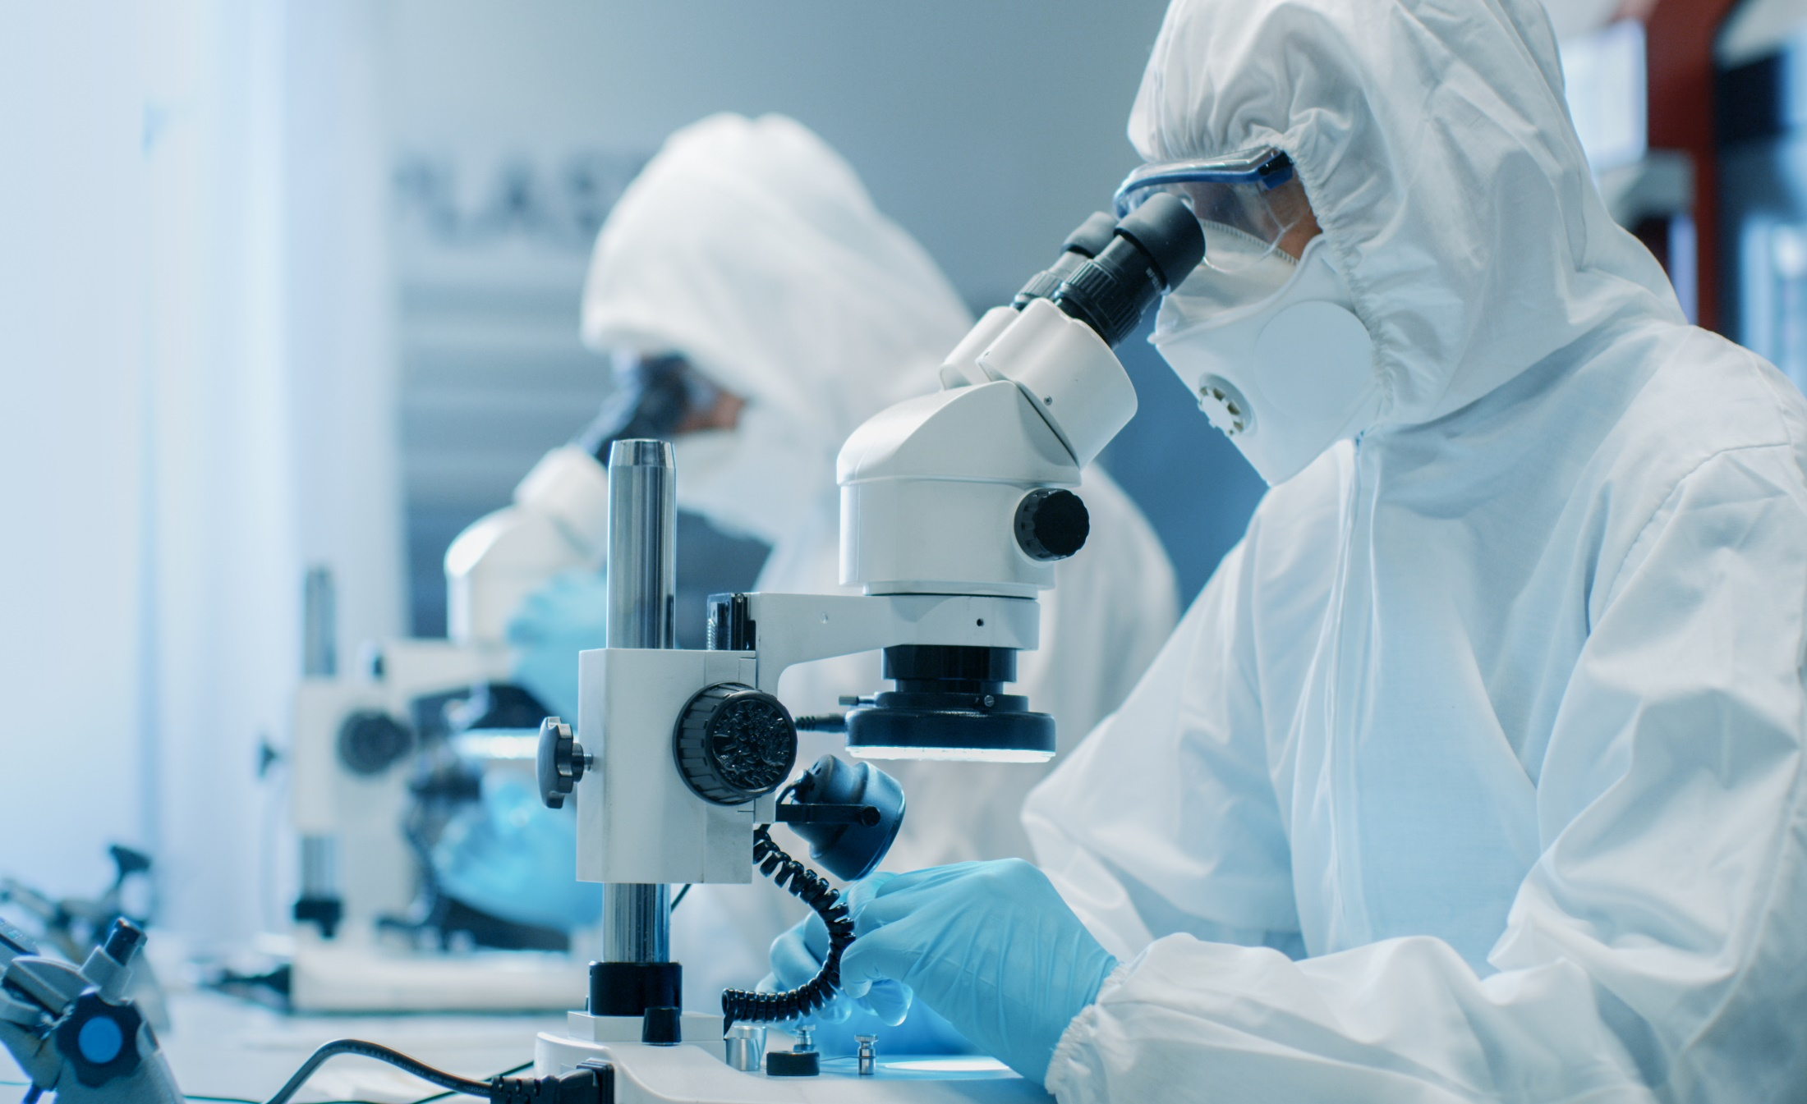
5
Who are Oxford Biomedica?
Find out more
Click on the image to go to Oxford Biomedica’s website where you will find out much more about who they are and what they do.
©VotesforSchools 2023
Notes:
References
https://oxb.com/
Images
Microsoft Office 365

Slide 15
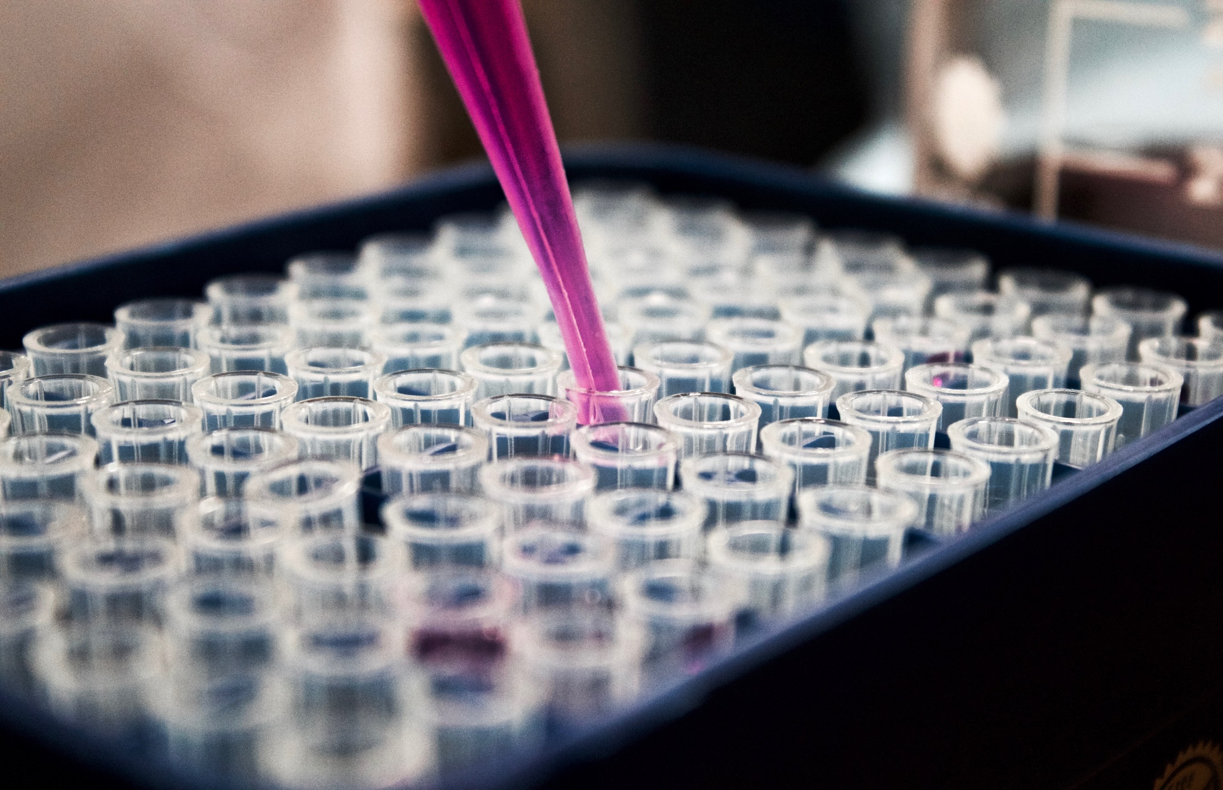

4
Who are Oxford Biomedica?
Pair discussion (2-3 mins)
Talk to a partner: have you heard of Oxford Biomedica? What do they do?
Oxford Biomedica (also known as OXB) is a quality and innovation led contract development and manufacturing organisation (CDMO) specialising in the development and manufacturing of viral vectors. Viral vectors are used by pharmaceutical to deliver life-changing therapies to patients.
You may have heard of them during the pandemic, when they produced 100 million vaccination doses.
They are based in Oxfordshire and have facilities in the US and in France too. They work with some of the most innovative pharmaceutical and biotechnology companies in the world.
©VotesforSchools 2023
Notes:
Images
Unsplash
References
www.oxb.com

Slide 16
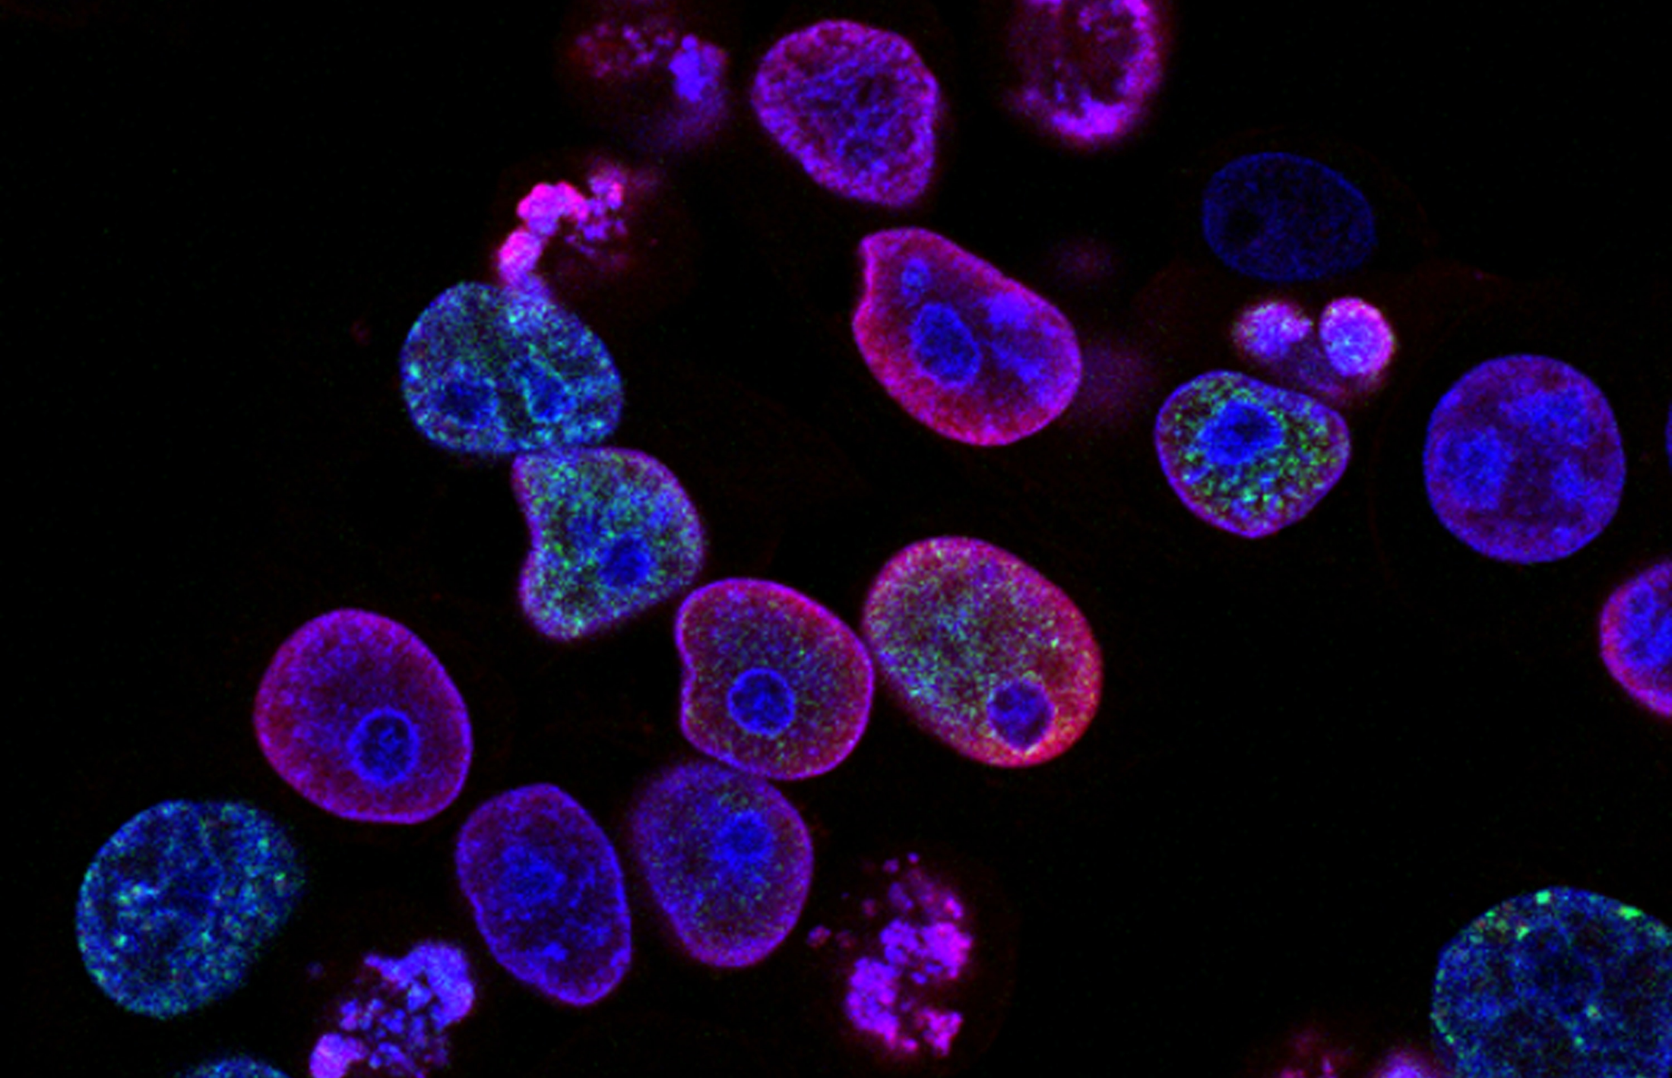
4
Who are Oxford Biomedica?
Definition: Viral vector
A carrier for a virus.
Cell and gene therapy is the treatment of disease by the delivery of therapeutic genetic material (DNA or RNA), into a patient’s cells.
One highly effective approach to delivering the genetic information is to re-engineer existing viruses to be safe delivery vehicles (vectors) to insert the genetic material into patients’ cells.
©VotesforSchools 2023
Notes:
Images
Unsplash
References
www.oxb.com

Slide 17

4
Who are Oxford Biomedica?
Pair discussion (2-3 mins)
How do you think the process of making vaccines is upscaled to make enough doses for a nationwide vaccination scheme?
Oxford Biomedica can upscale this process to make large amounts of a vaccine.
The next two slides explain how something can be upscaled.
©VotesforSchools 2023
Notes:
References
www.oxb.com
Images
iStock

Slide 18


4
Who are Oxford Biomedica?
Below are the ingredients needed to make paella for 4 people.
500g chicken
250g rice
1 onion
3 cloves of garlic
1 red pepper
4 tomatoes
3 tbsp. olive oil
1 tsp of salt
A pinch of saffron
650 ml water
1 chef
Total time: approx. 2 hours
Challenge:
So, what would you do if you needed to cook it for 110,000 people?
©VotesforSchools 2023
Notes:
Images
Unsplash
References
www.oxb.com

Slide 19


4
Who are Oxford Biomedica?
Do you scale-up and make one dish big enough to make 110,000 meals?
Below are the ingredients needed to make paella for 110,000 people.
13,750 kg chicken
6,875 kg rice
27,500 onions
82,500 cloves of garlic
27,500 red peppers
110,000 tomatoes
1238 litres olive oil
193 kg of salt
27,500 pinches of saffron (approx. 3.5kg)
18,000 litres water
27,500 chefs
Total time: difficult to estimate!
*Guinness world record for the biggest Paella ever made!
Do you scale-out and hire 27,500 chefs to cook multiple meals of 4?
The correct answer is to make one dish and scale-up!
In very simple terms, this is how you go from producing 100 vaccines to 100 million vaccines.
©VotesforSchools 2023
©VotesforSchools 2023
©VotesforSchools 2023
©VotesforSchools 2023
©VotesforSchools 2023
Notes:
Images
Unsplash
Guinness book of World Records – Valencian restauranteur Jaun Galbis set the record in 1992 -
References
www.oxb.com
https://fabianab89.wordpress.com/2013/11/10/paella/

Slide 20
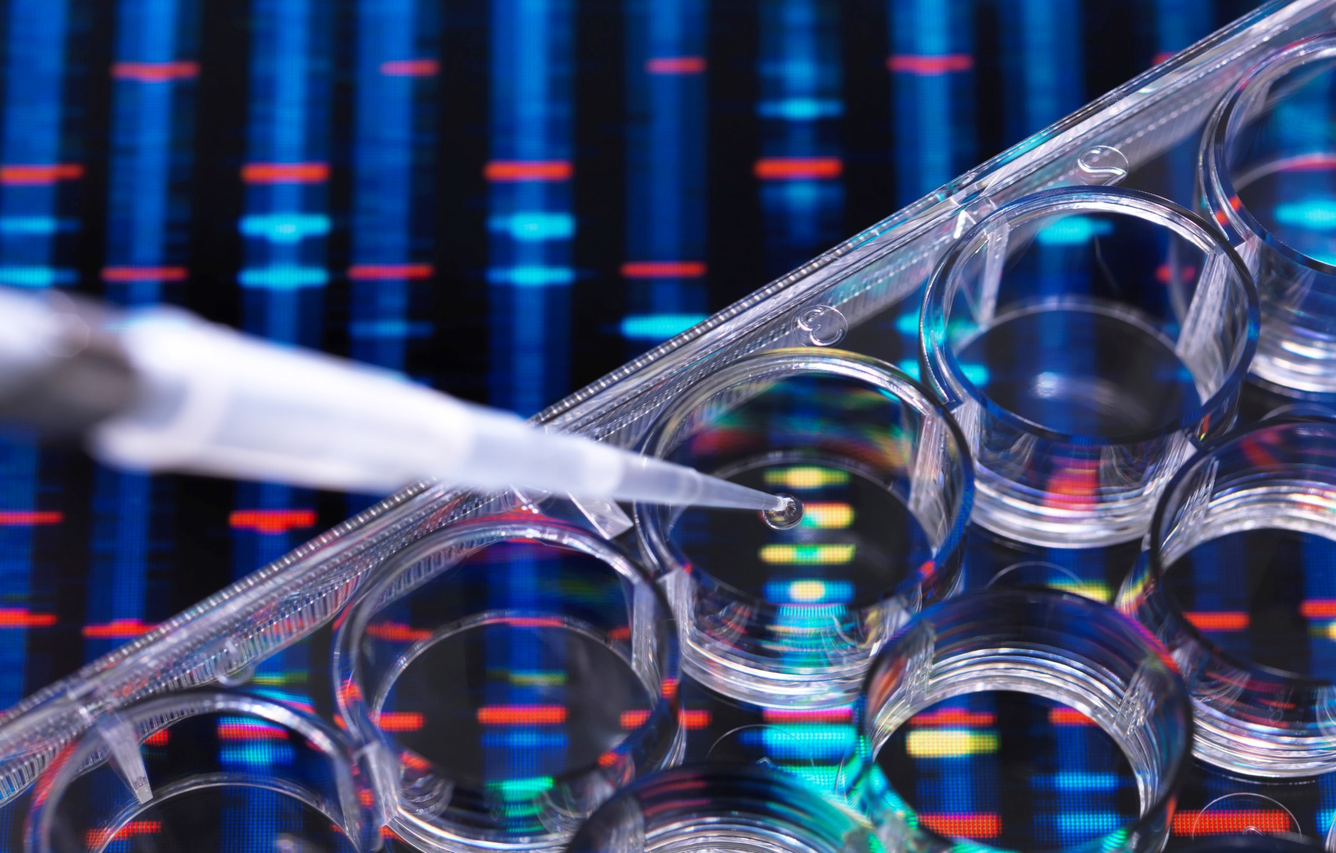
5
Which career pathways are there?
Which careers do you think need Biology?
Teacher
Pharmacist
Nurse
Geneticist
Veterinarian
Dentist
Doctor
Pathologist
Scientist
Microbiologist
Laboratory technician
Notes:
Images
Microsoft Office 365
References
www.oxb.com

Slide 21
5
Which career pathways are there?
Final reflection (2-3 mins)
If this lesson has inspired you to explore a future in Biology, why not find out more?
You could talk to family, friends and teachers about more careers using Biology.
You could have a look at the Oxford Biomedica website to find out more about what they do and if there is a future there for you.
Notes:
Images
Microsoft Office 365
References
www.oxb.com

Slide 22
5
Let’s do something life-changing together!
Which career pathways are there?
Process Research and Development (Process R&D)
at Oxford Biomedica:
Approximately 80 employees
Upstream scientists and engineers
Downstream scientists and engineers
Analytical support
Laboratory technicians
Technical writers
PhD students, interns and apprentices
Notes:
Images
www.oxb.com
References
www.oxb.com

Slide 23
What is the future of genetics?
KS5
In association with Oxford Biomedica
Written by VotesforSchools
©VotesforSchools 2023

Slide 24


Finding help & information
Oxfordshire's new careers platform, Find Your Future, is the next step for you to find out more and plan your future here in Oxfordshire.
Navigate your way around the links by clicking on the logo.
©VotesforSchools 2023
Notes:
Images
https://www.oxfordshirelep.com/findyourfuture
References
https://www.oxfordshirelep.com/findyourfuture
https://www.oxfordshirelep.com/sites/default/files/uploads/FindYourFutureParentsGuide.pdf

Slide 25
Appendix: Summary of DNA technology
In association with Oxford Biomedica
Written by VotesforSchools
©VotesforSchools 2023

Slide 26

Appendix: Summary
Isolation
of the DNA containing the required gene.
Insertion
of the DNA into a vector.
Transformation
Transfer of DNA into a suitable host.
Identification
Finding those host organisms containing the vector and DNA (by use of gene markers).
Growth/Cloning
of the successful host cells.
DNA from different source can be joined together if they have the same sticky ends (the same recognition site).
In order to have the same sticky ends, they must have been cut using the same restriction endonuclease.
Sticky ends are joined together using DNA ligase to join the sugar-phosphate backbone together.
The new DNA molecule is called recombinant DNA.
©VotesforSchools 2023
Notes:
References
https://www.who.int/health-topics/human-genome-editing
https://www.aqa.org.uk/
https://www.biologyonline.com/dictionary
OxLEP teacher encounters

Slide 27
Appendix: Summary
For transcription of any gene to take place, RNA polymerase must attach to the DNA near a gene. This is known as a promoter region.
If we want our DNA fragment to be transcribed, we need to attach it to the necessary promoter region in order to start the process.
There is a similar process when we finish transcription, known as the terminator. Again, we need to ensure we attach a terminator region to the other end of our DNA fragment to stop transcription.
Vector
Used to transport DNA into a host cell.
Plasmid
The most commonly used vector. A circular piece of DNA found in bacteria. Plasmids are useful because they nearly always contain antibiotic resistance genes (see subsequent slides).
©VotesforSchools 2023
Notes:
References
https://www.aqa.org.uk/
https://www.biologyonline.com/dictionary
OxLEP teacher encounters

Slide 28
Appendix: Summary
One of the antibiotic resistant genes is disrupted when the restriction enzymes cuts open the plasmid.
The other antibiotic resistant gene is used in selection of the correct host cells.
Transformation (Stage 3)
The plasmids must be reintroduced into the host cell (e.g. bacteria).
This process is called transformation.
However not all the bacterial cells will have the desired gene at the end of the process.
Reintroducing the plasmid
Plasmids and bacterial cells are mixed together in a medium containing calcium ions.
Calcium ions, combined with temperature change, makes the bacterial membrane permeable and therefore allows the plasmids to pass through into the cytoplasm.
©VotesforSchools 2023
Notes:
References
https://www.aqa.org.uk/
https://www.biologyonline.com/dictionary
OxLEP teacher encounters

Slide 29
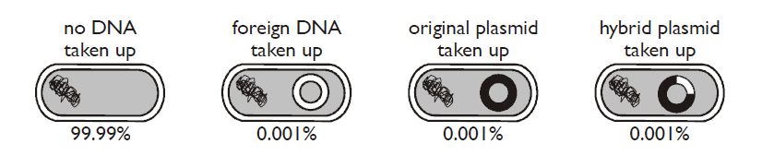
Appendix: Summary
Not all the bacterial cells end up with the desired gene.
Only a few bacterial cells (can be as little as 1%) take up the plasmids when the 2 are mixed.
Some plasmids will have closed up again without incorporating the DNA fragment. Sometimes the DNA fragment ends can join together to form its own plasmid.
©VotesforSchools 2023
Notes:
References
https://www.aqa.org.uk/
https://www.biologyonline.com/dictionary
OxLEP teacher encounters

Slide 30
Appendix: Summary
Identification (stage 4) of bacteria containing the plasmid
Firstly, we must identify the bacteria containing the plasmids – we do this by growing the bacteria on a medium containing an antibiotic.
The antibiotic resistant gene is found in the plasmid only and therefore the bacteria that survive must contain the plasmid.
©VotesforSchools 2023
Notes:
References
https://www.aqa.org.uk/
https://www.biologyonline.com/dictionary
OxLEP teacher encounters

Slide 31
Appendix: Summary
Identification (stage 4) of bacteria containing the plasmid with the DNA fragment
Gene markers are used to identify which plasmids have taken up the DNA fragment. This involves a second, separate gene on the plasmid.
Gene markers can be:
Resistance to an antibiotic
A fluorescent protein
An enzyme whose action can be identified.
The plasmid
The ampicillin resistance gene is disrupted when the restriction enzymes cuts open the plasmid.
©VotesforSchools 2023
Notes:
References
https://www.aqa.org.uk/
https://www.biologyonline.com/dictionary
OxLEP teacher encounters

Slide 32
Appendix: Summary
Antibiotic-resistance markers
Old technology that has been superseded by other methods.
The second antibiotic-resistance gene (e.g. resistance to tetracycline) is used to identify those plasmids with a DNA fragment in them.
If the DNA fragment has been inserted into the tetracycline resistance gene it will no longer grow on a medium containing tetracycline.
If we just grow on a plate with tetracycline, we will kill the cells that are not resistant to tetracycline (the ones that have taken up the plasmid containing our desired genes).
In order to identify the bacteria with our desired gene, we use a process called replica plating.
©VotesforSchools 2023
Notes:
References
https://www.aqa.org.uk/
https://www.biologyonline.com/dictionary
OxLEP teacher encounters

Slide 33
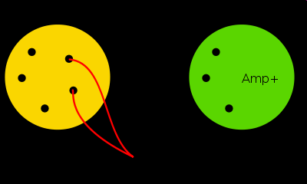
Appendix: Summary
Replica plating
The bacteria on the yellow plate have the plasmid.
The bacteria which do not grow on the green plate (containing ampicillin) contain a plasmid with a DNA fragment.
Ampicillin sensitive bacteria – these have the DNA fragment.
©VotesforSchools 2023
Notes:
References
https://www.aqa.org.uk/
https://www.biologyonline.com/dictionary
OxLEP teacher encounters

Slide 34
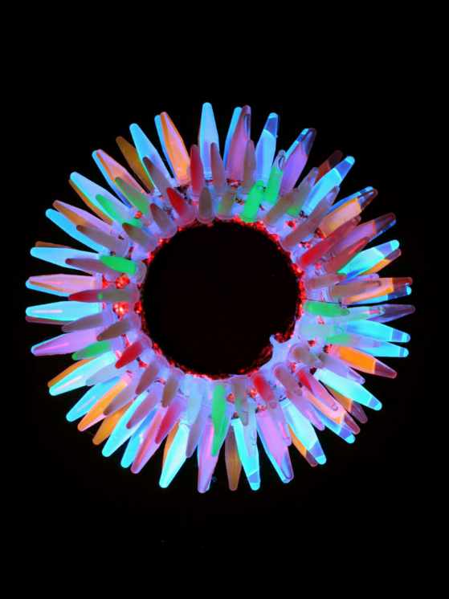
Appendix: Summary
Fluorescent markers
The gene from jellyfish which produces Green Fluorescent Protein (GFP) has been incorporated into a plasmid.
The gene to be cloned is transplanted into the centre of the GFP gene, therefore disrupting its transcription.
Results can be viewed under the microscope, making the process quicker.
If the hybrid plasmid has been taken up, the bacteria will not glow and can be identified.
If the original plasmid has been taken up, the bacteria will glow and would not be used.
©VotesforSchools 2023
Notes:
References
https://www.aqa.org.uk/
https://www.biologyonline.com/dictionary
OxLEP teacher encounters

Slide 35
Appendix: Summary
Enzyme markers
The enzyme lactase (that breaks down lactose) turns a colourless indicator a blue colour.
If the hybrid plasmid has been taken up, lactase will not be produced so the agar containing the indicator will remain colourless.
Required gene is transplanted into gene that makes lactase, disrupting it.
Growth & cloning
Once we have successfully inserted our gene into our organism, and checked that it is present, we now want to clone that organism to ensure that gene remains present in future generations.
This allows the gene to continue being translated, and therefore the protein we want to make will be made (eg. Insulin).
©VotesforSchools 2023
Notes:
References
https://www.aqa.org.uk/
https://www.biologyonline.com/dictionary

