Slide 1
Making Encounters Meaningful
www.oxlepskills.co.uk
Planning a Provider Encounter

Slide 2
Introduction and contents
Please use these slides to help plan and prepare for your Provider Encounter.
The first few slides explain what should be considered when planning an encounter. The remaining slides contain data and useful information that you may wish to include in your presentation.
Slides | Section
3-6 | Planning a provider encounter
7-8 | Opportunities within Oxfordshire
9 | Your Fabulous Future in Oxford
10-11 | The job market in Oxfordshire
12 | LMI data dashboards
13-17 | Apprenticeships
18 | Apprenticeship vacancies

Slide 3
Planning a provider encounter
An editable template is available that may be helpful when planning a provider encounter
Learner Outcomes
These may include outcomes that support learners to understand:
All available routes post 16 and post 18, including technical and vocational
Learner experience
Pathways to work
Recruitment & selection
Labour Market Information (LMI)
Outcomes may also support learner to develop specific knowledge and skills or have experiences of the provider/workplace

Slide 4
Planning a provider encounter
Description of event
Where does this fit within a progressive programme for learners and how will it cover the 4 requirements for an encounter as detailed in the provider access legislation:
Information about the provider and the approved technical education qualifications or apprenticeships that the provider offers
Information about the careers to which those technical education qualifications or apprenticeships might lead
A description of what learning or training with the provider is like
Responses to questions from the pupils about the provider or approved technical education qualifications and apprenticeships

Slide 5
Planning a provider encounter
Audience
The size of the group and year group
Any key contextual information about the school/college
Guidance on how to pitch the encounter/experience at the right level for students
Key contextual information about students and any adaptations required to make it accessible to all
If the students are imminently moving on to their next step, consider how this encounter fits within a wider package of transition support

Slide 6
Planning a provider encounter
Order of event
Are there any pre work or briefings needed e.g. for learners, staff or parents
What are the event timings
Tasks and who is performing them, who will be speaking and when etc.
Time for student reflection/questions built in
Any follow up activities or resources that will be provided
Any evaluation, or is a feedback opportunity planned
Audio visual
Find out what technology is available

Slide 7
Opportunities within Oxfordshire
Pair discussion (2-3 mins)
Talk to a partner about what opportunities you know about in your local area. What do people you know do as their career? Then, click to find out more about which sectors have roles on offer in Oxfordshire.
Definition: Sector
An area of work and production that makes money for an area or country.
Space & Satellite
Oxfordshire has state-of-the art technology
Advanced Engineering
Oxfordshire has a zero carbon target for 2030
Life Sciences
Including vaccinations, cryogenics & more
Construction
Ongoing development of green technologies
Health & Social Care
A variety of different roles are available
Autonomous Vehicles
Constant development of cutting-edge tech
Education
The universities have over 14,000 staff
Creative Industries
Including film & game design and creation
Manufacturing & Logistics
A thriving distribution industry
Challenge:
Did you know there were career opportunities in these sectors in Oxfordshire?
©VotesforSchools The WOW Show 2021

Slide 8
Opportunities within Oxfordshire
Digital Technology
With almost everyone using technology, this sector is always growing
Wholesale & Retail
There are thousands of retail roles with large & small retailers
Financial & Professional Services
All businesses need financial advice & support and legal advice
The Public Sector
Oxfordshire County Council have 1,300 staff in a variety of roles
Hospitality, Leisure & Tourism
Oxfordshire has thousands of visitors from all over the world
Charity Sector
There are many sectors that have opportunities for experience
There are so many opportunities in Oxfordshire, so why not take inspiration from closer to home?
©VotesforSchools The WOW Show 2021

Slide 9
Your Fabulous Future in Oxford
All the amazing career opportunities on your doorstep here in Oxfordshire!
The construction jobs you may not even know existed and how they fit with the more familiar trades you think you know about.

Slide 10
The job market in Oxfordshire
Around our county, people are designing life-saving vaccines, space tech, self-driving cars and some of the most popular video games!
78% of working-age people are employed
37,700+ businesses
99% of employers are small and medium businesses
93% of apprentices in Oxfordshire go into long-term employment
100% of higher level apprenticeships (Level 4+) led to long-term employment
Local employers want people with skills in communication, organisation and collaboration.

Slide 11
The job market in Oxfordshire
Compared to the rest of England, more people earn higher than average pay in Oxfordshire!
High number of vacancies within:
Human Health & Social Work
Professional, Scientific & Technical
Information & Communication
Local Growth Sectors:
Space
Life Sciences
Construction
Digital & Creative
Health & Social Care
Motorsport & Advanced Engineering

Slide 12
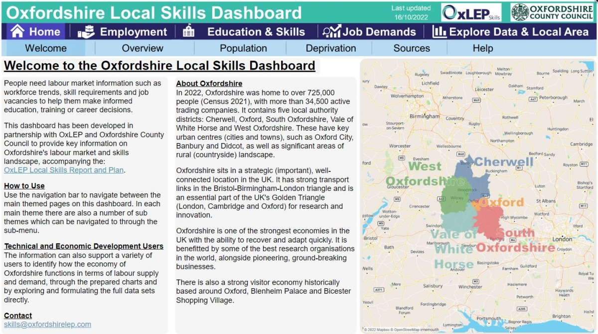
LMI data dashboards
Oxfordshire Local Skills Dashboard
Young people with SEND – Oxfordshire Your Futures

Slide 13
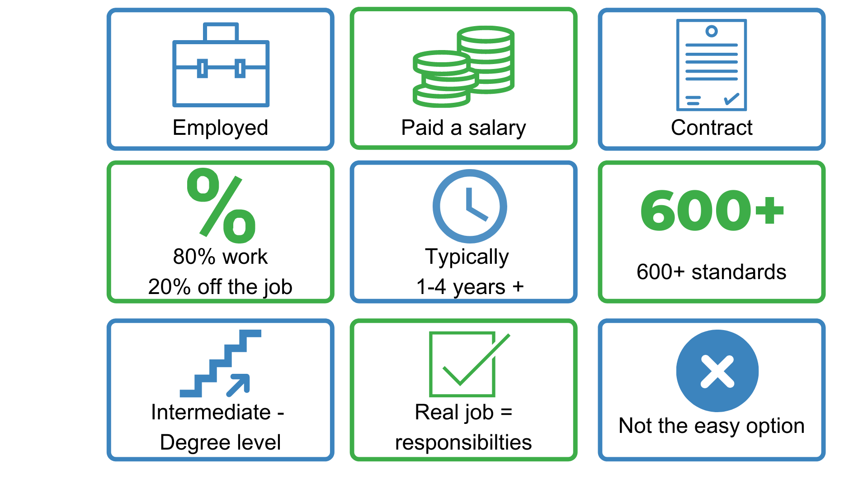
What are apprenticeships?

Slide 14
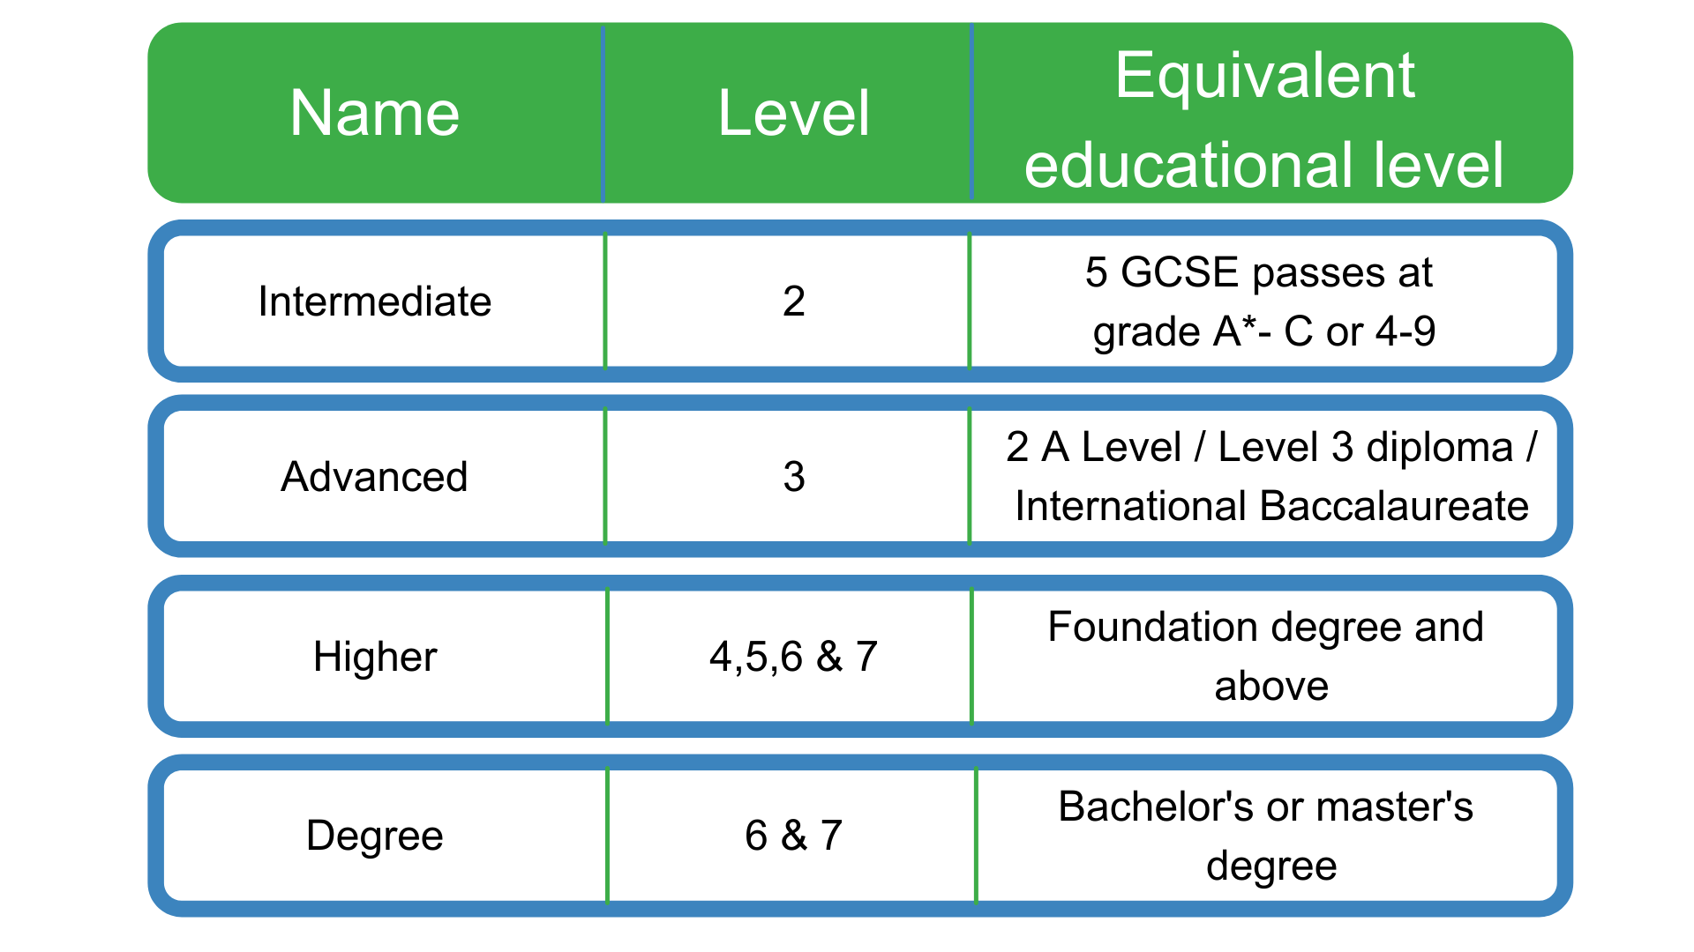
Apprenticeship levels

Slide 15
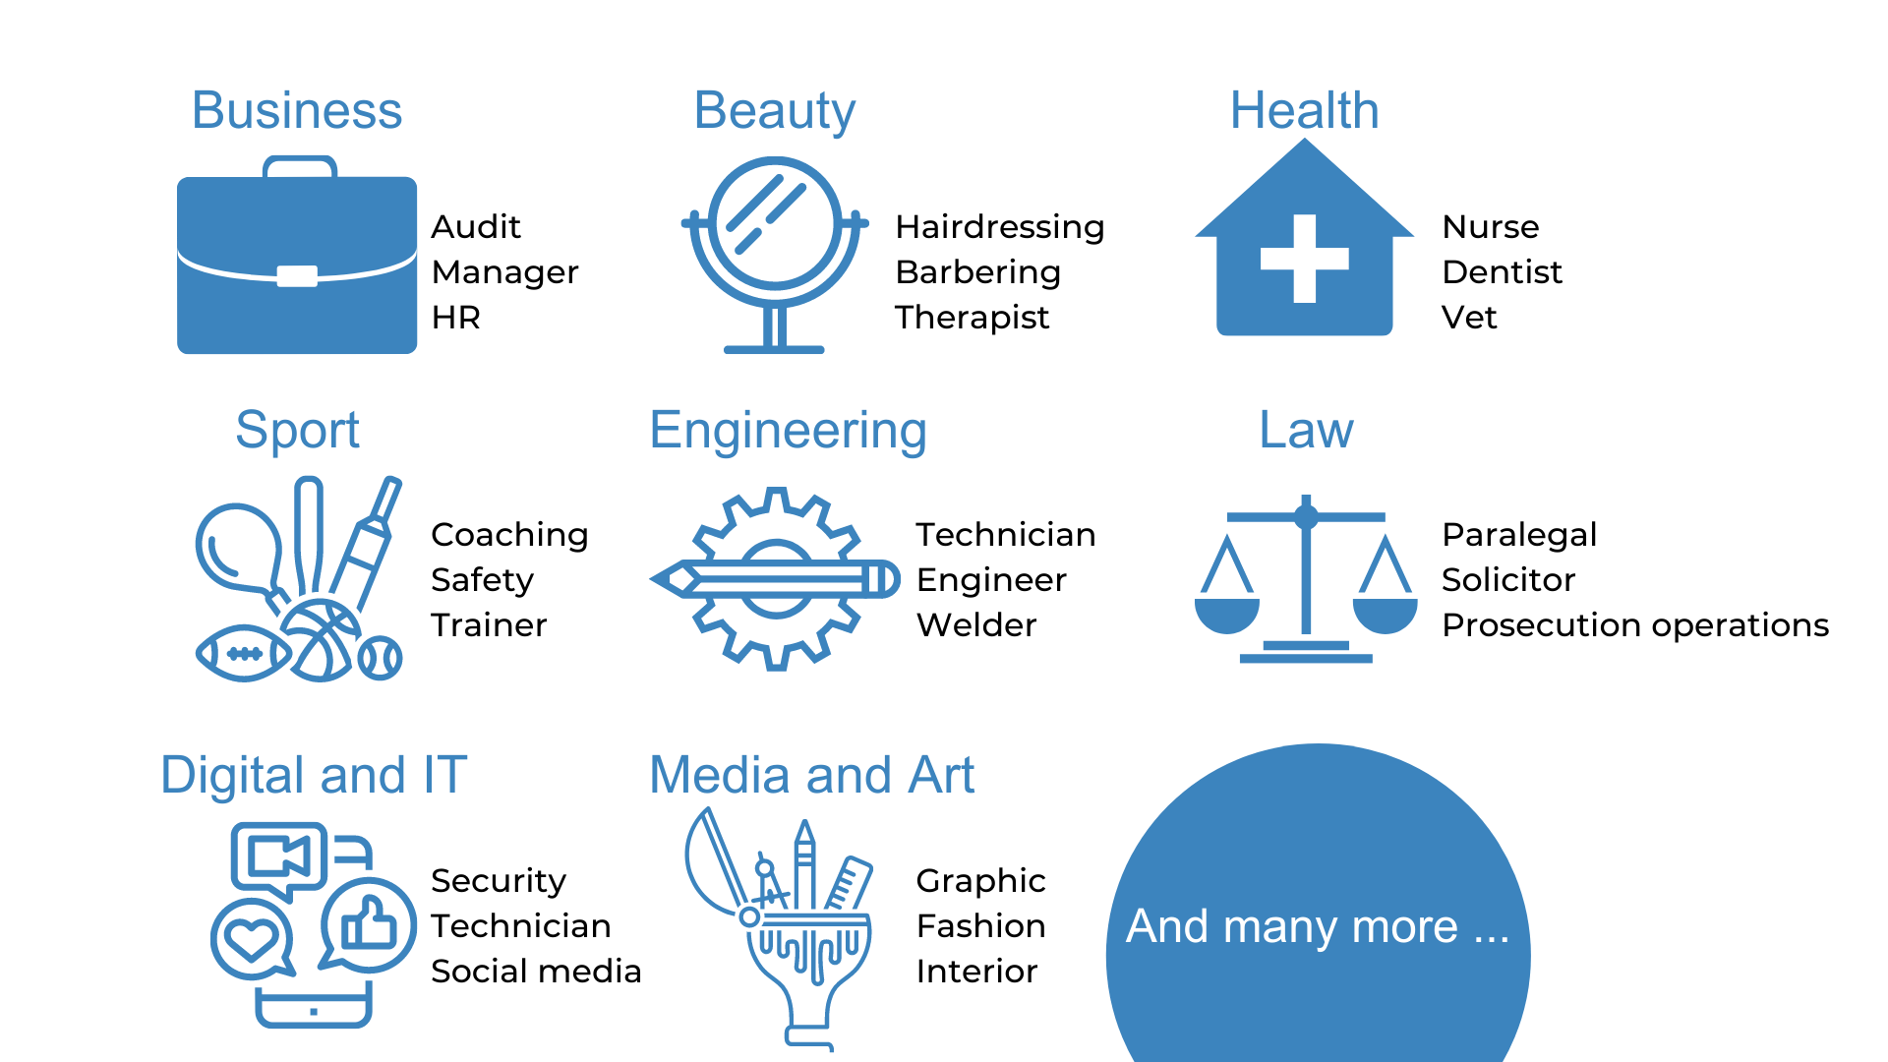
The range of apprenticeships

Slide 16
Which National and Oxfordshire employers offer apprenticeships?

Slide 17
Look inside the company
Logistics
IT and Cyber Security
Data Analytics
Sales
Business Development
Marketing
Human Resources (HR)
Finance
Legal
Facilities Management
Security
Customer Service
Training and Development

Slide 18
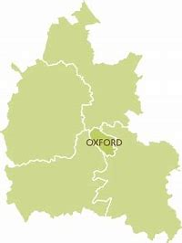
Apprenticeship vacancies near me – are there any?
For the latest apprenticeship vacancy data, visit: gov.uk
Vacancies are also listed here: oxme.info
In Oxford:
5 miles = 45 vacancies
10 miles = 72 vacancies
15 miles = 132 vacancies
20 miles = 165 vacancies
* Data as of 9th March 2023

Slide 19
OxLEP Skills
If you need any further help to plan and prepare for your Provider Encounter, please don’t hesitate to contact us.
skills@oxfordshirelep.com
www.oxlepskills.co.uk

