Slide 1
Finding Their Future
In association with VotesforSchools
©VotesforSchools 2023

Slide 2
A fabulous future in Oxfordshire?
Time to find out more about the fabulous future waiting for you in Oxfordshire…
There are over 350,000 people working in Oxfordshire and over 50,000 people are self-employed.
0:00-3:54
Click the image to watch The WOW Show film.
©VotesforSchools 2023
https://safeshare.tv/x/528251568
Notes:
YouTube Video Link: https://www.youtube.com/channel/UCXDSgY0E_aACHXcSqX14YNg
SafeShare Video Link: https://safeshare.tv/x/sualeIxU3F4
Images
Via video

Slide 3
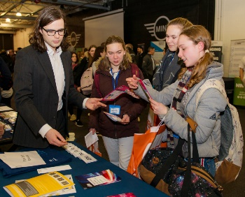
1
Opportunities in Oxfordshire
Have you thought about your future yet? What do you enjoy?
Whatever your interests, there is something for you!
There are lots of great opportunities in many different sectors across Oxfordshire. A great future awaits...
Whether you want an apprenticeship, T Levels, further education or to study for a degree, Oxfordshire has a pathway that would suit you.
©VotesforSchools 2023
Notes:
Images
iStock
OxLEP

Slide 4
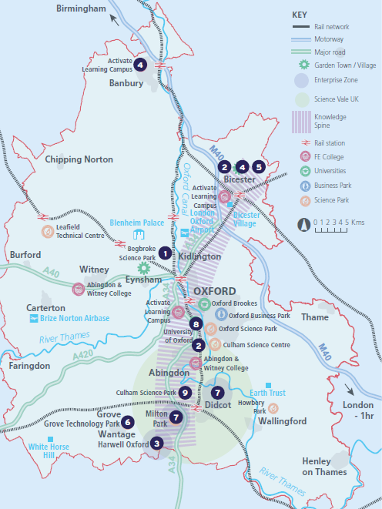
2
What’s in your area?
Pair discussion (2-3 mins)
Talk to a partner about what opportunities you know about in your local area. What do people you know do as their career?
There are opportunities in health, space, tourism, creative industries, construction and so much more.
No matter where you live in Oxfordshire, there is an amazing opportunity waiting for you.
During this presentation, you are going to find out about how one company can have a variety of different roles and career choices!
©VotesforSchools 2023
Notes:
Images
OxLEP
References
https://www.oxfordshirelep.com/sites/default/files/uploads/OxLEPLMIReportAugust2020.pdf

Slide 5
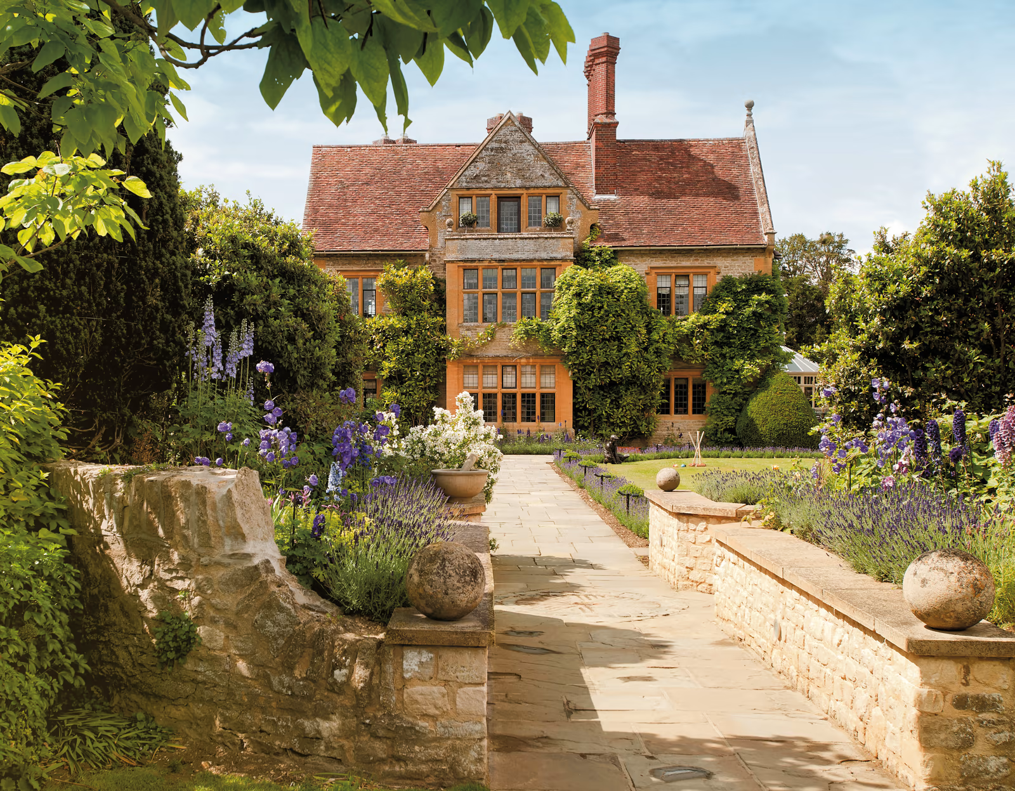
3
Explore Le Manoir aux Quat’Saisons
0:00-1:00
Click on the image to see more of Le Manoir. Think about the careers on offer here.
©VotesforSchools 2023
https://safeshare.tv/x/HwqTJsn3a98
Notes:
YouTube Video Link: https://www.youtube.com/watch?v=HwqTJsn3a98
SafeShare Video Link: https://safeshare.tv/x/HwqTJsn3a98
Images & References
https://www.belmond.com/hotels/europe/uk/oxfordshire/belmond-le-manoir-aux-quat-saisons/

Slide 6
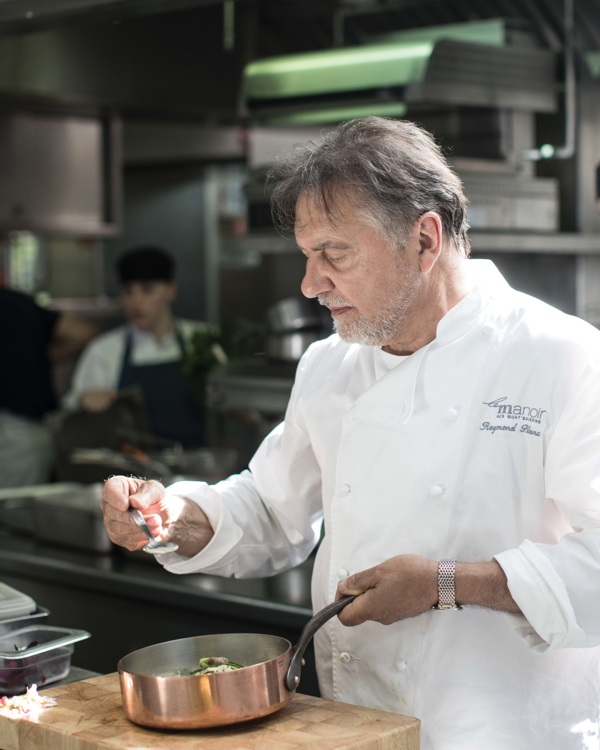
3
Explore Le Manoir aux Quat’Saisons
Group discussion (2-3 mins)
Based on the video, what were your first impressions of Le Manoir and its food?
As you saw in the video, Le Manoir is a beautiful setting with stunning gardens and innovative food.
The Restaurant has been open for 39 years and has two Michelin stars. Raymond Blanc OBE oversees the food.
Definition: Michelin star
An award given for exceptional cooking.
©VotesforSchools 2023
Notes:
Images
https://www.belmond.com/hotels/europe/uk/oxfordshire/belmond-le-manoir-aux-quat-saisons/gallery
References
https://www.belmond.com/hotels/europe/uk/oxfordshire/belmond-le-manoir-aux-quat-saisons/
https://guide.michelin.com/gb/en/restaurants
https://guide.michelin.com/gb/en/article/features/what-is-a-michelin-star

Slide 7
3
Explore Le Manoir aux Quat’Saisons
The building itself has 32 individually designed hotel rooms.
Le Manoir has vegetable and herb gardens that provide the kitchen with ultra-fresh, organic produce.
Definition: Organic
Food grown or produced without artificial chemicals.
©VotesforSchools 2023
Notes:
Images
https://www.belmond.com/hotels/europe/uk/oxfordshire/belmond-le-manoir-aux-quat-saisons/gallery
References
https://www.belmond.com/hotels/europe/uk/oxfordshire/belmond-le-manoir-aux-quat-saisons/
https://guide.michelin.com/gb/en/restaurants
https://guide.michelin.com/gb/en/article/features/what-is-a-michelin-star
https://dictionary.cambridge.org/dictionary/english/organic

Slide 8
3
Explore Le Manoir aux Quat’Saisons
As well as the hotel and restaurant, Le Manoir has The Raymond Blanc Cookery School.
It also has a The Raymond Blanc Gardening School where they share their world class gardens.
©VotesforSchools 2023
Notes:
Images
https://www.belmond.com/hotels/europe/uk/oxfordshire/belmond-le-manoir-aux-quat-saisons/gallery
References
https://www.belmond.com/hotels/europe/uk/oxfordshire/belmond-le-manoir-aux-quat-saisons/
https://guide.michelin.com/gb/en/restaurants
https://guide.michelin.com/gb/en/article/features/what-is-a-michelin-star
https://dictionary.cambridge.org/dictionary/english/organic

Slide 9
4
Why is Le Manoir’s food so special?
Le Manoir is considered one of Britain’s best restaurants. It has kept its two Michelin stars for 39 years.
It also has a Green Michelin Star. These are awarded for using sustainable produce sources and avoiding
food waste.
Definition: Sustainable produce
Food sources that are good for the environment.
©VotesforSchools 2023
Notes:
Images
https://www.belmond.com/hotels/europe/uk/oxfordshire/belmond-le-manoir-aux-quat-saisons/gallery
References
https://guide.michelin.com/gb/en/article/features/what-is-the-michelin-green-star-and-how-do-you-earn-one

Slide 10
4
Why is Le Manoir’s food so special?
Modern technology and transport means that we can eat any food at any time of the year.
However, if we eat food when it is naturally ready (“in season”), then it is considered tastier. It is also cheaper and better for the environment too.
©VotesforSchools 2023
Notes:
Images
https://www.belmond.com/hotels/europe/uk/oxfordshire/belmond-le-manoir-aux-quat-saisons/gallery
References
1) https://www.bbc.co.uk/bitesize/topics/zfmpb9q/articles/z3tcydm

Slide 11
4
Why is Le Manoir’s food so special?
Le Manoir is proud to use seasonal produce and locally-sourced food, and aims to be as environmentally aware as possible.
Definition: Seasonal produce
Food that becomes ripe and ready to eat during a certain season.
Pair discussion (2-3 mins)
What do you think a restaurant can do to be environmentally-friendly?
©VotesforSchools 2023
Notes:
Images
https://www.belmond.com/hotels/europe/uk/oxfordshire/belmond-le-manoir-aux-quat-saisons/gallery
References
1) https://www.bbc.co.uk/bitesize/topics/zfmpb9q/articles/z3tcydm

Slide 12
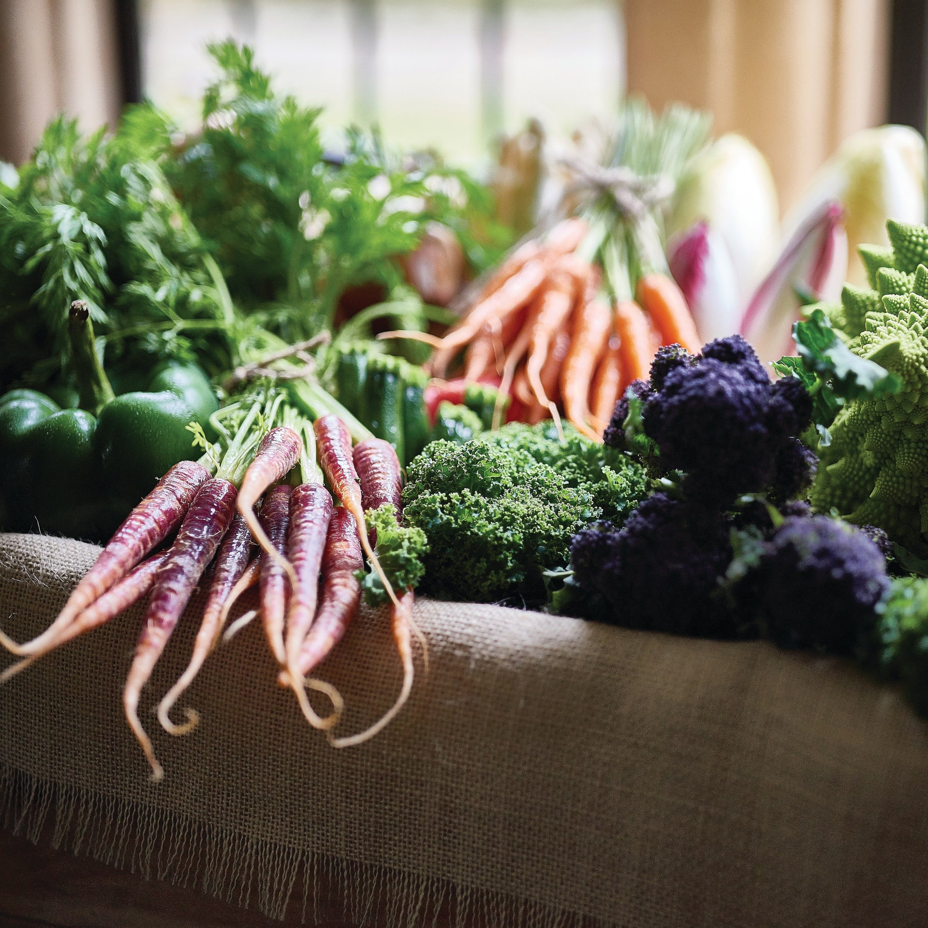
4
Why is Le Manoir’s food so special?
Did you think about food waste, no plastics, energy usage or something as simple as reusing waste water?
Le Manoir dries all of its food waste and uses it as compost in their
kitchen gardens.
This is called a “closed loop”. It means that no waste food is put in landfill and is reused to benefit the soil.
©VotesforSchools 2023
Notes:
Teacher Notes
Find out more about a closed loop & food waste here: https://tidyplanet.co.uk/closed-loop-food-waste-management-growing-trend-hospitality/
Images
1) https://www.belmond.com/hotels/europe/uk/oxfordshire/belmond-le-manoir-aux-quat-saisons/gallery
References
https://tidyplanet.co.uk/closed-loop-food-waste-management-growing-trend-hospitality/

Slide 13
4
Why is Le Manoir’s food so special?
Pair discussion (2-3 mins)
How do you think a restaurant decides what to serve on their menu?
Their menu is set with seasonal fruits and vegetables.
They use local farms to provide other food and only bring in fish from further away.
The produce used is seasonal and Le Manoir uses fresh vegetables and herbs from their own garden.
Challenge:
Work out how far the food in your lunch today travelled, just to be in your local shop or supermarket.
©VotesforSchools 2023
Notes:
Images
1) https://www.belmond.com/hotels/europe/uk/oxfordshire/belmond-le-manoir-aux-quat-saisons/gallery
References
https://www.foodafactoflife.org.uk/whole-school/whole-school-approach/curriculum-qualifications-and-frameworks/
https://www.bbc.co.uk/bitesize/topics/zjr8mp3/articles/zjnxwnb

Slide 14
4
Why is Le Manoir’s food so special?
Pair discussion (2 mins)
How can we reduce pollution through our food choices?
In the supermarket, food labels tell us where an item comes from.
For example, although UK farmers grow strawberries, the ones we buy could still be from Spain or even Egypt!
The further the food miles, the more pollution is produced. This pollution then contributes to climate change.
Definition: Food miles
How far food travels from where it is grown to where it is eaten.
©VotesforSchools 2023
Notes:
Images
https://www.belmond.com/hotels/europe/uk/oxfordshire/belmond-le-manoir-aux-quat-saisons/gallery
References
https://www.tridge.com/data-insights/seasonal-change-of-strawberry-imports-in-uk
https://www.bbcgoodfood.com/howto/guide/facts-about-food-miles

Slide 15
4
Why is Le Manoir’s food so special?
Pair reflection (1 min)
How do you feel about Le Manoir’s green Michelin star?
Do other restaurants need to do more to make sure their food is kinder to the environment?
©VotesforSchools 2023
Notes:
Images
https://www.belmond.com/hotels/europe/uk/oxfordshire/belmond-le-manoir-aux-quat-saisons/gallery

Slide 16
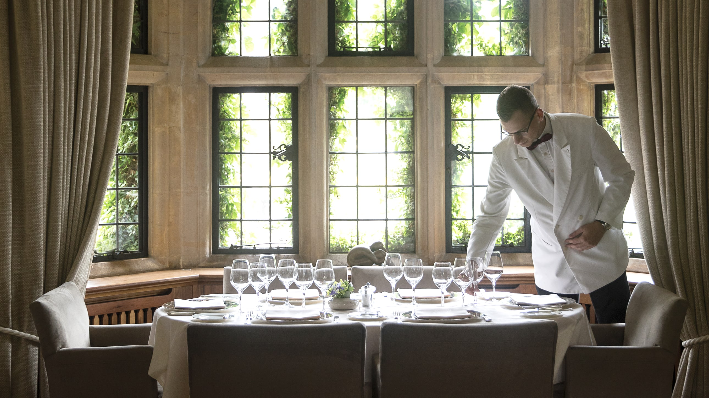
5
Why are Le Manoir’s people so special?
So now you’ve thought about the food, let’s think about the people.
Pair activity (2 mins)
Make a list of the career opportunities you think are available at Le Manoir, based on what you have seen so far.
©VotesforSchools 2023
Notes:
Images & References
https://www.belmond.com/hotels/europe/uk/oxfordshire/belmond-le-manoir-aux-quat-saisons/gallery

Slide 17
5
Why are Le Manoir’s people so special?
It takes a huge team to run a hotel and restaurant, making sure guests and diners have the best experience.
Group discussion (2-3 mins)
From your list, share the careers that are in hospitality.
Definition: Hospitality
Businesses such as hotels, bars, and restaurants that provide food, drink, or a place to sleep.
It’s important to remember there are many more roles behind the scenes too, such as sourcing ingredients to managing finances.
©VotesforSchools 2023
Notes:
Images
https://www.belmond.com/hotels/europe/uk/oxfordshire/belmond-le-manoir-aux-quat-saisons/gallery
References
https://dictionary.cambridge.org/dictionary/english/hospitality

Slide 18
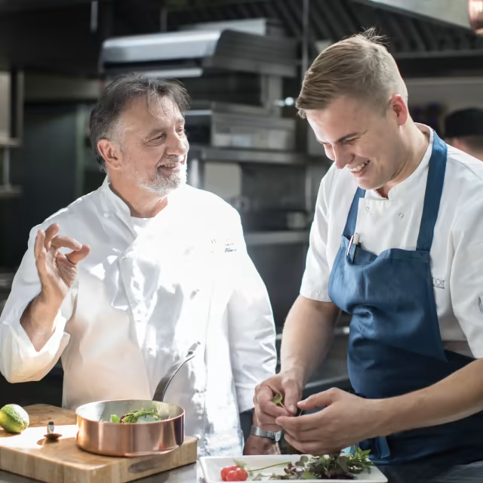
5
Why are Le Manoir’s people so special?
0:00-1:55
Click to watch a short film about the careers available at Le Manoir and Belmond.
Challenge:
Was there anything in the film that you see as your future?
©VotesforSchools 2023
https://safeshare.tv/x/TA9kzfdJYEc
Notes:
SafeShare Video Link: https://safeshare.tv/x/TA9kzfdJYEc
Images & References
https://www.belmond.com/hotels/europe/uk/oxfordshire/belmond-le-manoir-aux-quat-saisons/gallery

Slide 19
5
Why are Le Manoir’s people so special?
If you are interested in a career in hospitality, have you considered the skills you need?
Some practical skills can be easily taught, but what about the social and personal skills needed to work in this field?
©VotesforSchools 2023
Notes:
Images & References
https://www.belmond.com/hotels/europe/uk/oxfordshire/belmond-le-manoir-aux-quat-saisons/gallery

Slide 20
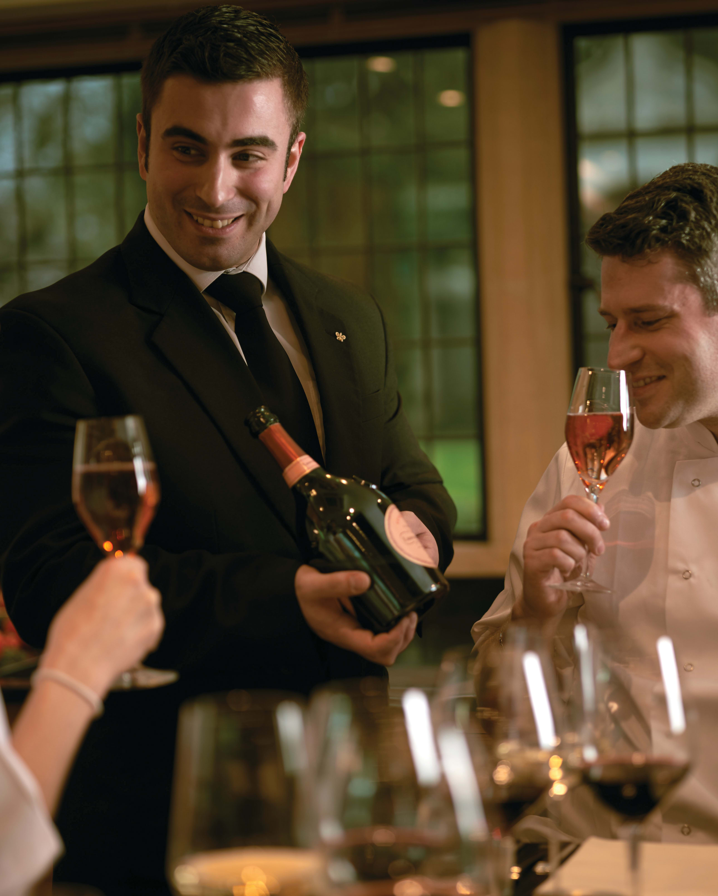
5
Why are Le Manoir’s people so special?
Individual reflection (2-3 mins)
Let’s think about working in hospitality. When you go to a restaurant, how do you expect the members of staff to act when you arrive?
When you go to any venue in the hospitality sector, body language is important. Does the person who greets you make eye contact? Do their facial expressions make you feel at ease?
After all, smiling is contagious! We feel happy and more comfortable when people greet us in a warm way.
©VotesforSchools 2023
Notes:
Images
https://www.belmond.com/hotels/europe/uk/oxfordshire/belmond-le-manoir-aux-quat-saisons/gallery
References
https://www.bbc.co.uk/bitesize/topics/zjr8mp3/articles/zjnxwnb

Slide 21
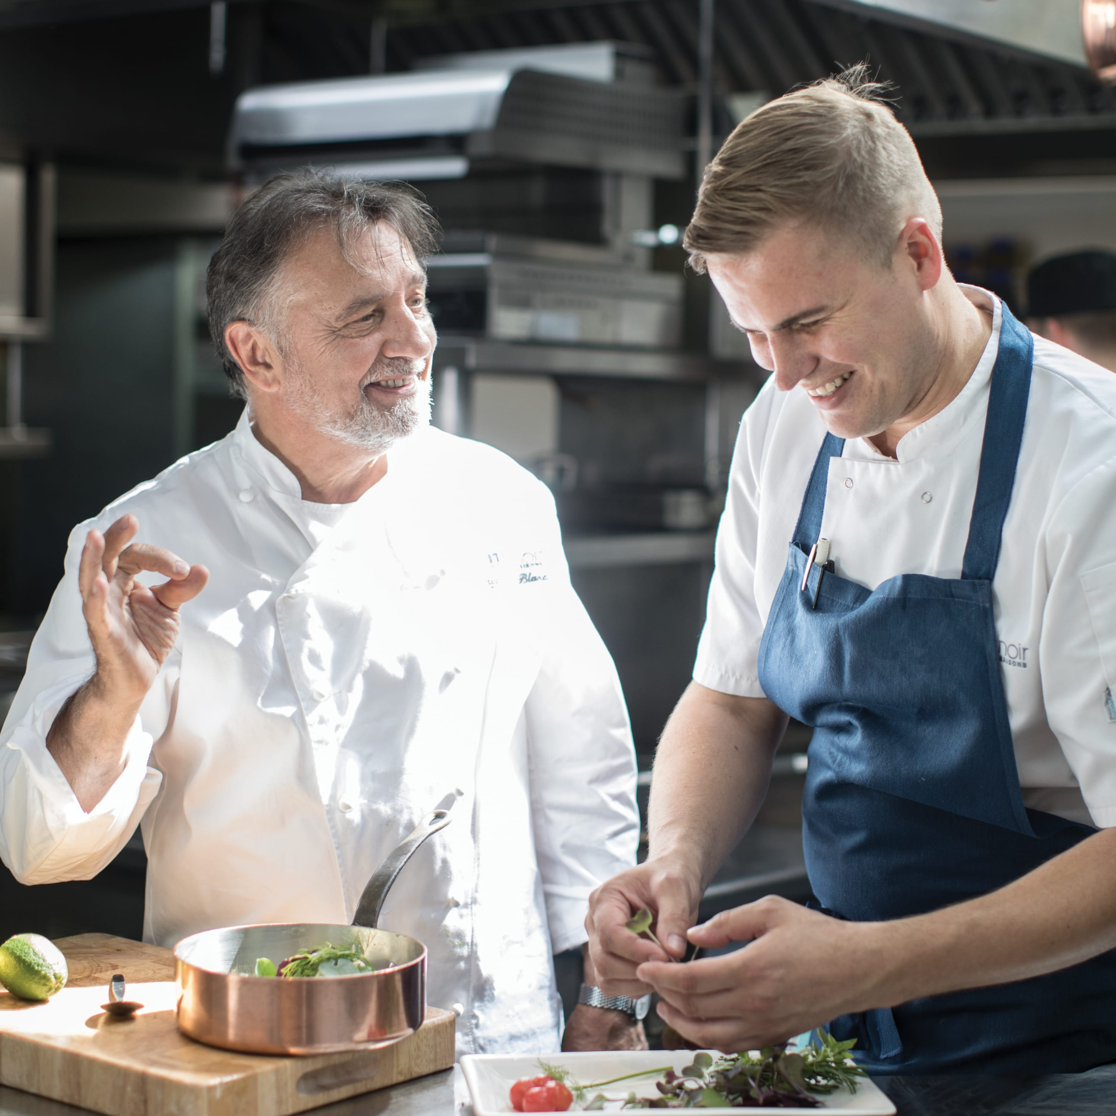
6
Now it’s your turn!
So now you’ve seen a little more about hospitality at Le Manoir, it’s your turn to think about which skills might be needed in a similar workplace.
Individual activity (2-3 mins)
Write down the top three skills you have that would suit working in hospitality.
Then, write down three skills you may need to work on.
Challenge:
While you do this, consider where you could practise or learn the skills needed to run a successful business like this!
©VotesforSchools 2023
Notes:
Images
https://www.belmond.com/hotels/europe/uk/oxfordshire/belmond-le-manoir-aux-quat-saisons/
References
1) …

Slide 22
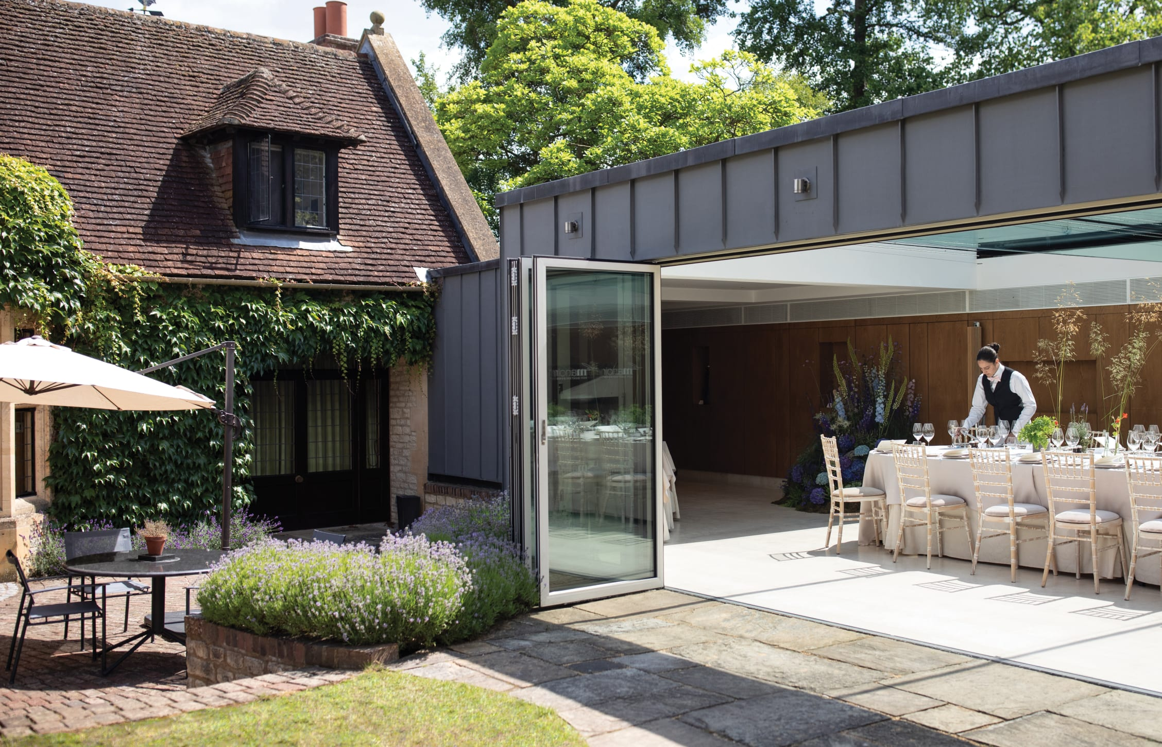
6
Now it’s your turn!
Did you think of any of the following?
Flexible
Tidy
Talking clearly
Good communication
Good time-keeping
Polite
Well-presented
Organised
Listening skills
Friendly & approachable
Attention-to- detail
Hard-working
©VotesforSchools 2023
Notes:
Images
https://www.belmond.com/hotels/europe/uk/oxfordshire/belmond-le-manoir-aux-quat-saisons/

Slide 23
6
Now it’s your turn!
Final reflection (2-3 mins)
If this lesson has inspired you to find a future in hospitality, why not do some research into what you need to learn, your skills, experience and courses you can attend in Oxfordshire?
Prospects
Oxford activate learning
Brookes
©VotesforSchools 2023
Notes:
Images
https://www.belmond.com/hotels/europe/uk/oxfordshire/belmond-le-manoir-aux-quat-saisons/
References
https://www.brookes.ac.uk/Study/Subject-areas/Hospitality-Tourism-and-Events-Management?
https://oxford.activatelearning.ac.uk/courses/career-pathways/hospitality-and-professional-cookery/
https://www.prospects.ac.uk/search?q=hospitality

Slide 24
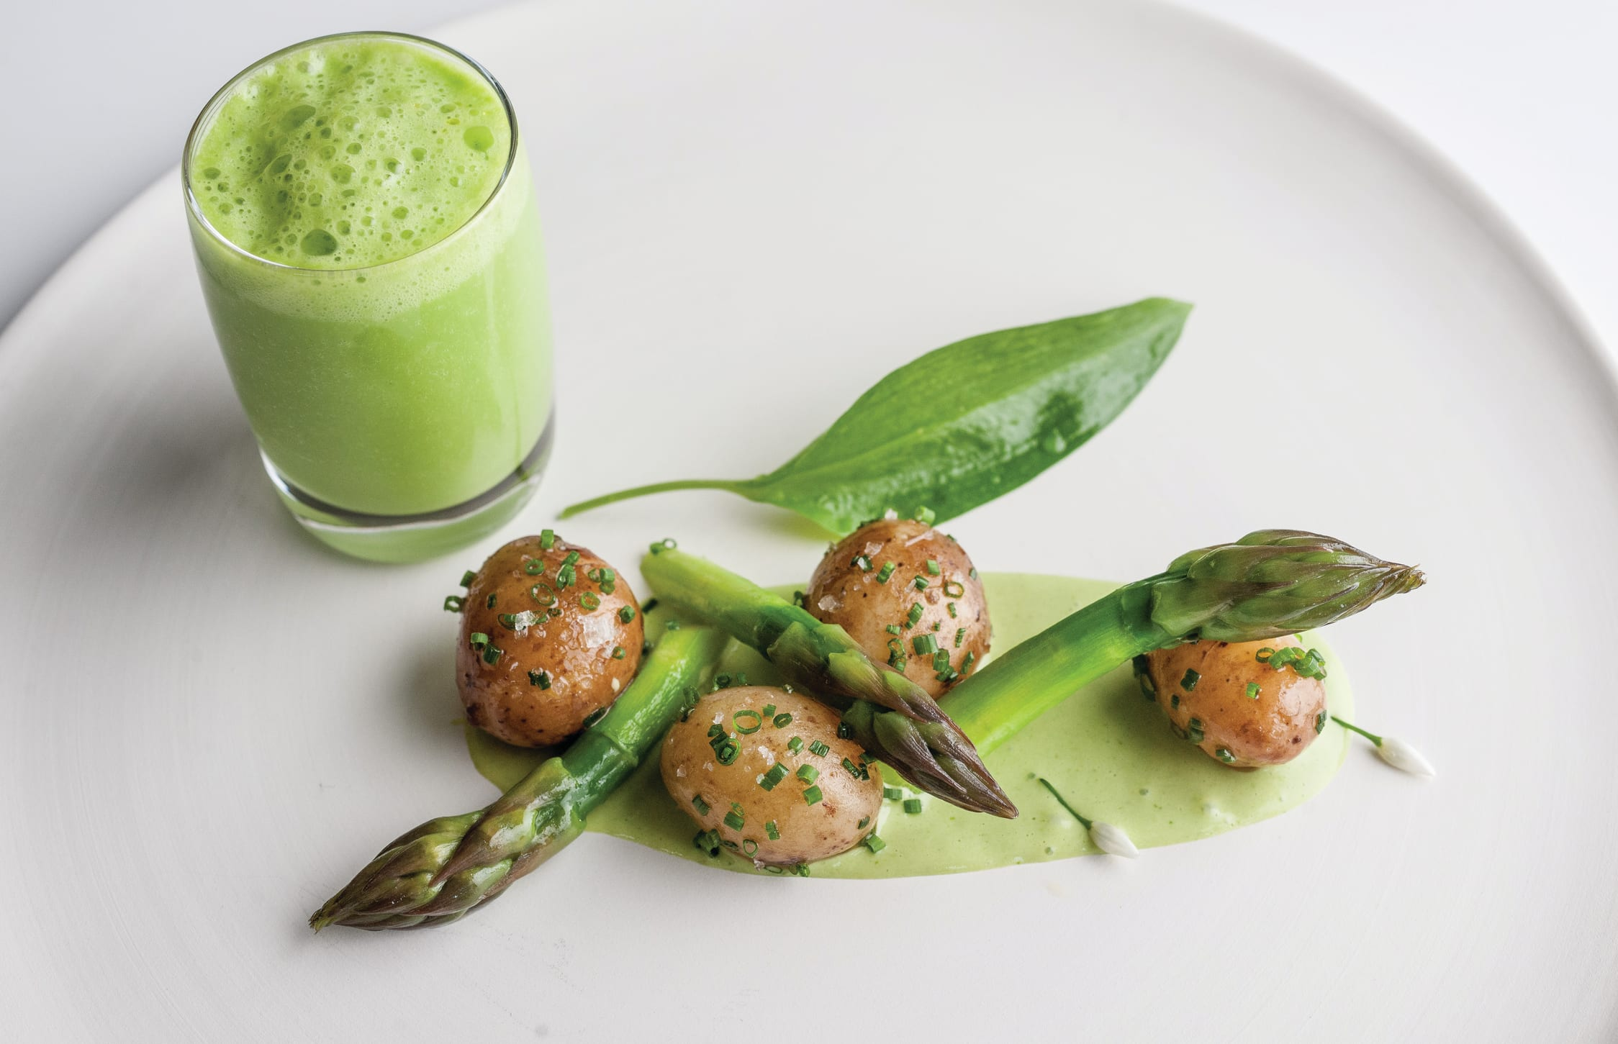
6
Now it’s your turn!
Challenge:
Have a look at a seasonal produce calendar and plan your own meal or menu using as many local and seasonal produce items as you can!
For example, asparagus is seasonal produce in June and July, and new potatoes are seasonal from April to July.
©VotesforSchools 2023
Notes:
Images
https://www.belmond.com/hotels/europe/uk/oxfordshire/belmond-le-manoir-aux-quat-saisons/
References
https://www.bbcgoodfood.com/seasonal-calendar

Slide 25
Finding help & information
Challenge:
Or, if you’re especially interested in learning about what Le Manoir has to offer,
find out more below. Just click the images for further information.
The Raymond Blanc Cookery School
At the school, you can gain hands-on experience in a professional kitchen as well as sampling some of the food!
The Raymond Blanc Cookery School
There are 11 gardens at Le Manoir, and at the school you can learn more about growing your own produce.
©VotesforSchools 2023
Notes:
Images
https://www.belmond.com/hotels/europe/uk/oxfordshire/belmond-le-manoir-aux-quat-saisons/
References
https://www.belmond.com/hotels/europe/uk/oxfordshire/belmond-le-manoir-aux-quat-saisons/
https://www.belmond.com/hotels/europe/uk/oxfordshire/belmond-le-manoir-aux-quat-saisons/about
https://www.belmond.com/hotels/europe/uk/oxfordshire/belmond-le-manoir-aux-quat-saisons/gardening-school
https://www.belmond.com/hotels/europe/uk/oxfordshire/belmond-le-manoir-aux-quat-saisons/cookery-school

Slide 26
Finding help & information
Oxfordshire's new careers platform, Find Your Future, is the next step for you to find out more and plan your future here in Oxfordshire.
Navigate your way around the platform by clicking on Find Your Future.
There is a guide on Find Your Future for students and parents to explore Your Fabulous Future in Oxfordshire. Take time to get excited and make plans!
©VotesforSchools 2023
Notes:
Images
https://www.oxfordshirelep.com/findyourfuture
References
https://www.oxfordshirelep.com/findyourfuture
https://www.oxfordshirelep.com/sites/default/files/uploads/FindYourFutureParentsGuide.pdf

Slide 27
Finding Their Future
In association with VotesforSchools
©VotesforSchools 2023

