Slide 1
Finding Their Future
In association with VotesforSchools
©VotesforSchools 2023

Slide 2
Lesson Plan
Lesson Duration: 30-45 minutes
4 mins | A fabulous future in Oxfordshire? | Whole class | Students watch the Oxfordshire WOW Show film to introduce the lesson.
2-3 mins | 1. Opportunities in Oxfordshire | Whole class | Students are asked to think about their future here in Oxfordshire.
2-3 mins | 2. What’s in your area? | Individual/Pair | Students talk to a partner about opportunities in Oxfordshire for their future career.
5 mins | 3. Meet RAL Space | Pair | Students learn more about RAL Space and their work in the space industry, including watching a short film.
5-8 mins | 4. The science of thermal engineering | Pair | Students learn about conduction, convection and radiation and their impact on instruments that are used in space.
2-3 mins | 5. Why is this important for space? | Whole class | Students think about the heat and cold of space and why instruments need to be protected from the range of temperatures there.
5-6 mins | 6. Protecting the temperature of instruments | Whole class | Students learn about Multi-Layer Insulation (MLI), how it is made and how it is used to protect instruments
10-15 mins | 7. Now it’s your turn! | Whole class | Students now design their own space blankets based on an experiment involving ice cubes, foil and netting. See slide 18 for the required apparatus and method.
N/A | Finding help & information | Whole class | Students have the opportunity to find out more about where they will find more information to help them build their future.
To take the session further, why not conduct the final experiment using different materials to create the blankets?
©VotesforSchools 2023

Slide 3
Using the resources
The following lesson has been prepared for minimum teacher preparation time. Each slide has information and a discussion or activity for learners.
Film clips are uploaded through SafeShare TV, meaning they can be played directly from the link on the slide without adverts or using YouTube. Timings are displayed in the box alongside the linked image.
Please view the lesson in “Slide Show” mode in PowerPoint. This is to ensure animations are displayed in the correct order, including any answers.
All links and references are in the “Notes” section under the slide should you need any further information.
At the end of the lesson, there are further help and support links if you would like to go further in a particular area or wish to find out more about opportunities in Oxfordshire or with the employer featured.
This lesson is one in a series, created through the pairing of an Oxfordshire school with an Oxfordshire employer. If you would like to find out more, contact the Oxfordshire Local Enterprise Partnership.
As this lesson has an emphasis on maths, specifically nets of shapes, it would best sit alongside a maths unit covering this content.
©VotesforSchools 2023

Slide 4
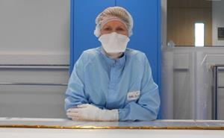
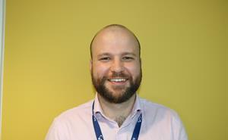
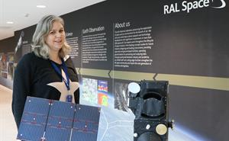
Finding help & information
RAL Space employ over 335​ expert staff. They are based in the Harwell Space Cluster and in the Chilbolton Observatory. The Team is made up of scientists, engineers and professionals. They all work together to make their missions & projects a success! For more information, see slide 20 of the lesson or visit the links outlined below.
Navigate your way around the website and watch short clips of career opportunities here.
Head to the next slide to discover more about Find Your Future!
©VotesforSchools 2023
Notes:
Images
1) https://www.oxfordshirelep.com/findyourfuture
References
https://www.ralspace.stfc.ac.uk/Pages/Careers.aspx
https://www.ralspace.stfc.ac.uk/Pages/Career-Profiles-.aspx

Slide 5
Finding help & information
Oxfordshire's new careers platform, Find Your Future, is the next step for you to find out more and plan your future here in Oxfordshire.
Navigate your way around the platform by clicking on Find Your Future.
There is a guide on Find Your Future for students and parents to explore Your Fabulous Future in Oxfordshire. Take time to get excited and make plans!
©VotesforSchools 2023
Notes:
Images
https://www.oxfordshirelep.com/findyourfuture
References
https://www.oxfordshirelep.com/findyourfuture
https://www.oxfordshirelep.com/sites/default/files/uploads/FindYourFutureParentsGuide.pdf

