Slide 1
Finding Their Future
In association with VotesforSchools
©VotesforSchools 2023

Slide 2
?
Lesson outcomes
Possible mathematical objectives for this lesson:
Recognise nets of familiar 3D shapes (e.g. cube, cuboid, triangular prism)
Find area by counting squares
Make 3D models by linking given faces or edges
Understand and use the formula for the area of a rectangle
Use the formula for the area of a triangle
Calculate the surface area of a cube, cuboid or triangular prism
Calculate the surface area of a cylinder
Calculate surface area of non-prisms (e.g. cones)
©VotesforSchools 2023

Slide 3
?
Skills needed
Creativity: Be creative when designing your box! Think of different 3D shapes you could use: can you make a design that nobody else will think of?
Resilience: You will need to keep going if you make a mistake! If you design a difficult net, you may need to modify your design so that it all fits together properly.
Teamwork: You will work as a group in Lesson 1, and in a pair for Lessons 2 and 3.
Independence: Try to work things out for yourself, without asking for help. Look back in your books for any formulas you might need.
Problem-solving: If you design a tricky net, you will have to work out how all the pieces will fit together.
©VotesforSchools 2023

Slide 4
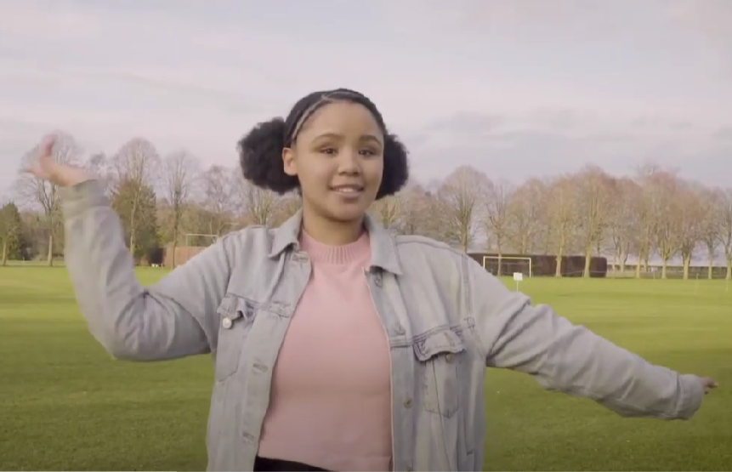
A fabulous future in Oxfordshire?
Time to find out more about the fabulous future waiting for you in Oxfordshire…
There are over 350,000 people working in Oxfordshire and over 50,000 people are self-employed.
0:00-3:54
Click the image to watch The WOW Show film.
©VotesforSchools 2023
https://safeshare.tv/x/528251568
Notes:
YouTube Video Link: https://www.youtube.com/channel/UCXDSgY0E_aACHXcSqX14YNg
SafeShare Video Link: https://safeshare.tv/x/sualeIxU3F4
Images
Via video

Slide 5
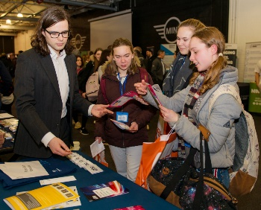
1
Opportunities in Oxfordshire
Have you thought about your future yet? What do you enjoy?
Whatever your interests, there is something for you!
There are lots of great opportunities in many different sectors across Oxfordshire. A great future awaits...
Whether you want an apprenticeship, T Levels, further education or to study for a degree, Oxfordshire has a pathway that would suit you.
©VotesforSchools 2023
Notes:
Images
iStock
OxLEP

Slide 6
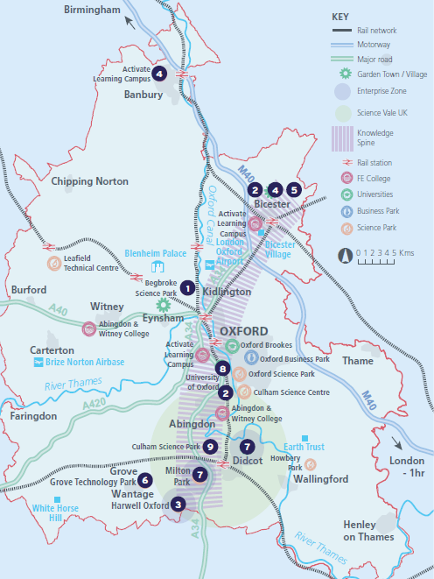
2
What’s in your area?
Pair discussion (2-3 mins)
Talk to a partner about what opportunities you know about in your local area. What do people you know do as their career?
There are opportunities in health, space, tourism, creative industries, construction and so much more.
No matter where you live in Oxfordshire, there is an amazing opportunity waiting for you.
During this presentation, you are going to find out about how one possible career path in design and marketing.
©VotesforSchools 2023
Notes:
Images
OxLEP
References
https://www.oxfordshirelep.com/sites/default/files/uploads/OxLEPLMIReportAugust2020.pdf

Slide 7
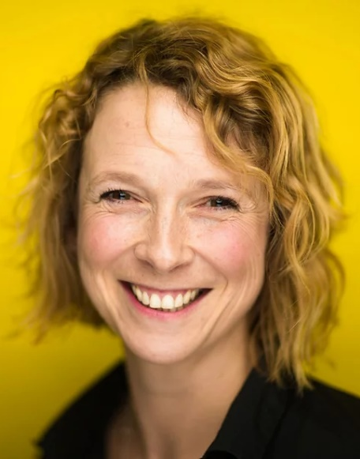
3
Meet Push Start Marketing
Definition: Marketing
A job to improve the number of people buying a product or service.
Push Start Marketing is based in Witney, Oxfordshire and is run by Lucy Lavers. She offers a wide range of marketing services to help businesses produce marketing that will help them
to grow.
Marketing is about knowing what your customers want, what your competitors are doing, and selling and promoting your product.
©VotesforSchools 2023
Notes:
Images
Courtesy of Lucy Lavers
https://www.pushstartmarketing.co.uk/
References
https://www.pushstartmarketing.co.uk/
https://dictionary.cambridge.org/dictionary/english/marketing
https://www.cim.co.uk/qualifications/get-into-marketing/

Slide 8
4
Promoting a brand or product
Discussion (2-3 mins)
Talk to a partner: how many ways can you come up with to promote or sell a brand or product? Then, click on the image below to hear more about marketing.
Marketing has changed a lot over time.
0:00-1:42
In the past, newspapers, cinemas, magazines and TV were the main ways of selling a product or service.
More recently, social media has become popular for advertising all sorts of different products.
©VotesforSchools 2023
Notes:
You Tube Video Link: https://www.youtube.com/watch?v=XWPAJZ21tBE
SafeShare TV Video Link: https://safeshare.tv/x/XWPAJZ21tBE
Images
Via video
References:
https://dictionary.cambridge.org/dictionary/english/marketing

Slide 9
5
Creating a product
Marketing can be all about a brand or it can be a specific product. For example, an Easter egg.
There will be thousands of different types and designs. They will all compete to be bought by the customers.
Discussion (3-4 mins)
If you were creating your own Easter egg, how would you make it stand out from the others on the shelf? Head to the next slide for some ideas.
Definition: Product
Something that has been made to be sold.
©VotesforSchools 2023
Notes:
Images
Unsplash
References
https://dictionary.cambridge.org/dictionary/english/product

Slide 10
5
Creating a product
Designers work backwards, so think of what you want the final shape to be and then work out how you are going to create that as a net. (Designers often use software to do this part!)
Have you thought about how to keep the egg safe? How will your design protect the egg?
Consider the environment: how could you reduce plastic and/or waste?
Make sure there is space on your box for a logo and key information, like ingredients and nutritional values.
©VotesforSchools 2023
Notes:
Images
Unsplash

Slide 11
6
Knowing your audience
Discussion (3-4 mins)
How does packaging change to appeal to different people? Think of some examples.
When you are creating packaging it is really important to know who your audience is. Who are you selling your product to?
This will influence your colours, text, graphics and marketing strategy.
Consider age, interests and current trends.
©VotesforSchools 2023
Notes:
Images
Unsplash

Slide 12
7
A career in package design
Discussion (3 mins)
When you think of successful brands, who comes to mind and why? Consider things like logos and adverts.
Just for today, you are going to have a career in Design! Head to the next slide to read some top tips from a Package Designer.
©VotesforSchools 2023
Notes:
Images
iStock

Slide 13
7
A career in package design
1
1
Make a 3D prototype first, then "reverse engineer" it, to create a single 2D net.
2
The packaging can't just look good, it also has to protect what's inside, especially if it’s an egg!
2
3
3
To reduce plastic, use a cardboard "blister pack" to protect the goods.
4
Leave "communication space" on your packaging for things like the brand name, ingredients and contact information.
4
5
5
Make sure it’s creative and eye-catching!
Challenge:
What kinds of packaging would be the best for the environment and would successfully reduce waste?
©VotesforSchools 2023
Notes:
Images
Unsplash
References
1) Push Start Marketing

Slide 14
8
The maths of packaging
Discussion (2 mins)
What do you think is important when manufacturing packaging for products?
Definition: Manufacturing
Making a product, often in a factory.
The measurements must be accurate.
The packaging must be cost-effective to produce.
©VotesforSchools 2023
Notes:
Images
Microsoft Office 365
References
https://dictionary.cambridge.org/dictionary/english/manufacture

Slide 15
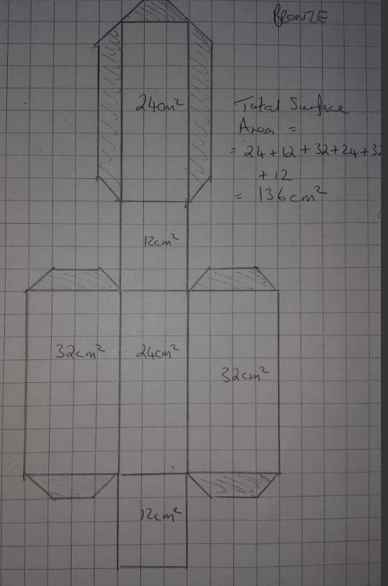
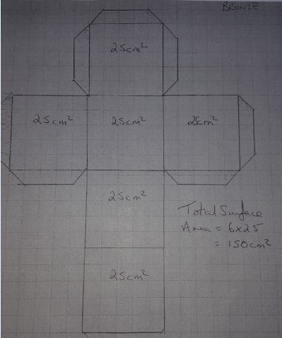
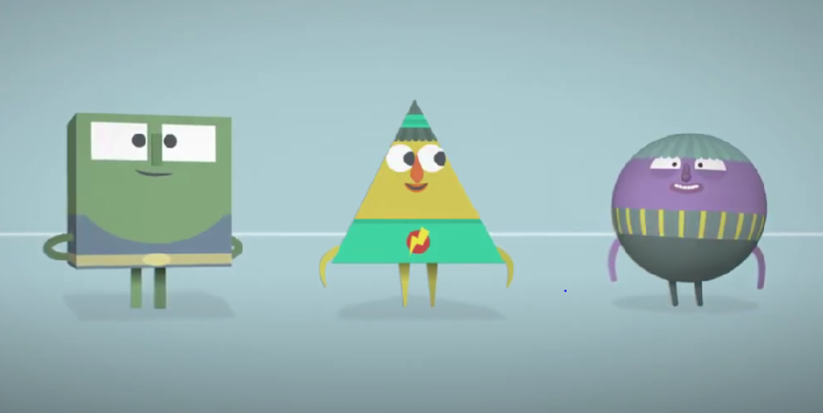
8
The maths of packaging
Discussion (2 mins)
What is the net of a shape? Do you know how to make one?
Definition: Net
A flat shape that, when cut out, will fold into a 3D shape.
0:00-0:44
Click on the image to find out more about nets.
©VotesforSchools 2023
Notes:
YouTube Video Link: https://www.youtube.com/watch?v=Fnuvmd8ggfU
SafeShare Video Link: https://safeshare.tv/x/ss63bad2a6cafd4
Images
1) OxLEP Project
References
https://www.bbc.co.uk/bitesize/topics/zt7xk2p/articles/z247tv4

Slide 16
9
Now it’s your turn!
Now you know more about packaging and marketing, it’s your turn…
Individual activity (15-20 mins)
Your task is to design your own net for an Easter Egg box. Follow these steps as you go:
Draw a plan for the net and the logo on a piece of paper.
Copy your plan neatly onto your A3 card (there is only 1 piece of card per pair!).
Work out the total surface area of your box.
Success Criteria:
Make sure your box is big enough.
Consider all the key points made about marketing and packaging design.
Be creative: design something eye-catching!
©VotesforSchools 2023
Notes:
Images
Unsplash
iStock

Slide 17
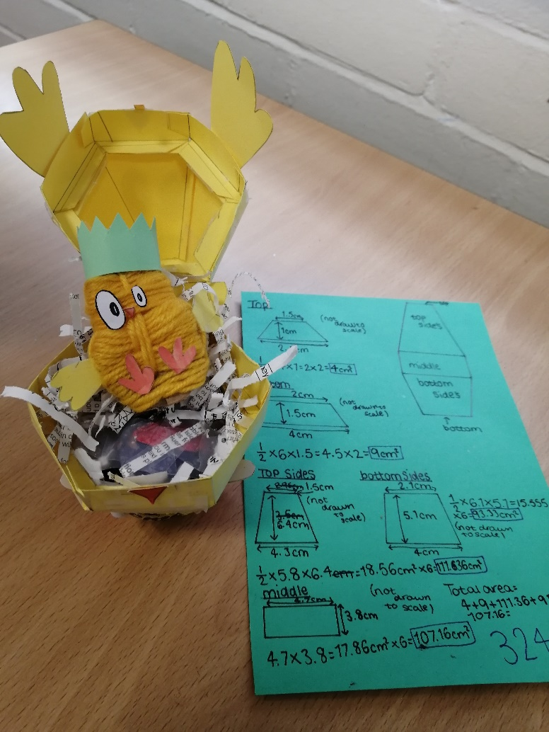
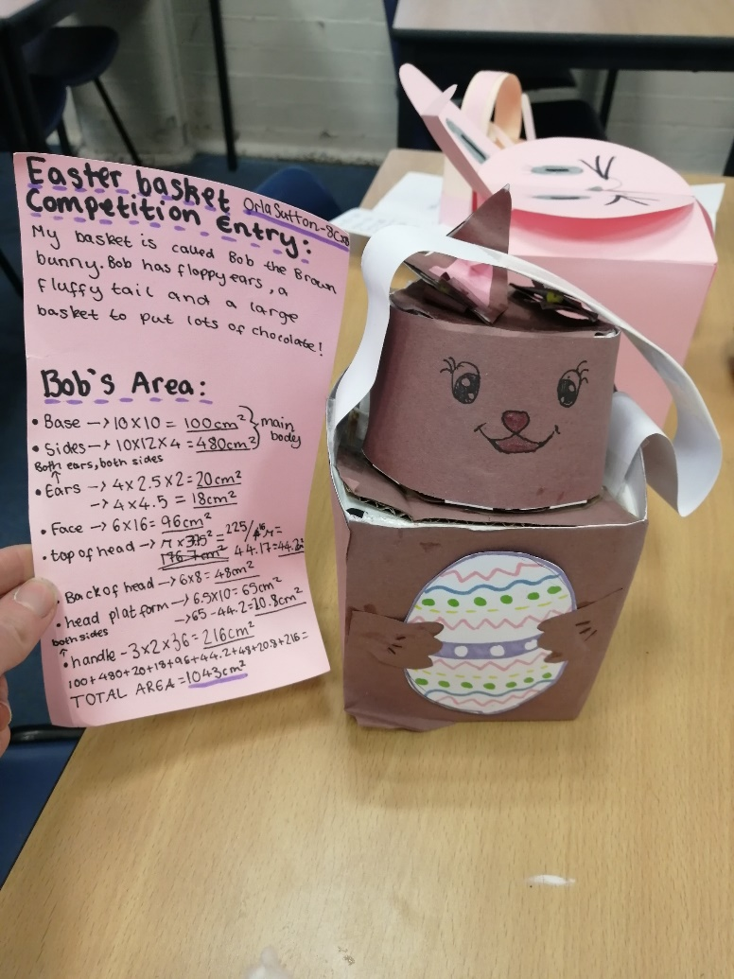
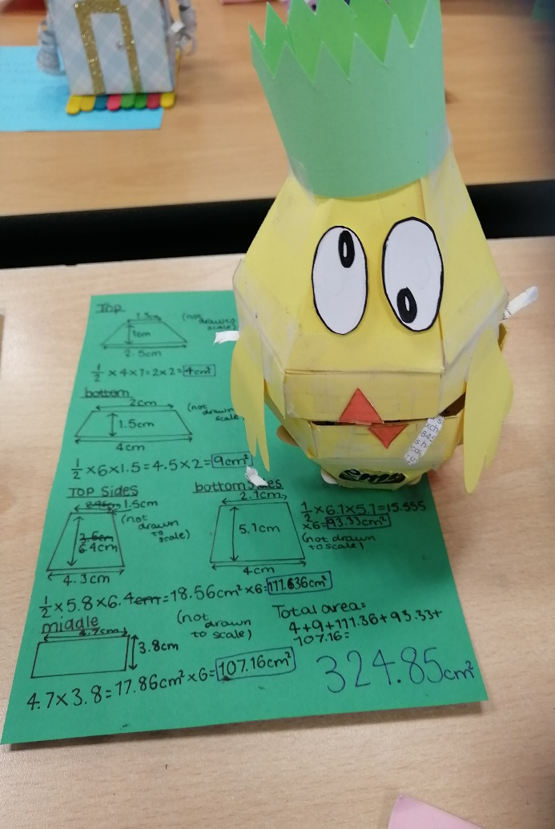
9
Now it’s your turn!
Challenge:
Why not carry on with this task at home? Create your full design! Below and on the next slide are some of the original classes’ designs!
©VotesforSchools 2023
Notes:
Images
OxLEP Project

Slide 18
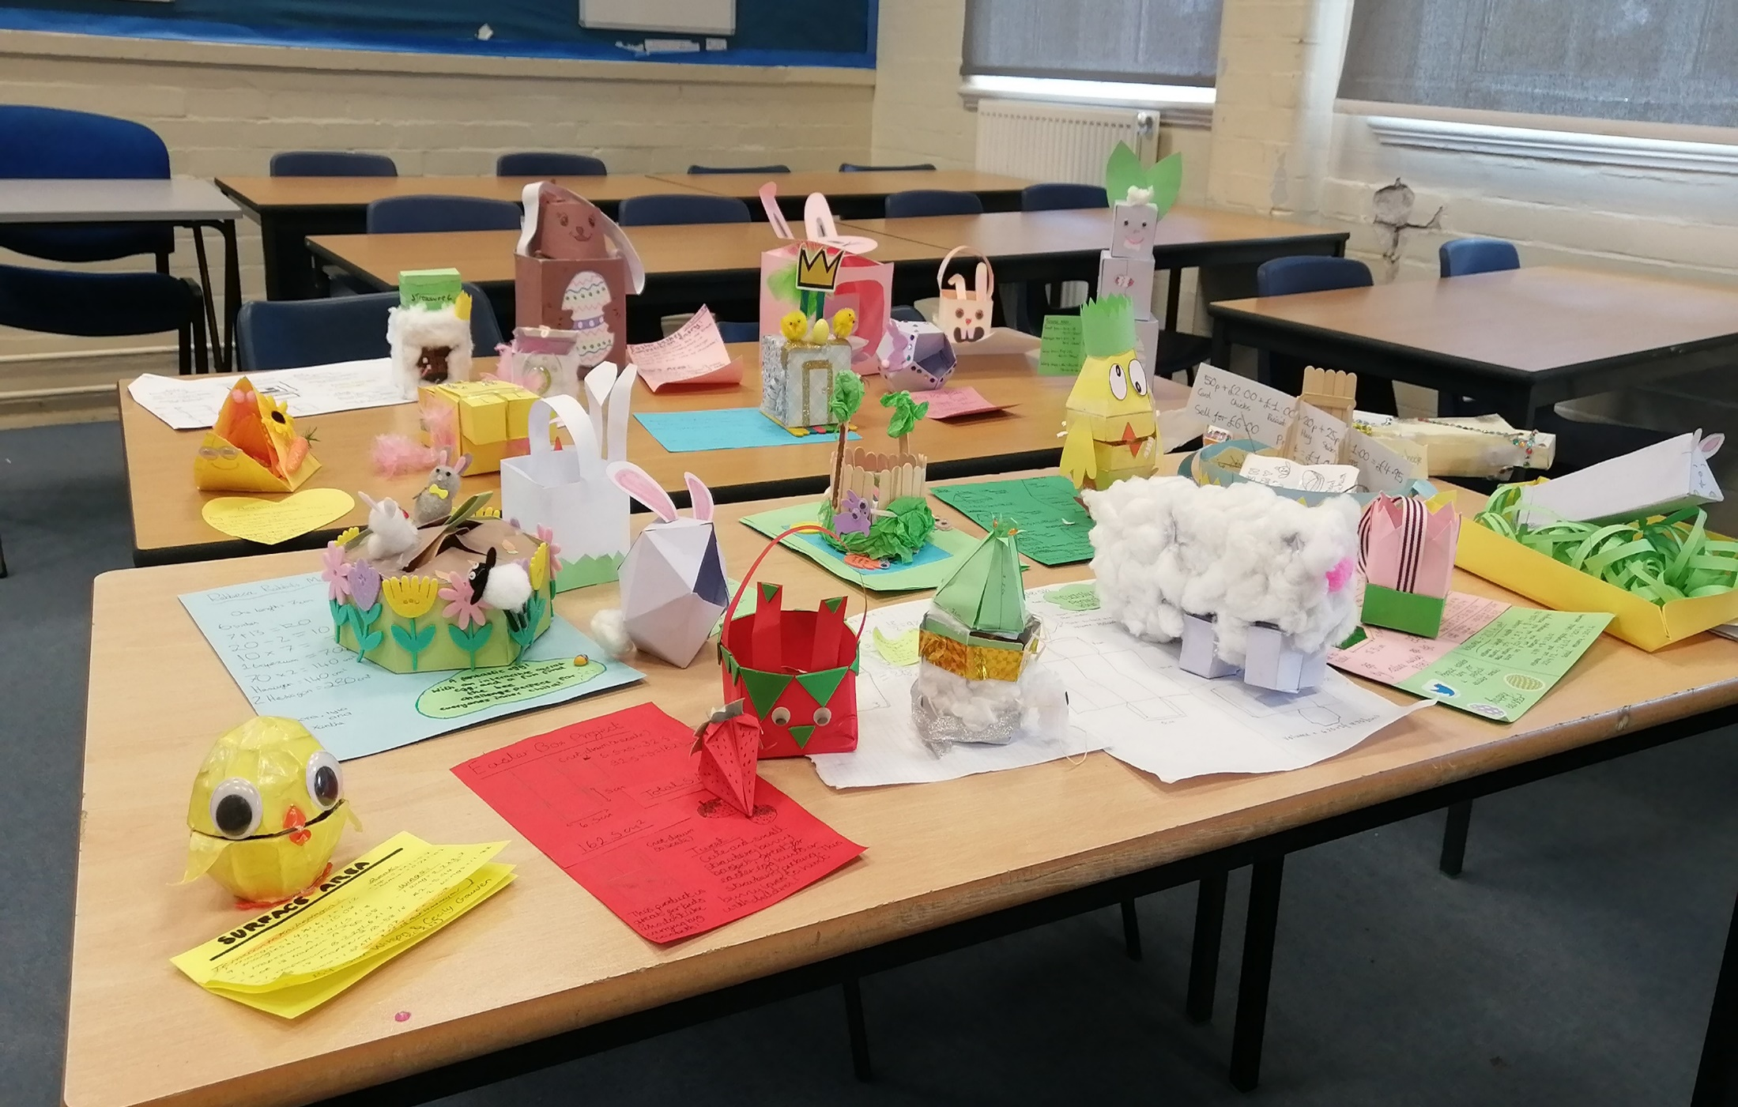
9
Now it’s your turn!
©VotesforSchools 2023
Notes:
Images
OxLEP Project

Slide 19
Finding help & information
Push Start Marketing, who you met at the beginning of the lesson, have links to their services below.
Consultancy
Website & webcopy
Publications
Retained services
You can find out more about how to get into this kind of work at The National Careers Service. Routes into this include:
A university course
An apprenticeship
Working towards this role
Head to the next slide to discover more about Find Your Future!
©VotesforSchools 2023
Notes:
References
https://www.pushstartmarketing.co.uk/marketing-strategy-consultancy
https://www.pushstartmarketing.co.uk/websites-and-webcopy
https://www.pushstartmarketing.co.uk/magazines-for-town-councils
https://www.pushstartmarketing.co.uk/retained-marketing-support
https://nationalcareers.service.gov.uk/job-profiles/packaging-technologist
https://www.iom3.org/group/packaging-group.html
https://www.oxfordshirelep.com/findyourfuture

Slide 20
Finding help & information
Oxfordshire's new careers platform, Find Your Future, is the next step for you to find out more and plan your future here in Oxfordshire.
Navigate your way around the platform by clicking on Find Your Future.
There is a guide on Find Your Future for students and parents to explore Your Fabulous Future in Oxfordshire. Take time to get excited and make plans!
©VotesforSchools 2022
Notes:
Images
https://www.oxfordshirelep.com/findyourfuture
References
https://www.oxfordshirelep.com/findyourfuture
https://www.oxfordshirelep.com/sites/default/files/uploads/FindYourFutureParentsGuide.pdf

Slide 21
Finding Their Future
In association with VotesforSchools
©VotesforSchools 2022

