Slide 1
Finding Their Future
In association with VotesforSchools
©VotesforSchools 2023

Slide 2
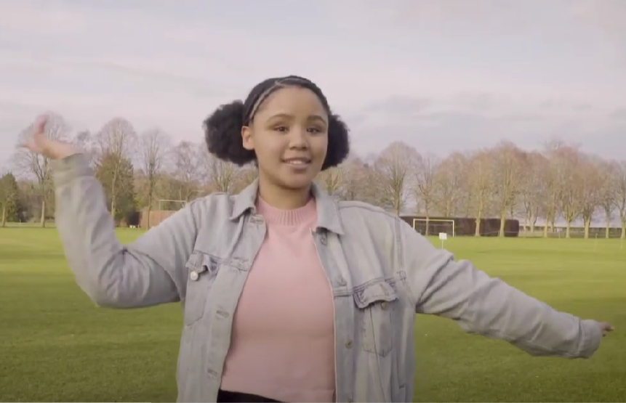
A fabulous future in Oxfordshire?
Time to find out more about the fabulous future waiting for you in Oxfordshire…
There are over 350,000 people working in Oxfordshire and over 50,000 people are self-employed.
0:00-3:54
Click the image to watch The WOW Show film.
©VotesforSchools 2023
https://safeshare.tv/x/528251568
Notes:
YouTube Video Link: https://www.youtube.com/channel/UCXDSgY0E_aACHXcSqX14YNg
SafeShare Video Link: https://safeshare.tv/x/sualeIxU3F4
Images
Via video

Slide 3
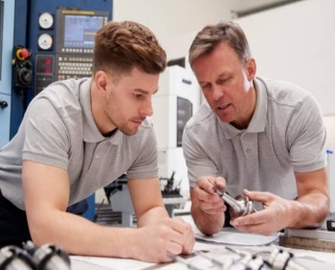
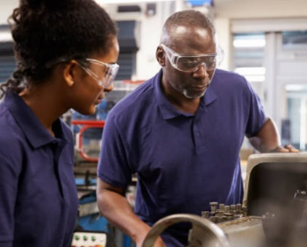
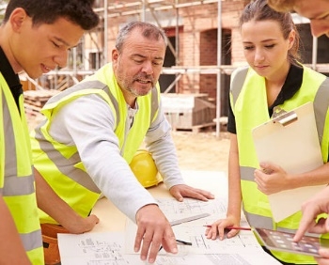
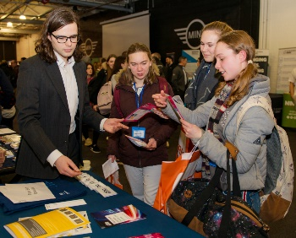
1
Opportunities in Oxfordshire
Have you thought about your future yet? What do you enjoy?
Whatever your interests, there is something for you!
There are lots of great opportunities in many different sectors across Oxfordshire. A great future awaits...
Whether you want an apprenticeship, T Levels, further education or to study for a degree, Oxfordshire has a pathway that would suit you.
©VotesforSchools 2023
Notes:
Images
iStock
OxLEP

Slide 4
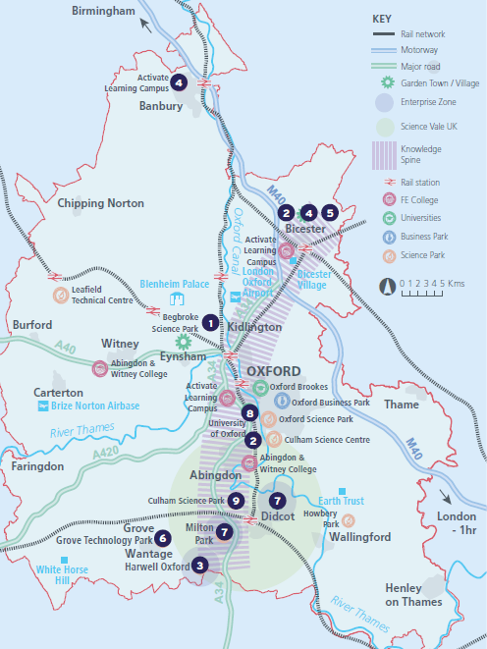
2
What’s in your area?
Pair discussion (2-3 mins)
Talk to a partner about what opportunities you know about in your local area. What do people you know do as their career?
There are opportunities in health, space, tourism, creative industries, construction and so much more.
No matter where you live in Oxfordshire, there is an amazing opportunity waiting for you.
During this presentation, you are going to find out about how one company can have a variety of different roles and career choices!
©VotesforSchools 2023
Notes:
Images
OxLEP
References
https://www.oxfordshirelep.com/sites/default/files/uploads/OxLEPLMIReportAugust2020.pdf

Slide 5
3
Meet RAL Space
0:00-1:48
Click on the image to see more of RAL Space’s incredible work.
©VotesforSchools 2023
https://safeshare.tv/x/9Nr6lohmbhY
Notes:
YouTube Video Link: https://www.youtube.com/watch?v=9Nr6lohmbhY
SafeShare Video Link: https://safeshare.tv/x/9Nr6lohmbhY
Images
Via RAL Space

Slide 6
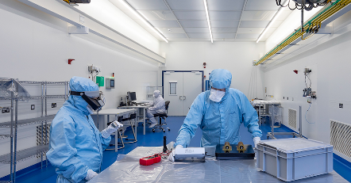
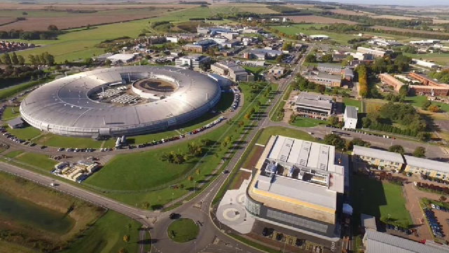
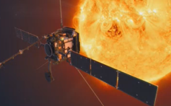
3
Meet RAL Space
RAL Space employs around 330 people in Oxfordshire.
Activity (2-3 mins)
Click the image to go to the virtual tour.
They design and build space instruments, research space and develop space technologies for private and Government space exploration.
Notes:
Virtual Tour link: https://www.ralspace.stfc.ac.uk/Virtual%20Tour/RALSpaceV1/index.aspx
Images
Via video
References
https://www.ralspace.stfc.ac.uk/Pages/home.aspx

Slide 7
4
The science of thermal engineering
Discussion (2-3 mins)
Talk to a partner: what do you know about the transfer of heat? The next three slides will explain more!
Once an instrument has been designed, scientists, technicians and engineers solve the problems that arise to build it successfully.
©VotesforSchools 2023
Notes:
Images
Microsoft Office 365
References
1) https://dictionary.cambridge.org/dictionary/english/conduction

Slide 8
4
The science of thermal engineering
Definition: Conduction
The transfer of heat via direct contact.
The first method of heat transfer to consider is conduction.
Thermal engineering is about understanding heat transfer processes. This is important in space.
©VotesforSchools 2023
Notes:
Images
iStock
Pixabay
References
https://dictionary.cambridge.org/dictionary/english/conduction

Slide 9
4
The science of thermal engineering
Definition: Convection
The transfer of heat through a liquid or gas caused by molecular movement.
The second method of heat transfer to think about is convection.
When designing and building instruments for space, it is very important to understand the process fully.
©VotesforSchools 2023
Notes:
Images
iStock
Pixabay
References
https://dictionary.cambridge.org/dictionary/english/convection

Slide 10
4
The science of thermal engineering
Conduction and convection in space is very different as it is a vacuum and so the particles are not there to transfer heat.
Definition: Vacuum
A space which has little or no matter.
©VotesforSchools 2023
Notes:
Images
iStock
Pixabay
References
https://dictionary.cambridge.org/dictionary/english/vacuum

Slide 11
4
The science of thermal engineering
Definition: Radiation
The transfer of heat through electromagnetic radiation.
The third method of heat transfer to think about is radiation.
Challenge:
What problems might radiation cause for an instrument designed for space?
©VotesforSchools 2023
Notes:
Images
iStock
Pixabay
References
https://dictionary.cambridge.org/dictionary/english/radiation

Slide 12
4
The science of thermal engineering
When a piece of instrumentation is designed and created for space, lots of people are involved at each step.
It will take years, but the last step before it is launched into space is to test it.
The tests make sure it will do what it was built to do, while also guaranteeing that it will keep working for a very long time.
©VotesforSchools 2023
Notes:
Images
iStock

Slide 13
5
Why is this important for space?
Discussion (2-3 mins)
Why do you think temperature is important for space instrumentation? What happens if something breaks?
When millions of pounds have been spent on this technology, it needs to be protected against the conditions in space. Take a look at the table below to see the temperatures at which things will still work.
Space can be extremely cold.
It can also be really warm due to the Sun’s radiation.
Component | Operating Temperature ( ̊C) | Survival Temperature ( ̊C)
Electronics | 0 to 50 | -20 to 70
Batteries | 0 to 40 | -20 to 70
Infrared detectors | -269 to -173 | -269 to 35
Solar panels | -100 to 125 | -100 to 125
Challenge:
Is there an “optimum” temperature for all of these components?
©VotesforSchools 2023
Notes:
References
https://www.ralspace.stfc.ac.uk/Pages/home.aspx

Slide 14
6
Protecting the temperature of instruments
Discussion (2 mins)
Have you ever seen blankets used for sportspeople at the end of an event such as a race? What do they look like?
Reflection (1 min)
What processes take place to make the blanket effective?
©VotesforSchools 2023
Notes:
Images
iStock
References
https://www.ralspace.stfc.ac.uk/Pages/Multi-Layer-Insulation-Facility.aspx
https://www.ralspace.stfc.ac.uk/Pages/Multi-layer-insulation.aspx

Slide 15
6
Protecting the temperature of instruments
Active control
This is when something is actively done, like putting heating on the instrument to make sure it doesn’t freeze. It cannot be fixed if it breaks.
Passive thermal control
Passive control is less likely to break as it is a simple method of controlling temperature, like wrapping an instrument in a blanket.
©VotesforSchools 2023
Notes:
Images
iStock
References
https://www.ralspace.stfc.ac.uk/Pages/Multi-Layer-Insulation-Facility.aspx
https://www.ralspace.stfc.ac.uk/Pages/Multi-layer-insulation.aspx

Slide 16
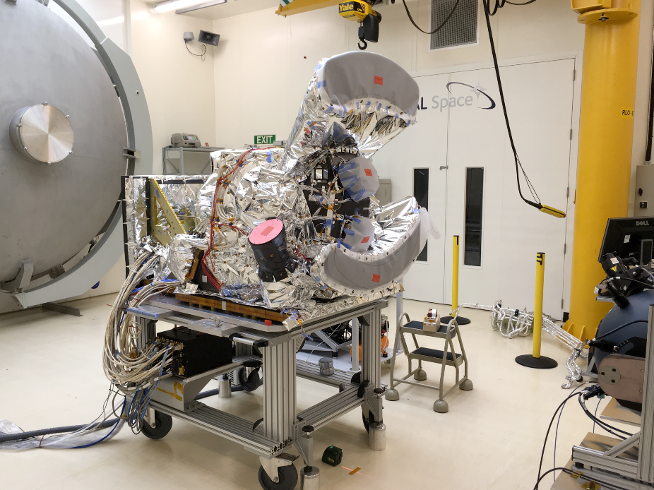
6
Protecting the temperature of instruments
Here is an instrument wrapped in RAL Space multi-layer insulation.
Definition: Multi-Layer Insulation (MLI)
Thin layers of foil separated by netting material.
It is a special kind of foil, not just the aluminium sort you can buy! It has special properties to make it strong.
©VotesforSchools 2023
Notes:
Images
Multi-Layer Insulation on SLSTR and MIRI - STFC RAL Space​​
References
https://www.ralspace.stfc.ac.uk/Pages/Multi-Layer-Insulation-Facility.aspx
https://www.ralspace.stfc.ac.uk/Pages/Multi-layer-insulation.aspx
Images
Multi-Layer Insulation on SLSTR and MIRI Credit: STFC RAL Space​​

Slide 17
6
Protecting the temperature of instruments
The foil is shiny to limit radiative heat transfer.
Discussion (2 mins)
Why do you think there is netting in between each layer of foil?
The net separates the layers of foil to prevent heat conduction.
©VotesforSchools 2023
Notes:
Images
Multi-Layer Insulation on SLSTR and MIRI - STFC RAL Space​​
References
https://www.ralspace.stfc.ac.uk/Pages/Multi-Layer-Insulation-Facility.aspx
https://www.ralspace.stfc.ac.uk/Pages/Multi-layer-insulation.aspx

Slide 18
7
Now it’s your turn!
Think you know your stuff about creating space instruments? Let’s put it to the test! For the next activity, you will need:
Three ice cubes
Aluminium foil
Netting (e.g. from oranges)
A heat source (e.g. a lamp)
You are going to use these items to create your own MLI and find out how many layers of insulation are needed to make sure heat transfer doesn’t happen.
Challenge:
While you do this, consider what it is showing you about keeping instruments safe in space, especially in times of extreme cold & heat!
©VotesforSchools 2023
Notes:
Teacher Note: If you need a hint to get started, watch our video that explains how to make thermal space blankets (MLI) at home: https://youtu.be/dqbY2_vL3RI
Images
Pixabay
Canva
Pixabay
References
1) …

Slide 19
7
Now it’s your turn!
Three ice cubes
Aluminium foil
Netting (e.g. from oranges)
A heat source (e.g. a lamp)
Class activity (10-15 mins)
Wrap one of the ice cubes in a piece of foil. This is single-layer insulation.
Wrap another ice cube in one layer of netting, followed by a layer of foil. Do this three times.
Repeat step 2, but this time do it five times.
Leave your ice cubes under the lamp for 5-10 minutes.
When the time is up, take a look at your ice cubes and make a note of what you find.
Bonus round: If you have any extra ice cubes, foil or netting, experiment with different numbers of layers. Can you find the ideal amount?
©VotesforSchools 2023
Notes:
Teacher Note: If you need a hint to get started, watch our video that explains how to make thermal space blankets (MLI) at home: https://youtu.be/dqbY2_vL3RI
Images
Pixabay
Canva
Pixabay
References
1) …

Slide 20
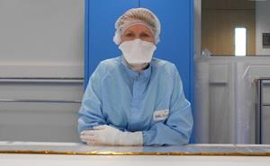
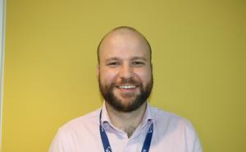
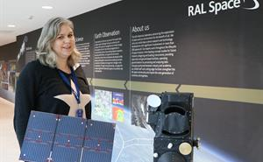
Finding help & information
Want to know more about careers in this area?
Click the images below to see some job profiles!
Technician
Engineer
Scientist
RAL have many routes into the industry including apprenticeships. Click the Career Profile table above to find out more.
©VotesforSchools 2023
Notes:
Images
1) https://www.oxfordshirelep.com/findyourfuture
References:
https://www.ralspace.stfc.ac.uk/Pages/Career-Profiles-.aspx
https://www.ralspace.stfc.ac.uk/Pages/Celine-Elledge.aspx Example of a technician career path - Celine Elledge - Multi-Layer Insulation (MLI) Technician
https://www.ralspace.stfc.ac.uk/Pages/alex-davidson-pa-group-leader.aspx Example of an engineer - Alex Davidson - Product Assurance Group Leader
https://www.ralspace.stfc.ac.uk/Pages/Caroline-Cox.aspx Example of a scientist - Caroline Cox -Research Scientist

Slide 21
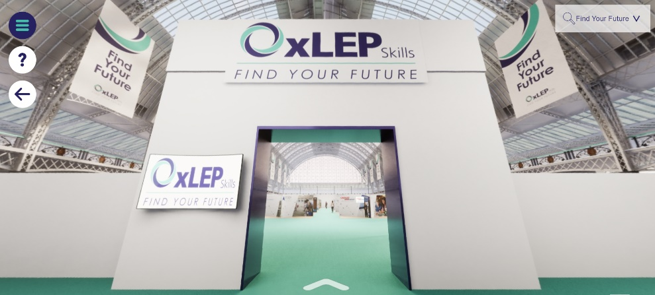
Finding help & information
Oxfordshire's new careers platform, Find Your Future, is the next step for you to find out more and plan your future here in Oxfordshire.
Navigate your way around the platform by clicking on Find Your Future.
There is a guide on Find Your Future for students and parents to explore Your Fabulous Future in Oxfordshire. Take time to get excited and make plans!
©VotesforSchools 2023
Notes:
Images
https://www.oxfordshirelep.com/findyourfuture
References
https://www.oxfordshirelep.com/findyourfuture
https://www.oxfordshirelep.com/sites/default/files/uploads/FindYourFutureParentsGuide.pdf

Slide 22
Finding Their Future
In association with VotesforSchools
©VotesforSchools 2023

