Slide 1
Your Fabulous Future in Oxfordshire
In association with VotesforSchools and The WOW Show
©VotesforSchools The WOW Show

Slide 2
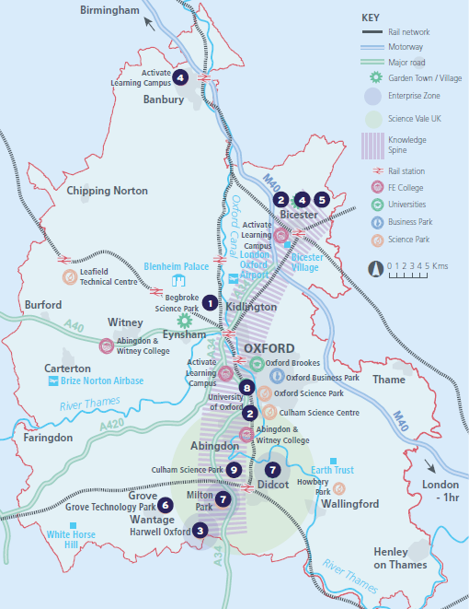
What is Labour Market Information (LMI)?
Labour Market Information (LMI) is a useful tool to help research future jobs in the local area, understand the skills needed for certain roles and the demand for future employment.
In Oxfordshire, there are fantastic opportunities in whatever pathway you want to take!
There are over 350,000 people working in Oxfordshire and over 50,000 people are self-employed.
During this presentation, you are going to find out more about what’s available to you, and this will help with your career choices going forward!
©VotesforSchools The WOW Show
Notes:
References:
https://www.oxfordshirelep.com/sites/default/files/uploads/OxLEPLMIReportAugust2020.pdf
Images:
Istock
OxLEP

Slide 3
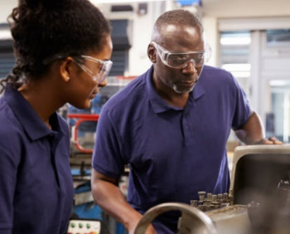
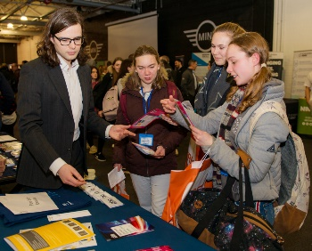
Opportunities in Oxfordshire
Have you thought about your future yet? What do you enjoy?
Whatever your interests, there is something for you!
There are lots of great opportunities in many different sectors across Oxfordshire. A great future awaits...
Whether you want an apprenticeship, T Levels, further education or to study for a degree, Oxfordshire has a pathway that would suit you.
©VotesforSchools The WOW Show
Notes:
Images:
iStock
OxLEP

Slide 4
Opportunities in Health & Social Care
The NHS, Health and Social Care all have a variety of opportunities with different entry levels and pathways, with over 46,000 people working across their services in Oxfordshire.
There are currently shortages within the health and social care system, so it’s more important than ever that people know about the opportunities on offer!
There are career opportunities in the following:
Health Science Services
Medical & Dental
Allied Health Professionals
Adult Social Care
Qualified & Unqualified Nursing
Corporate & Administrative Services
Some key questions to ask yourself:
Are you compassionate?
Can you offer respect & dignity?
Do you want to improve lives?
Are you committed to quality care?
Do you enjoy working with others?
Do you want a job that grows with you?
©VotesforSchools The WOW Show
Notes:
Images:
Icons8
References:
https://www.oxfordhealth.nhs.uk/contacts/work/
https://www.healthcareers.nhs.uk/working-health/working-nhs/nhs-constitution

Slide 5
Opportunities in Innovation
Oxfordshire is at the cutting edge of innovation with roles in transformative technologies, space and life sciences.
Oxfordshire are world-leaders in the technologies of digital health, space-led data applications and autonomous vehicles (e.g. self-driving cars).
Harwell Science and Innovation Campus is located in Oxfordshire. It has over 90 space organisations and is the largest space cluster in Europe! Many of the roles require degree-level or higher education, and the skills needed include Maths, Physics & Engineering. They also have some apprenticeships.
Meanwhile, Quantum Computing creates technologies that allow computers to make breakthroughs in a range of areas, including medicine.
You may have seen it near Didcot!
©VotesforSchools The WOW Show
Notes:
YouTube Video Link: https://www.youtube.com/watch?v=y4yNbwdZKeg (2 mins 25 secs)
Images:
iStock
Icons8
References:
https://youtu.be/OWJCfOvochA?list=TLGGRfqgk1PS5UQxNjAyMjAyMQ
http://www.culham.org.uk/

Slide 6
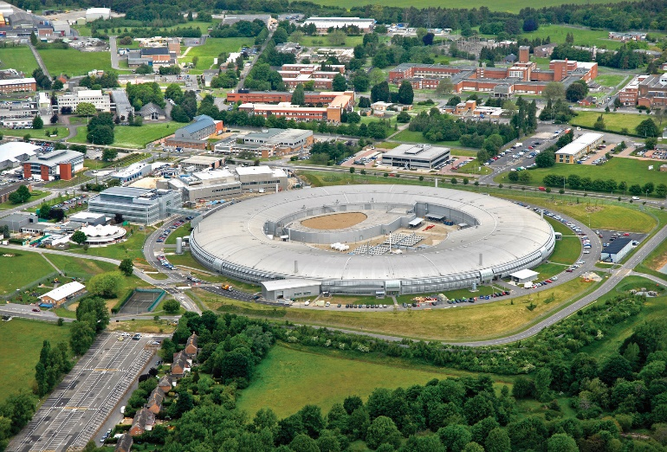
Opportunities in Science
The field of science, including medical research and development, is thriving in Oxfordshire, so there are many roles to choose from.
One of the most well-known discoveries of recent times to come out of Oxfordshire is AstraZeneca’s Coronavirus vaccine!
Oxford Biomedical Research Centre is based at Oxford University Hospitals and is a National Institute for Health Research (NIHR).
There are also several new innovation centres at the Oxford BioEscalator, the Begbroke Accelerator, Harwell Science & Innovation Campus, and Culham Science Centre.
Some of the key skills needed for these roles:
Biomedical Science
Chemistry
Engineering
Computer Science
Data Analytics
©VotesforSchools The WOW Show
Notes:
References:
https://oxfordbrc.nihr.ac.uk/about-us-intro/
https://www.youtube.com/watch?v=_zuO3oEmZn4&feature=emb_logo
Images:
1) iStock

Slide 7
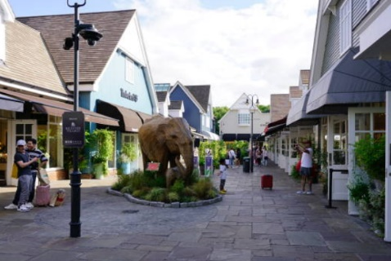
Opportunities in Tourism
Oxfordshire has a great tourist economy, with the historic Oxford University, beautiful Blenheim Palace and popular Bicester Shopping Village.
Through these venues and many others, there are lots of careers available in travel and tourism in Oxfordshire.
Oxford University doesn’t just need academic staff to keep its position as a world-leading place to learn! There are a wide range of opportunities available here such as gardeners, librarians or IT support.
Blenheim Palace hosts events throughout the year, including weddings and conferences. This means there are lots of jobs here too.
Bicester Village is one of the top tourist destinations in the UK. It has high value retailers in one central shopping area with lots entry level full and part-time retail jobs.
©VotesforSchools The WOW Show
Notes:
References:
https://www.experienceoxfordshire.org/?s=visitor+information
https://www.thebicestervillageshoppingcollection.com/en/home/
https://www.tbvsc.com/bicester-village/en
Images:
iStock
OxLEP
Icons8

Slide 8
Opportunities in Small Businesses
99% of Oxfordshire employers are small or medium sized enterprises with up to 249 employees, and 85% of these are micro businesses with less than ten employees.
Only 155 businesses in Oxfordshire have 250 employees or more.
Maybe you have your own idea for a business or have a business your family already owns? Are you the next entrepreneur with your own idea?
There were 5.9 million small businesses across the UK at the start of 2020.
There are definitely advantages to working for smaller businesses.
Fewer employees could mean:
Varied roles
More flexibility
Promotion opportunities
Access to all staff
Personal achievement
©VotesforSchools The WOW Show
Notes:
References:
https://www.businessinnovationmag.co.uk/oxfordshire-smes-demonstrate-uks-second-highest-turnover-growth-research-shows/
https://www.fsb.org.uk/uk-small-business-statistics.html
Images:
iStock
OxLEP
Icons8

Slide 9
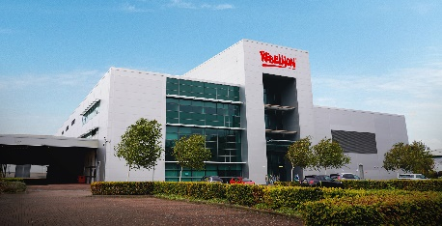
Opportunities in Creative Industries
If the creative sector is more your thing, there are plenty of jobs on offer in this area in Oxfordshire too!
The local sector’s strengths include computer games, software development and high performance computing, as well as film and TV.
Did you know Rebellion Film Studios recently opened a £78m studio facility in Didcot?
This shows how important Oxfordshire is in the development of this sector, and you could be a part of it!
Do any of the following areas appeal to you?
Art & Design
Production
Animation
Marketing
Coding & IT
Quality Assurance
©VotesforSchools The WOW Show
Notes:
References:
https://rebellionfilmstudios.com/about/
https://rebellion.com/
Images:
iStock
OxLEP
Icons8

Slide 10
Opportunities in Advanced Manufacturing
Advanced Manufacturing includes everything from electric cars to 3D printing. So, it might be the area for you without you even realising it!
Roles in advanced manufacturing are available either through Apprenticeships or Degree level education.
Oxfordshire has fantastic opportunities in high-performance technology and motorsport engineering. This will also lead to increased demand for engineers, scientists, biochemists and software developers in the area.
If you have great ideas and a problem-solving approach, then maybe this is the career path for you!
Oxfordshire has so many opportunities in technology and innovation.
©VotesforSchools The WOW Show
Notes:
References:
https://www.rc-harwell.ac.uk/research/advanced-manufacturing/
https://www.oxinst.com/segments/advanced-manufacturing
Images:
Harwell
Icons8

Slide 11
Opportunities in Construction
With all these different sectors thriving and growing in Oxfordshire, homes for new residents are going to be important too! There are over 20 construction companies in Oxfordshire.
If you are interested in construction and the environment, Greencore have a range of careers centred around building healthy, modern, safe homes.
They also have a clear objective in order to manage their environmental impact: all of their developments and projects are zero carbon and have net zero energy usage!
The results of this include lower energy bills and a smaller carbon footprint for homeowners.
Some of the career paths on offer include:
Planning
Management
Design
Building
Admin & Support
©VotesforSchools The WOW Show
Notes:
References:
https://www.greencoreconstruction.co.uk/
https://www.nationalgrid.com/stories/energy-explained/what-is-net-zero - Explanation of net-zero
https://www.wbdg.org/resources/net-zero-energy-buildings
Images:
https://www.greencoreconstruction.co.uk/
Icons8

Slide 12
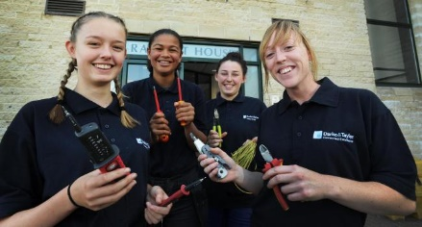
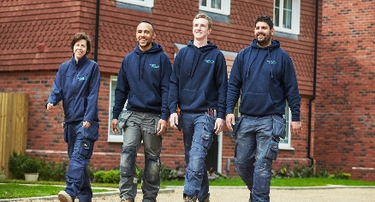
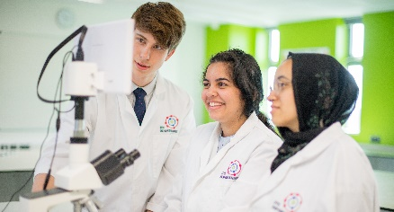
Routes to your future!
From choosing your GCSE subjects, through to Further or Higher Education there is a route to suit everyone. Check out Find Your Future for more information.
T Levels
Apprenticeships
A Levels
Degree Level Apprenticeships
Degrees
©VotesforSchools The WOW Show
Notes:
References:
https://www.oxfordshirelep.com/findyourfuture
Images:
iStock
Icons8

Slide 13
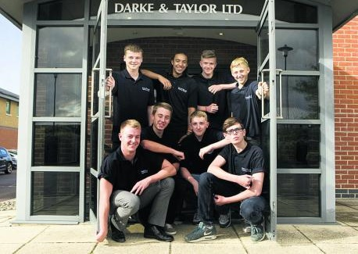
Finding help & information
School is just the start of your learning journey, you can continue to learn and develop new skills every day, no matter where you are!
Continually developing your personal skills, reskilling and upskilling allows you to create the future you want.
Definition: Reskill
To learn new skills so that you can do a different or evolving job.
Definition: Upskill
To learn new skills or to teach workers new skills.
Challenge:
There are great resources to help you make decisions about your future. Why not visit https://www.oxfordshirelep.com/findyourfuture? Or, you can speak to you teacher or school careers advisers for more information.
©VotesforSchools The WOW Show
Notes:
References:
https://www.oxfordshirelep.com/findyourfuture
https://dictionary.cambridge.org/dictionary/english/reskill
https://dictionary.cambridge.org/dictionary/english/upskill
Images:
OxLEP
Icons8

Slide 14
Finding help & information
Oxfordshire's new careers’ platform, Find Your Future is the next step for you to find out more and plan your future here in Oxfordshire.
Navigate your way around the platform by clicking on Find Your Future.
There is a guide on Find Your Future for students and parents to explore Your Fabulous Future in Oxfordshire. Take time to get excited and make plans!
©VotesforSchools The WOW Show
Notes:
References:
https://www.oxfordshirelep.com/findyourfuture
https://www.oxfordshirelep.com/sites/default/files/uploads/FindYourFutureParentsGuide.pdf
Images:
1) https://www.oxfordshirelep.com/findyourfuture

Slide 15
A fabulous future in Oxfordshire?
Time to find out more about the fabulous future waiting for you in Oxfordshire!
Click on The WOW Show to watch the film!
0:00-3:54
©VotesforSchools The WOW Show
Notes:
You Tube Video Link: https://www.youtube.com/channel/UCXDSgY0E_aACHXcSqX14YNg
Safe Share Video Link: https://safeshare.tv/x/ss641b2616a375c
References
https://www.harwellcampus.com/wp-content/uploads/Harwell-Life-Sciences-Brochure.pdf
https://www.astrazeneca.co.uk/
https://www.harwellcampus.com/vision/
Images:
OxLEP
Icons8

Slide 16
Your Fabulous Future in Oxfordshire
In association with VotesforSchools and The WOW Show
©VotesforSchools The WOW Show

