Slide 1
Your Fabulous Future in Oxfordshire
In association with VotesforSchools and The WOW Show
©VotesforSchools The WOW Show 2021

Slide 2
Learning objectives for today
To draw conclusions from researching and evaluating relevant job and labour market information (LMI) to support your future plans.
To develop and apply enterprising qualities and skills in your approach to learning, work and career planning.
To research and evaluate progression pathways and return on investment for the higher and further education, training, apprenticeship, employment and volunteering options that are open to you.
Keywords
Labour Market Information (LMI): Information about the jobs and careers available in a geographical area.
Career planning: Improving your chances of being involved and qualified for your chosen career.
Progression pathways: Directions of study and work experience to support a career pathway.
©VotesforSchools The WOW Show 2021
Notes:
References:
https://dictionary.cambridge.org/dictionary/english/career
https://dictionary.cambridge.org/dictionary/english/progression

Slide 3
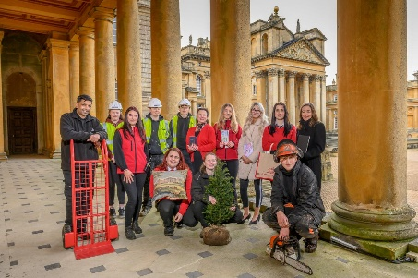
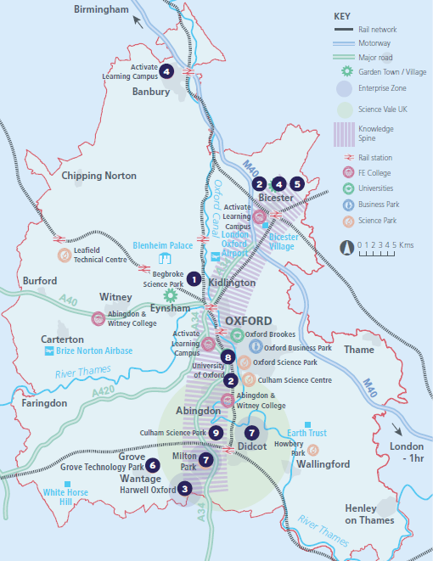
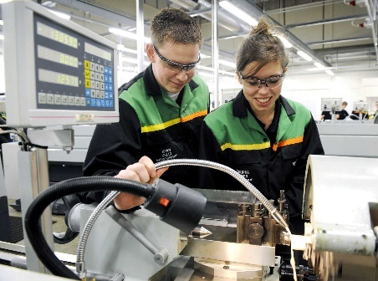
1
What is Labour Market Information (LMI)?
Definition: Labour Market Information (LMI)
Information about the jobs and careers available.
Pair discussion (2-3 mins)
Have you ever used Labour Market Information to look for job opportunities? Did you know that this information exists and where to find it in Oxfordshire?
Labour Market Information (LMI) is a useful tool to help research future jobs in the local area, understand the skills needed for certain roles and the demand for future employment.
If you are aware of what is available in your local area it can help you think about all of the opportunities that are on offer to you in Oxfordshire!
©VotesforSchools The WOW Show 2021
Notes:
Images
OxLEP
Pixabay
Icons8

Slide 4
2
What is the LMI in Oxfordshire?
Pair discussion (2-3 mins)
Talk to a partner about which employers are in your local area. What sector are they from and what they do or manufacture?
Then, click to find out more about which sectors have roles on offer in Oxfordshire.
Definition: Sector
An area of work and production that makes money for an area or country.
Advanced Engineering
Oxfordshire has a zero carbon target for 2030
Space & Satellite
Oxfordshire has state-of-the art technology
Life Sciences
Including vaccinations, cryogenics & more
Construction
Ongoing development of green technologies
Health & Social Care
A variety of different roles are available
Autonomous Vehicles Constant development of cutting-edge tech
Education
The universities have over 14,000 staff
Creative Industries
Including film & game design and creation
Manufacturing & Logistics
A thriving distribution industry
Challenge:
Did you know there were career opportunities in these sectors in Oxfordshire?
©VotesforSchools The WOW Show 2021
Notes:
References
https://dictionary.cambridge.org/dictionary/english/sector
Cryogenics definition - cryogenics, which deals with extremely low temperatures, has no connection with cryonics, the belief that a person’s body or body parts can be frozen at death, stored in a cryogenic vessel, and later brought back to life. https://home.cern/science/engineering/cryogenics-low-temperatures-high-performance
Images
Icons8

Slide 5
2
What is the LMI in Oxfordshire?
Digital Technology
With almost everyone using technology, this sector is always growing
Wholesale & Retail
There are thousands of retail roles with large & small retailers
Financial & Professional Services
All businesses need financial advice & support and legal advice
The Public Sector
Oxfordshire County Council have 1,300 staff in a variety of roles
Hospitality, Leisure & Tourism
Oxfordshire has thousands of visitors from all over the world
Charity Sector
There are many sectors that have opportunities for experience
There are so many opportunities in Oxfordshire, so why not take inspiration from closer to home?
©VotesforSchools The WOW Show 2021
Notes:
References
https://dictionary.cambridge.org/dictionary/english/sector
Experience Oxfordshire promotional video: https://www.youtube.com/watch?v=fkUZuj2QIms
Images
Icons8

Slide 6
3
A fabulous future in Oxfordshire?
The NHS, Health and Social Care all have a variety of opportunities with different entry levels and pathways, with over 46,000 people working across their services in Oxfordshire.
The world-renowned centre of clinical excellence is one of the largest NHS teaching trusts in the UK.
There are career opportunities in the following areas:
Health Science Services
Medical & Dental
Allied Health Professionals
Adult Social Care
Qualified & Unqualified Nursing
Corporate & Administrative Services
There are currently shortages within the health and social care system, so it’s more important than ever that people know about the opportunities on offer!
©VotesforSchools The WOW Show
Notes:
Images:
Icons8
iStock
References:
https://www.oxfordhealth.nhs.uk/contacts/work/
https://www.healthcareers.nhs.uk/working-health/working-nhs/nhs-constitution

Slide 7
3
A fabulous future in Oxfordshire?
Time to find out more about the fabulous future waiting for you in Oxfordshire!
0:00-3:54
Pair activity (2-3 mins)
After you have watched The WOW Show film, work with a partner and think about the advantages and disadvantages of working in a company in Oxfordshire with several hundred people compared to say just 10 or 20 - or working for yourself. Which do you feel would be of most interest to you?
Do you know that right here on our doorstep we have a fantastic mix of employers who represent some of the most important and exciting areas of employment for this country in the future. In this film we can take a look at some of them.
In the employment areas we have just seen, Oxfordshire has a huge variety of employers of different sizes from very large companies to lots of small and medium enterprises.
©VotesforSchools The WOW Show
Notes:
You Tube Video Link: https://www.youtube.com/channel/UCXDSgY0E_aACHXcSqX14YNg
Safe Share Video Link: https://safeshare.tv/x/ss641b2616a375c
References
https://www.harwellcampus.com/wp-content/uploads/Harwell-Life-Sciences-Brochure.pdf
https://www.astrazeneca.co.uk/
https://www.harwellcampus.com/vision/
Images:
OxLEP
Icons8

Slide 8
4
What skills do you need?
Pair activity (4-5 mins)
To make your first steps into a career, you need a range of different skills. Can you come up with a list of the soft skills you think are needed to be employable? Then, click to see the skills Oxfordshire businesses thought were most important.
Leadership
Problem-solving
Communication
Innovation
Customer service
Self-motivation
Positivity
Management
Pair reflection (1-2 mins)
Why do you think these skills are key for a successful business?
All these skills reflect the changing business landscape and the evolving needs of employers in Oxfordshire.
Definition: Soft skills
There are many soft skills, the ability to communicate for example is one.
What others can you think of?.
Definition: Skill shortage
When there are not enough people available with the right skills needed by employers
©VotesforSchools The WOW Show 2021
Notes:
References
https://www.prospects.ac.uk/careers-advice/getting-a-job/skills-shortages-and-covid-19
https://www.oxfordshirelep.com/sites/default/files/uploads/OxLEP%20Skills%20Strategy.pdf
https://dictionary.cambridge.org/dictionary/english/soft-skills
Images
1) Icons8

Slide 9
5
Progression pathways
OxLEP Skills is here to help you find the right career pathway. The National Careers Service (NCS) offers free and impartial information, advice and guidance to help you with your decisions about careers, courses and work.
Oxme is the young people's website for Oxfordshire County Council. It contains information about health, learning, work experience, jobs for young people
Small group discussion (3-5 mins)
In groups, discuss the following:
How are you making a plan for your future?
Do you know where to get help and support in Oxfordshire?
What are the most important issues for you and your future plans?
Definition: Progression pathway
A mapping out of how to progress your future with work and training.
Challenge:
What inspiration could you take from what you have discussed today when making plans?
©VotesforSchools The WOW Show 2021
Notes:
References:
https://oxme.info/
https://www.oxfordshirelep.com/skills/our-approach
https://www.oxfordshirelep.com/skills
Images:
iStock
Icons8

Slide 10
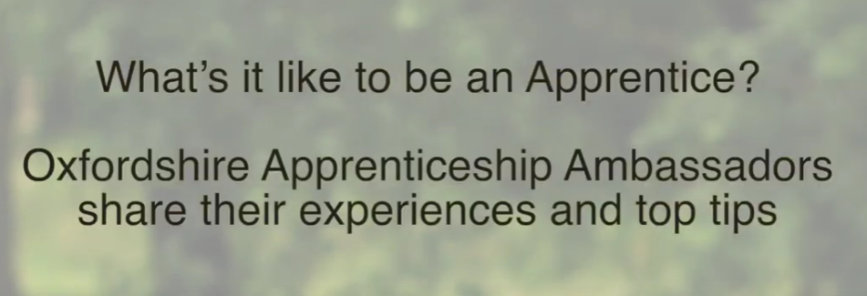
6
Planning your future: Apprenticeships
0:00-2:16
Small group discussion
(4-5 mins)
Click the image to watch the clip. Then, discuss the advantages and disadvantages of being an apprentice.
Apprenticeships are a great way to earn while you learn how to do a job. There are lots of opportunities to develop your skills and improve your earning potential as you develop independence and confidence.
Challenge:
You can search for apprenticeships in Oxfordshire by clicking the Oxme logo below, or you can look for apprenticeships on the Government apprenticeship portal. Local FE Colleges also place apprentices, so contacting their apprenticeship teams is another option. Why not give one of these a go?
©VotesforSchools The WOW Show 2021
https://safeshare.tv/x/ss604f2a835bc1e
Notes:
YouTube Video Link: https://www.youtube.com/watch?v=exbe2nvV11g
SafeShare Link: https://safeshare.tv/x/ss604f2a835bc1e
References:
https://www.oxfordshirelep.com/skills/our-programmes/apprenticeships
https://oxme.info/cms/earn/apprenticeships
http://oxme.info/cms/opportunities?f%5B0%5D=field_employment_type%3A575
https://www.findapprenticeship.service.gov.uk/
https://oxme.info/cms/learn/go-college
https://www.oxfordshirelep.com/events/event/apprenticeships-looking-forward-and-oxfordshire-apprenticeship-awards-2021-launch
Images:
https://twitter.com/oxlepskills
Icons8

Slide 11
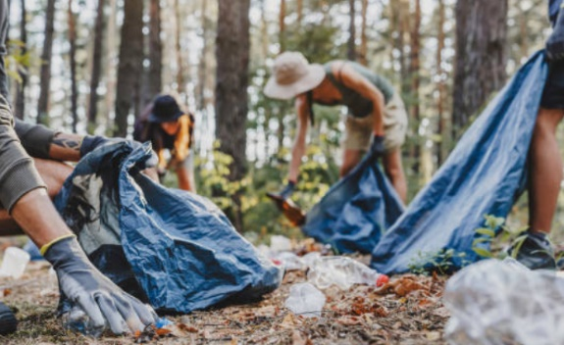
6
Planning your future: Volunteering
There are lots of opportunities to volunteer in Oxfordshire. Voluntary work can really help with gaining experience and finding a job you love.
Small group discussion (2-3 mins)
What are the advantages of volunteering?
How could it help with a job or career?
Which other skills might you learn while volunteering?
What opportunities are there to volunteer where you are?
Then, click to see just some of the perks of volunteering…
Great social interactions
Excellent experience
Sense of satisfaction
Opportunity to try new things
Challenge:
Why not check out what’s available near you and see how to get involved?
©VotesforSchools The WOW Show 2021
Notes:
References:
https://www.oxfordshire.gov.uk/residents/community-and-living/volunteering-oxfordshire
Images:
iStock
Icons8

Slide 12
7
Getting prepared: Interviews
Interviews form an important part of any application process, no matter what your chosen sector or career. So how much do you know about the do’s and don’ts?
Pair discussion (3-5 mins)
Spend 2 minutes discussing with a partner what your Top 3 Tips for interview success would be, based on your experience and knowledge. Then click to see if any of your suggestions are listed!
Challenge:
Choose one of these pieces of advice. How can you work on this for yourself?
1
Be prepared: Knowing your stuff and being ready for anything is vital for a successful interview.
2
Look after yourself: Before your interview, try to keep hydrated, eat well and stay calm.
3
First impressions count: Make yours a good one by dressing smartly.
4
Listen carefully: ask them to clarify if you don't understand the question.
5
Concentrate: Talk slowly and clearly, and stop to think about your answers.
6
Be honest: Answer questions truthfully and don’t be afraid to ask questions of your own.
©VotesforSchools The WOW Show 2021

Slide 13
6
Getting prepared: Personal Statements
Individual activity (5+ mins)
Have you started to write your personal statement? Below are some ideas of what you can include. Why not make a start? You could write down some notes, or mind-map your ideas for each section.
Introduction
Your reasons for applying, why you think you would be a good applicant and what sets you apart from other applicants.
What you enjoy most about each of your subjects, and the skills and knowledge you have built during this time.
Your studies
Work experience
Any work experience, volunteering or paid jobs you have undertaken, what you did to make these a success, and how they link to your application.
Anything outside of lesson time which has built skills or confirmed your desire to pursue this chosen path, such as trips, books, videos or talks.
Wider learning
Hobbies & interests
How you use your free time, any awards you have won and what you enjoy – essentially showing that you’re a well-rounded person!
A summary of your motivations (reasons) for applying, and how you see it shaping your future.
Conclusion
©VotesforSchools The WOW Show 2021
Notes:
References:
https://www.thestudentroom.co.uk
Images:
Icons8

Slide 14
Finding help & information
Oxfordshire's new careers’ platform, Find Your Future is the next step for you to find out more and plan your future here in Oxfordshire.
Navigate your way around the platform by clicking on Find Your Future.
There is a guide on Find Your Future for students and parents to explore Your Fabulous Future in Oxfordshire. Take time to get excited and make plans!
©VotesforSchools The WOW Show
Notes:
References:
https://www.oxfordshirelep.com/findyourfuture
https://www.oxfordshirelep.com/sites/default/files/uploads/FindYourFutureParentsGuide.pdf
Images:
1) https://www.oxfordshirelep.com/findyourfuture

Slide 15
Get to know the employers!
Want to find out more?
Click on the logos to visit the websites of each employer featured below!
The University of Oxford has a huge variety of roles, don’t just think teaching! They also have a great apprenticeship scheme.
Diamond Light Source is one of the most advanced scientific facilities in the world, and its pioneering capabilities are helping to keep the UK at the forefront of scientific research!
The Culham Centre for Fusion Energy is the UK’s national nuclear fusion laboratory. They are researching generating low-carbon electricity.
Unipart Group brings together manufacturing, logistics and consultancy to create imaginative solutions for customers..
Morgan Sindall has a graduate programme, traineeships and apprenticeships so there are many routes into all areas of modern construction.
©VotesforSchools The WOW Show
Notes:
References:
https://www.ox.ac.uk/
https://www.apprenticeships.ox.ac.uk/
https://www.diamond.ac.uk/Careers/Apprenticeships.html
https://www.diamond.ac.uk/Home/About.html
https://www.gov.uk/government/organisations/uk-atomic-energy-authority
https://ccfe.ukaea.uk/careers/early-careers/
https://www.unipart.com/
https://www.morgansindallconstruction.com/
https://www.morgansindallconstruction.com/careers/

Slide 16
Get to know the employers!
Want to find out more?
Click on the logos to visit the websites of each employer featured below!
Harwell is one of the leading science and innovation campuses in Europe with over 200 organisations on the 900 hectare site (that’s pretty huge…).
Oxford NHS Hospitals provide physical and mental health services and social care. They have over 6,000 employees!
Rebellion is known for producing books, comics, TV and film, but at its core it is a leading developer and publisher of games, such as Sniper Elite 4.
Oxbotica is one of the world’s leading autonomous driving software companies. They build software for use in the real world, using ideas from the areas of physics, robotics, maths and artificial intelligence.
Williams Racing employs around 600 people in the heart of the UK’s “Motorsport Valley” in rural Oxfordshire.
©VotesforSchools The WOW Show
Notes:
References
https://www.harwellcampus.com/media-centre/harwell-campus-information-pack/
https://www.oxfordhealth.nhs.uk/
https://rebellion.com/about-us/
https://www.oxbotica.com/
https://www.williamsf1.com/

Slide 17
Get to know the employers!
Want to find out more?
Click on the logos to visit the websites of each employer featured below!
Greencore Construction helps people build modern, dream homes with low impact on the environment.
Blenheim Palace is a big source of tourism in Oxfordshire, and it also hosts sporting events, banquets and weddings.
Oxford University Press create high quality academic and education resources. You may even have some of their textbooks!
Over 8,000 people work for Thames Valley Police with many varied roles and volunteering opportunities available.
BMW Mini run apprenticeships and internships, as well as taking graduates. They have a programme called “Girls Go Technical” to encourage young women to join.
©VotesforSchools The WOW Show
Notes:
References
https://www.greencoreconstruction.co.uk/
https://www.blenheimpalace.com/
https://global.oup.com/?cc=gb
https://tvpcareers.co.uk/
https://www.mini.co.uk/en_GB/home/why-mini/mini-uk-production.html

