Slide 1
Your Fabulous Future in Oxfordshire
In association with VotesforSchools and The WOW Show
©VotesforSchools The WOW Show
©VotesforSchools The WOW Show
Notes:
References:
1) https://www.senteacher.org/download/77/DyslexiaFont.html - Font used throughout

Slide 2
Learning objectives for today
To be aware of what job and labour market information (LMI) is and what it can do for you.
To recognise the qualities and skills needed for employability and provide evidence for those you have demonstrated both in and out of school.
Keywords
LMI: Labour Market Information (LMI): Information about the jobs and careers available in a geographical area.
Sector: The areas into which the economic activity of a country is divided.
Employability: Having the skills and abilities needed to have a job or career.
©VotesforSchools The WOW Show
Notes:
References
https://dictionary.cambridge.org/dictionary/english/sector
https://dictionary.cambridge.org/dictionary/english/employability

Slide 3
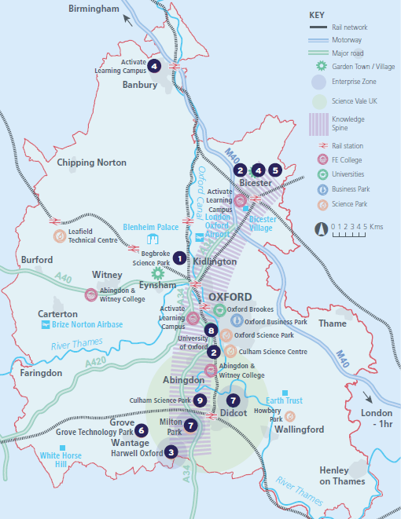
1
What is Labour Market Information (LMI)?
Discuss (2 mins)
Where are you in Oxfordshire?
Discuss (2 mins)
What are you near to?
Schools? Airports? Workplaces?
If you are aware of what is available in your local area it can help you decide what you could do when you leave school.
©VotesforSchools The WOW Show
Notes:
Images
OxLEP
Pixabay
Icons8

Slide 4
1
What is Labour Market Information (LMI)?
Labour Market Information can help people make informed choices about which jobs and industry sectors are available in their area.
Discuss (2 mins)
Have you thought about what you would like to do for your job in the future?
Define: Labour Market Information (LMI)
Information about the jobs and careers available.
©VotesforSchools The WOW Show
Notes:
Images
OxLEP
Pixabay
Icons8

Slide 5
2
What is the LMI in Oxfordshire?
Class discussion (2 mins)
What jobs have you heard of in your area?
Click to find out more about which sectors have roles on offer in Oxfordshire.
Charity Sector
Warehouse Work
The NHS
Construction
Education
Gaming
Challenge:
Did you know anyone who works in any of these areas?
©VotesforSchools The WOW Show
Notes:
References
https://dictionary.cambridge.org/dictionary/english/sector
Images
Icons8

Slide 6
2
What is the LMI in Oxfordshire?
Class discussion (2 mins)
Have you spoken to anyone about what you want to do when you leave school?.
Buses and Trains
Retail/Shops
Oxfordshire Council
Care
Film
©VotesforSchools The WOW Show
Notes:
References
https://dictionary.cambridge.org/dictionary/english/sector
Images
Icons8

Slide 7
3
A fabulous future in Oxfordshire?
There are lots of possibilities across Oxfordshire, watch The WOW Show film to see some of the great places people go to work.
0:00-3:54
Whole class activity
(5 -8 mins)
Discuss the exciting opportunities available in Oxfordshire for you.
©VotesforSchools The WOW Show
https://safeshare.tv/x/528251568
Notes:
You Tube Video Link: https://www.youtube.com/channel/UCXDSgY0E_aACHXcSqX14YNg
Safe Share Video Link: https://safeshare.tv/x/ss641b2616a375c
Images:
OxLEP
Icons8

Slide 8
4
What skills do you need?
Class activity (2-3 mins)
When you begin to look for a job or your next steps after school, what skills do you think are important?
Click if you need a few hints!
Friendly
Problem-solving
Doing your best
Positivity
Good communication
Teamwork
Organisation
©VotesforSchools The WOW Show
Notes:
References
https://www.prospects.ac.uk/careers-advice/getting-a-job/skills-shortages-and-covid-19
https://www.oxfordshirelep.com/sites/default/files/uploads/OxLEP%20Skills%20Strategy.pdf
https://dictionary.cambridge.org/dictionary/english/soft-skills
Images
1) Icons8

Slide 9
4
What skills do you need?
Reflection (4-5 mins)
What are your skills?
What are you really good at?
Friendly
Problem-solving
Doing your best
Positivity
Good communication
Teamwork
Organisation
©VotesforSchools The WOW Show
Notes:
References
https://www.prospects.ac.uk/careers-advice/getting-a-job/skills-shortages-and-covid-19
https://www.oxfordshirelep.com/sites/default/files/uploads/OxLEP%20Skills%20Strategy.pdf
https://dictionary.cambridge.org/dictionary/english/soft-skills
Images
1) Icons8

Slide 10
5
How employable are you?
0:00-1:38
Discuss (2 mins)
Before you watch the video, discuss which of the skills you’ve looked at today you think you have. Do you think this makes you a good candidate for a job?
Class activity (2 mins)
Come up with a list of positive things about you.
You can help others by telling them what you think is a great skill that they have.
©VotesforSchools The WOW Show
https://safeshare.tv/x/ss602199d2bb0de
Notes:
Alternative Video Link – Employability Skills: https://www.youtube.com/watch?v=tKKPUYfOkvw
References
https://www.youtube.com/watch?v=tKKPUYfOkvw – The WOW Show – Employability skills.
https://safeshare.tv/x/ss602199d2bb0de - Safeshare link to the clip on Youtube.
https://oxfordshireyouth.org/get-involved/
Images
Icons8
https://www.youtube.com/watch?v=tKKPUYfOkvw
https://oxfordshireyouth.org/

Slide 11
The following slides contain information for staff on employers in Oxfordshire and those featured in The WOW Show film.
©VotesforSchools The WOW Show
©VotesforSchools The WOW Show

Slide 12
Get to know the employers!
Want to find out more?
Click on the logos to visit the websites of each employer featured below!
The University of Oxford has a huge variety of roles, don’t just think teaching! They also have a great apprenticeship scheme.
Diamond Light Source is one of the most advanced scientific facilities in the world, and its pioneering capabilities are helping to keep the UK at the forefront of scientific research!
The Culham Centre for Fusion Energy is the UK’s national nuclear fusion laboratory. They are researching generating low-carbon electricity.
Unipart Group brings together manufacturing, logistics and consultancy to create imaginative solutions for customers.
Morgan Sindall has a graduate programme and traineeships and apprenticeships so there are many routes into all areas of modern construction.
©VotesforSchools The WOW Show
Notes:
References:
https://www.ox.ac.uk/
https://www.apprenticeships.ox.ac.uk/
https://www.diamond.ac.uk/Careers/Apprenticeships.html
https://www.diamond.ac.uk/Home/About.html
https://www.gov.uk/government/organisations/uk-atomic-energy-authority
https://ccfe.ukaea.uk/careers/early-careers/
https://www.unipart.com/
https://www.morgansindallconstruction.com/
https://www.morgansindallconstruction.com/careers/

Slide 13
Get to know the employers!
Want to find out more?
Click on the logos to visit the websites of each employer featured below!
Harwell is one of the leading science and innovation campuses in Europe with over 200 organisations on the 900 hectare site (that’s pretty huge…).
Oxford NHS Hospitals provide physical and mental health services and social care. They have over 6,000 employees!
Rebellion is known for producing books, comics, TV and film, but at its core it is a leading developer and publisher of games, such as Sniper Elite 4.
Oxbotica is one of the world’s leading autonomous driving software companies. They build software for use in the real world, using ideas from the areas of physics, robotics, maths and artificial intelligence.
Williams Racing employs around 600 people in the heart of the UK’s “Motorsport Valley” in rural Oxfordshire.
©VotesforSchools The WOW Show
Notes:
References
https://www.harwellcampus.com/media-centre/harwell-campus-information-pack/
https://www.oxfordhealth.nhs.uk/
https://rebellion.com/about-us/
https://www.oxbotica.com/
https://www.williamsf1.com/

Slide 14
Get to know the employers!
Want to find out more?
Click on the logos to visit the websites of each employer featured below!
Greencore Construction helps people build modern, dream homes with low impact on the environment.
Blenheim Palace is a big source of tourism in Oxfordshire, and it also hosts sporting events, banquets and weddings.
Oxford University Press create high quality academic and education resources. You may even have some of their textbooks!
Over 8,000 people work for Thames Valley Police with many varied roles and volunteering opportunities available.
BMW Mini run apprenticeships and internships, as well as taking graduates. They have a programme called “Girls Go Technical” to encourage young women to join.
©VotesforSchools The WOW Show
Notes:
References
https://www.greencoreconstruction.co.uk/
https://www.blenheimpalace.com/
https://global.oup.com/?cc=gb
https://tvpcareers.co.uk/
https://www.mini.co.uk/en_GB/home/why-mini/mini-uk-production.html

