Slide 1
Y10 LMI Lesson: Your Fabulous Future in Oxfordshire
In association with VotesforSchools and The WOW Show
©VotesforSchools The WOW Show

Slide 2
Learning objectives for today
To be aware of what job and labour market information (LMI) is and what it can do for you.
To show that you have acquired and developed qualities and skills to improve your employability.
To research your education, training, apprenticeship, employment and volunteering options including information about the best progression pathways through to specific goals.
Keywords
Labour Market Information (LMI): Information about the jobs and careers available in a geographical area.
Employability: Having skills and abilities that allow you to be employed.
Curriculum Vitae (CV): A written description of your skills, qualifications and experience.
©VotesforSchools The WOW Show
Notes:
References:
https://dictionary.cambridge.org/dictionary/english/employability
https://dictionary.cambridge.org/dictionary/english/curriculum vitae

Slide 3
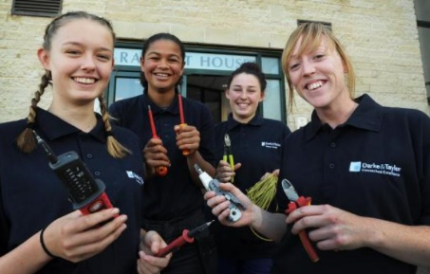
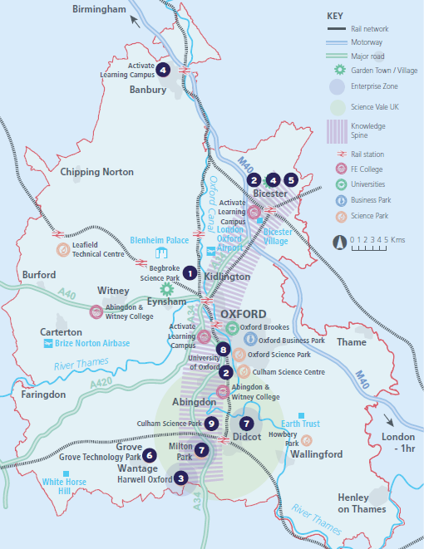
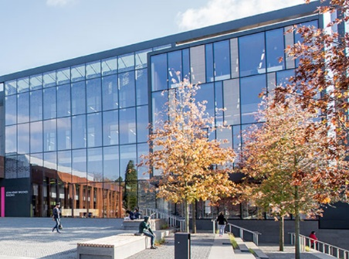
1
What is Labour Market Information (LMI)?
Definition: Labour Market Information (LMI)
Information about the jobs and careers available.
Class discussion (2-3 mins)
What do you know about Labour Market Information in your area? How can you find out more to help make decisions about your future?
Labour Market Information (LMI) is a useful tool to help research future jobs in the local area, understand the skills needed for certain roles and the demand for future employment.
If you are aware of what is available in your local area it can help you decide what your choices could be when you complete your GCSEs.
©VotesforSchools The WOW Show 2021
Notes:
Images
OxLEP
Pixabay
Icons8

Slide 4
2
What is the LMI in Oxfordshire?
Pair discussion (2-3 mins)
Talk to a partner about what opportunities you know about in your local area. What do people you know do as their career? Then, click to find out more about which sectors have roles on offer in Oxfordshire.
Definition: Sector
An area of work and production that makes money for an area or country.
Space & Satellite
Oxfordshire has state-of-the art technology
Advanced Engineering
Oxfordshire has a zero carbon target for 2030
Life Sciences
Including vaccinations, cryogenics & more
Construction
Ongoing development of green technologies
Health & Social Care
A variety of different roles are available
Autonomous Vehicles Constant development of cutting-edge tech
Education
The universities have over 14,000 staff
Creative Industries
Including film & game design and creation
Manufacturing & Logistics
A thriving distribution industry
Challenge:
Did you know there were career opportunities in these sectors in Oxfordshire?
©VotesforSchools The WOW Show 2021
Notes:
References
https://dictionary.cambridge.org/dictionary/english/sector
Cryogenics definition - cryogenics, which deals with extremely low temperatures, has no connection with cryonics, the belief that a person’s body or body parts can be frozen at death, stored in a cryogenic vessel, and later brought back to life. https://home.cern/science/engineering/cryogenics-low-temperatures-high-performance
Images
Icons8

Slide 5
2
What is the LMI in Oxfordshire?
Digital Technology
With almost everyone using technology, this sector is always growing
Wholesale & Retail
There are thousands of retail roles with large & small retailers
Financial & Professional Services
All businesses need financial advice & support and legal advice
The Public Sector
Oxfordshire County Council have 1,300 staff in a variety of roles
Hospitality, Leisure & Tourism
Oxfordshire has thousands of visitors from all over the world
Charity Sector
There are many sectors that have opportunities for experience
There are so many opportunities in Oxfordshire, so why not take inspiration from closer to home?
©VotesforSchools The WOW Show 2021
Notes:
References
https://dictionary.cambridge.org/dictionary/english/sector
Experience Oxfordshire promotional video: https://www.youtube.com/watch?v=fkUZuj2QIms
Images
Icons8

Slide 6
3
A fabulous future in Oxfordshire?
Now to take a closer look at one of the employers in the many sectors in Oxfordshire.
Oxfordshire Greentech is the business network supporting the growth of the low-carbon sector in Oxfordshire. They are aiming for a sustainable, low-carbon future in Oxfordshire and around the world!
Individual reflection (2-3 mins)
How important is the environment to you?
Do you think businesses should be spending money researching and developing environmentally-friendly technology?
Advanced Oxford is a business directory of those working in low-carbon and environmental sectors.
Definition: Low-carbon:
Reducing the amount of carbon dioxide (CO₂) released into the atmosphere.
©VotesforSchools The WOW Show
Notes:
References
https://www.greencoreconstruction.co.uk/
https://oxfordshiregreentech.co.uk/about-us/team/
https://dictionary.cambridge.org/dictionary/english/zero-carbon
https://www.advancedoxford.com/green-recovery/business-directory/
Images
1) iStock

Slide 7
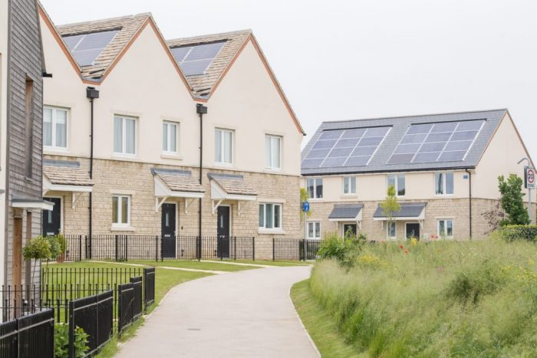
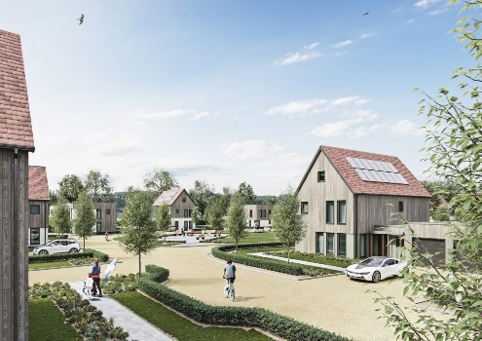
3
A fabulous future in Oxfordshire?
If you are interested in construction, Greencore have careers in all aspects of building healthy, modern and safe homes. There are over 20 construction companies in Oxfordshire.
Pair discussion (1-2 mins)
How is the work Greencore do different to more “traditional” construction companies? Does this unique approach make you more interested in working somewhere like this? How will it help Oxfordshire?
0:00-1:53
There are careers in planning, management, design and build. There are also a large number of administration and support roles.
©VotesforSchools The WOW Show
https://safeshare.tv/x/ss605653aaa864b
Notes:
You Tube Video Link: https://www.youtube.com/watch?v=jKRXAHeczHI (0:00 – 1:53)
Safe Share Video Link: https://safeshare.tv/x/ss605653aaa864b
References
https://www.greencoreconstruction.co.uk/
https://oxfordshiregreentech.co.uk/about-us/team/
Images
OxLEP
Icons8

Slide 8
3
A fabulous future in Oxfordshire?
Time to find out more about the fabulous future waiting for you in Oxfordshire!
0:00-3:54
Pair activity (2-3 mins)
After you have watched The WOW Show film, work with a partner and think about the advantages and disadvantages of working in a company in Oxfordshire with several hundred people compared to say just 10 or 20 - or working for yourself. Which do you feel would be of most interest to you?
Do you know that right here on our doorstep we have a fantastic mix of employers who represent some of the most important and exciting areas of employment for this country in the future. In this film we can take a look at some of them.
In the employment areas we have just seen, Oxfordshire has a huge variety of employers of different sizes from very large companies to lots of small and medium enterprises.
©VotesforSchools The WOW Show
Notes:
You Tube Video Link: https://www.youtube.com/channel/UCXDSgY0E_aACHXcSqX14YNg
Safe Share Video Link: https://safeshare.tv/x/ss641b2616a375c
References
https://www.harwellcampus.com/wp-content/uploads/Harwell-Life-Sciences-Brochure.pdf
https://www.astrazeneca.co.uk/
https://www.harwellcampus.com/vision/
Images:
OxLEP
Icons8

Slide 9
4
Are you employable?
Pair discussion (3-5 mins)
“Employability” is a word you are likely to hear a lot about when it comes to careers. Before you watch the film below, talk to a partner about what skills you think make someone “employable” and why. Then click the image to see if any of your suggestions are true!
0:00-1:38
Individual reflection (2-3 mins)
Now you’ve seen the film, can you rate your employability skills out of 10? How could you improve them?
Challenge:
Consider this: many of the employers in Oxfordshire are looking for people with passion who want to learn and grow along with their business. Could that be you?
©VotesforSchools The WOW Show
https://safeshare.tv/x/ss602199d2bb0de
Notes:
YouTube Video Link: https://www.youtube.com/watch?v=tKKPUYfOkvw
SafeShare Video Link: https://safeshare.tv/x/ss602199d2bb0de
Images
Via video
Icons8

Slide 10
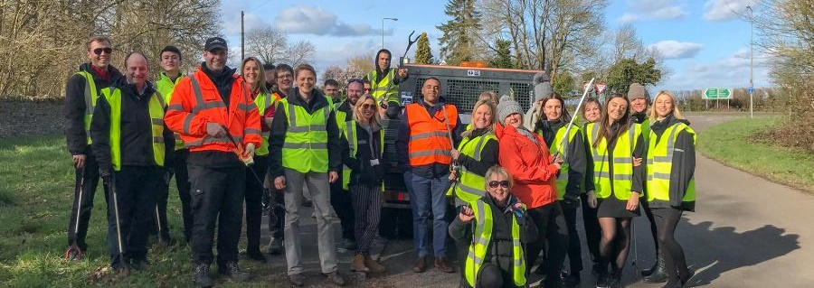
4
Are you employable?
Employers need people who have the physical and mental skills to carry out the jobs required but also to fit in with their existing workforce.
Surveys of employers in Oxfordshire showed that the following skills are in demand:
Sales
Marketing
Finance & Accounts
Computer Literacy
Organisation
Management
Communication
Care
Individual reflection (1-2 mins)
Which of these skills can you build through what you learn at school?
Which can you build through other activities available in Oxfordshire?
Challenge:
Maybe you could do some voluntary work or join a club to improve these skills and have something to add to your CV?
©VotesforSchools The WOW Show
Notes:
References
1) https://ox-lmi.ox-ai.com/categories/Employers%20And%20Educators/Skills%20and%20Qualities%20Demanded
Images
Icons8
OxLEP

Slide 11
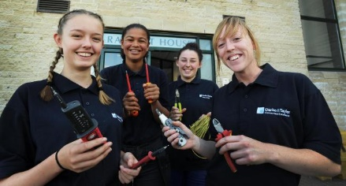
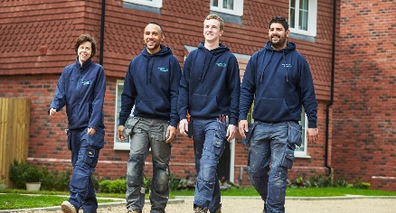
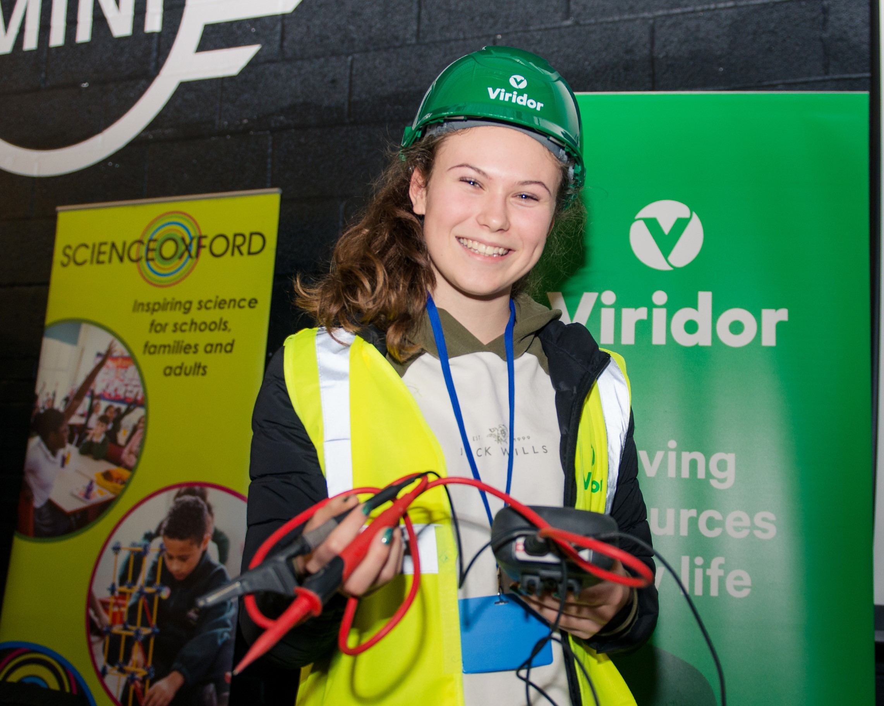
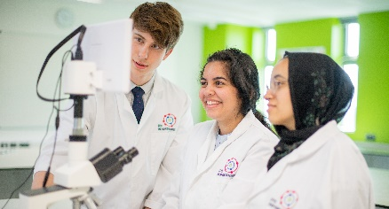
5
Planning your future
Once you have an idea of what you want to do, you can begin to create plans to make sure it happens! There are lots of different routes your future could take, so it’s up to you…
Pair/Small group discussion (2-3 mins)
Discuss with a partner or in a small group: what do you want to do when you leave school? Click if you need some ideas.
Apprenticeships
Traineeships
T Levels
A Levels
Internships
University
At the end of this lesson you will find the link to the OxLEP platform signposting you to your Fabulous Future in Oxfordshire!
Find Your Future
©VotesforSchools The WOW Show
Notes:
References:
1) https://www.oxfordshirelep.com/findyourfuture
Images
iStock
Icons8

Slide 12
6
Preparing your Curriculum Vitae (CV)
Definition: CV
A summary of your experience and education, along with other relevant information about your qualifications.
To get to where you want to be, one important step is having a strong and interesting curriculum vitae (also known as a CV). For your CV to shine, you need to know how to show off your strengths, as well as understanding how to work on any of your weaknesses.
Paired activity (4-5 mins)
Work together to write some notes for a personal statement or a short introduction to yourself for a CV – how do you highlight all your strongest qualities and qualifications?
Then, write a list of some weaknesses or areas for improvement, and consider how you can address these.
Ask your teacher for some good examples.
Top Tip #1:
Make your CV short and snappy, as employers may only spend a short time looking at it!
Top Tip #2:
Every time you apply for a job, make sure your CV is written with the role in mind.
Challenge:
Continue to work on your CV at home and see what you can add to it to make sure you stand out to a potential employer!
©VotesforSchools The WOW Show
Notes:
References
https://dictionary.cambridge.org/dictionary/english/curriculum vitae
Images
iStock
Icons8

Slide 13
Finding help & information
Oxfordshire's new careers’ platform, Find Your Future is the next step for you to find out more and plan your future here in Oxfordshire.
Navigate your way around the platform by clicking on Find Your Future.
There is a guide on Find Your Future for students and parents to explore Your Fabulous Future in Oxfordshire. Take time to get excited and make plans!
©VotesforSchools The WOW Show
Notes:
References:
https://www.oxfordshirelep.com/findyourfuture
https://www.oxfordshirelep.com/sites/default/files/uploads/FindYourFutureParentsGuide.pdf
Images:
1) https://www.oxfordshirelep.com/findyourfuture

Slide 14
Get to know the employers!
Want to find out more?
Click on the logos to visit the websites of each employer featured below!
The University of Oxford has a huge variety of roles, don’t just think teaching! They also have a great apprenticeship scheme.
Diamond Light Source is one of the most advanced scientific facilities in the world, and its pioneering capabilities are helping to keep the UK at the forefront of scientific research!
The Culham Centre for Fusion Energy is the UK’s national nuclear fusion laboratory. They are researching generating low-carbon electricity.
Unipart Group brings together manufacturing, logistics and consultancy to create imaginative solutions for customers.
Morgan Sindall has a graduate programme, traineeships and apprenticeships so there are many routes into all areas of modern construction.
©VotesforSchools The WOW Show
Notes:
References:
https://www.ox.ac.uk/
https://www.apprenticeships.ox.ac.uk/
https://www.diamond.ac.uk/Careers/Apprenticeships.html
https://www.diamond.ac.uk/Home/About.html
https://www.gov.uk/government/organisations/uk-atomic-energy-authority
https://ccfe.ukaea.uk/careers/early-careers/
https://www.unipart.com/
https://www.morgansindallconstruction.com/
https://www.morgansindallconstruction.com/careers/

Slide 15
Get to know the employers!
Want to find out more?
Click on the logos to visit the websites of each employer featured below!
Harwell is one of the leading science and innovation campuses in Europe with over 200 organisations on the 900 hectare site (that’s pretty huge…).
Oxford NHS Hospitals provides physical and mental health services and social care. They have over 6,000 employees!
Rebellion is known for producing books, comics, TV and film, but at its core it is a leading developer and publisher of games, such as Sniper Elite 4.
Oxbotica is one of the world’s leading autonomous driving software companies. They build software for use in the real world, using ideas from the areas of physics, robotics, maths and artificial intelligence.
Williams Racing employs around 600 people in the heart of the UK’s “Motorsport Valley” in rural Oxfordshire.
©VotesforSchools The WOW Show
Notes:
References
https://www.harwellcampus.com/media-centre/harwell-campus-information-pack/
https://www.oxfordhealth.nhs.uk/
https://rebellion.com/about-us/
https://www.oxbotica.com/
https://www.williamsf1.com/

Slide 16
Get to know the employers!
Want to find out more?
Click on the logos to visit the websites of each employer featured below!
Greencore Construction helps people build modern, dream homes with low impact on the environment.
Blenheim Palace is a big source of tourism in Oxfordshire, and it also hosts sporting events, banquets and weddings.
Oxford University Press create high quality academic and education resources. You may even have some of their textbooks!
Over 8,000 people work for Thames Valley Police with many varied roles and volunteering opportunities available.
BMW Mini run apprenticeships and internships, as well as taking graduates. They have a programme called “Girls Go Technical” to encourage young women to join.
©VotesforSchools The WOW Show
Notes:
References
https://www.greencoreconstruction.co.uk/
https://www.blenheimpalace.com/
https://global.oup.com/?cc=gb
https://tvpcareers.co.uk/
https://www.mini.co.uk/en_GB/home/why-mini/mini-uk-production.html

