Slide 1
Y11 LMI Lesson: Your Fabulous Future in Oxfordshire
In association with VotesforSchools and The WOW Show
©VotesforSchools The WOW Show 2021

Slide 2
Learning objectives for today
To be aware of what job and labour market information (LMI) is and what it can do for you.
To know your rights and responsibilities in a selection process and the strategies to use to improve your chances of being chosen.
To research your education, training, T Levels, apprenticeship, employment and volunteering options including information about the best progression pathways through to specific goals.
Keywords
Labour Market Information (LMI): Information about the jobs and careers available in a geographical area.
Employability: Having skills and abilities that allow you to be employed.
Curriculum Vitae: A written description of your skills, qualifications and experience.
©VotesforSchools The WOW Show 2021
Notes:
References:
https://dictionary.cambridge.org/dictionary/english/employability
https://dictionary.cambridge.org/dictionary/english/curriculum vitae

Slide 3
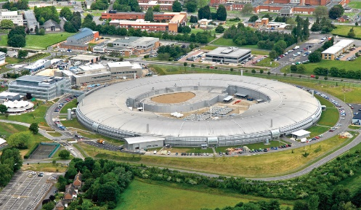
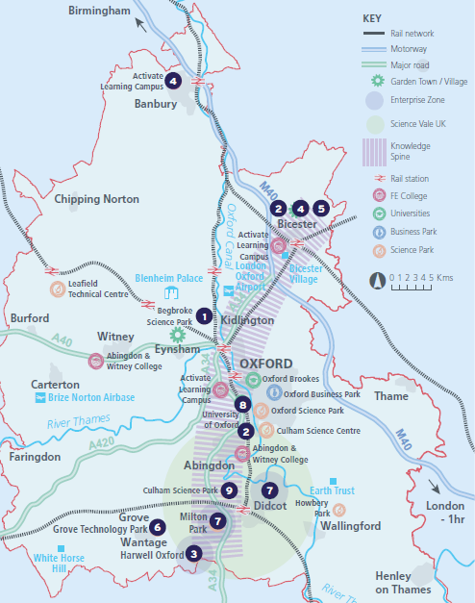
1
What is Labour Market Information (LMI)?
Definition: Labour Market Information (LMI)
Information about the jobs and careers available.
Pair discussion (2-3 mins)
How does Labour Market Information help you find a job here in Oxfordshire?
Where can you find all of the information you need?
Labour Market Information (LMI) is a useful tool to help research future jobs in the local area, understand the skills needed for certain roles and the demand for future employment.
If you are aware of what is available in your local area, it can help you decide what you could do as a career when you leave school.
Challenge:
Have you searched the oxme website for training and opportunities? If not, give it a go!
©VotesforSchools The WOW Show 2021
Notes:
References:
https://oxme.info/
https://www.oxfordshirelep.com/findyourfuture - The new website
Images
OxLEP
Pixabay
Icons8

Slide 4
2
What is the LMI in Oxfordshire?
Pair discussion (2-3 mins)
Talk to a partner about what opportunities you know about in your local area. What do people you know do as their career? Then, click to find out more about which sectors have roles on offer in Oxfordshire.
Definition: Sector
An area of work and production that makes money for an area or country.
Space & Satellite
Oxfordshire has state-of-the art technology
Advanced Engineering
Oxfordshire has a zero carbon target for 2030
Life Sciences
Including vaccinations, cryogenics & more
Construction
Ongoing development of green technologies
Health & Social Care
A variety of different roles are available
Autonomous Vehicles
Constant development of cutting-edge tech
Education
The universities have over 14,000 staff
Creative Industries
Including film & game design and creation
Manufacturing & Logistics
A thriving distribution industry
Challenge:
Did you know there were career opportunities in these sectors in Oxfordshire?
©VotesforSchools The WOW Show 2021
Notes:
References
https://dictionary.cambridge.org/dictionary/english/sector
Cryogenics definition - cryogenics, which deals with extremely low temperatures, has no connection with cryonics, the belief that a person’s body or body parts can be frozen at death, stored in a cryogenic vessel, and later brought back to life. https://home.cern/science/engineering/cryogenics-low-temperatures-high-performance
Images
Icons8

Slide 5
2
What is the LMI in Oxfordshire?
Digital Technology
With almost everyone using technology, this sector is always growing
Wholesale & Retail
There are thousands of retail roles with large & small retailers
Financial & Professional Services
All businesses need financial advice & support and legal advice
The Public Sector
Oxfordshire County Council have 1,300 staff in a variety of roles
Hospitality, Leisure & Tourism
Oxfordshire has thousands of visitors from all over the world
Charity Sector
There are many sectors that have opportunities for experience
There are so many opportunities in Oxfordshire, so why not take inspiration from closer to home?
©VotesforSchools The WOW Show 2021
Notes:
References
https://dictionary.cambridge.org/dictionary/english/sector
Experience Oxfordshire promotional video: https://www.youtube.com/watch?v=fkUZuj2QIms
Images
Icons8

Slide 6
3
A fabulous future in Oxfordshire?
0:00-1:00
If the prospect of working with autonomous vehicles (or cars in general) caught your eye, you’ll be pleased to know there are lots of great opportunities in Oxfordshire!
From Williams Racing, to BMW Mini, to automated vehicles, there are hundreds of opportunities in a variety of roles.
Pair activity (2-3 mins)
Click the image above to watch a short video. Then, with a partner, can you list how many roles there could be in this industry? Don’t forget the number of extra staff who would support teams like this…
BMW Mini, GKN, ProDrive, Oxbotica and others are at the forefront of vehicle electrification in the UK.
There are roles in customer support, design, build, testing, innovation and much more.
©VotesforSchools The WOW Show 2021
https://safeshare.tv/x/7cRSABqBjkU
Notes:
YouTube Video Link: https://youtu.be/7cRSABqBjkU
SafeShare Video Link: https://safeshare.tv/x/7cRSABqBjkU
References:
https://www.williamsf1.com/
https://www.gknautomotive.com/en/company/careers/
https://www.prodrive.com/
https://www.oxbotica.com/

Slide 7
3
A fabulous future in Oxfordshire?
Time to find out more about the fabulous future waiting for you in Oxfordshire!
0:00-3:54
Pair activity (2-3 mins)
After you have watched The WOW Show film, work with a partner and think about the advantages and disadvantages of working in a company in Oxfordshire with several hundred people compared to say just 10 or 20 - or working for yourself. Which do you feel would be of most interest to you?
Do you know that right here on our doorstep we have a fantastic mix of employers who represent some of the most important and exciting areas of employment for this country in the future. In this film we can take a look at some of them.
In the employment areas we have just seen, Oxfordshire has a huge variety of employers of different sizes from very large companies to lots of small and medium enterprises.
©VotesforSchools The WOW Show
Notes:
You Tube Video Link: https://www.youtube.com/channel/UCXDSgY0E_aACHXcSqX14YNg
Safe Share Video Link: https://safeshare.tv/x/ss641b2616a375c
References
https://www.harwellcampus.com/wp-content/uploads/Harwell-Life-Sciences-Brochure.pdf
https://www.astrazeneca.co.uk/
https://www.harwellcampus.com/vision/
Images:
OxLEP
Icons8

Slide 8
4
Are you visible online?
No matter which sector your dream career is in and how far away it may seem, there are steps that you can take now to give yourself the best possible chance of being noticed by employers for all the right reasons! That’s where social media comes in…
0:00-0:14
Pair/Small group activity (2-3 mins)
Click the image on the left to watch a video, and then discuss with a partner or in a small group which social media platforms you are on and how you think they represent you, using the questions on the next slide to help you.
©VotesforSchools The WOW Show 2021
https://safeshare.tv/x/ss604f2e42c3540
Notes:
YouTube Video Link: https://www.youtube.com/watch?v=lWcQax3knAE (00:10 – 00:24)
SafeShare Video Link: https://safeshare.tv/x/ss604f2e42c3540
Images
Via video
Icons8

Slide 9
4
Are you visible online?
Is it a true representation of you?
Do you look reliable and responsible?
What does it say about your interests?
Have you shared anything offensive?
Have you been tagged in anything?
Challenge:
Clean up your act online by removing anything you thought might hold you back!
Linkedin is an online network focussing on career development. You can add your details, upload a CV and look for opportunities in the career you are interested in. There are also training, classes and seminars for you to watch and take part in.
Have you added your profile?
LinkedIn is a great place to present yourself in a professional manner and to connect with people in careers and companies that you are interested in.
©VotesforSchools The WOW Show 2021
https://safeshare.tv/x/ss604f2e42c3540
Notes:
References:
https://www.linkedin.com/company/linkedin/
https://www.businessinsider.com/what-is-linkedin?r=US&IR=T
Images
Via video
Icons8

Slide 10
5
Planning your future: Getting an idea
Pair discussion (1-2 mins)
Apart from cleaning up your act online, what do you think is the best way to plan for your future career?
Have you got clear ideas about what you want to do, or do you need some help deciding?
Pair discussion (3-5 mins)
Work through the following questions with a partner to help form some ideas for your plan.
What are your interests?
What are you good at?
In what environment would you like to work?
Do you want to work as part of a team or on your own?
Ideally, much money would you like to earn?
Would you mind working shifts (i.e. less regular hours)?
Do you see yourself working locally or somewhere new?
What makes you happy?
Challenge:
The OxLEP website, www.oxfordshirelep.com/findyourfuture is a great source of information and help to guide you towards your fabulous future!
©VotesforSchools The WOW Show 2021
Notes:
References:
1) www.oxfordshirelep.com/findyourfuture
Images:
1) Icons8

Slide 11
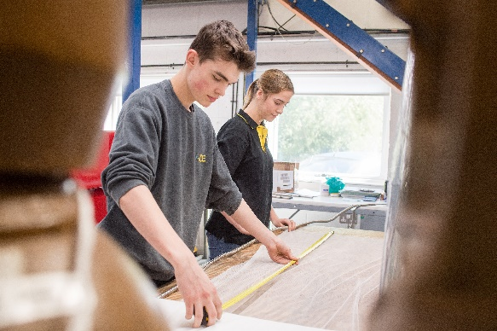
5
Planning your future: Alternative options
T levels are an option you may not have considered when it comes to planning your future. They combine classroom learning with industry experience specifically designed for a certain sector or employer.
Definition: T Levels:
A 2-year qualification as an alternative to A levels, apprenticeships or other post-16 courses.
You spend 80% of your time in the classroom and 20% on a 45-day placement with an employer. This specific training will help you to find a role in your chosen sector.
There are currently only a small number of T levels available, but this will continue to grow with more and more added each year. From Sept 2021, the initial courses in Oxfordshire are Digital IT and Healthcare.
Pair activity (2-3 mins)
Talk to a partner about your future plans. Are you thinking about further education, or would you prefer a practical way to learn the skills you need? What opportunities are there in Oxfordshire?
©VotesforSchools The WOW Show 2021
Notes:
References:
https://www.tlevels.gov.uk/students
https://www.gov.uk/government/publications/introduction-of-t-levels/introduction-of-t-levels
https://www.gov.uk/government/publications/providers-selected-to-deliver-t-levels - List of T level providers.

Slide 12
6
Preparing for interviews
Interviews form an important part of any application process, no matter what your chosen sector or career. So how much do you know about the do’s and don’ts?
Pair discussion (3-5 mins)
Spend 2 minutes discussing with a partner what your Top 3 Tips for interview success would be, based on your experience and knowledge. Then click to see if any of your suggestions are listed!
Challenge:
Choose one of these pieces of advice. How can you work on this for yourself?
1
Be prepared: Knowing your stuff and being ready for anything is vital for a successful interview.
2
Look after yourself: Before your interview, try to keep hydrated, eat well and stay calm.
3
First impressions count: Make yours a good one by dressing smartly.
4
Listen carefully: ask them to clarify if you don't understand the question.
5
Concentrate: Talk slowly and clearly, and stop to think about your answers.
6
Be honest: Answer questions truthfully and don’t be afraid to ask questions of your own.
©VotesforSchools The WOW Show 2021

Slide 13
Finding help & information
Oxfordshire's new careers’ platform, Find Your Future is the next step for you to find out more and plan your future here in Oxfordshire.
Navigate your way around the platform by clicking on Find Your Future.
There is a guide on Find Your Future for students and parents to explore Your Fabulous Future in Oxfordshire. Take time to get excited and make plans!
©VotesforSchools The WOW Show
Notes:
References:
https://www.oxfordshirelep.com/findyourfuture
https://www.oxfordshirelep.com/sites/default/files/uploads/FindYourFutureParentsGuide.pdf
Images:
1) https://www.oxfordshirelep.com/findyourfuture

Slide 14
Get to know the employers!
Want to find out more?
Click on the logos to visit the websites of each employer featured below!
The University of Oxford has a huge variety of roles, don’t just think teaching! They also have a great apprenticeship scheme.
Diamond Light Source is one of the most advanced scientific facilities in the world, and its pioneering capabilities are helping to keep the UK at the forefront of scientific research!
The Culham Centre for Fusion Energy is the UK’s national nuclear fusion laboratory. They are researching generating low-carbon electricity.
Unipart Group brings together manufacturing, logistics and consultancy to create imaginative solutions for customers.
Morgan Sindall has a graduate programme, traineeships and apprenticeships so there are many routes into all areas of modern construction.
©VotesforSchools The WOW Show
Notes:
References:
https://www.ox.ac.uk/
https://www.apprenticeships.ox.ac.uk/
https://www.diamond.ac.uk/Careers/Apprenticeships.html
https://www.diamond.ac.uk/Home/About.html
https://www.gov.uk/government/organisations/uk-atomic-energy-authority
https://ccfe.ukaea.uk/careers/early-careers/
https://www.unipart.com/
https://www.morgansindallconstruction.com/
https://www.morgansindallconstruction.com/careers/

Slide 15
Get to know the employers!
Want to find out more?
Click on the logos to visit the websites of each employer featured below!
Harwell is one of the leading science and innovation campuses in Europe with over 200 organisations on the 900 hectare site (that’s pretty huge…).
Oxford NHS Hospitals provide physical and mental health services and social care. They have over 6,000 employees!
Rebellion is known for producing books, comics, TV and film, but at its core it is a leading developer and publisher of games, such as Sniper Elite 4.
Oxbotica is one of the world’s leading autonomous driving software companies. They build software for use in the real world, using ideas from the areas of physics, robotics, maths and artificial intelligence.
Williams Racing employs around 600 people in the heart of the UK’s “Motorsport Valley” in rural Oxfordshire.
©VotesforSchools The WOW Show
Notes:
References
https://www.harwellcampus.com/media-centre/harwell-campus-information-pack/
https://www.oxfordhealth.nhs.uk/
https://rebellion.com/about-us/
https://www.oxbotica.com/
https://www.williamsf1.com/

Slide 16
Get to know the employers!
Want to find out more?
Click on the logos to visit the websites of each employer featured below!
Greencore Construction helps people build modern, dream homes with low impact on the environment.
Blenheim Palace is a big source of tourism in Oxfordshire, and it also hosts sporting events, banquets and weddings.
Oxford University Press create high quality academic and education resources. You may even have some of their textbooks!
Over 8,000 people work for Thames Valley Police with many varied roles and volunteering opportunities available.
BMW Mini run apprenticeships and internships, as well as taking graduates. They have a programme called “Girls Go Technical” to encourage young women to join.
©VotesforSchools The WOW Show
Notes:
References
https://www.greencoreconstruction.co.uk/
https://www.blenheimpalace.com/
https://global.oup.com/?cc=gb
https://tvpcareers.co.uk/
https://www.mini.co.uk/en_GB/home/why-mini/mini-uk-production.html

