Slide 1
Y7 LMI Lesson: Your Fabulous Future in Oxfordshire
In association with VotesforSchools and The WOW Show
©VotesforSchools The WOW Show

Slide 2
Learning objectives for today
To be aware of what job and labour market information (LMI) is and what it can do for you.
To recognise the qualities and skills needed for employability and provide evidence for those you have demonstrated both in and out of school.
Keywords
LMI: Labour Market Information (LMI): Information about the jobs and careers available in a geographical area.
Sector: The areas into which the economic activity of a country is divided.
Employability: Having the skills and abilities needed to have a job or career.
©VotesforSchools The WOW Show
Notes:
References
https://dictionary.cambridge.org/dictionary/english/sector
https://dictionary.cambridge.org/dictionary/english/employability

Slide 3
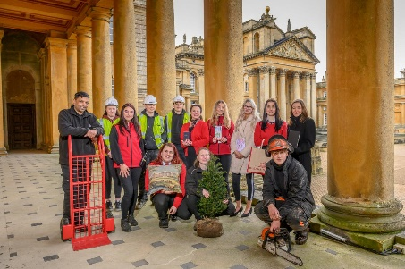
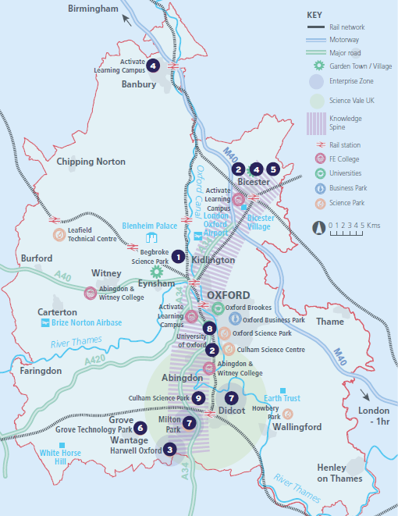
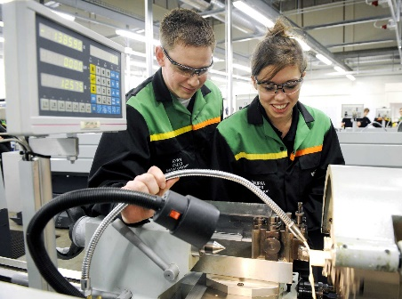
1
What is Labour Market Information (LMI)?
Definition: Labour Market Information (LMI)
Information about the jobs and careers available.
Class discussion (2 mins)
How do you think Labour Market Information could help you find a job?
Labour Market Information (LMI) is a useful tool to help research future jobs in the local area, understand the skills needed for certain roles and the demand for future employment.
If you are aware of what is available in your local area it can help you decide what you could do when you leave school.
©VotesforSchools The WOW Show
Notes:
Images
OxLEP
Pixabay
Icons8

Slide 4
2
What is the LMI in Oxfordshire?
Pair discussion (2-3 mins)
Talk to a partner about what opportunities you know about in your local area. Then, click to find out more about which sectors have roles on offer in Oxfordshire.
Definition: Sector
An area of work and production that makes money for an area or country.
Space & Satellite
Green Technology
Life Sciences
Construction
The NHS
Autonomous (self-driving) Vehicles
Education
Gaming
Film
Challenge:
Did you know there were career opportunities in these sectors in Oxfordshire?
©VotesforSchools The WOW Show
Notes:
References
https://dictionary.cambridge.org/dictionary/english/sector
Images
Icons8

Slide 5
2
What is the LMI in Oxfordshire?
Digital Technology
With almost everyone using technology, this sector is always growing
Wholesale & Retail
There are thousands of retail roles with large & small retailers
Financial & Professional Services
All businesses need financial advice & support and legal advice
The Public Sector
Oxfordshire County Council have 1,300 staff in a variety of roles
Hospitality, Leisure & Tourism
Oxfordshire has thousands of visitors from all over the world
Charity Sector
There are many sectors that have opportunities for experience
There are so many opportunities in Oxfordshire, so why not take inspiration from closer to home?
©VotesforSchools The WOW Show 2021
Notes:
References
https://dictionary.cambridge.org/dictionary/english/sector
Experience Oxfordshire promotional video: https://www.youtube.com/watch?v=fkUZuj2QIms
Images
Icons8

Slide 6
2
What is the LMI in Oxfordshire?
Individual/Pair activity (3-5 mins)
Now you’ve seen the range of active sectors in Oxfordshire, it’s time to see what this looks like in more detail. On your own or in a pair, choose the right answer to fill the gap in each statement – you can use the icons to help you. Then click to see if you’re right!
There are over ___ people employed in Oxfordshire.
A
350,000
B
150,000
C
50,000
You don’t need to work for a large company, there are hundreds of “___-companies” too.
A
Mega
B
Medium
C
Micro
Good ___ was the top skill asked for by employers.
A
Cooking
Communication
Manners
B
C
Future growth is expected in the areas of tourism, digital and ___.
A
Education
B
Food
C
Shops
There are opportunities in space, life sciences and ___ technologies.
A
Past
B
Present
C
Future
Over 2,000 ___ work within Oxfordshire.
A
Farmers
B
Vets
C
Nurses
©VotesforSchools The WOW Show
Notes:
References
https://www.oxfordshirelep.com/sites/default/files/uploads/OxLEPLMIReportAugust2020.pdf
Images
Icons8

Slide 7
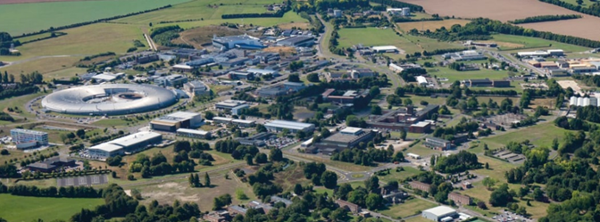
3
A fabulous future in Oxfordshire?
As you have seen, one of the fabulous opportunities in Oxfordshire is in the Life Sciences sector.
If you enjoy science, Harwell has hundreds of opportunities for innovation technologies in life sciences.
At Harwell, there are 6000 people across over 200 organisations! One of the organisations is AstraZeneca who you may have heard about because of their role in creating one of the COVID-19 vaccines. There are even plans to build affordable housing for employees on the Harwell site.
If you’ve ever driven near to it, you will have seen that it is the size of a small town!
©VotesforSchools The WOW Show
Notes:
References
https://www.harwellcampus.com/wp-content/uploads/Harwell-Life-Sciences-Brochure.pdf
https://www.astrazeneca.co.uk/
https://www.harwellcampus.com/vision/
Images:
OxLEP
Icons8

Slide 8
3
A fabulous future in Oxfordshire?
Time to find out more about the fabulous future waiting for you in Oxfordshire!
0:00-3:54
Pair activity (2-3 mins)
After you have watched The WOW Show film, work with a partner and think about the advantages and disadvantages of working in a company in Oxfordshire with several hundred people compared to say just 10 or 20 - or working for yourself. Which do you feel would be of most interest to you?
Do you know that right here on our doorstep we have a fantastic mix of employers who represent some of the most important and exciting areas of employment for this country in the future. In this film we can take a look at some of them.
In the employment areas we have just seen, Oxfordshire has a huge variety of employers of different sizes from very large companies to lots of small and medium enterprises.
©VotesforSchools The WOW Show
Notes:
You Tube Video Link: https://www.youtube.com/channel/UCXDSgY0E_aACHXcSqX14YNg
Safe Share Video Link: https://safeshare.tv/x/ss641b2616a375c
References
https://www.harwellcampus.com/wp-content/uploads/Harwell-Life-Sciences-Brochure.pdf
https://www.astrazeneca.co.uk/
https://www.harwellcampus.com/vision/
Images:
OxLEP
Icons8

Slide 9
4
What skills do you need?
Pair activity (4-5 mins)
To make your first steps into a career in Oxfordshire in one of the sectors looked at today (or any others), you need a range of different skills.
Can you come up with a list of the skills you think are needed to be employable?
Click if you need a few image clues!
Leadership
Problem-solving
Speaking & listening
Teamwork
Aiming high
Good timekeeping
Positivity
Good communication
Pair reflection (1-2 mins)
How many did you come up with?
Remember, the world of work isn’t all about qualifications and the grades you get: “essential skills” like the ones you have just looked at are really important too.
Definition: Essential skills
People's abilities to communicate with each other and work well together.
Definition: Skills shortage
When there are not enough people available with the skills needed to do the jobs, which need to be done.
©VotesforSchools The WOW Show
Notes:
References
https://www.prospects.ac.uk/careers-advice/getting-a-job/skills-shortages-and-covid-19
https://www.oxfordshirelep.com/sites/default/files/uploads/OxLEP%20Skills%20Strategy.pdf
https://dictionary.cambridge.org/dictionary/english/soft-skills
Images
1) Icons8

Slide 10
4
What skills do you need?
Oxfordshire have also identified the following skills required for employers in the area.
Did you come up with any of these in the last activity?
Self-motivation
Communication
Customer Service
Self-motivation means that you can motivate yourself to work hard and succeed at all you do.
Communication is key, whether you are working in a small team or a huge organisation.
Good customer service is important for a successful business – customers will keep coming back!
Planning Skills
Innovation
Enthusiasm
Planning skills help create successful interactions and allow projects to happen as they should.
Innovation is key to planning for the future, and the world always needs new ideas.
Enthusiasm is infectious and having a positive working environment is really important.
Definition: Skills’ gap
The difference between the skills required for a job and the skills employees have.
©VotesforSchools The WOW Show
Notes:
Images
Icons8

Slide 11
5
How employable are you?
0:00-1:38
Pair discussion (2-3 mins)
Before you watch the video, discuss which of the skills you’ve looked at today you think you have. Do you think this makes you a good candidate for a job in Oxfordshire?
In addition to having the qualifications needed for a job, you also need to be employable. This means having some (or all) of the skills we have looked at today! There are lots of ways that you can build these skills, such as at youth clubs, through volunteering, or by helping out in your local community!
Pair activity (2-5 mins)
Come up with a list of positive things you can do locally to improve your employability skills.
Need some advice?
Click the logo to visit the Oxfordshire Youth website, who have lots of helpful information.
©VotesforSchools The WOW Show
https://safeshare.tv/x/ss602199d2bb0de
Notes:
Alternative Video Link – Employability Skills: https://www.youtube.com/watch?v=tKKPUYfOkvw
References
https://www.youtube.com/watch?v=tKKPUYfOkvw – The WOW Show – Employability skills.
https://safeshare.tv/x/ss602199d2bb0de - Safeshare link to the clip on Youtube.
https://oxfordshireyouth.org/get-involved/
Images
Icons8
https://www.youtube.com/watch?v=tKKPUYfOkvw
https://oxfordshireyouth.org/

Slide 12
Finding help & information
Oxfordshire's new careers’ platform, Find Your Future is the next step for you to find out more and plan your future here in Oxfordshire.
Navigate your way around the platform by clicking on Find Your Future.
There is a guide on Find Your Future for students and parents to explore Your Fabulous Future in Oxfordshire. Take time to get excited and make plans!
©VotesforSchools The WOW Show
Notes:
References:
https://www.oxfordshirelep.com/findyourfuture
https://www.oxfordshirelep.com/sites/default/files/uploads/FindYourFutureParentsGuide.pdf
Images:
1) https://www.oxfordshirelep.com/findyourfuture

Slide 13
Get to know the employers!
Want to find out more?
Click on the logos to visit the websites of each employer featured below!
The University of Oxford has a huge variety of roles, don’t just think teaching! They also have a great apprenticeship scheme.
Diamond Light Source is one of the most advanced scientific facilities in the world, and its pioneering capabilities are helping to keep the UK at the forefront of scientific research!
The Culham Centre for Fusion Energy is the UK’s national nuclear fusion laboratory. They are researching generating low-carbon electricity.
Unipart Group brings together manufacturing, logistics and consultancy to create imaginative solutions for customers.
Morgan Sindall has a graduate programme, traineeships and apprenticeships so there are many routes into all areas of modern construction.
©VotesforSchools The WOW Show
Notes:
References:
https://www.ox.ac.uk/
https://www.apprenticeships.ox.ac.uk/
https://www.diamond.ac.uk/Careers/Apprenticeships.html
https://www.diamond.ac.uk/Home/About.html
https://www.gov.uk/government/organisations/uk-atomic-energy-authority
https://ccfe.ukaea.uk/careers/early-careers/
https://www.unipart.com/
https://www.morgansindallconstruction.com/
https://www.morgansindallconstruction.com/careers/

Slide 14
Get to know the employers!
Want to find out more?
Click on the logos to visit the websites of each employer featured below!
Harwell is one of the leading science and innovation campuses in Europe with over 200 organisations on the 900 hectare site (that’s pretty huge…).
Oxford NHS Hospitals provide physical and mental health services and social care. They have over 6,000 employees!
Rebellion is known for producing books, comics, TV and film, but at its core it is a leading developer and publisher of games, such as Sniper Elite 4.
Oxbotica is one of the world’s leading autonomous driving software companies. They build software for use in the real world, using ideas from the areas of physics, robotics, maths and artificial intelligence.
Williams Racing employs around 600 people in the heart of the UK’s “Motorsport Valley” in rural Oxfordshire.
©VotesforSchools The WOW Show
Notes:
References
https://www.harwellcampus.com/media-centre/harwell-campus-information-pack/
https://www.oxfordhealth.nhs.uk/
https://rebellion.com/about-us/
https://www.oxbotica.com/
https://www.williamsf1.com/

Slide 15
Get to know the employers!
Want to find out more?
Click on the logos to visit the websites of each employer featured below!
Greencore Construction helps people build modern, dream homes with low impact on the environment.
Blenheim Palace is a big source of tourism in Oxfordshire, and it also hosts sporting events, banquets and weddings.
Oxford University Press create high quality academic and education resources. You may even have some of their textbooks!
Over 8,000 people work for Thames Valley Police with many varied roles and volunteering opportunities available.
BMW Mini run apprenticeships and internships, as well as taking graduates. They have a programme called “Girls Go Technical” to encourage young women to join.
©VotesforSchools The WOW Show
Notes:
References
https://www.greencoreconstruction.co.uk/
https://www.blenheimpalace.com/
https://global.oup.com/?cc=gb
https://tvpcareers.co.uk/
https://www.mini.co.uk/en_GB/home/why-mini/mini-uk-production.html

