Slide 1
Y8 LMI Lesson: Your Fabulous Future in Oxfordshire
In association with VotesforSchools and The WOW Show
©VotesforSchools The WOW Show

Slide 2
Learning objectives for today
To be aware of what job and labour market information (LMI) is and what it can do for you.
To identify how to stand up to stereotyping and discrimination that is damaging to you and those around you.
To identify different kinds of work and why people’s satisfaction with their working lives varies.
Keywords
Labour Market Information (LMI): Information about the jobs and careers available in a geographical area.
Stereotyping: A set idea that people have about what someone or something is like, especially an idea that is wrong.
Discrimination: Treating a person or particular group of people differently, especially in a worse way from the way in which you treat other people, because of their skin colour, sex, sexuality, etc.
©VotesforSchools The WOW Show
Notes:
References:
https://dictionary.cambridge.org/dictionary/english/stereotyping
https://dictionary.cambridge.org/dictionary/english/discrimination

Slide 3
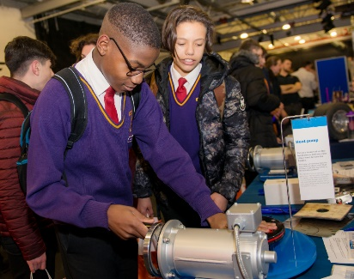
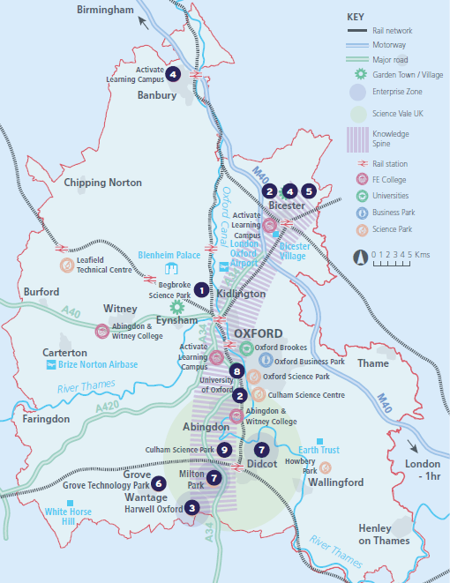
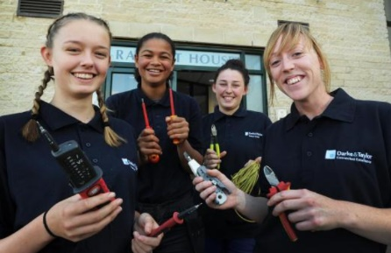
1
What is Labour Market Information (LMI)?
Definition: Labour Market Information (LMI)
Information about the jobs and careers available.
Class discussion (2 mins)
How do you think Labour Market Information could help you find a job?
Labour Market Information (LMI) is a useful tool to help research future jobs in the local area, understand the skills needed for certain roles and the demand for future employment.
If you are aware of what is available in your local area it can help you decide what you could do when you leave school.
©VotesforSchools The WOW Show
Notes:
Images
OxLEP
Pixabay
Icons8

Slide 4
2
What is the LMI in Oxfordshire?
Pair discussion (2-3 mins)
Talk to a partner about what opportunities you know about in your local area. Then, click to find out more about which sectors have roles on offer in Oxfordshire.
Definition: Sector
An area of work and production that makes money for an area or country.
Space & Satellite
Green Technology
Life Sciences
Construction
The NHS
Autonomous (self-driving) Vehicles
Education
Gaming
Film
Challenge:
Did you know there were career opportunities in these sectors in Oxfordshire?
©VotesforSchools The WOW Show
Notes:
References
https://dictionary.cambridge.org/dictionary/english/sector
Images
Icons8

Slide 5
2
What is the LMI in Oxfordshire?
Digital Technology
With almost everyone using technology, this sector is always growing
Wholesale & Retail
There are thousands of retail roles with large & small retailers
Financial & Professional Services
All businesses need financial advice & support and legal advice
The Public Sector
Oxfordshire County Council have 1,300 staff in a variety of roles
Hospitality, Leisure & Tourism
Oxfordshire has thousands of visitors from all over the world
Charity Sector
There are many sectors that have opportunities for experience
There are so many opportunities in Oxfordshire, so why not take inspiration from closer to home?
©VotesforSchools The WOW Show 2021
Notes:
References
https://dictionary.cambridge.org/dictionary/english/sector
Experience Oxfordshire promotional video: https://www.youtube.com/watch?v=fkUZuj2QIms
Images
Icons8

Slide 6
2
What is the LMI in Oxfordshire?
Individual or pair activity (3-5 mins)
Now you’ve seen the range of active sectors in Oxfordshire, it’s time to see what this looks like in more detail. On your own or in a pair, choose the right answer to fill the gap in each statement – you can use the icons to help you. Then click to see if you’re right!
There are over ___ people employed in Oxfordshire.
A
350,000
B
150,000
C
50,000
You don’t need to work for a large company, there are hundreds of “___-companies” too.
A
Mega
B
Medium
C
Micro
Good ___ was the top skill asked for by employers.
A
Cooking
B
Communication
C
Manners
Future growth is expected in the areas of tourism, digital and ___.
A
Education
B
Food
C
Shops
There are opportunities in space, life sciences and ___ technologies.
A
Past
B
Present
C
Future
Over 2,000 ___ work within Oxfordshire.
A
Farmers
B
Vets
C
Nurses
©VotesforSchools The WOW Show
Notes:
References
https://www.oxfordshirelep.com/sites/default/files/uploads/OxLEPLMIReportAugust2020.pdf
Images
Icons8

Slide 7
3
The UK Space Sector
The space sector is one of the fastest growing sectors of the UK economy
You could be working on a new satellite or developing technology to map a distant planet.
You could be helping to make new discoveries about our solar system or using satellites to study pollution on Earth.
You might be connecting the world’s most remote communities or helping aid agencies reach a disaster zone.
30,000 new jobs will be created in the sector by 2030.
The UK is also a leader in the application of space derived data, and Oxfordshire has become a very attractive place to start a new business.
All Encompassing - Space technology affects almost every part of our lives from weather forecasting and satellite TV, to global communications and navigation.
A career in the space industry could include any of these areas and much more.
The UK is a world leader in space technology and science, and UK teams are involved in dozens of missions from spacecraft orbiting other planets to the many satellites monitoring the Earth.
©VotesforSchools The WOW Show
Notes:
The UK Space Sector
Fast Growing
The space sector is one of the fastest growing sectors of the UK economy. In the last four years it’s grown at a rate of 6.6% compared to 1.7% for the rest of the economy. 30,000 new jobs will be created in the sector by 2030.
World Leading
The UK is a world leader in space technology and science, and UK teams are involved in dozens of missions from spacecraft orbiting other planets to the many satellites monitoring the Earth. The UK is also a leader in the application of space derived data, and has become a very attractive place to incubate or start a new business.
All Encompassing
Space technology affects almost every part of our lives from weather forecasting and satellite TV, to global communications and navigation. A career in the space industry could include any of these areas and much more.
You might be working on a new satellite or developing technology to map a distant planet. You could be helping to make new discoveries about our solar system or using satellites to study pollution on Earth. You might be connecting the world’s most remote communities or helping aid agencies reach a disaster zone.
Images:
1) Icons8

Slide 8
3
A fabulous future in Oxfordshire?
0:00-2:26
Pair activity (3-5 mins)
How has technology changed in your lifetime?
What do you think will be the key developments in technology in the future?
Could Oxfordshire lead the way in these developments?
Space technologies are now part of our everyday life. Not only this, but innovation in this field is considered key to the future of communication.
Open Cosmos uses space to help tackle Earth’s biggest challenges! They create technology to collect information from space. This includes software and ready-to-launch small satellite platforms.
Open Cosmos employs over 40 people of over 10 nationalities.
Definition: Satellite:
A device in space that can send and receive information, such as TV, radio, etc.
©VotesforSchools The WOW Show
https://safeshare.tv/x/y4yNbwdZKeg
Notes:
YouTube Video Link: https://www.youtube.com/watch?v=y4yNbwdZKeg&feature=emb_logo
References:
https://www.open-cosmos.com/
https://www.oxfordlearnersdictionaries.com/definition/english/satellite
Images:
1) Icons8

Slide 9
3
A fabulous future in Oxfordshire?
Time to find out more about the fabulous future waiting for you in Oxfordshire!
0:00-3:54
Pair activity (2-3 mins)
After you have watched The WOW Show film, work with a partner and think about the advantages and disadvantages of working in a company in Oxfordshire with several hundred people compared to say just 10 or 20 - or working for yourself. Which do you feel would be of most interest to you?
Do you know that right here on our doorstep we have a fantastic mix of employers who represent some of the most important and exciting areas of employment for this country in the future. In this film we can take a look at some of them.
In the employment areas we have just seen, Oxfordshire has a huge variety of employers of different sizes from very large companies to lots of small and medium enterprises.
©VotesforSchools The WOW Show
Notes:
You Tube Video Link: https://www.youtube.com/channel/UCXDSgY0E_aACHXcSqX14YNg
Safe Share Video Link: https://safeshare.tv/x/ss641b2616a375c
References
https://www.harwellcampus.com/wp-content/uploads/Harwell-Life-Sciences-Brochure.pdf
https://www.astrazeneca.co.uk/
https://www.harwellcampus.com/vision/
Images:
OxLEP
Icons8

Slide 10
4
What is a stereotype?
Pair activity (3-5 mins)
Click to see some phrases. In your pairs, choose two. Your task is to write what you think these phrases really mean and how they contribute to gender stereotypes.
Definition: Stereotype:
A set idea that people have about what someone or something is like, especially an idea that is wrong.
Stereotyping is a type of prejudice as it is a view often based on the appearance of a person.
“You throw like a girl!”
“Give us a smile!”
“Boys don’t cry.”
“You need to man up…”
“You’re just attention-seeking.”
“You’ll get over it.”
Challenge:
Would you think twice about using any of these phrases again?
©VotesforSchools The WOW Show
Notes:
References:
https://dictionary.cambridge.org/dictionary/english/stereotyping

Slide 11
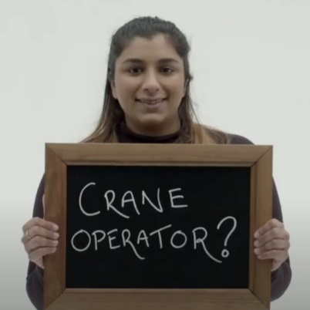
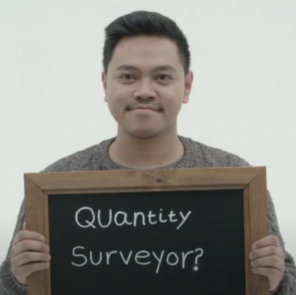
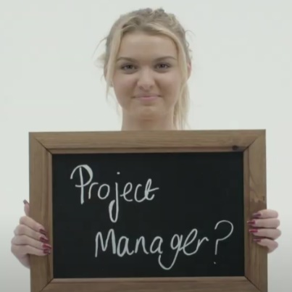
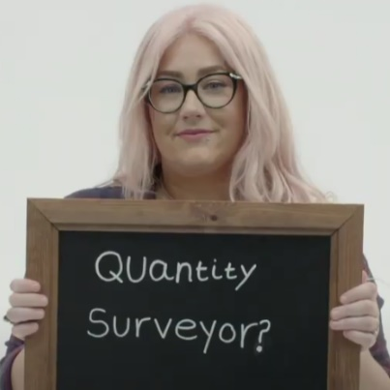
4
What is a stereotype?
In the last activity, you might have had an image in mind of the kind of people who are likely to work in this sector. Now let’s take that idea a bit further…
Class discussion (4-5 mins)
Click the image to watch a short film. When you’ve finished, discuss the following question: are there any roles that you think can only be carried out by either just a man or just a woman? Why?
0:00-3:00
We can sometimes assume that certain sectors and roles require a particular type of person. However, the opposite is true! Most careers are open to everyone when they receive the right training.
Individual reflection (1-2 mins)
What is it about certain roles that make us think that only one type of person can do them?
©VotesforSchools The WOW Show
https://safeshare.tv/x/9xCn-Kwy97U
Notes:
YouTube Video Link: https://www.youtube.com/watch?v=9xCn-Kwy97U&feature=emb_logo
SafeShare Video Link: https://safeshare.tv/x/9xCn-Kwy97U
The WOW Show Link: https://www.thewowshow.org/mythbusters/
Images:
1) Via video

Slide 12
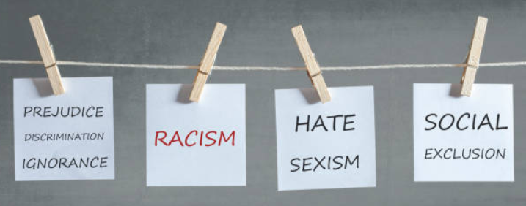
5
What is discrimination?
Stereotyping can lead to discrimination without realising it, so it is important to always treat people equally.
Pair discussion (2-3 mins)
Talk to a partner about the following question: have you ever felt discriminated against? When? What did you do?
Equality means making sure individuals or groups are not treated differently based on a specific “protected characteristic”. These characteristics include race, gender, disability, religion or belief, sex, sexual orientation and age.
Definition: Discrimination
Treating a person or group of people differently, especially in a worse way from the way in which you treat other people.
Diversity aims to recognise, respect and value people’s differences. This then means they are able to reach their full potential and contribute to society because they have been encouraged through an inclusive culture.
©VotesforSchools The WOW Show
Notes:
References:
https://dictionary.cambridge.org/dictionary/english/discrimination
https://www.oxfordshirelep.com/sites/default/files/uploads/Equality%20and%20Diversity%20Statement%20v2%20230519.pdf
Images:
Icons8
iStock

Slide 13
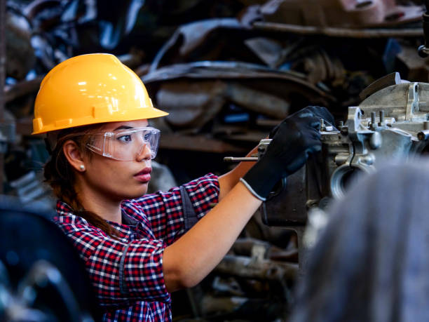
5
What is discrimination?
As you have seen today, discrimination can affect what we choose to do as a future career. This can then lead to industries or companies missing out on having a more diverse workforce (the group of people working for them).
Final reflection (1-2 mins)
How has what you have explored today opened your eyes to your own career possibilities? How will you use what you have learned today to make sure you find your future in Oxfordshire?
Challenge:
The next three slides contain more information on different Oxfordshire employers and the career opportunities they have on offer – why not check them out and see if they offer a job that appeals to you?
©VotesforSchools The WOW Show
Notes:
References:
https://dictionary.cambridge.org/dictionary/english/discrimination
https://www.oxfordshirelep.com/sites/default/files/uploads/Equality%20and%20Diversity%20Statement%20v2%20230519.pdf
Images:
Icons8
iStock

Slide 14
Finding help & information
Oxfordshire's new careers’ platform, Find Your Future is the next step for you to find out more and plan your future here in Oxfordshire.
Navigate your way around the platform by clicking on Find Your Future.
There is a guide on Find Your Future for students and parents to explore Your Fabulous Future in Oxfordshire. Take time to get excited and make plans!
©VotesforSchools The WOW Show
Notes:
References:
https://www.oxfordshirelep.com/findyourfuture
https://www.oxfordshirelep.com/sites/default/files/uploads/FindYourFutureParentsGuide.pdf
Images:
1) https://www.oxfordshirelep.com/findyourfuture

Slide 15
Get to know the employers!
Want to find out more?
Click on the logos to visit the websites of each employer featured below!
The University of Oxford has a huge variety of roles, don’t just think teaching! They also have a great apprenticeship scheme.
Diamond Light Source is one of the most advanced scientific facilities in the world, and its pioneering capabilities are helping to keep the UK at the forefront of scientific research!
The Culham Centre for Fusion Energy is the UK’s national nuclear fusion laboratory. They are researching generating low-carbon electricity.
Unipart Group brings together manufacturing, logistics and consultancy to create imaginative solutions for customers.
Morgan Sindall has a graduate programme, traineeships and apprenticeships so there are many routes into all areas of modern construction.
©VotesforSchools The WOW Show
Notes:
References:
https://www.ox.ac.uk/
https://www.apprenticeships.ox.ac.uk/
https://www.diamond.ac.uk/Careers/Apprenticeships.html
https://www.diamond.ac.uk/Home/About.html
https://www.gov.uk/government/organisations/uk-atomic-energy-authority
https://ccfe.ukaea.uk/careers/early-careers/
https://www.unipart.com/
https://www.morgansindallconstruction.com/
https://www.morgansindallconstruction.com/careers/

Slide 16
Get to know the employers!
Want to find out more?
Click on the logos to visit the websites of each employer featured below!
Harwell is one of the leading science and innovation campuses in Europe with over 200 organisations on the 900 hectare site (that’s pretty huge…).
Oxford HNS Hospitals provide physical and mental health services and social care. They have over 6,000 employees!
Rebellion is known for producing books, comics, TV and film, but at its core it is a leading developer and publisher of games, such as Sniper Elite 4.
Oxbotica is one of the world’s leading autonomous driving software companies. They build software for use in the real world, using ideas from the areas of physics, robotics, maths and artificial intelligence.
Williams Racing employs around 600 people in the heart of the UK’s “Motorsport Valley” in rural Oxfordshire.
©VotesforSchools The WOW Show
Notes:
References
https://www.harwellcampus.com/media-centre/harwell-campus-information-pack/
https://www.oxfordhealth.nhs.uk/
https://rebellion.com/about-us/
https://www.oxbotica.com/
https://www.williamsf1.com/

Slide 17
Get to know the employers!
Want to find out more?
Click on the logos to visit the websites of each employer featured below!
Greencore Construction helps people build modern, dream homes with low impact on the environment.
Blenheim Palace is a big source of tourism in Oxfordshire, and it also hosts sporting events, banquets and weddings.
Oxford University Press create high quality academic and education resources. You may even have some of their textbooks!
Over 8,000 people work for Thames Valley Police with many varied roles and volunteering opportunities available.
BMW Mini run apprenticeships and internships, as well as taking graduates. They have a programme called “Girls Go Technical” to encourage young women to join.
©VotesforSchools The WOW Show
Notes:
References
https://www.greencoreconstruction.co.uk/
https://www.blenheimpalace.com/
https://global.oup.com/?cc=gb
https://tvpcareers.co.uk/
https://www.mini.co.uk/en_GB/home/why-mini/mini-uk-production.html

