Slide 1
Y9 LMI Lesson: Your Fabulous Future in Oxfordshire
In association with VotesforSchools and The WOW Show
©VotesforSchools The WOW Show

Slide 2
Learning objectives for today
To be aware of what job and labour market information (LMI) is and what it can do for you.
To show that you can be positive, flexible and well-prepared at transition points in your life.
To know how to negotiate and make plans and decisions carefully to help you get the qualifications, skills and experience you need.
Keywords
Labour Market Information (LMI): Information about the jobs and careers available in a geographical area.
Aspirations: Something that you hope to achieve.
©VotesforSchools The WOW Show
Notes:
References:
https://dictionary.cambridge.org/dictionary/english/aspirations
https://dictionary.cambridge.org/dictionary/english/

Slide 3
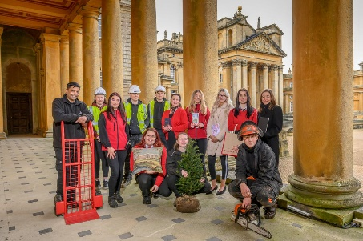
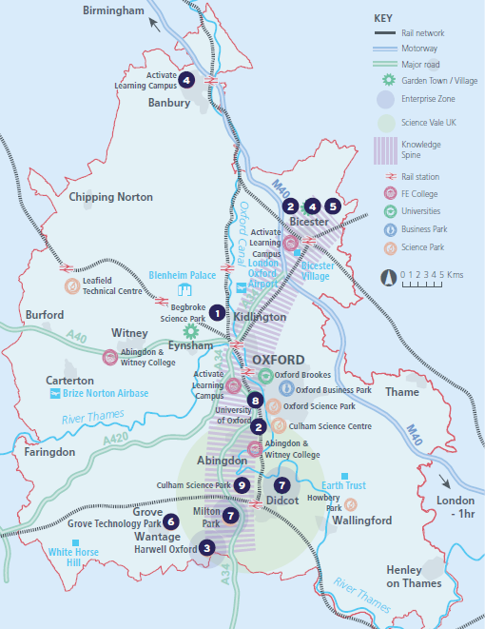
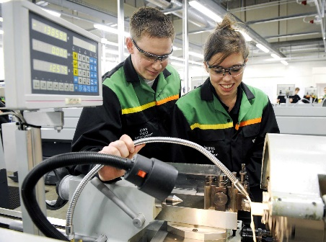
1
What is Labour Market Information (LMI)?
Definition: Labour Market Information (LMI)
Information about the jobs and careers available.
Class discussion (2 mins)
What do you know about Labour Market Information in your area? How can you find out more?
Labour Market Information (LMI) is a useful tool to help research future jobs in the local area, understand the skills needed for certain roles and the demand for future employment.
If you are aware of what is available in your local area it can help you decide what your choices could be when you complete your GCSEs.
©VotesforSchools The WOW Show
Notes:
References
1) OxLEP SKills
Images
OxLEP
Pixabay
Icons8

Slide 4
2
What is the LMI in Oxfordshire?
Pair discussion (2-3 mins)
Talk to a partner about what opportunities you know about in your local area. What do people you know do as their career? Then, click to find out more about which sectors have roles on offer in Oxfordshire.
Definition: Sector
An area of work and production that makes money for an area or country.
Space & Satellite
Oxfordshire has state-of-the art technology
Advanced Engineering
Oxfordshire has a zero carbon target for 2030
Life Sciences
Including vaccinations, cryogenics & more
Construction
Ongoing development of green technologies
Health & Social Care
A variety of different roles are available
Autonomous Vehicles
Constant development of cutting-edge tech
Education
The universities have over 14,000 staff
Creative Industries
Including film & game design and creation
Manufacturing & Logistics
A thriving distribution industry
Challenge:
Did you know there were career opportunities in these sectors in Oxfordshire?
©VotesforSchools The WOW Show 2021
Notes:
References
https://dictionary.cambridge.org/dictionary/english/sector
Cryogenics definition - cryogenics, which deals with extremely low temperatures, has no connection with cryonics, the belief that a person’s body or body parts can be frozen at death, stored in a cryogenic vessel, and later brought back to life. https://home.cern/science/engineering/cryogenics-low-temperatures-high-performance
Images
Icons8

Slide 5
2
What is the LMI in Oxfordshire?
Digital Technology
With almost everyone using technology, this sector is always growing
Wholesale & Retail
There are thousands of retail roles with large & small retailers
Financial & Professional Services
All businesses need financial advice & support and legal advice
The Public Sector
Oxfordshire County Council have 1,300 staff in a variety of roles
Hospitality, Leisure & Tourism
Oxfordshire has thousands of visitors from all over the world
Charity Sector
There are many sectors that have opportunities for experience
There are so many opportunities in Oxfordshire, so why not take inspiration from closer to home?
©VotesforSchools The WOW Show 2021
Notes:
References
https://dictionary.cambridge.org/dictionary/english/sector
Experience Oxfordshire promotional video: https://www.youtube.com/watch?v=fkUZuj2QIms
Images
Icons8

Slide 6
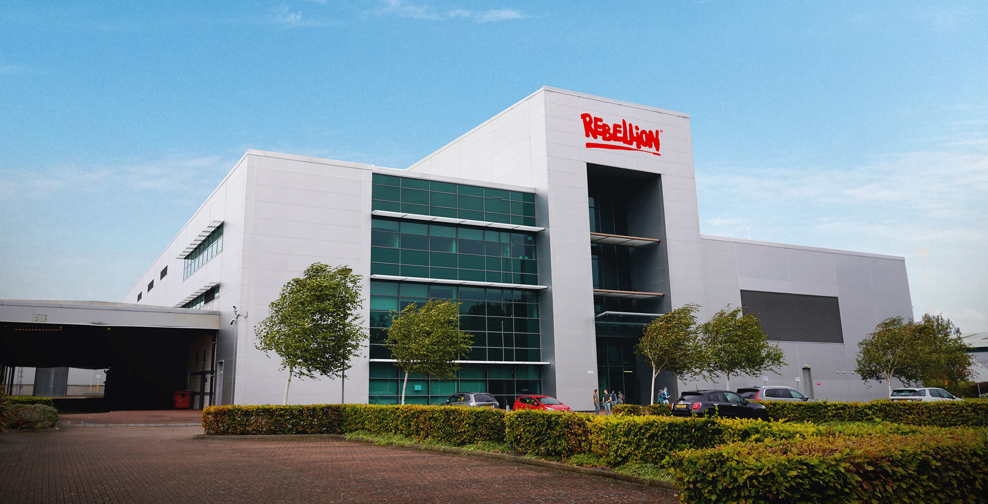
3
A fabulous future in Oxfordshire?
Now we’re going to take a closer look at one of the local employers and the career opportunities they have on offer.
Rebellion is known worldwide for its computer games, comics and films. There are many different roles available with them, including programming, art and animation.
Pair discussion (2-5 mins)
Watch the video about Rebellion and then talk about the following questions:
Which skills did you see in the video?
Were any of these what you expected someone might need for a job as an animator?
Which other careers could the skills on display here be useful for?
Do you have any of these skills?
0:00-1:00
Rebellion are always looking for talented and creative people who have a passion for making great games and want to be at the forefront of developing gaming technology.
Definition: Animator
A person who creates pictures, cartoons, films and moving images.
©VotesforSchools The WOW Show
https://safeshare.tv/x/yFrJfr8nSck
Notes:
YouTube Video Link: https://www.youtube.com/watch?v=yFrJfr8nSck (2:00 – 3:00 only)
SafeShare Video Link: https://safeshare.tv/x/yFrJfr8nSck
References:
https://careers.rebellion.com/#/
https://dictionary.cambridge.org/dictionary/english/animator
Images:
Icons8
Via video

Slide 7
3
A fabulous future in Oxfordshire?
Time to find out more about the fabulous future waiting for you in Oxfordshire!
0:00-3:54
Pair activity (2-3 mins)
After you have watched The WOW Show film, work with a partner and think about the advantages and disadvantages of working in a company in Oxfordshire with several hundred people compared to say just 10 or 20 - or working for yourself. Which do you feel would be of most interest to you?
Do you know that right here on our doorstep we have a fantastic mix of employers who represent some of the most important and exciting areas of employment for this country in the future. In this film we can take a look at some of them.
In the employment areas we have just seen, Oxfordshire has a huge variety of employers of different sizes from very large companies to lots of small and medium enterprises.
©VotesforSchools The WOW Show
https://safeshare.tv/x/528251568
Notes:
You Tube Video Link: https://www.youtube.com/channel/UCXDSgY0E_aACHXcSqX14YNg
Safe Share Video Link: https://safeshare.tv/x/ss641b2616a375c
References
https://www.harwellcampus.com/wp-content/uploads/Harwell-Life-Sciences-Brochure.pdf
https://www.astrazeneca.co.uk/
https://www.harwellcampus.com/vision/
Images:
OxLEP
Icons8

Slide 8
4
Are you ready for transition?
Before you can kickstart your career at somewhere like Rebellion, some transitions need to take place! This starts with your GCSEs…
Definition: Transition
The change from one part of your life to a new phase.
Pair discussion (3-5 mins)
Click to watch a video about choosing your GCSEs. Discuss with your partner: what can you do to make sure you feel confident about your choices?
0:00-2:42
During the move from KS3 to KS4, you may feel more ready to think about your future when you leave school.
It is important to choose the right GCSEs to make sure you are qualified to do your dream job!
But, if you are not sure what you want to do, try to choose a good balance to keep your options open.
Don’t forget, most of us work for about 40 years so it’s important you choose things that you enjoy! Match that to the huge variety of opportunities you have seen in Oxfordshire.
©VotesforSchools The WOW Show
https://safeshare.tv/x/d_ssJV_XfjQ
Notes:
YouTube Video Link: https://www.youtube.com/watch?v=d_ssJV_XfjQ&feature=emb_logo
SafeShare Video Link: https://safeshare.tv/x/d_ssJV_XfjQ
References:
1) https://www.prospects.ac.uk/careers-advice/getting-a-job/skills-shortages-and-covid-19
2) https://dictionary.cambridge.org/dictionary/english/transition
3) https://www.youtube.com/watch?v=d_ssJV_XfjQ&feature=emb_logo
Images
From video
Icons8

Slide 9
5
Choosing your GCSEs
Pair discussion (2 mins)
Have you thought about which GCSEs you would like to do? How will they help you achieve your future goals in Oxfordshire?
As you saw on the last slide, it’s important to think about these things when it comes to choosing your GCSEs:
What you want to do in the future
What subjects you are good at
Which subjects you enjoy
0:00-1:48
Although age 13 or 14 might feel quite early to be thinking about a career, choices you make now can really help in the future!
Watch (2 mins)
Click to find out more about exactly what GCSEs are and why they are important. Was there anything in the video you didn’t know about?
Challenge:
Talk to your teachers or school careers adviser about the subjects you'll need for different careers, or look them up on the National Careers Service website.
©VotesforSchools The WOW Show
https://safeshare.tv/x/_BisOOPk7xw
Notes:
YouTube Video Link: https://www.youtube.com/watch?v=_BisOOPk7xw
SafeShare Video Link: https://safeshare.tv/x/_BisOOPk7xw
References:
https://www.youtube.com/channel/UCPwftEor7g8nOg6cu-R0KXw (University of Exeter)
https://oxme.info/cms/learn/gcse-choices
http://oxme.info/cms/learn/careers-and-education-information-advice-and-guidance
https://nationalcareersservice.direct.gov.uk/job-profiles/home

Slide 10
6
Planning your future
Pair/Small group activity (2-4 mins)
Discuss: what are your main interests? What are you good at? Has the film given you any thoughts about your future career? Click for some ideas and question prompts to see what might be important to you!
Money
Hours
Shifts
Is there an amount of money you want to earn?
A normal full-time job is around 37 hours a week – would this suit you?
Is there a time of day you would like to work?
Colleagues
Values
Learning
Would you prefer to work alone or in a large team?
What values matter to you when it comes to who you work for?
Would you like to continue learning new skills?
©VotesforSchools The WOW Show
Notes:
Images:
iStock
Icons8

Slide 11
Finding help & information
Oxfordshire's new careers’ platform, Find Your Future is the next step for you to find out more and plan your future here in Oxfordshire.
Navigate your way around the platform by clicking on Find Your Future.
There is a guide on Find Your Future for students and parents to explore Your Fabulous Future in Oxfordshire. Take time to get excited and make plans!
©VotesforSchools The WOW Show
Notes:
References:
https://www.oxfordshirelep.com/findyourfuture
https://www.oxfordshirelep.com/sites/default/files/uploads/FindYourFutureParentsGuide.pdf
Images:
1) https://www.oxfordshirelep.com/findyourfuture

Slide 12
Get to know the employers!
Want to find out more?
Click on the logos to visit the websites of each employer featured below!
The University of Oxford has a huge variety of roles, don’t just think teaching! They also have a great apprenticeship scheme.
Diamond Light Source is one of the most advanced scientific facilities in the world, and its pioneering capabilities are helping to keep the UK at the forefront of scientific research!
The Culham Centre for Fusion Energy is the UK’s national nuclear fusion laboratory. They are researching generating low-carbon electricity.
Unipart Group brings together manufacturing, logistics and consultancy to create imaginative solutions for customers.
Morgan Sindall has a graduate programme, traineeships and apprenticeships so there are many routes into all areas of modern construction.
©VotesforSchools The WOW Show
Notes:
References:
https://www.ox.ac.uk/
https://www.apprenticeships.ox.ac.uk/
https://www.diamond.ac.uk/Careers/Apprenticeships.html
https://www.diamond.ac.uk/Home/About.html
https://www.gov.uk/government/organisations/uk-atomic-energy-authority
https://ccfe.ukaea.uk/careers/early-careers/
https://www.unipart.com/
https://www.morgansindallconstruction.com/
https://www.morgansindallconstruction.com/careers/

Slide 13
Get to know the employers!
Want to find out more?
Click on the logos to visit the websites of each employer featured below!
Harwell is one of the leading science and innovation campuses in Europe with over 200 organisations on the 900 hectare site (that’s pretty huge…).
Oxford NHS Hospitals provide physical and mental health services and social care. They have over 6,000 employees!
Rebellion is known for producing books, comics, TV and film, but at its core it is a leading developer and publisher of games, such as Sniper Elite 4.
Oxbotica is one of the world’s leading autonomous driving software companies. They build software for use in the real world, using ideas from the areas of physics, robotics, maths and artificial intelligence.
Williams Racing employs around 600 people in the heart of the UK’s “Motorsport Valley” in rural Oxfordshire.
©VotesforSchools The WOW Show
Notes:
References
https://www.harwellcampus.com/media-centre/harwell-campus-information-pack/
https://www.oxfordhealth.nhs.uk/
https://rebellion.com/about-us/
https://www.oxbotica.com/
https://www.williamsf1.com/

Slide 14
Get to know the employers!
Want to find out more?
Click on the logos to visit the websites of each employer featured below!
Greencore Construction helps people build modern, dream homes with low impact on the environment.
Blenheim Palace is a big source of tourism in Oxfordshire, and it also hosts sporting events, banquets and weddings.
Oxford University Press create high quality academic and education resources. You may even have some of their textbooks!
Over 8,000 people work for Thames Valley Police with many varied roles and volunteering opportunities available.
BMW Mini run apprenticeships and internships, as well as taking graduates. They have a programme called “Girls Go Technical” to encourage young women to join.
©VotesforSchools The WOW Show
Notes:
References
https://www.greencoreconstruction.co.uk/
https://www.blenheimpalace.com/
https://global.oup.com/?cc=gb
https://tvpcareers.co.uk/
https://www.mini.co.uk/en_GB/home/why-mini/mini-uk-production.html

