Slide 1
Finding Their Future
In association with VotesforSchools
©VotesforSchools 2022

Slide 2
Lesson Plan
Lesson Duration: 45 minutes
4 mins | A fabulous future in Oxfordshire | Whole class | Students watch the Oxfordshire WOW Show film to introduce the lesson
2-3 mins | 1. Opportunities in Oxfordshire | Whole class | Students are asked to think about their future here in Oxfordshire.
2-3 mins | 2. What’s in your area? | Individual/Pair | Students talk to a partner about opportunities in Oxfordshire for their future career.
5 mins | 3. Meet Prodrive | Pair | Students learn more about Prodrive and what happens there including a video introducing what they do and how they have developed engineering solutions for the future.
10 mins | 4. The science of racing | Whole class/ Individual | Students find out about the science of racing and the knowledge needed to create a race winning sports car.
20 mins | 5. Now it’s your turn! | Pair/ Individual | Students work in teams to design their own sports car including a team name, livery and design for a winning car.
N/A | Finding help and information | Whole class | Students have the opportunity to find out more about where they will find more information to help them build their future.
Possible extension work could involve making and testing different shapes of car to investigate the scientific principles covered in this lesson.
©VotesforSchools 2022

Slide 3
Using the resources
The following lesson has been prepared for minimum teacher preparation time. Each slide has information and a discussion or activity for learners.
Film clips are uploaded through SafeShare TV, meaning they can be played directly from the link on the slide without adverts or using YouTube. Timings are displayed in the box alongside the linked image.
Please view the lesson in “Slide Show” mode in PowerPoint. This is to ensure animations are displayed in the correct order, including any answers.
All links and references are in the ‘Notes section’ under the slide should you need any further information.
At the end of the lesson, there are further help and support links if you would like to go further in a particular area or wish to find out more about opportunities in Oxfordshire or with the employer featured.
This lesson is one in a series, created through the pairing of an Oxfordshire school with an Oxfordshire employer. If you would like to find out more contact the Oxfordshire Local Enterprise Partnership.
©VotesforSchools The WOW Show 2022
Notes:
References & Images

Slide 4
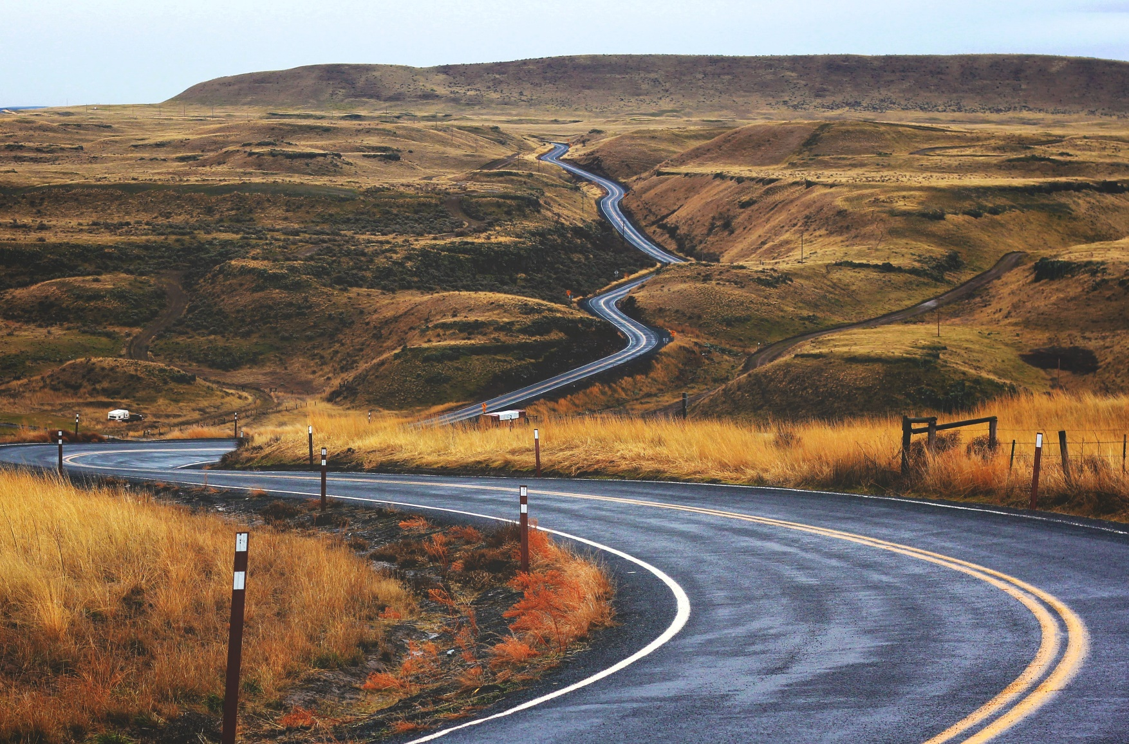
Finding help & information
Technician
Engineering
Composites
Advanced Technology
HR
Branding
Motorsport
Finance
Click on the words to link to the careers opportunities in each of the areas listed.
©VotesforSchools 2022
Notes:
Images
Unsplash
References
https://careers.prodrive.com/
https://careers.prodrive.com/vacancies?filter=technician
https://careers.prodrive.com/vacancies/filter/composites
https://careers.prodrive.com/vacancies/filter/prodrive-at
https://careers.prodrive.com/vacancies?filter=hr
https://careers.prodrive.com/vacancies/filter/motorsport
https://careers.prodrive.com/vacancies?filter=engineering
https://careers.prodrive.com/vacancies/filter/prodrive-at
https://careers.prodrive.com/vacancies/filter/brandand
https://careers.prodrive.com/vacancies?filter=finance

Slide 5
Finding help & information
Qualifications required?
Engineering Degree 3yrs / Masters 5yrs – option to take sandwich placement in industry
Mechanical / Motorsport / Electrical
Apprenticeships / HND / Foundation year
Make the most of your CV
Formula Student
Work Experience
Attitude
©VotesforSchools 2022

Slide 6
Finding help & information
Oxfordshire's new careers platform, Find Your Future, is the next step for you to find out more and plan your future here in Oxfordshire.
Navigate your way around the platform by clicking on Find Your Future.
There is a guide on Find Your Future for students and parents to explore Your Fabulous Future in Oxfordshire. Take time to get excited and make plans!
©VotesforSchools 2022
Notes:
Images
https://www.oxfordshirelep.com/findyourfuture
References
https://www.oxfordshirelep.com/findyourfuture
https://www.oxfordshirelep.com/sites/default/files/uploads/FindYourFutureParentsGuide.pdf

