Slide 1
Finding Their Future
In association with VotesforSchools
©VotesforSchools 2022

Slide 2
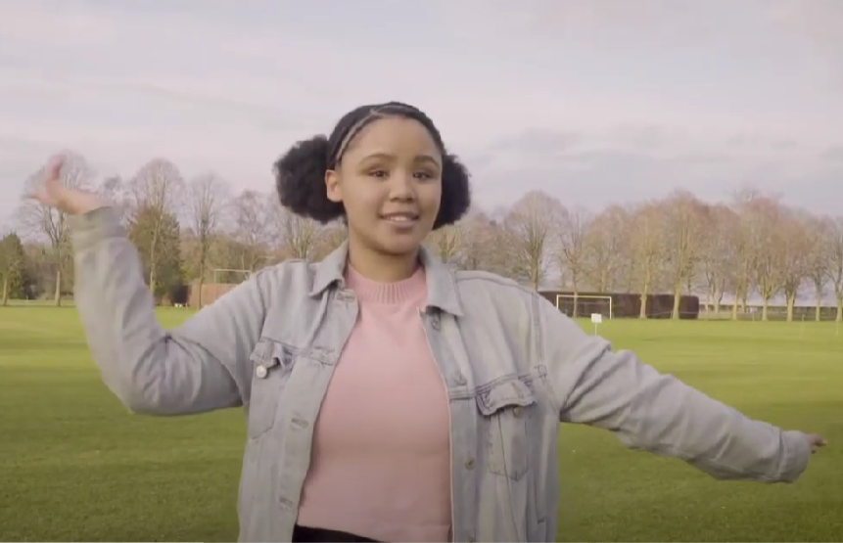
A fabulous future in Oxfordshire?
Time to find out more about the fabulous future waiting for you in Oxfordshire…
There are over 350,000 people working in Oxfordshire and over 50,000 people are self-employed.
0:00-3:54
Click the image to watch The WOW Show film.
©VotesforSchools 2022
https://safeshare.tv/x/528251568
Notes:
YouTube Video Link: https://www.youtube.com/channel/UCXDSgY0E_aACHXcSqX14YNg
SafeShare Video Link: https://safeshare.tv/x/sualeIxU3F4
Images
Via video

Slide 3
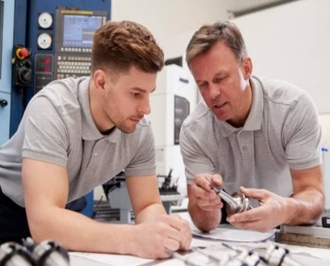
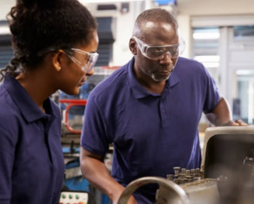
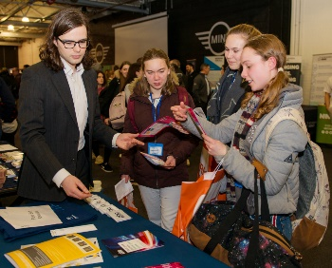
1
Opportunities in Oxfordshire
Have you thought about your future yet? What do you enjoy?
Whatever your interests, there is something for you!
There are lots of great opportunities in many different sectors across Oxfordshire. A great future awaits...
Whether you want an apprenticeship, T Levels, further education or to study for a degree, Oxfordshire has a pathway that would suit you.
©VotesforSchools 2022
Notes:
Images
iStock
OxLEP

Slide 4
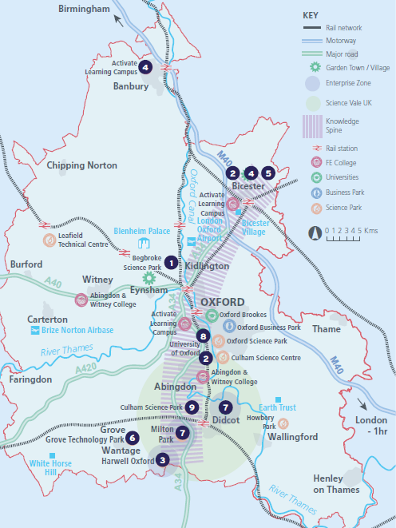
2
What’s in your area?
Pair discussion (2-3 mins)
Talk to a partner about what opportunities you know about in your local area. What do people you know do as their career?
There are opportunities in health, space, tourism, creative industries, construction and so much more.
No matter where you live in Oxfordshire, there is an amazing opportunity waiting for you.
During this presentation, you are going to find out about how science could help with your career going forward!
©VotesforSchools 2022
Notes:
Images
OxLEP
References
https://www.oxfordshirelep.com/sites/default/files/uploads/OxLEPLMIReportAugust2020.pdf

Slide 5
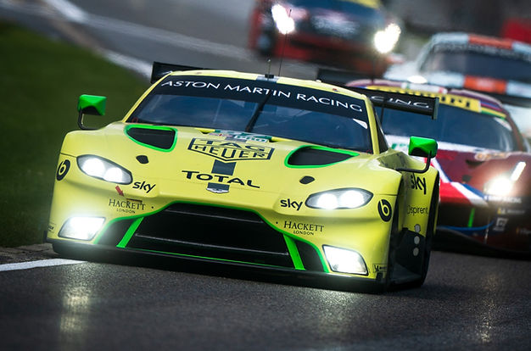
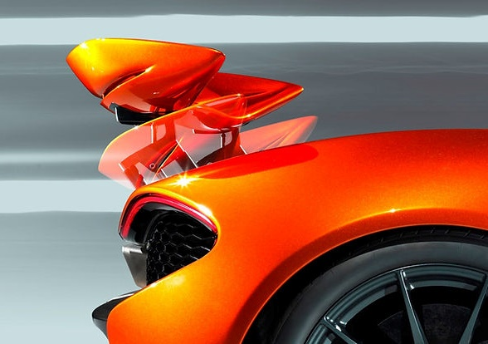
3
Meet Prodrive!
At Prodrive, they like to challenge the ordinary. By combining motorsport culture with a free-thinking approach, they create innovative engineering solutions.
They also help brands achieve success in motorsport and are the business behind some of the greatest achievements in global motorsport!
Prodrive is the world’s most successful multi-disciplined motorsport businesses. You are going to learn a little more about them and the careers they offer.
©VotesforSchools 2022
Notes:
Images
https://www.prodrive.com/
References
https://www.prodrive.com/

Slide 6
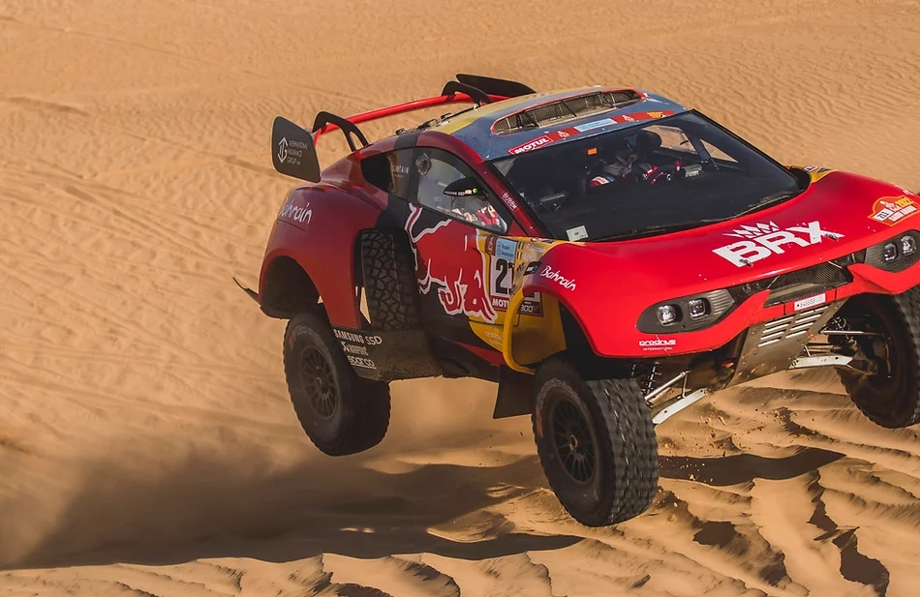
3
Meet Prodrive: Motorsport
No other business has won as many titles across such a wide range of motorsport disciplines. These include:
World Rally titles for Subaru with Colin McRae, Richard Burns and Petter Solberg
British Touring Car Championships with BMW and Ford
World sportscar and Le Mans titles with Aston Martin and Ferrari
©VotesforSchools 2022
Notes:
Images
https://www.prodrive.com/
References
https://www.prodrive.com/
https://www.prodrive.com/about-us

Slide 7
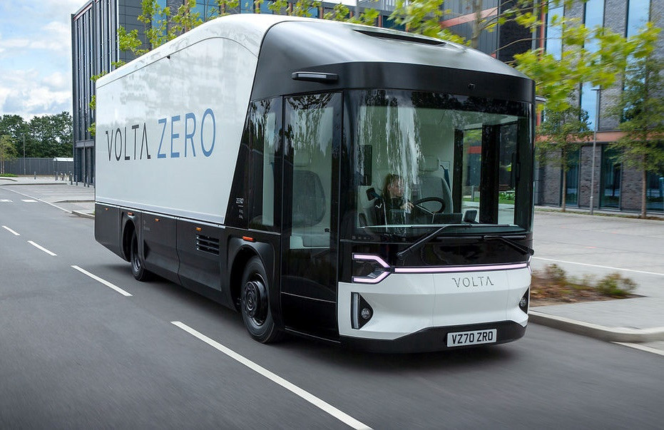
3
Meet Prodrive: Advanced Technology
For the last 20 years, Prodrive has transferred its skills to developing innovative engineering solutions for businesses in the automotive, aerospace, marine and other industry sectors. Today you will find them working on ground-breaking projects for leading vehicle manufacturers, such as:
The creation of the Volta fully-electric truck
Electrically-powered fuelling systems for the world’s largest commercial jet engines
The most advanced active aerosystems
Luxury interior systems for executive jets
©VotesforSchools 2022
Notes:
Images
https://www.prodrive.com/
References
https://www.prodrive.com/
https://www.prodrive.com/about-us

Slide 8
3
Meet Prodrive!
0:00-1:28
There are many roles at Prodrive. Click the image to find out more about a career in design.
©VotesforSchools 2022
https://safeshare.tv/x/jCmNy71dEDw
Notes:
YouTube Video Link: https://www.youtube.com/watch?v=jCmNy71dEDw
Safeshare Video Link: https://safeshare.tv/x/jCmNy71dEDw
Images
1) https://www.prodrive.com/

Slide 9
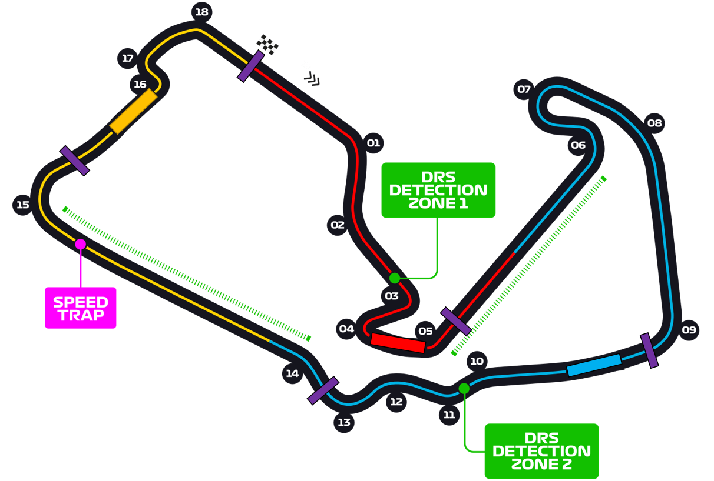
4
The science of racing
As part of this session, we are looking for the fastest lap around the Silverstone Circuit.
On to the track
You are going to find out about the issues around designing a Formula 1 car and then have a go at designing your own!
©VotesforSchools 2022
Notes:
Reference:
Images:
1) https://www.prodrive.com/

Slide 10
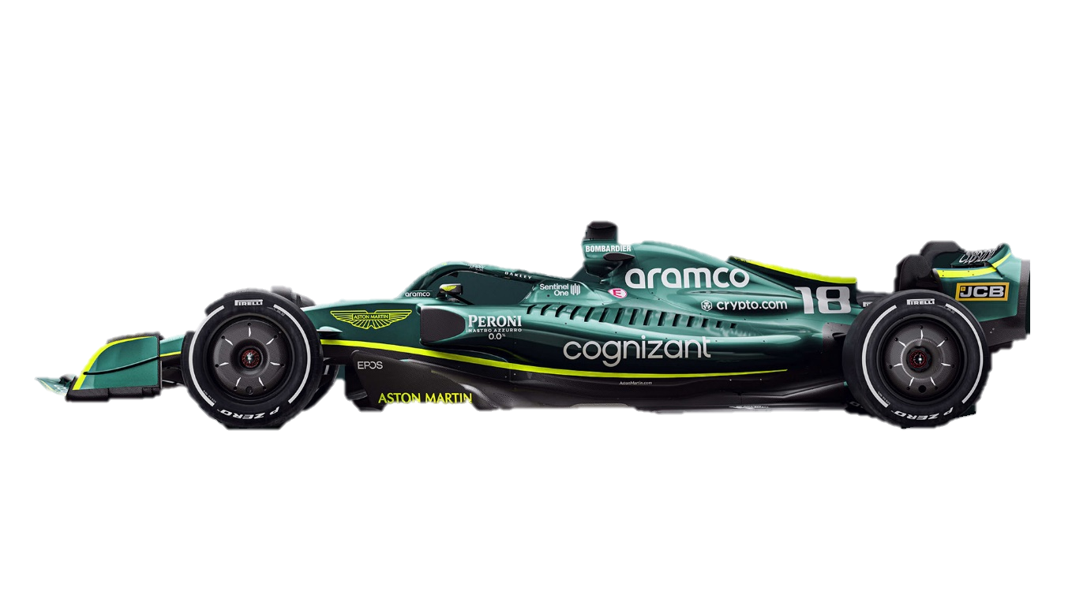
4
The science of racing
Pair discussion (2 mins)
Talk to a partner: what do you think these terms mean when you race a car?
Lift
Thrust
Drag
Weight
©VotesforSchools 2022
Notes:
Reference:
Images:
1) https://www.prodrive.com/

Slide 11
4
The science of racing
Lift is caused by the air moving over and under the car causing it to lift up slightly.
Lift
Drag is the force opposing thrust and is exerted by air particles hitting the car. Engineers want to minimise this force to make the car go faster.
Thrust
Drag
Thrust is the force pushing the car forwards. Engineers want to maximise this force so the car goes faster!
Weight is the force of gravity acting on a mass. Engineers want to make the car as light as possible by decreasing mass!
Weight
Pair discussion (2 mins)
How much did you know?
©VotesforSchools 2022
Notes:
References:
https://www.prodrive.com/
https://www.prodrive.com/about-us
https://www.nas.nasa.gov/About/Education/Racecar/physics.html
https://www.presticebdt.com/lift-and-drag-force-generation-in-racing-cars/
https://en.wikipedia.org/wiki/Bernoulli%27s_principle

Slide 12
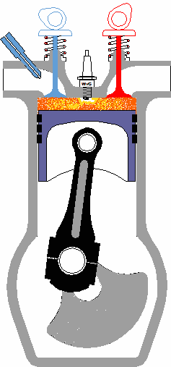
4
The science of racing
Pair discussion (2 mins)
Known as thrust force, how do you think a car moves forwards? Discuss in your pairs before clicking to see a diagram and a step-by-step guide!
1
Fuel is injected into the engine cylinder.
2
The spark plug ignites the fuel creating a small explosion, pushing the piston down.
3
This creates a rotating motion, which is transferred to the wheels of the car.
©VotesforSchools 2022
Notes:
Images
https://prodrive.com/
References
https://www.prodrive.com/
https://www.prodrive.com/about-us

Slide 13
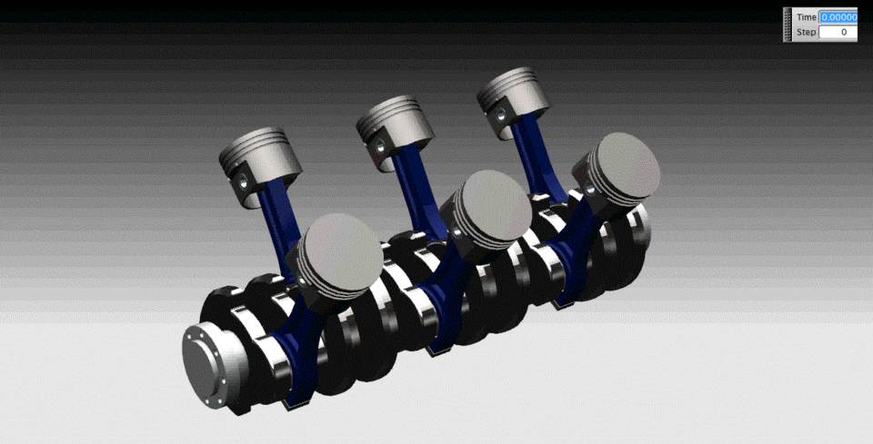
4
The science of racing
Lift
2
1
Thrust
Drag
3
Weight
Imagine everything you just looked at happening with all 6 cylinders and you have the basics of the engine!
©VotesforSchools 2022
Notes:
Images
1) https://prodrive.com/
References
https://www.prodrive.com/
https://www.prodrive.com/about-us

Slide 14
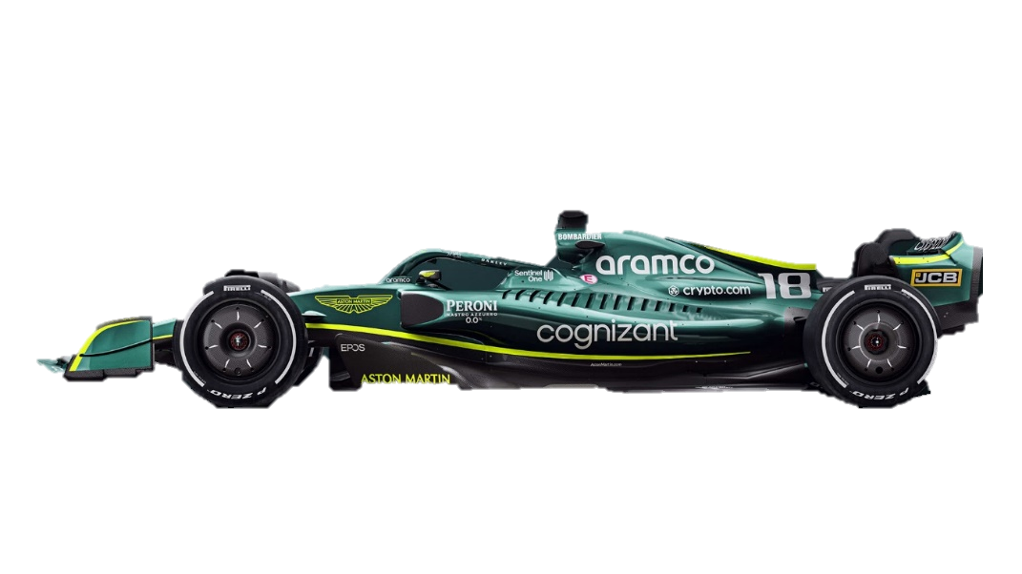
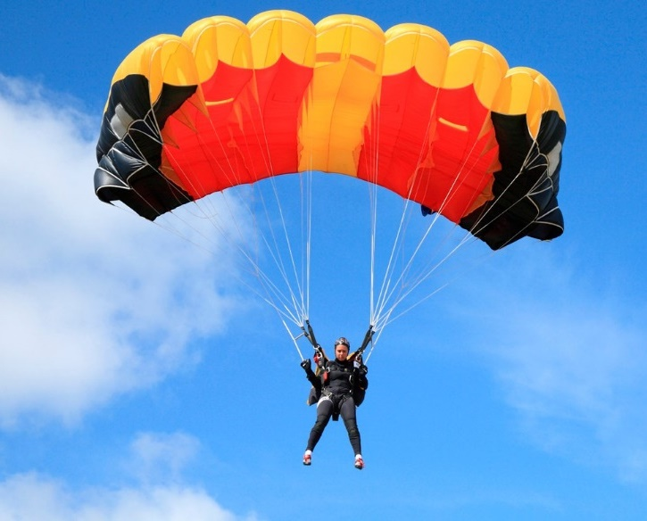
4
The science of racing
Discussion (2 mins)
What do you think drags the car back as you move forward?
Drag
You can’t see it, but every day you are battling to get through the particles in the air. You know they are there because you can feel them through wind or when you move your arm quickly!
F1 teams want to reduce as much of this force as possible as it slows cars down.
It is the same force that parachutes use to their advantage. The more surface area for the air particles to act on, the more drag will be produced. This then slows you down!
Discussion (2 mins)
How do you think F1 teams reduce drag?
©VotesforSchools 2022
Notes:
Images
https://prodrive.com/
References
https://www.prodrive.com/
https://www.prodrive.com/about-us

Slide 15
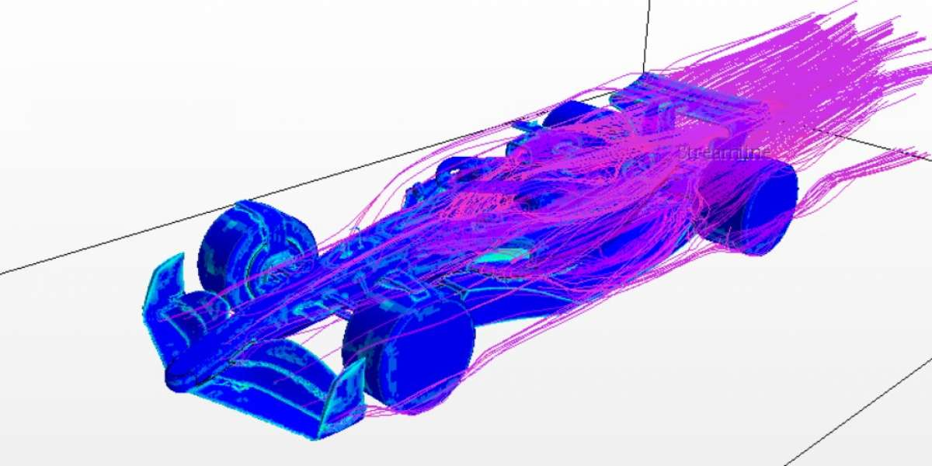
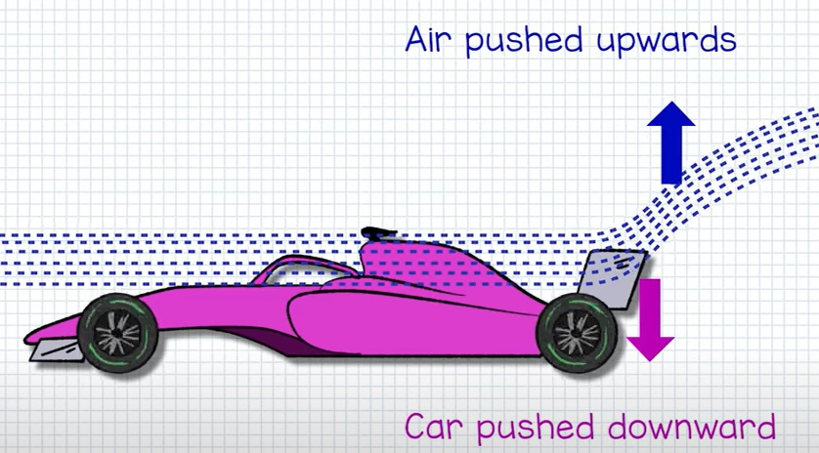
4
The science of racing
Formula 1 cars need to be designed as streamlined as possible to reduce the drag force and go faster!
Definition: Streamlined
Designed in a way that makes movement easier through air.
We said earlier that weight is the downward force on the car, which is true, but there is another force acting here that teams can take advantage of. This is called downforce.
Challenge:
Have you seen the shapes of spoilers on cars, how do you think that might affect air flow and the forces acting on the car?
©VotesforSchools 2022
Notes:
Images
https://prodrive.com/
References
https://www.prodrive.com/
https://www.prodrive.com/about-us
https://dictionary.cambridge.org/dictionary/english/streamlined

Slide 16
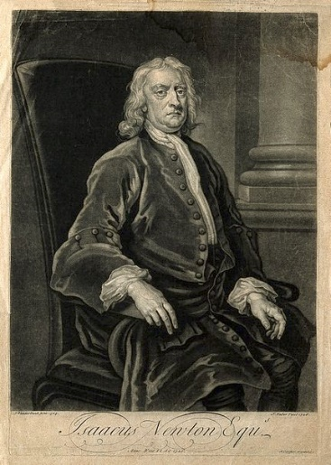
4
The science of racing
Because of the shape of the car, air is forced over the car and onto the rear wing (spoiler).
As the air is moved upwards, the force pushes downwards, helping to stick the car to the track!
Definition: Exert
To use something – such as power or force – to make something happen.
This is an example of Newton’s Third Law – every action has an equal and opposite reaction. Force air up and it will push you down.
Notes:
Images
https://prodrive.com/
https://commons.wikimedia.org/wiki/File:Sir_Isaac_Newton._Mezzotint_by_J._Faber,_junior,_1726,_after_Wellcome_V0004265.jpg
References
https://www.prodrive.com/
https://www.prodrive.com/about-us
https://dictionary.cambridge.org/dictionary/english/exert

Slide 17
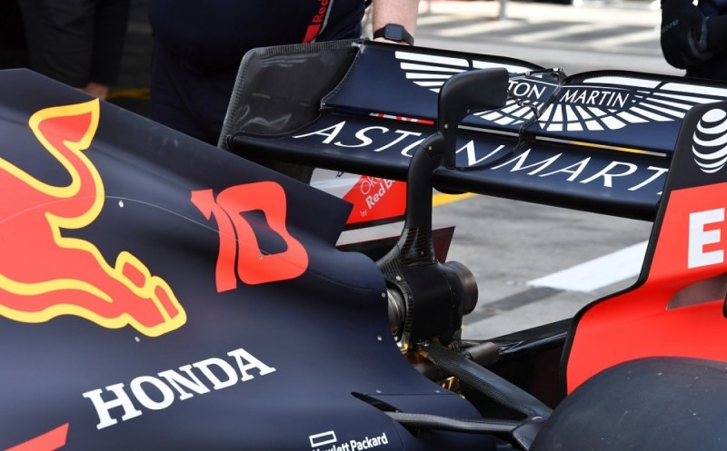
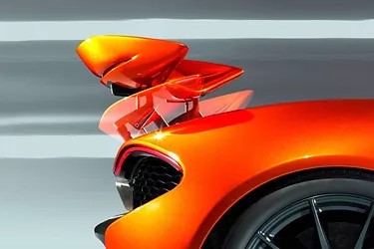
4
The science of racing
Downforce is the reason the cars can go around corners so quickly without losing grip or flying off!
In theory, F1 cars create so much downforce, that they could potentially drive upside down!
Formula 1 engineers can change the angles and details of different parts of the car depending on what they want to achieve.
For example, a rear wing that looks like this will create more downforce. While this helps the car turn corners, it also produces more drag. It’s a balance!
©VotesforSchools 2022
Notes:
Images
https://prodrive.com/
References
https://www.prodrive.com/
https://www.prodrive.com/about-us

Slide 18
5
Now it’s your turn!
Your Team needs…
Activity (20 mins)
Now you have learned about the science of creating a Formula 1 car, it’s time for you to have a go!
1. A name!
?
Head to the next slide for a reminder on how to make your car as aerodynamic as possible.
2. A sponsor
3. A livery design (how the car looks)
Challenge:
Feel free to modify the shape to improve the aerodynamics you have discussed.
©VotesforSchools 2022
Notes:
Images
???
Pixabay
References
https://www.prodrive.com/
https://www.prodrive.com/about-us

Slide 19
5
Now it’s your turn!
Remember everything you have heard in the lesson and design your own car. Don’t forget to make it bright and eye-catching too!
Lift
Thrust
Drag
Weight
©VotesforSchools 2022
Notes:
References:
Images:
1) https://prodrive.com/

Slide 20
5
Now it’s your turn!
Here is a basic shape to start with if you are struggling to start.
©VotesforSchools 2022
Notes:
References:
Images:
1) https://prodrive.com/

Slide 21
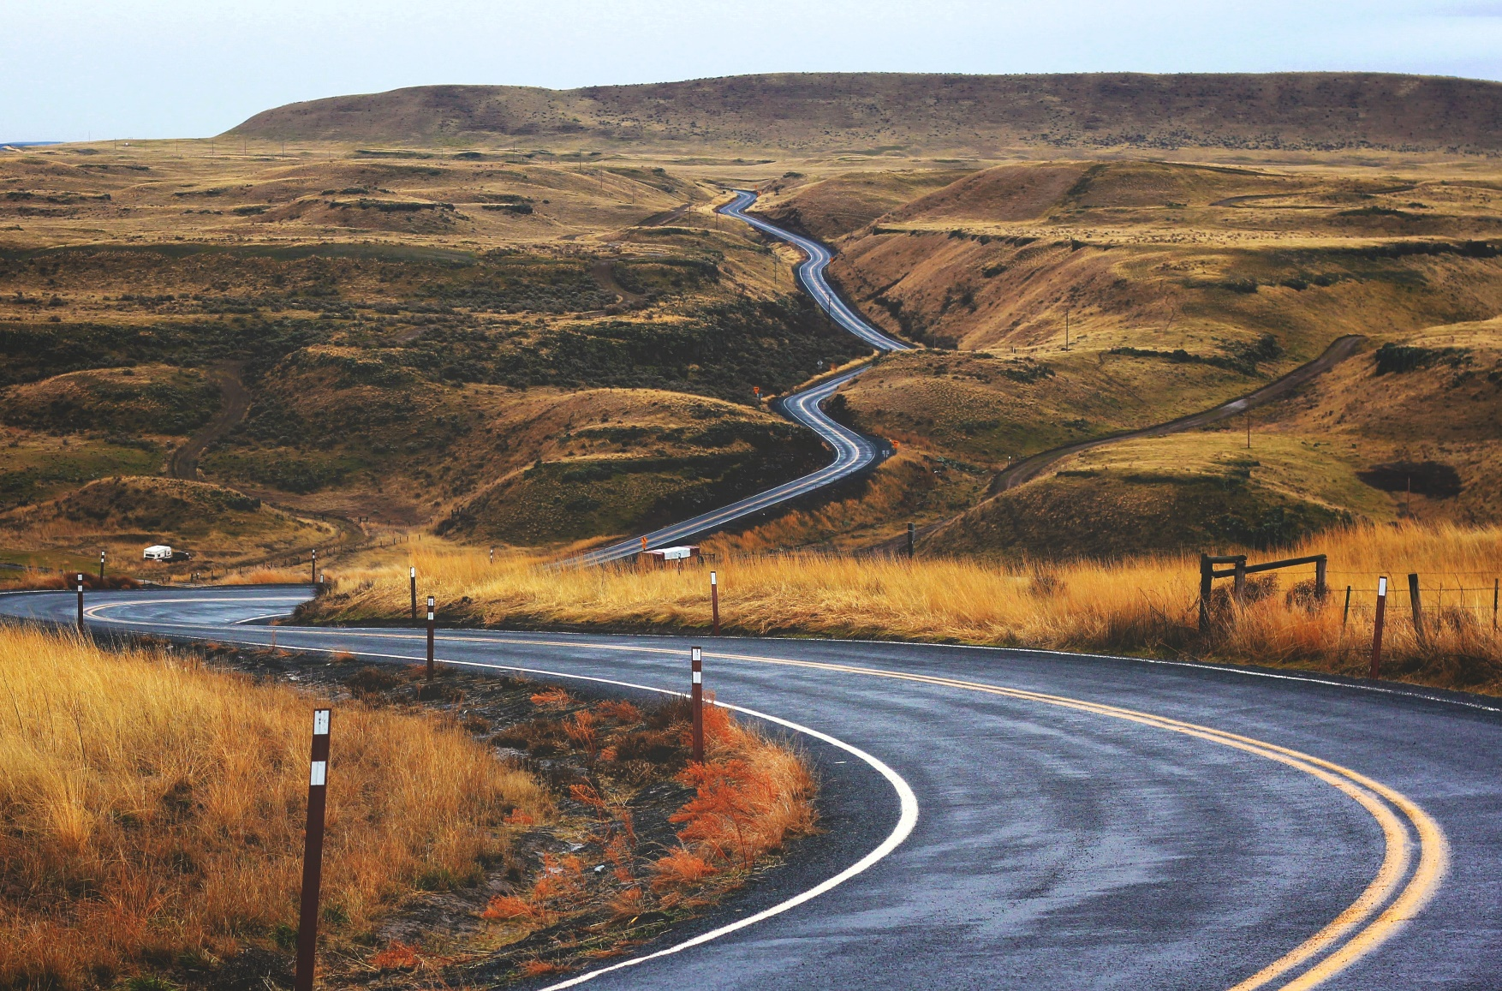
Finding help & information
Technician
Engineering
Composites
Advanced Technology
HR
Branding
Motorsport
Finance
Click on the words to link to the careers opportunities in each of the areas listed.
©VotesforSchools 2022
Notes:
Images
Unsplash
References
https://careers.prodrive.com/
https://careers.prodrive.com/vacancies?filter=technician
https://careers.prodrive.com/vacancies/filter/composites
https://careers.prodrive.com/vacancies/filter/prodrive-at
https://careers.prodrive.com/vacancies?filter=hr
https://careers.prodrive.com/vacancies/filter/motorsport
https://careers.prodrive.com/vacancies?filter=engineering
https://careers.prodrive.com/vacancies/filter/prodrive-at
https://careers.prodrive.com/vacancies/filter/brandand
https://careers.prodrive.com/vacancies?filter=finance

Slide 22
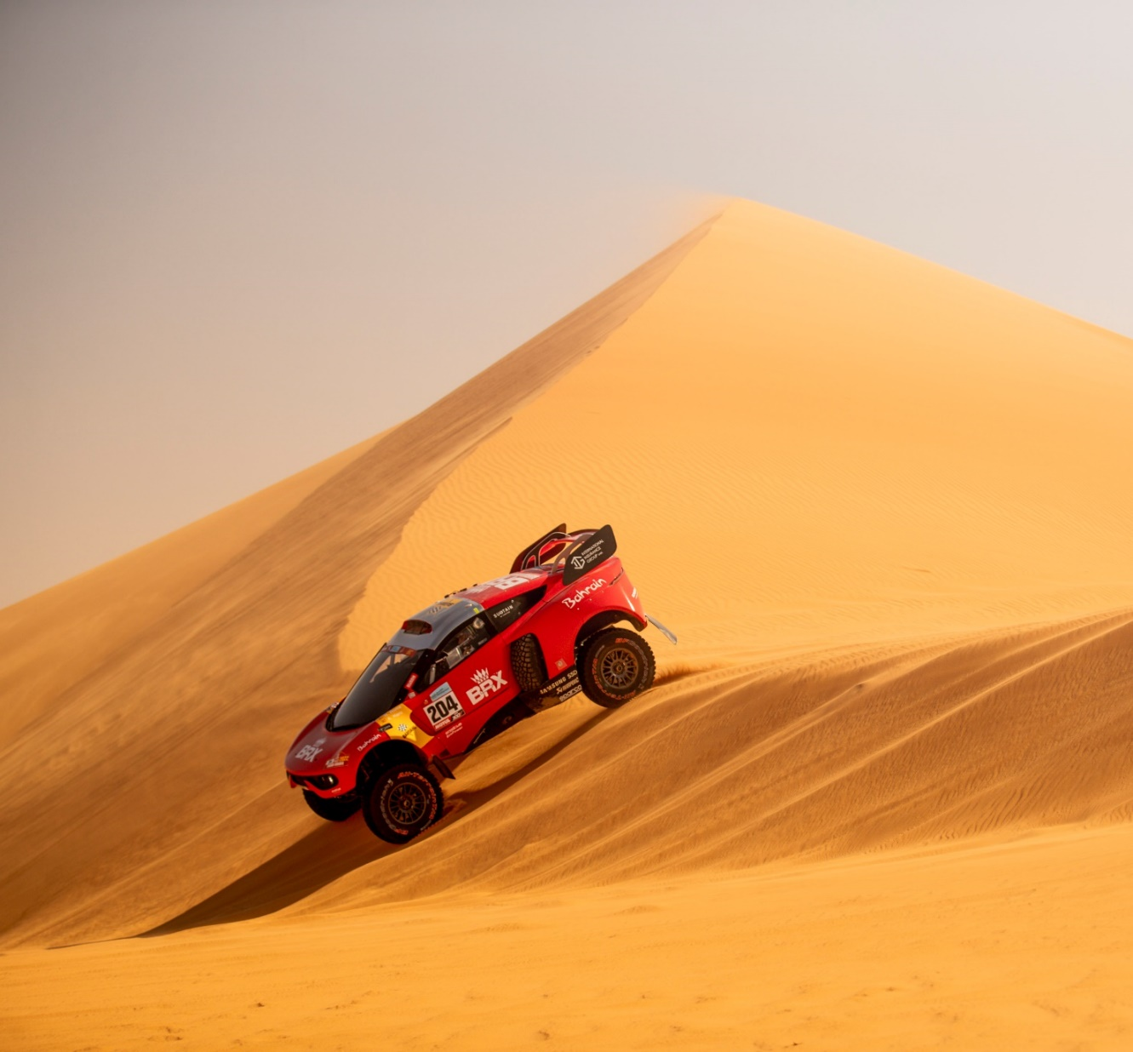
Finding help & information
Qualifications required?
Engineering Degree 3yrs / Masters 5yrs – option to take sandwich placement in industry
Mechanical / Motorsport / Electrical
Apprenticeships / HND / Foundation year
Make the most of your CV
Formula Student
Work Experience
Attitude

Slide 23
Finding help & information
Oxfordshire's new careers platform, Find Your Future, is the next step for you to find out more and plan your future here in Oxfordshire.
Navigate your way around the platform by clicking on Find Your Future.
There is a guide on Find Your Future for students and parents to explore Your Fabulous Future in Oxfordshire. Take time to get excited and make plans!
©VotesforSchools 2022
Notes:
Images
https://www.oxfordshirelep.com/findyourfuture
References
https://www.oxfordshirelep.com/findyourfuture
https://www.oxfordshirelep.com/sites/default/files/uploads/FindYourFutureParentsGuide.pdf

Slide 24
Finding Their Future
In association with VotesforSchools
©VotesforSchools 2022

