Slide 1
Finding Their Future
In association with VotesforSchools
©VotesforSchools 2022

Slide 2
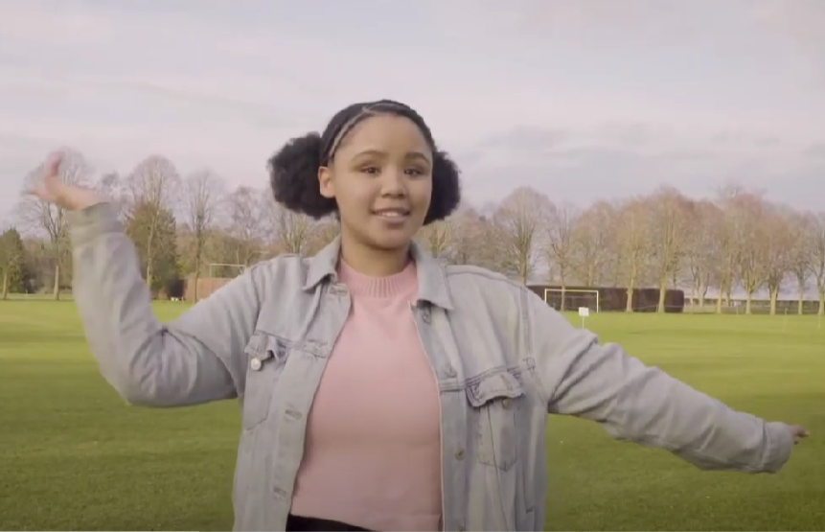
A fabulous future in Oxfordshire?
Time to find out more about the fabulous future waiting for you in Oxfordshire…
There are over 350,000 people working in Oxfordshire and over 50,000 people are self-employed.
0:00-3:54
Click the image to watch The WOW Show film.
©VotesforSchools 2022
https://safeshare.tv/x/528251568
Notes:
YouTube Video Link: https://www.youtube.com/channel/UCXDSgY0E_aACHXcSqX14YNg
SafeShare Video Link: https://safeshare.tv/x/sualeIxU3F4
Images
Via video

Slide 3
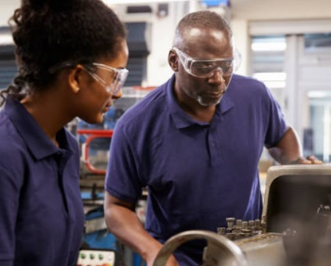
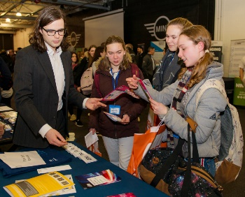
1
Opportunities in Oxfordshire
Have you thought about your future yet? What do you enjoy?
Whatever your interests, there is something for you!
There are lots of great opportunities in many different sectors across Oxfordshire. A great future awaits...
Whether you want an apprenticeship, T Levels, further education or to study for a degree, Oxfordshire has a pathway that would suit you.
©VotesforSchools 2022
Notes:
Images
iStock
OxLEP

Slide 4
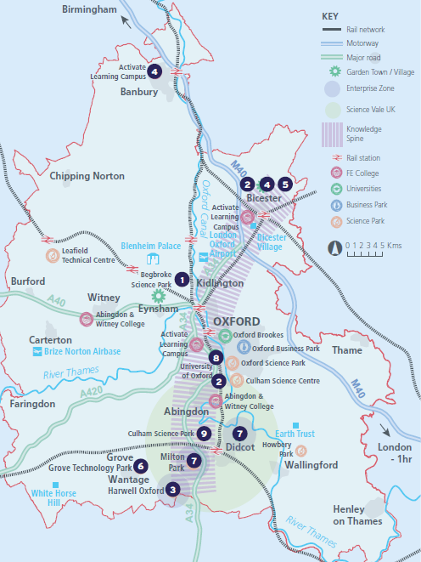
2
What’s in your area?
Pair discussion (2-3 mins)
Talk to a partner about what opportunities you know about in your local area. What do people you know do as their career?
There are opportunities in health, space, tourism, creative industries, construction and so much more.
No matter where you live in Oxfordshire, there is an amazing opportunity waiting for you.
During this presentation, you are going to find out about how the RAF could help with your career choices going forward!
©VotesforSchools 2022
Notes:
Images
OxLEP
References
https://www.oxfordshirelep.com/sites/default/files/uploads/OxLEPLMIReportAugust2020.pdf

Slide 5
3
Meet the RAF
The RAF describe its mission statement as "... [to provide] an agile, adaptable and capable Air Force that, person for person, is second to none, and that makes a decisive air power contribution in support of the UK Defence Mission".
If you join the Royal Air Force, they offer much more than just a job – ‘you’ll have opportunities that no other employer can hope to match. From worldwide travel to lifelong friendships, life in the RAF is a unique experience.’
There are lots of great opportunities in engineering, cyberspace, logistics, medical services, aircrew, operations and so much more.
©VotesforSchools 2022
Notes:
Images
https://recruitment.raf.mod.uk/
References
https://recruitment.raf.mod.uk/
https://recruitment.raf.mod.uk/roles-in-the-raf

Slide 6
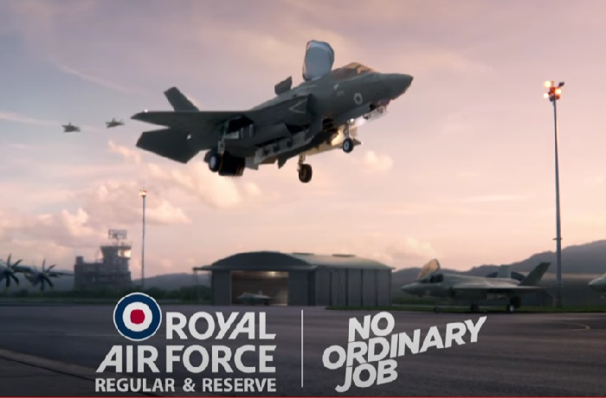
3
Meet the RAF
0:00-1:14
Click the image to find out more about the different roles in the RAF.
©VotesforSchools 2022
https://safeshare.tv/x/1sM3E4xFB0Y
Notes:
YouTube Video Link: https://www.youtube.com/watch?v=1sM3E4xFB0Y
Safeshare Video link: https://safeshare.tv/x/1sM3E4xFB0Y
Images
1) https://recruitment.raf.mod.uk/

Slide 7
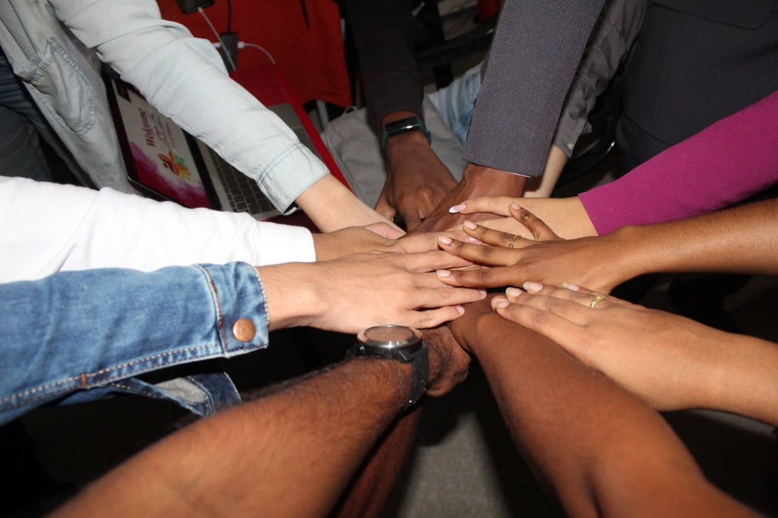
4
Teamwork is key
Teamwork is vital in any career and working well together means working with your strengths to get the job done well.
Teamwork also means ‘everyone having a voice and feeling valued’, which is the key to having a successful outcome in any task.
The RAF team works alongside the Army, the Royal Navy, other officials and the public.
It relies on everyone treating all others with respect.
©VotesforSchools 2022
Notes:
Images
Unsplash
References
https://recruitment.raf.mod.uk/recruitment/media/3897/20200703-raf_ap1_2019_rev_3_page_spreads.pdf
https://www.brighthr.com/articles/culture-and-performance/teamwork/the-importance-of-teamwork-in-the-workplace/

Slide 8
5
Now it’s your turn!
Pair discussion (2-3 mins)
If you are ever split into a group for a task, what role do you usually take?
Which skills do you need for that role?
On the next few slides are the skills associated with four key roles. Your job is to decide which role you would be best in.
Leader
Problem-solver
Designer
Communicator
©VotesforSchools 2022
Notes:
Images
Pixabay

Slide 9
5
Now it’s your turn!
Are you a leader?
The Centre for Creative Leadership* says there are 10 characteristics of a good leader.
Activity (2-3 mins)
Write down the top 3 characteristics you think a good leader should have. Then click to find out the top 10!
Integrity
Gratitude
Respect
Delegation
Communication
Empathy
Influence
Courage
Learning agility
Self-awareness
Challenge:
How could you improve your leadership skills?
Leader
©VotesforSchools 2022
Notes:
Images
Pixabay
References
*https://www.ccl.org/articles/leading-effectively-articles/characteristics-good-leader/

Slide 10
5
Now it’s your turn!
Are you a leader?
Pair discussion (2-3 mins)
Which leadership skills do you have?
It has been reported that there is a shortage of leadership skills in companies around the world. Some managers are not able to lead their teams effectively, which means that the working output for some teams is lower than it should be.
Leaders, and perhaps more importantly leadership skills, are going to be needed in the years ahead. Are you going to be leading in the future?
Challenge:
How could you improve your leadership skills?
Leader
©VotesforSchools 2022
Notes:
Images
Pixabay
References
https://www.gallup.com/cliftonstrengths/en/356072/how-to-be-better-leader.aspx?gclid=Cj0KCQjw2MWVBhCQARIsAIjbwoMbZpLFeuk_8ekv1075OAvy_YXissmnMME4881Ehp7IKYO43OdNY4AaArBDEALw_wcB#ite-356321

Slide 11
5
Now it’s your turn!
Are you a problem-solver?
Sometimes problems need creative thinking; someone to see something in a different way.
Pair reflection (2-3 mins)
Talk to a partner: if you have a problem, how do you solve it? Share some ideas with others in the class.
STEM (Science, Technology, Engineering and Mathematics) may not usually be considered creative, but many of the problems in STEM need creative solutions.
Often a big problem needs more than one person to find a solution, too.
Challenge:
How could you improve your problem-solving skills?
Problem-solver
©VotesforSchools 2022
Notes:
Images
Pixabay
References
https://www.forbes.com/sites/joefolkman/2018/11/25/what-great-problem-solvers-do-differently/?sh=1cea41ef2566
https://www.thebalancecareers.com/creative-thinking-definition-with-examples-2063744

Slide 12
5
Now it’s your turn!
Are you a designer?
Definition: Prototype
The first example of something being made.
Pair reflection (2-3 mins)
When you hear the term “designer”, what do you think about?
As you read earlier, solving a problem may need a creative solution. Designing can refer to art, clothing, TV, gaming or even creating a resource for schools!
Designing can involve thinking, drawing, building and testing a prototype.
Challenge:
How could you improve your designing skills?
Designer
©VotesforSchools 2022
Notes:
Images
Pixabay
References
https://www.forbes.com/sites/joefolkman/2018/11/25/what-great-problem-solvers-do-differently/?sh=1cea41ef2566
https://www.thebalancecareers.com/creative-thinking-definition-with-examples-2063744

Slide 13
5
Now it’s your turn!
Are you a communicator?
Good communication is one of the key skills asked for by most employers.
Speaking, listening, writing reports, and creating diagrams are all ways in which we communicate with each other in our professional lives.
Class discussion (2-3 mins)
Which careers do you think need good communication skills? Click for some ideas if you need them.
A doctor would need to be a great listener to hear what the patient’s problem involved.
A lecturer would need good speaking skills to make a subject interesting and easily understood.
Communicator
©VotesforSchools 2022
Notes:
Images
Pixabay
References
https://www.forbes.com/sites/joefolkman/2018/11/25/what-great-problem-solvers-do-differently/?sh=1cea41ef2566
https://www.thebalancecareers.com/creative-thinking-definition-with-examples-2063744

Slide 14
5
Now it’s your turn!
Group activity (2-3 mins)
Split into teams of 4 or 5 people, then listen to or read the scenario. Your mission? Work together to find your role and solve the problem!
An earthquake has struck Oxtown City. It has destroyed the only bridge, flattened houses and blocked all but one route in and out of the city. The people there are in desperate need of help.
Leader
Problem-solver
Communicator
Designer
You will need to work as a team to solve some of the islanders’ problems and think about what will be most important.
There are also other tasks to complete, such as delivering emergency supplies and constructing an emergency bridge.
©VotesforSchools 2022
Notes:
References
RAF Coding Project

Slide 15
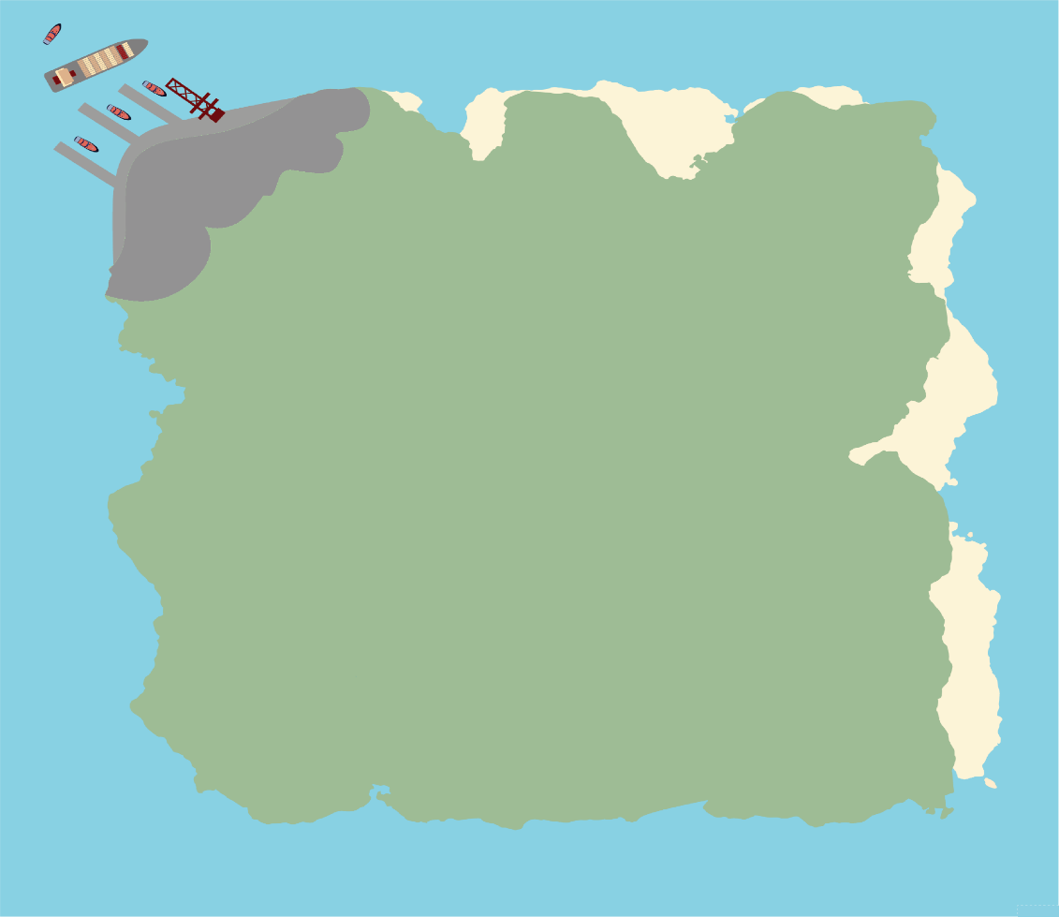
5
Now it’s your turn!
Activities
In your teams come up with a plan to help the islanders get back to normal.
1. Make a list – Which are the most important tasks to solve first?
2. What help will you need and where can you find that help and support you need?
3. Can you program a robot to move around the red squares on the island to view the damage safely?
4. How might the RAF have the key skills to help in this situation?
Be aware:
Each area marked with a red square is currently too dangerous to explore and must not be crossed.
5
THE PORT
PIPELINE EXIT
RESERVOIR (WATER SUPPLY)
4
3
THE BRIDGE
PEOPLE
PIPELINE ENTRANCE
BUILDINGS
2
DAMAGED ROAD
BASE
1
A
B
C
D
E
©VotesforSchools 2022
Notes:
Images
RAF Coding Project
References
https://your.yale.edu/learn-and-grow-how-teamwork-makes-dream-work#:~:text=The%20now%2Dfamous%20%E2%80%9Cteamwork%20makes,it%20was%2018%20years%20ago.

Slide 16
Finding help & information
The Royal Air Force has unique opportunities that you won’t find in any other career. The career offers work in the UK and overseas.
There are many routes into the RAF. For example, an Apprenticeship in the Royal Air Force offers you the chance to gain a professional qualification.
©VotesforSchools 2022
Notes:
Images
https://www.oxfordshirelep.com/findyourfuture
References
https://www.raf.mod.uk/recruitment/career-and-benefits
https://www.raf.mod.uk/recruitment/find-your-role
https://www.raf.mod.uk/recruitment/apprenticeships

Slide 17
Finding help & information
Oxfordshire's new careers platform, Find Your Future, is the next step for you to find out more and plan your future here in Oxfordshire.
Navigate your way around the platform by clicking on Find Your Future.
There is a guide on Find Your Future for students and parents to explore Your Fabulous Future in Oxfordshire. Take time to get excited and make plans!
©VotesforSchools 2022
Notes:
Images
https://www.oxfordshirelep.com/findyourfuture
References
https://www.oxfordshirelep.com/findyourfuture
https://www.oxfordshirelep.com/sites/default/files/uploads/FindYourFutureParentsGuide.pdf

Slide 18
Finding Their Future
In association with VotesforSchools
©VotesforSchools 2022

Slide 19
Extension activities
The Smallpeicetrust have full details of the coding success program for schools.
They can add to this topic by allowing a computing element of programming to the activities using Lego.
©VotesforSchools 2022
Notes:
References:
https://www.smallpeicetrust.org.uk/coding-success
Images:
1)

