Slide 1
Finding Their Future
In association with VotesforSchools
©VotesforSchools 2022

Slide 2
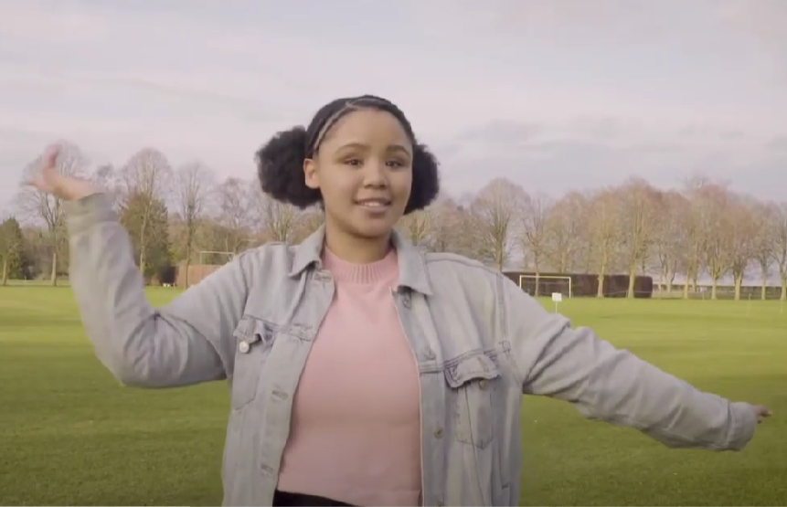
A fabulous future in Oxfordshire?
Time to find out more about the fabulous future waiting for you in Oxfordshire…
There are over 350,000 people working in Oxfordshire and over 50,000 people are self-employed.
0:00-3:54
Click the image to watch The WOW Show film.
©VotesforSchools 2022
https://safeshare.tv/x/528251568
Notes:
YouTube Video Link: https://www.youtube.com/channel/UCXDSgY0E_aACHXcSqX14YNg
SafeShare Video Link: https://safeshare.tv/x/sualeIxU3F4
Images
Via video

Slide 3
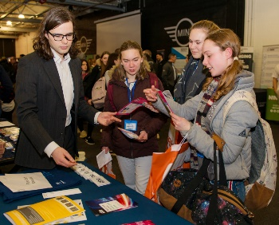
1
Opportunities in Oxfordshire
Have you thought about your future yet? What do you enjoy?
Whatever your interests, there is something for you!
There are lots of great opportunities in many different sectors across Oxfordshire. A great future awaits...
Whether you want an apprenticeship, T Levels, further education or to study for a degree, Oxfordshire has a pathway that would suit you.
©VotesforSchools 2022
Notes:
Images
iStock
OxLEP

Slide 4
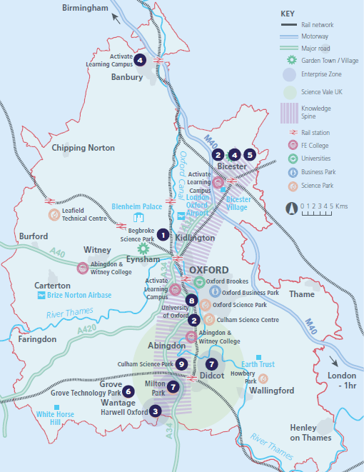
2
What’s in your area?
Pair discussion (2-3 mins)
Talk to a partner about what opportunities you know about in your local area. What do people you know do as their career?
There are opportunities in health, space, tourism, creative industries, construction and so much more.
No matter where you live in Oxfordshire, there is an amazing opportunity waiting for you.
During this presentation, you are going to find out about how one company can have a variety of different roles and career choices!
©VotesforSchools 2022
Notes:
Images
OxLEP
References
https://www.oxfordshirelep.com/sites/default/files/uploads/OxLEPLMIReportAugust2020.pdf

Slide 5
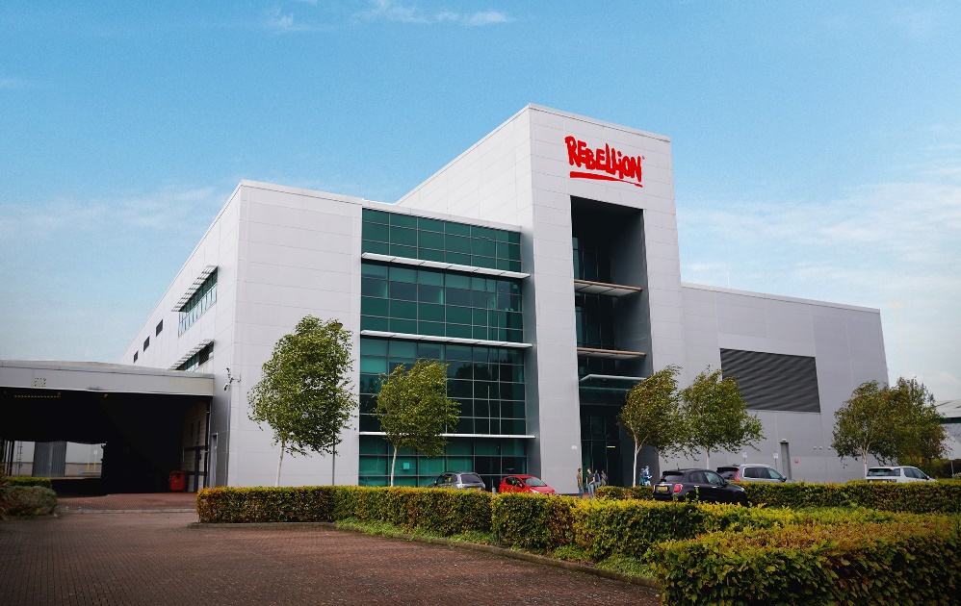
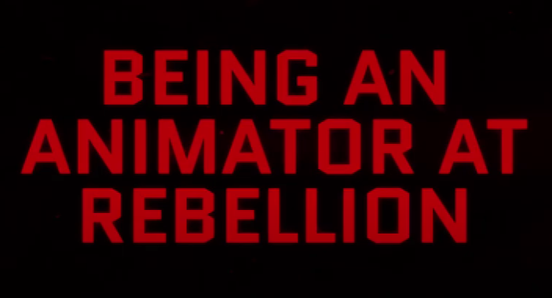
3
Meet Rebellion!
Rebellion is known worldwide for its computer games, comics and films. There are many different roles available with them, including programming, art and animation.
0:00-1:00
Activity (2-3 mins)
Click the image on the right to watch a film about some of the work at Rebellion.
Rebellion are always looking for talented and creative people who have a passion for making great games and want to be at the forefront of developing gaming technology.
Definition: Animator
A person who creates pictures, cartoons, films and moving images.
©VotesforSchools 2022
https://safeshare.tv/x/yFrJfr8nSck
Notes:
YouTube Video Link: https://www.youtube.com/watch?v=yFrJfr8nSck (2:00 – 3:00 only)
SafeShare Video Link: https://safeshare.tv/x/yFrJfr8nSck
Images
Via video
https://rebellion.com/
References
https://careers.rebellion.com/#/
https://dictionary.cambridge.org/dictionary/english/animator

Slide 6
3
Meet Rebellion
0:00-1:00
Click on the Rebellion logo to see more of their incredible work.
©VotesforSchools 2022
https://safeshare.tv/x/EgT-DBBWWbE
Notes:
PLEASE NOTE: there are no age restrictions shown on this trailer – the game footage included is listed below if you wish to view it prior to use with students. Thank you
YouTube Video Link: https://www.youtube.com/watch?v=EgT-DBBWWbE
SafeShare Video Link: https://safeshare.tv/x/EgT-DBBWWbE
Images
Via Rebellion
REBELLION INFORMATION FROM TRAILER:
Follow us on: Facebook: https://www.facebook.com/RebellionFil...
Twitter: https://twitter.com/RebellionFilmTV
Linkedin: https://www.linkedin.com/company/rebe...
#Rebellion #Showreel #VirtualProdution #ICVFX #unrealengine
00:00 Project: Ice Waste Land
00:07 Zombie Army: Legion of the Dead
00:14 Camera Tracking Only
00:18 Project: Dinosaur
00:27 Zombie Army: Legion of the Dead
00:30 Camera Tracking Only
00:34 Evil Genius 2 Cinematic Trailer
00:37 Camera Tracking Only
00:40 Unreal Onset Supervision Only
00:45 Project: Flying Car
00:50 Percival
01:02 Project: Space Station
01:08 Outro

Slide 7
4
Careers at Rebellion
As you have seen, Rebellion are known for creating computer games, comics and films.
Marketing
Finance
But, in addition to roles in programming, art and animation, there are other parts of the business that are just as important.
Budgeting
Recruitment
Administration
Human resources
These roles help the business run well, for example: paying staff, advertising new products or managing their social media posts.
The next few slides will look at three of these in more detail.
©VotesforSchools 2022
Notes:
Images
Unsplash

Slide 8
4
Marketing at Rebellion
Have you ever thought about a career in marketing?
Discussion (4-5 mins)
What do you think marketing is? Where do you think sharing a new product would get the most attention?
Social media
Television
Websites
Magazines
Celebrities
YouTube
Definition: Marketing
Promoting and selling products or services.
Challenge:
Find out the cost of advertising in different places. Which is the cheapest?
©VotesforSchools 2022
Notes:
References
https://dictionary.cambridge.org/dictionary/english/marketing

Slide 9
4
Marketing at Rebellion
Getting the price right with a new product is important.
Discussion (4-5 mins)
How do you think a company comes up with a price for their product? Write down three things that they must think about. Click for some ideas!
Definition: Brand
A certain type of product sold under a recognised name.
How well-known the brand is.
Who will buy the product.
What buyers are prepared to pay.
The cost to make the product.
©VotesforSchools 2022
Notes:
Images
Unsplash
References
https://dictionary.cambridge.org/dictionary/english/brand

Slide 10
4
Human Resources at Rebellion
Discussion (1-2 mins)
What do you think the term “Human Resources” refers to?
Within any company, there are always people who look after the other people working there.
Definition: Human Resources
Also known as “HR”, these are the people who are responsible for finding, paying and helping employees, especially if they have any problems.
They make sure people are paid the right amount at the right time.
They may help to interview and employ people at the company.
They may also sort out any complaints or problems an employee has.
©VotesforSchools 2022
Notes:
Images
Unsplash
References
https://dictionary.cambridge.org/dictionary/english/human-resources

Slide 11
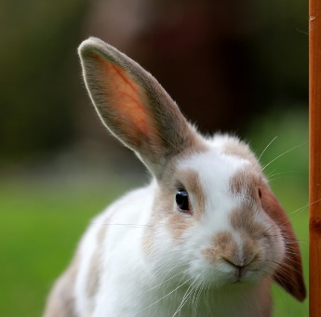
4
Human Resources at Rebellion
Individual reflection (1-2 mins)
Communication skills are especially important in an HR role. So, how are your communication skills? Do you always make sure that you do the things below?
Value and respect the speaker?
Look at the person speaking?
Wait your turn to speak?
Ask thoughtful questions?
Think about what is being said?
Listen to all of the information?
Pair activity (1-2 mins)
Come up with a list of things you can do to improve your communication skills!
©VotesforSchools 2022
Notes:
Images
Unsplash
References
https://dictionary.cambridge.org/dictionary/english/human-resources

Slide 12
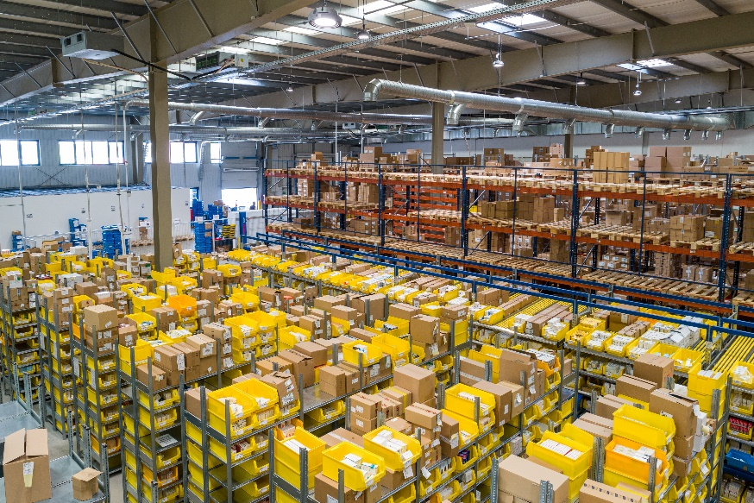
4
Finance at Rebellion
Are you interested in accounts and banking?
Discussion (1-2 mins)
When people buy a computer game, where do you think the money goes? What does it pay for? Click for some ideas!
Definition: Finance
Managing the money.
Costs of running a business
Marketing and promotion
Wages for employees
Tax and VAT
Profits for the company
Rent on the building
©VotesforSchools 2022
Notes:
Images
Unsplash
References
https://dictionary.cambridge.org/dictionary/english/finance

Slide 13
5
Now it’s your turn!
Individual activity (15-20 mins)
Now you know more about Rebellion, create a new evil genius character for a game.
Challenge:
Why not carry on with this task at home?
What would this character look like?
Where does the character live?
Rebellion is developing a new characters for a game. As a designer your task is to create an evil genius.
Which characteristics make them an evil genius?
Who are they arch enemies with?
©VotesforSchools 2022
Notes:
Images
Via Rebellion

Slide 14
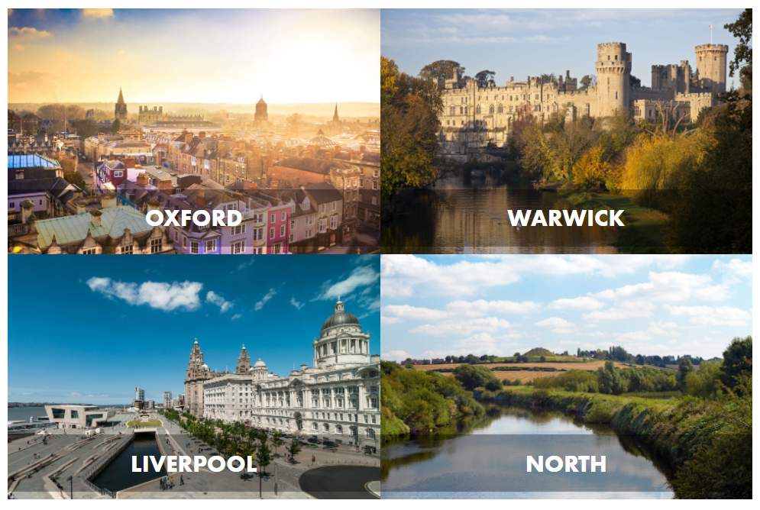
Finding help & information
Rebellion also have multiple sites with career opportunities. Click to find out more about them!
©VotesforSchools 2022
Notes:
Images
1) https://www.oxfordshirelep.com/findyourfuture
References
https://careers.rebellion.com/

Slide 15
Finding help & information
Situated in Warwick Technology Park, less than a kilometre from Warwick Castle and the historic town of Leamington Spa, their Warwick studio has a great location and room to grow.
For animation purposes only. Please do not remove.
Their HQ is situated by the Thames with a local gastropub, coffee roastery, supermarkets and more. Walk just 5 minutes to the train station and 15 to the heart of one of Europe’s most beautiful cities!
©VotesforSchools 2022
Notes:
Images
1) https://www.oxfordshirelep.com/findyourfuture
References
https://careers.rebellion.com/

Slide 16
Finding help & information
Based in Runcorn, their Liverpool studio is situated in Manor Park on the river Mersey. With good commuter links, it is close to Bridgewater Canal and the historic Norton Priory, which boast great walks and grounds.
Rebellion North is based in the market town of Ossett, near Leeds. Accessible for Manchester, Sheffield and York, their newest studio is ideally placed to access fabulous walking and cycling trails.
©VotesforSchools 2022
Notes:
Images
1) https://www.oxfordshirelep.com/findyourfuture
References
https://careers.rebellion.com/

Slide 17
Finding help & information
Oxfordshire's new careers platform, Find Your Future, is the next step for you to find out more and plan your future here in Oxfordshire.
Navigate your way around the platform by clicking on Find Your Future.
There is a guide on Find Your Future for students and parents to explore Your Fabulous Future in Oxfordshire. Take time to get excited and make plans!
©VotesforSchools 2022
Notes:
Images
https://www.oxfordshirelep.com/findyourfuture
References
https://www.oxfordshirelep.com/findyourfuture
https://www.oxfordshirelep.com/sites/default/files/uploads/FindYourFutureParentsGuide.pdf

Slide 18
Finding Their Future
In association with VotesforSchools
©VotesforSchools 2022

