Slide 1



Finding Their Future
In association with VotesforSchools
©VotesforSchools 2022

Slide 2



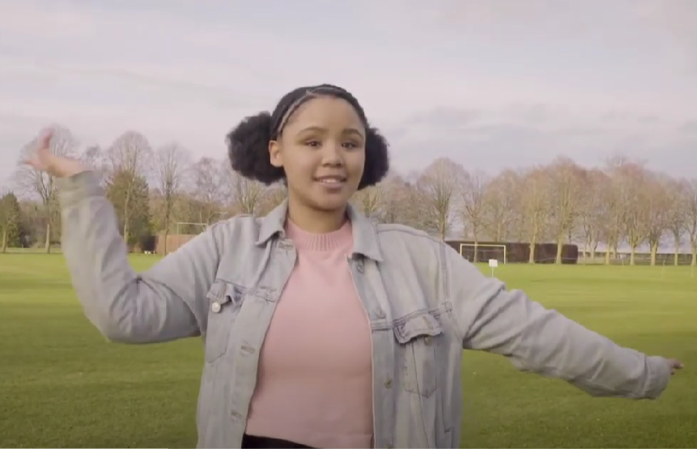
A fabulous future in Oxfordshire?
Time to find out more about the fabulous future waiting for you in Oxfordshire…
There are over 350,000 people working in Oxfordshire and over 50,000 people are self-employed.
0:00-3:54
Click the image to watch The WOW Show film.
©VotesforSchools 2022
https://safeshare.tv/x/528251568
Notes:
YouTube Video Link: https://www.youtube.com/channel/UCXDSgY0E_aACHXcSqX14YNg
SafeShare Video Link: https://safeshare.tv/x/sualeIxU3F4
Images
Via video

Slide 3

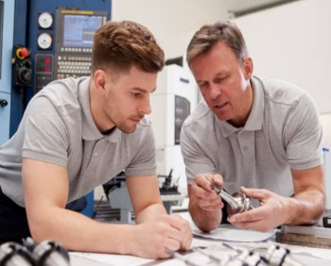

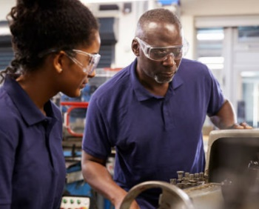

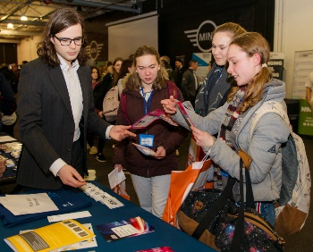

1
Opportunities in Oxfordshire
Have you thought about your future yet? What do you enjoy?
Whatever your interests, there is something for you!
There are lots of great opportunities in many different sectors across Oxfordshire. A great future awaits...
Whether you want an apprenticeship, T Levels, further education or to study for a degree, Oxfordshire has a pathway that would suit you.
©VotesforSchools 2022
Notes:
Images
iStock
OxLEP

Slide 4
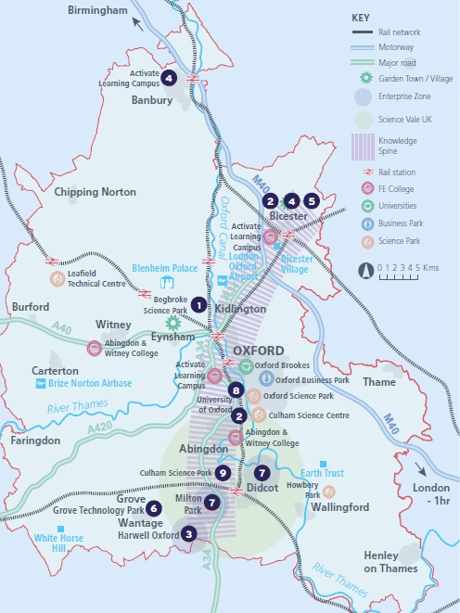


2
What’s in your area?
Pair discussion (2-3 mins)
Talk to a partner about what opportunities you know about in your local area. What do people you know do as their career?
There are opportunities in health, space, tourism, creative industries, construction and so much more.
No matter where you live in Oxfordshire, there is an amazing opportunity waiting for you.
During this presentation, you are going to find out about how new technology could feature with your career choices going forward!
©VotesforSchools 2022
Notes:
Images
OxLEP
References
https://www.oxfordshirelep.com/sites/default/files/uploads/OxLEPLMIReportAugust2020.pdf

Slide 5

3
Meet UKAEA RACE
There are many roles within UKAEA. Click the image to find out more about their work.
0:00-2:00
©VotesforSchools 2022
Notes:
You Tube Video Link: https://www.youtube.com/watch?v=qekyWEXXn2M
Safeshare TV Video link: https://safeshare.tv/x/qekyWEXXn2M#
References:
Images:

Slide 6
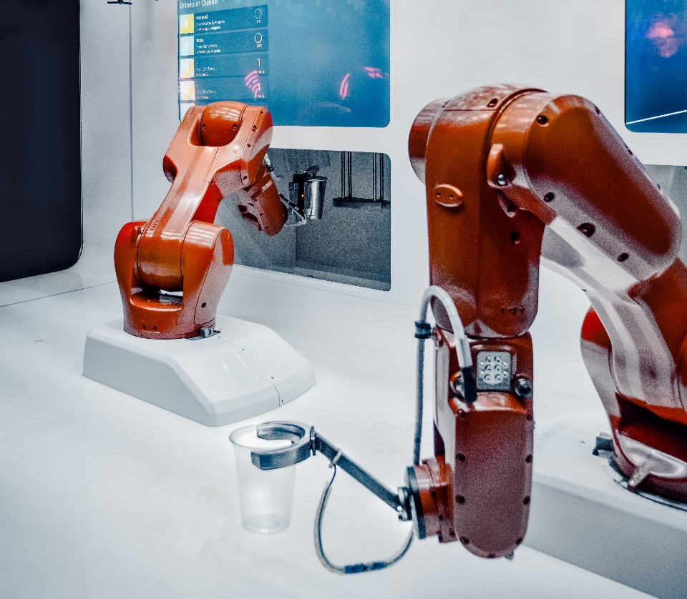
3
Meet UKAEA RACE
Robotics are used in so many work places for so many different tasks. RACE specialise in creating robotics to be used in challenging situations.
Pair discussion (2-3 mins)
Talk to a partner about where you think robotics would be useful, maybe where a person couldn’t or wouldn’t want to be.
Definition: Robotics
Using robots to perform tasks.
You may have come up with nuclear industries, space, mining or construction. These are all areas that use robotics to complete tasks in areas unfit or unsafe for humans to work in.
They also carry out lots of simple automated tasks in factories too!
©VotesforSchools 2022
Notes:
References:
https://race.ukaea.uk/about-race/delivering-robotics/
https://dictionary.cambridge.org/dictionary/english/robotics
Images:
Unsplash

Slide 7

3
Meet UKAEA RACE
At UKAEA (United Kingdom Atomic Energy Authority) they design and build robotics for some of the most difficult tasks.
In addition to robotics, UKAEA are working on driverless vehicles and other automated technology that helps tasks be completed safely, quickly and efficiently without a person being in control.
Class discussion (3-4 mins)
What do you think the challenges might be for designers of driverless vehicles?
Would you be happy to be driven around Oxfordshire by one of these vehicles?
©VotesforSchools 2022
Notes:
References:
https://race.ukaea.uk/
https://race.ukaea.uk/about-race/
Images:
1) iStock

Slide 8
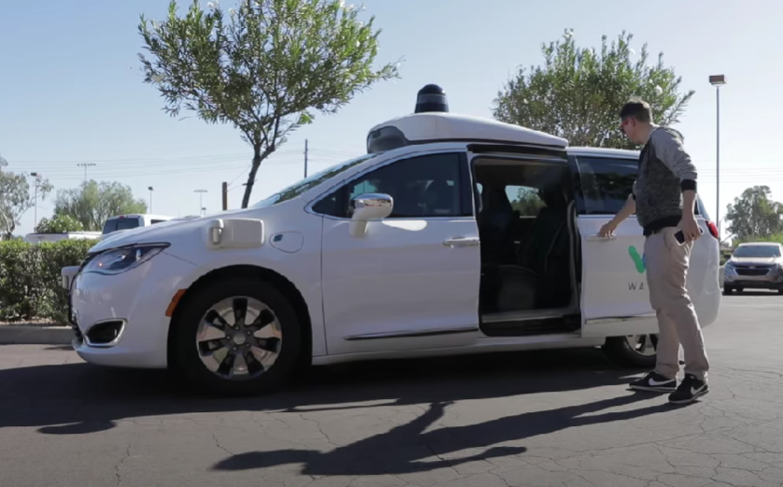
4
Now it’s your turn!
Let’s look at autonomous cars. They can sense their environment and operate without a person driving.
Autonomous cars use a lot of different sensors to tell them about their environment e.g. the road, other cars, pedestrians, cyclists
Watch (3 mins)
Watch the video about the trial of autonomous cars in Arizona (USA).
0:00-3:22
Discuss (3 mins)
How would you feel being a passenger in this car?
©VotesforSchools 2022
Notes:
You Tube Video Link: https://www.youtube.com/watch?v=2hqTnmn51Fg&t=28s
Safeshare TV Video link: https://safeshare.tv/x/2hqTnmn51Fg
References:
Images:
1)

Slide 9

4
Now it’s your turn!
Lots of careers involve solving a problem and as you saw in the film autonomous cars clearly have many problems to solve.
Next you will see how UKAEA think about the problems they need to solve.
First, a little fun video about problem solving!
0:00-2:27
©VotesforSchools 2022
Notes:
You Tube Video Link: https://www.youtube.com/watch?v=ofFy7vRgXSg
Safeshare TV Video Link: https://safeshare.tv/x/ofFy7vRgXSg
References:
https://race.ukaea.uk/
https://race.ukaea.uk/about-race/
Images:
1)

Slide 10




4
Now it’s your turn!
Problems can be solved in lots of different ways and often need more than one person and more than one type of thinking to solve them!
Define the problem, what are we trying to achieve?
There are lots of problems that we find out in life as we go along.
Background research (has this problem been solved before?)
Some problems have been solved others need a solution.
Create a set of requirements
Understanding the problem is key, what do we need to create?
Brainstorm, evaluate options and choose a solution
Working as a team ideas for a solution can be tried and tested.
©VotesforSchools 2022
Notes:
References:
https://race.ukaea.uk/
https://race.ukaea.uk/about-race/
Images:
1)

Slide 11




4
Now it’s your turn!
Oxfordshire has decided to be a trial centre for a new autonomous car trial. Think about everything that you would need; consider the people, places and any other features of Oxfordshire that would need to be taken into account.
Group activity:
Get into small groups of 4 or 5. Then come up with a list of requirements for an autonomous car if there was to be a trial of them in your local area?
E.G. how would people feel, what would they need to know?
Which area would make a suitable trial area and why?
Challenge:
Can you come up with a social media campaign to launch the trial?
©VotesforSchools 2022
Notes:
References:
Images:
1) Icon8

Slide 12


Finding help & information
Do you want to help shape the future of the world's energy?
There are a multitude of exciting career opportunities at UKAEA’s fusion research and technology programme at Culham Science Centre.
View fusion research in action at Culham Centre for Fusion Energy!
©VotesforSchools 2022
Notes:
References:
https://race.ukaea.uk/careers/
https://ccfe.ukaea.uk/about-ccfe/visit-ccfe/
Images:
1) https://www.oxfordshirelep.com/findyourfuture

Slide 13

On the web:
www.ccfe.ukaea.uk
www.euro-fusion.org
By email: Education@ukaea.uk
Notes:
Direct people to other general UKAEA inboxes if you think appropriate including: EarlyCareers@ukaea.uk [apprenticeships, graduate scheme, placements, etc], Recruitment@ukaea.uk [general job enquiries and specific job roles], Mediaenquiry@ukaea.uk [press enquiries and media visits], Education@ukaea.uk [school/university visits and student questions], or Communications@ukaea.uk [general visit enquiries, public open events, industry visits, etc].
*Due to safeguarding policy, do not communicate via your personal UKAEA email address for students aged 18 and under. Instead direct them to Education@ukaea.uk or EarlyCareers@ukaea.uk depending on the nature of their enquiry, and someone with a DBS check monitoring those inboxes will coordinate the reply.

Slide 14




Finding help & information
Oxfordshire's new careers platform, Find Your Future, is the next step for you to find out more and plan your future here in Oxfordshire.
Navigate your way around the platform by clicking on Find Your Future.
There is a guide on Find Your Future for students and parents to explore Your Fabulous Future in Oxfordshire. Take time to get excited and make plans!
©VotesforSchools 2022
Notes:
Images
https://www.oxfordshirelep.com/findyourfuture
References
https://www.oxfordshirelep.com/findyourfuture
https://www.oxfordshirelep.com/sites/default/files/uploads/FindYourFutureParentsGuide.pdf

Slide 15
Finding Their Future
In association with VotesforSchools
©VotesforSchools 2022

